Slide 1



Optimal climate policy in the face of tipping points and asset stranding
Frank Venmans^{1,2}
Emanuele Campiglio^{1,3}, Simon Dietz¹
1 London School of Economics and Political Science, Grantham Institute 2 University of Mons 3 University of Bologna

Slide 2
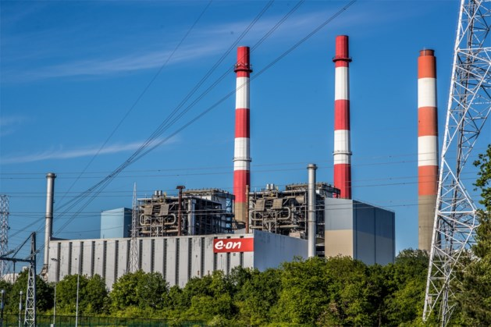

Slide 3
Aim of the paper
Define optimal emissions path, optimal green investment and optimal dirty (dis)investment for the world economy
Define optimal prudence in the face of
  Macro economic risk
  New information on the climate system
  Possibility of a tipping point in the climate system
What if we delay optimal policy?
What if we want to keep dirty capital until their end-of-life?

Slide 4
Climate and mitigation objectives
Source: IPCC (2018)
Notes:
The accumulation of greenhouse gases in the atmosphere is putting at risk the stability of the climate system
There is also significant concern about non-linearities and tipping points in the climate system that may be encountered in the not-too-distant future
For these reasons, the international community has agreed to limit the increase in global temperatures by reducing greenhouse gas emissions to net zero over a period of just a few decades.
Reducing emissions in this way will require a drastic reduction in the production and consumption of fossil fuels.

Slide 5
IEA, world Energy Outlook 2020.

Slide 6
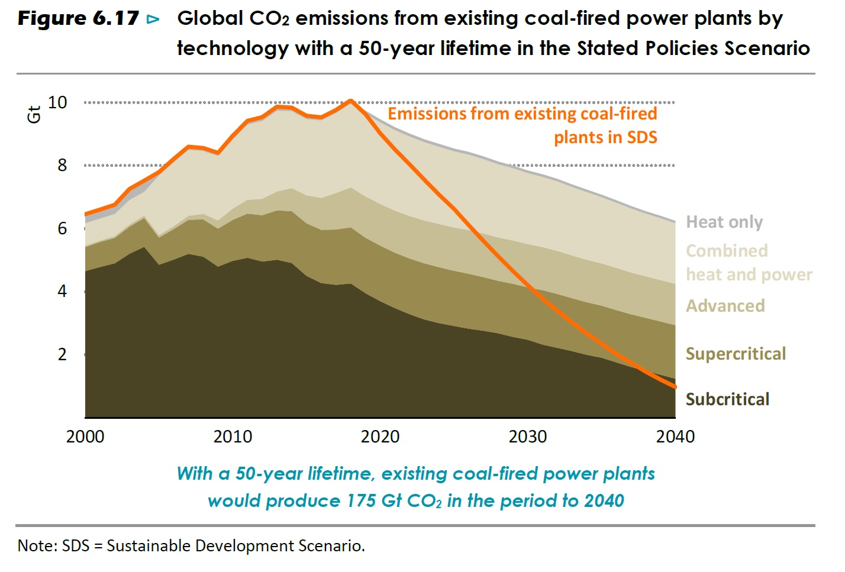
IEA, world Energy Outlook 2020

Slide 9
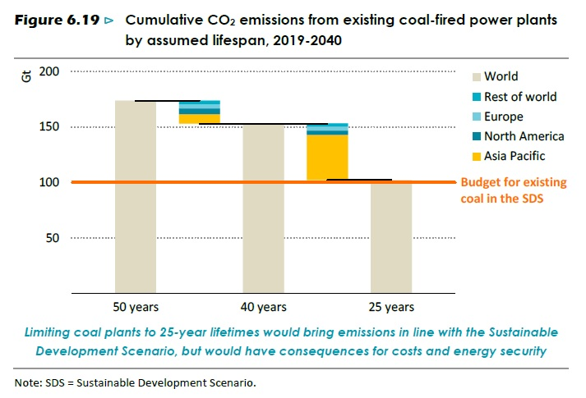

Slide 10
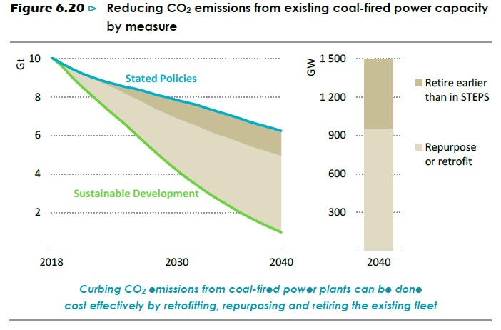
IEA, world Energy Outlook 2019

Slide 11
IEA, world Energy Outlook 2020
Notes:
“A number of international oil and gas companies have recently reduced the reported value of their assets, providing a very tangible expression of uncertainty over future prospects. Chevron initiated the trend in December 2019 and was followed by BP, Shell, Eni and Total. Together they have written down over $50 billion, representing around 5- 15% of each company’s market capitalisation at the time of the write-downs. The assets concerned were mostly unconventional oil and gas resources, deepwater projects, LNG infrastructure and refining assets.”

Slide 12
Locked into high-carbon capital assets
Many of existing physical capital stocks are fossil-based
  Coal/gas power plants and distribution networks
  Steel mills
  Road networks
Physical capital stocks
  Long-lived (e.g. 50 years for coal plants)
  Large initial investments under expectation of productive asset life
  Costly to repurpose to other (low-carbon) uses
Notes:
However, the majority of capital stocks and infrastructure have been designed to work in tandem with the use of fossil fuels
(e.g. coal and gas power plants and accompanying electricity distribution networks, steel mills and road networks).
These are typically long-lived physical assets, financed with large initial investments under the expectation of a long and profitable asset life. Once installed, it would be costly, or sometimes impossible, to convert high-carbon stocks to other low-carbon uses.
This creates a strong incumbency bias against a rapid low-carbon transition, as: i) firms do not want to suffer a negative revaluation of their assets, or a reduction in capacity utilisation; ii) investors holding financial assets issued by high-carbon firms want to avoid a drop in their market valuation.

Slide 13
In between 2 extreme strategies
No stranding strategy
  This minimises stranding costs and contributes to smoothing the transition…
  …but it warms the earth fast and accentuates tipping point risks
Abrupt stranding strategy
  Scrap today high-carbon capital stocks ahead of their natural end-of-life…
  …but, if done abruptly, it would create large stranding costs
Notes:
So, there is a potential trade-off between climate stability and the stranding of existing high-carbon assets.
Two strategies at the extremes of this trade-off can be identified.
First, we can adopt a no-stranding strategy. We continue using existing high-carbon capital stocks at full capacity until they reach their natural end-of-life. If there is no new investment in fossil capital, and assuming the availability of low-carbon technological alternatives, this would lead to a smooth process of substitution between high- and low-carbon capital stocks, avoiding losses for the owners of fossil capital assets. However, the long lives of certain high-carbon assets (e.g.coal plants typically operate for around 50 years) is thought to make this strategy incompatible with the achievement of more stringent climate goals such as limiting global warming to 2°C, as well as accentuating the risks of crossing climate tipping points.
Second, we can adopt a total stranding strategy. We just stop using high-carbon capital stocks, ignoring the fact that they could be used for much more time. This strategy would help achieving climate objective, but, if done all at once, would cause stranding costs, which in turn might trigger large macroeconomic and financial costs. This is what is currently in many AIM that do not have inertia of emissions.
So, the research question of our paper is: what is the most appropriate course of action between these two costly extremes?

Slide 14
Integrated assessment model
Economic growth model + climate
We maximize welfare
  Different from minimizing costs for a given temperature target.
A top down/general equilibrium model
  Focus on dynamic optimization and risk assessment
  Different from engineering/energy models with a lot of detail

Slide 15
Social Cost of Carbon
= Marginal Abatement Cost
Reducing one unit of emissions avoids a continued stream of climate damages in the future (SCC)
Reducing an extra unit of emissions is costly (MAC)
  Low-emission technologies are more expensive than high-emission technologies.
  Low emission technologies are even more expensive if
    they replace high-emission technologies before end-of-life
    they are retrofitted to existing capital
    lead to macro-economic adjustment costs

Slide 16
Our contribution
The model has three distinctive characteristics:
  Rigidities associated with both capital accumulation and capital conversion (stranding)
  Data-driven emission abatement cost function
  Multiple climate and economic uncertainties captured by stochastic processes
Notes:
The model has three distinctive characteristics:
Rigidities associated with both capital accumulation and capital conversion (stranding) Unlike other models such as DICE
Multiple climate and economic uncertainties captured by stochastic processes. Rozenberg et al. 2020, Baldwin et al. 2020.
Data-driven emission abatement cost function. Unlike Hambel et al. 2020

Slide 17
1.a Investment adjustment costs
Large investment concentrated in one period more expensive than spread over multiple periods
Investment adjustment costs
Investment

Slide 18
1. Stranding/repurposing costs
Emissions decreasing at more than 5% per year requires repurposing/stranding
  Decay rate of dirty capital 4%
  Decrease of carbon intensity of dirty capital 1%
Repurposing is cheap for small amounts and costly for large amounts.
Costs
Repurposing/stranding
R*
Notes:
POINT for internal discussion: we assume homogenous reconversion costs across sectors

Slide 19
2. Costs of emission reductions
Costs of emission reductions in our model are fitted on data from detailed energy system models contained in the IPCC and NGFS database.
Total Abatement Cost (% of GDP)
Abatement
E=0

Slide 20
3. Uncertainty
Economic uncertainty
  Correlated Brownian motions on both types of capital stocks
  Disasters à la Barro (2009)
Climate uncertainty
  Brownian motion on temperature
  Disasters à la Barro increase in temperature
Epstein-Zinn preferences (RRA=4)
Recursive optimization (dynamic programming with 5 states)

Slide 21
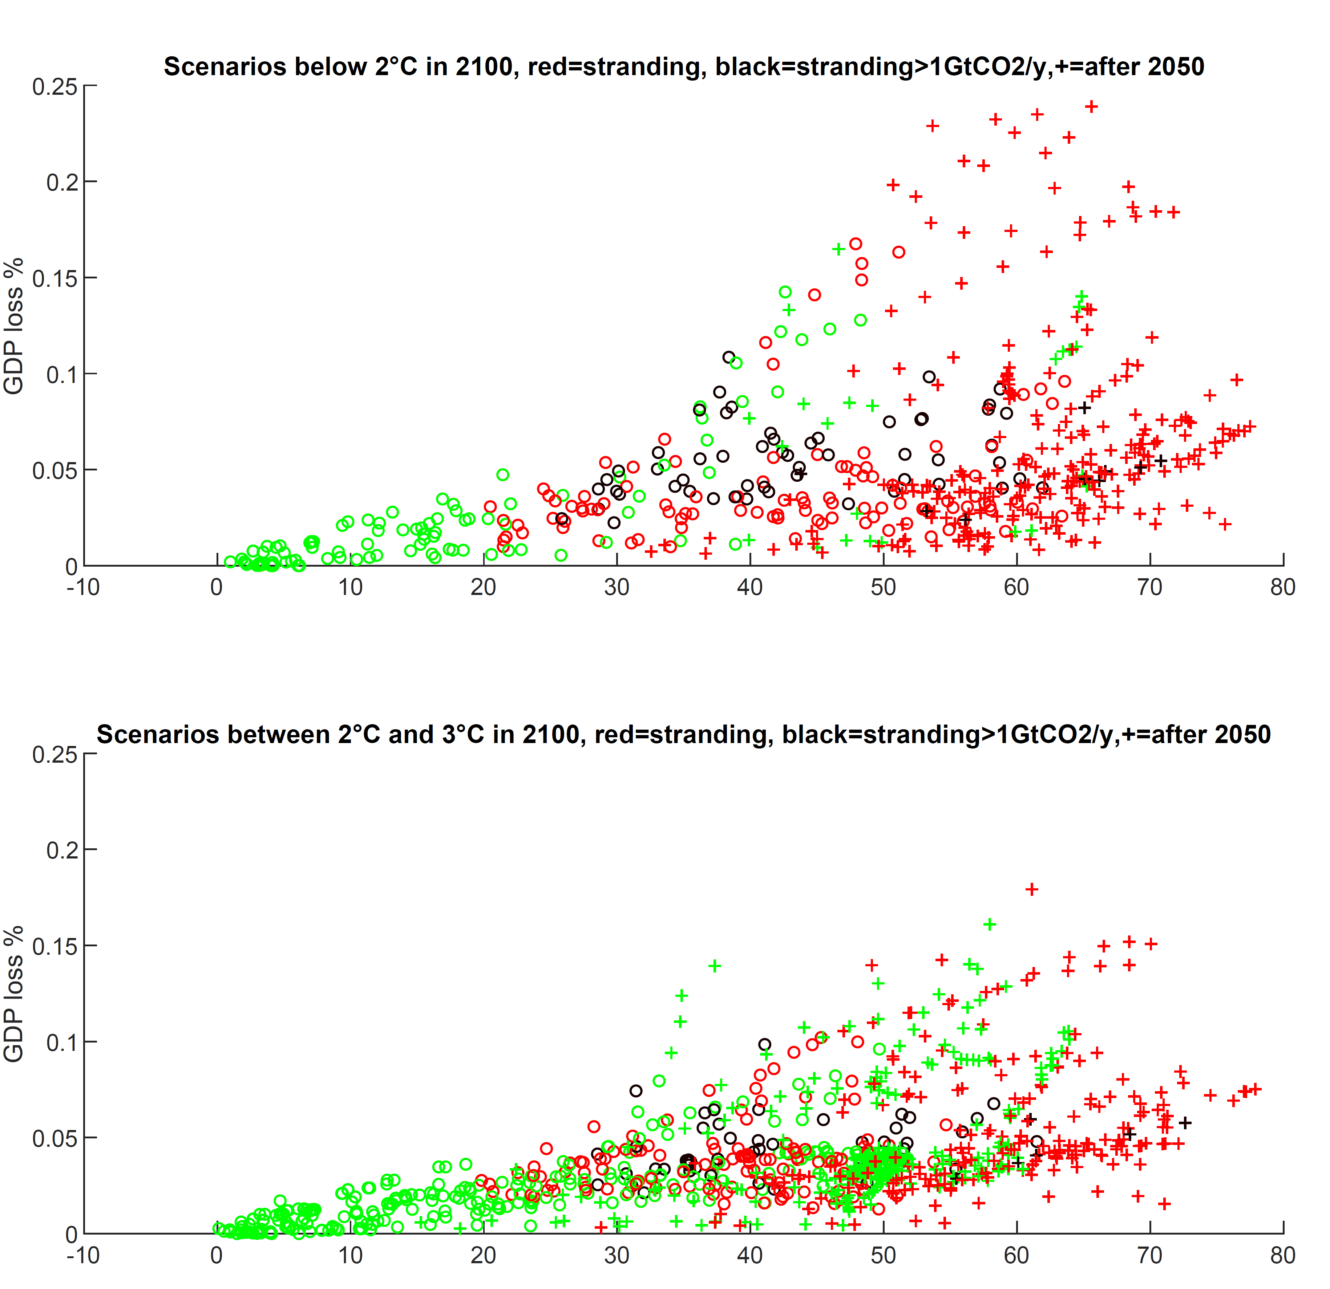

Slide 22
Results

Slide 24
Notes:
0,7% of welfare loss that 108 Trillion of $.

Slide 25
Notes:
0,2% loss of welfare, 25 Trillion $.

Slide 29
Conclusions
Inertia of dirty capital has a large impact on the optimal emission scenario. The social cost of carbon is 15% higher.
Starting in 2020
  repurpose/strand 400 $Billion of dirty assets per year (1.5% of total investment)
  at a cost of 300 $Billion per year.
Delay until 2030
  stranded assets are 75% larger
  repurposing/stranding costs double.
Policies that try to avoid repurposing/stranding
  social cost of carbon which is 10% higher
  A net welfare loss of 10 $Trillion.
I countries believe the Paris agreement will be respected; they can limit stranded assets by stringent climate policy today.

Slide 30
Back-up slides

Slide 31
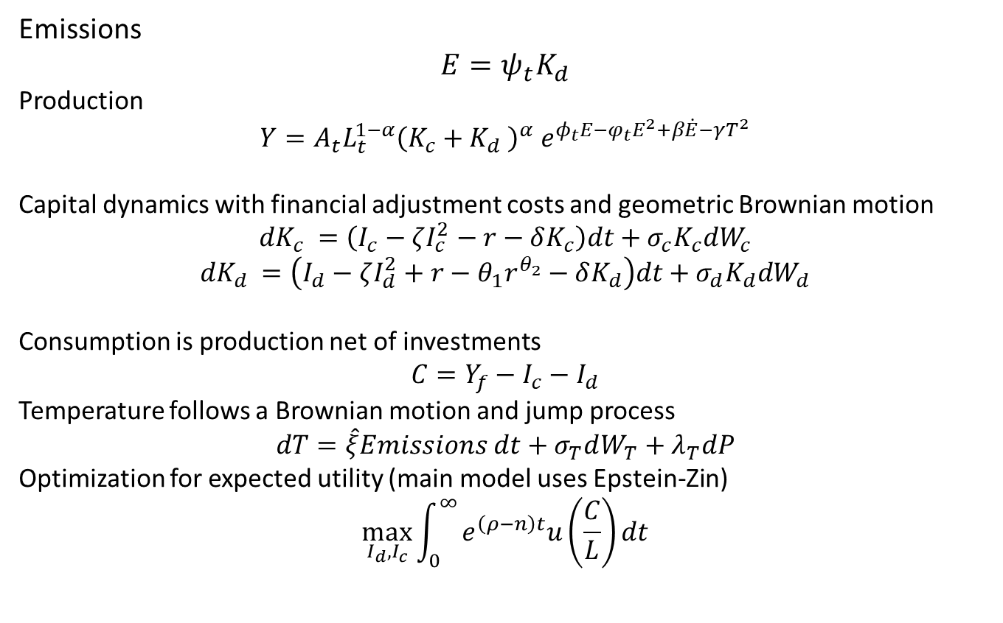
Equations
Emissions
$$E=ψ_{t}K_{d}$$
Production
$$Y=A_{t}{L_{t}^{1−α}\left(K_{c}+K_{d} \right)}^{α}{ e}^{φ_{t}E−φ_{t}E^{2}+β\dot{E}−γT^{2}}$$
Capital dynamics with financial adjustment costs and geometric Brownian motion
$${dK}_{c} =\left(I_{c}−ζI_{c}^{2}−r−δK_{c}\right)dt+σ_{c}K_{c}dW_{c}$$
$${dK}_{d} =\left(I_{d}−ζI_{d}^{2}+r−θ_{1}r^{θ_{2}}−δK_{d}\right)dt+σ_{d}K_{d}dW_{d}$$
Consumption is production net of investments
$$C=Y_{f}−I_{c}−I_{d}$$
Temperature follows a Brownian motion and jump process
$$dT=\hat{ξ}Emissions dt+σ_{T}dW_{T}+λ_{T}dP$$
Optimization for expected utility (main model uses Epstein-Zin)
$$\max_{I_{d}, I_{c}}{\int_{0}^{∞}{e^{\left(ρ−n\right)t}u\left(\frac{C}{L}\right)dt}}$$

Slide 33
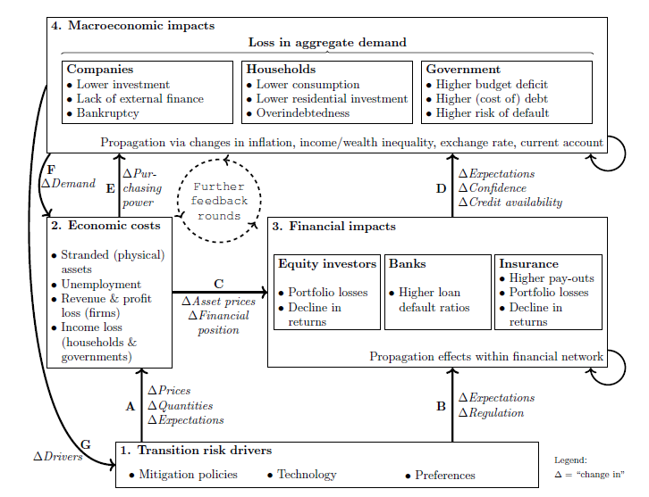
Macro-financial transition costs
Source: Semieniuk et al. (2020)
Notes:
Just in case you want to show something about transition costs and macro-financial spillovers

Slide 34
Bibliography
Baldwin, E., Cai, Y., Kuralbayeva, K., Mar. 2020. To build or not to build? Capital stocks and climate policy. Journal of Environmental Economics and Management 100, 102235.
Coulomb, R., Lecuyer, O., Vogt-Schilb, A., Jun. 2019. Optimal Transition from Coal to Gas and Renewable Power Under Capacity Constraints and Adjustment Costs. Environmental and Resource Economics 73 (2), 557–590.
Epstein, L. G., Zin, S. E., 1989. Substitution, Risk Aversion, and the Temporal Behavior of Consumption and Asset Returns: A Theoretical Framework. Econometrica 57 (4), 937–969
Gould, J. P., 1968. Adjustment Costs in the Theory of Investment of the Firm. The Review of Economic Studies 35 (1), 47–55
Hambel, C., Kraft, H., van der Ploeg, F., 2020. Asset Pricing and Decarbonization: Diversification versus Climate Action. Discussion Paper Series 901, Department of Economics, University of Oxford.
IPCC, 2018. Global warming of 1.5°C. Intergovernmental Panel on Climate Change.
Rozenberg, J., Vogt-Schilb, A., Hallegatte, S., Mar. 2020. Instrument choice and stranded assets in the transition to clean capital. Journal of Environmental Economics and Management 100, 102183.
van der Ploeg, F., Rezai, A., Mar. 2020. The risk of policy tipping and stranded carbon assets. Journal of Environmental Economics and Management 100,102258.
Vogt-Schilb, A., Meunier, G., Hallegatte, S., Mar. 2018. When starting with the most expensive option makes sense: Optimal timing, cost and sectoral allocation of abatement investment. Journal of Environmental Economics and Management 88, 210–233.

