Slide 1
IAEE 2021 ONLINE CONFERENCE
  MEASURING ENERGY POVERTY IN MOZAMBIQUE: IS ENERGY POVERTY A PURALY RURAL PHENOMENON?
AUTHORS
Mendita A. Ugembe
Miguel C. Brito
Roula Inglesi-Lotz
June 2021
Notes:
Typo in the title,
I would suggest you add the affiliations of the authors next to their names.

Slide 2
Contents
Introduction
1.1.Mozambican Energy Situation
1.2. Electricity Market
1.3. Electricity Access and Consumption
2. Method
3. Results
3.1. Overview
3.2. MEPI, Headcount ratio and Intensity of Energy poverty
4. Conclusions

Slide 3
1. Introduction
Table A1. Mozambican energy resources by source.
Type | Localization | Reserves | Reserves potential | Installed capacity | National consumption
Non-Renewables | Tete | Coal | 2.4 billion tones | 14 million toe/year
 | Inhambane, Sofala, and Cabo Delgado | Natural gas | 129.6 trillion m³ | 3.1 billion m³/year | 5360.0TJ-gross in 2018
 | Cabo Delgado | Oil | 2 Mt* | -
Renewables | All country | Hydro | 2187MW/year | 1200 MW/year | 10%
 |  | Wind | 5GW | 1.145MW
 |  | Solar | 5.4kWh/m2/day | 599MW
 |  | Biomass | 2GW | -
Mozambique is the largest energy producer in Southern African Development Community - SADC
Notes:
I would suggest that you do not have the numbering in your titles; personal preference, not a rule.

Slide 4
1. Introduction
With a HDI=0.446, Mozambique is the sixth poorest country (UN 2019)
66.7% of the Mozambican Population lives in rural areas, of which
  77.8% are women and children under 16 years old
66% of the active population Works in agriculture, fishery and forestry, of which
  87.8% are rural women
Almost 70% of the Mozambican population lives without electricity
Principal energy source: traditional solid biomass (charcoal and firewood)

Slide 5
1. Introduction
The country adopted de UN Sustainable Development Goals
Expectation: Universal access to electricity by 2030
Efforts made through: Ministry of Land, Environment and Rural Development (MITADER):
    Energy Fund (FUNAE);
    Mozambican Government´s Five-year Plan for 2015-2019; and
    National Development Strategy for 2015-2053

Slide 6
1. Introduction
Efforts focused mainly on rural development ignoring the existence of urban poverty.
Research questions:
Is Energy poverty a purely rural Phenomenon?
What is the magnitude and impact of energy poverty in Mozambique?
Objective:
Measure the Magnitude and intensity of energy poverty in Mozambique, calculating the MEPI at national, regional and provincial levels using the 2015 DHS data for 7169 Mozambican households.

Slide 7
2. Methods
Multidimensional Energy Poverty Index (MEPI) approach proposed by (Nussbaumer et al., 2012) and created by OPHI and UNDP (Sher et al., 2014).
Using Demographic and Health Surveys- DHS data for 7169 Mozambican households for the year 2015.

Slide 8
2. Methods
Indicators and Weights of MEPI dimensions
Dimension | Indicator | weight | Variable | deprivation cut-off (poor if…)
Cooking | Modern cooking fuel | 0.2 | Type of cooking fuel | use of any fuel besides electricity, LPG, kerosene, natural gas, or biogas
 | Indoor pollution | 0.2 | Food cooked in the house or in a separate building using traditional solid biomass | True
Lighting | Electricity access | 0.2 | Has access to electricity | False
Services provided by household appliances | Household appliances ownership | 0.13 | Has refrigerator | False
Entertainment/ Education | Entertainment/Education appliances ownership | 0.13 | Has radio or television | False
Communication | Telecommunications means | 0.13 | Has mobile phone | False
Source: adapted from (Nussbaumer et al., 2012).

Slide 9
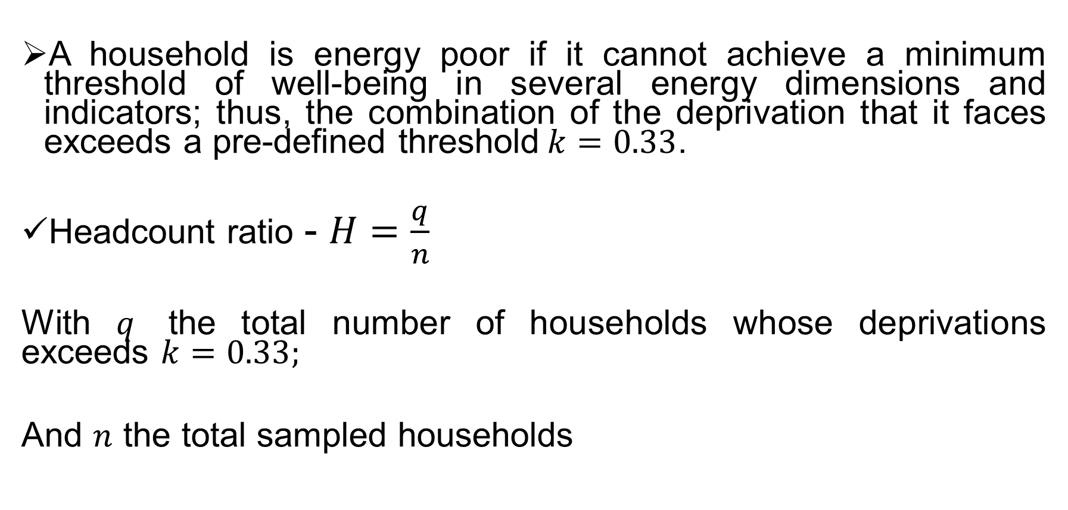
2. Methods
A household is energy poor if it cannot achieve a minimum threshold of well-being in several energy dimensions and indicators; thus, the combination of the deprivation that it faces exceeds a pre-defined threshold$k=0.33$.
Headcount ratio - $H=\frac{q}{n}$
With $q$ the total number of households whose deprivations exceeds $k=0.33;$
And $n$ the total sampled households

Slide 10
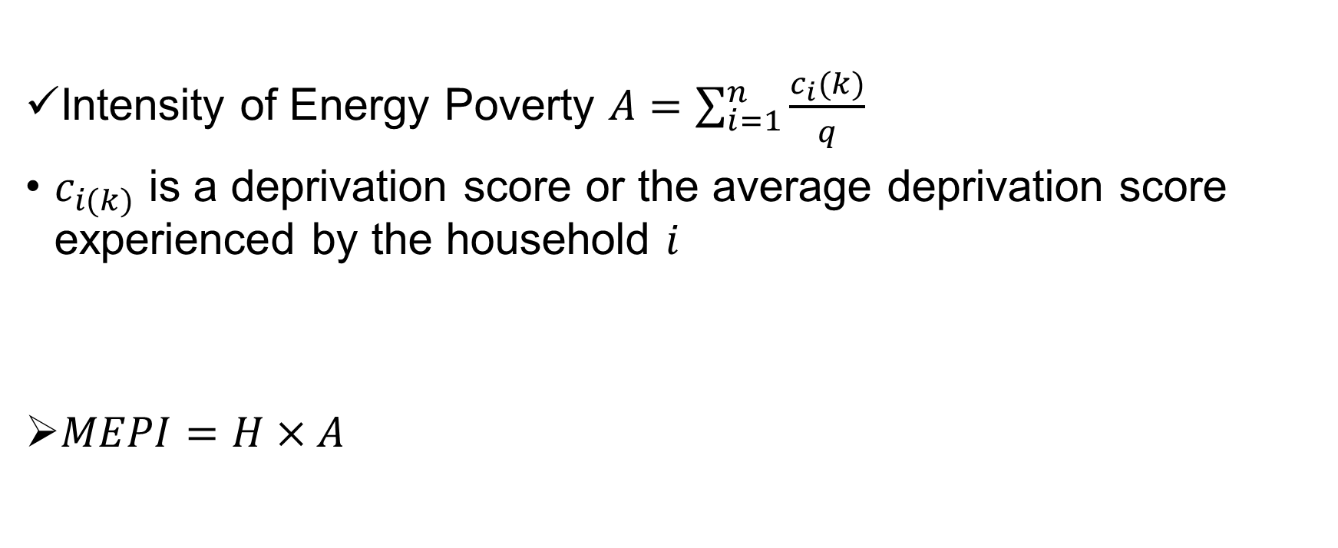
2. Methods
Intensity of Energy Poverty $A=\sum_{i=1}^{n}{\frac{c_{i}(k)}{q}}$
$c_{i(k)}$ is a deprivation score or the average deprivation score experienced by the household $i$
$MEPI=H×A$

Slide 11
3. Results
3.2. MEPI, Headcount ratio and Intensity of Energy poverty
Figure 7. MEPI results at the national and provincial level
Source: Built from DHS survey data.

Slide 12
3. Results
Figure 8. Headcount ratio (H) at the national and provincial levels, representing the fraction of energy-poor households.
Source: Built from DHS survey data

Slide 13
3. Results
Figure 9. The intensity of energy poverty (A) at the national and provincial level
Source: Built from DHS survey data.

Slide 14
5. Conclusions
Energy poverty in the country is a rural and urban phenomenon and it coexists with income poverty;
We found diverse landscape of energy poverty across Mozambican provinces, suggesting that public policies should be defined at the provincial level and not via one umbrella policy to address energy poverty
We suggest the inclusion of a new variable related to productive uses of energy

Slide 15
THANK YOU
FCUL
UNIVERSITY OF PRETORIA
PROJECTO NICHE/MOZ-231/263

