Slide 1
How to Replicate the H2-Vision Project in the Netherlands to Elsewhere in the World?
1st IAEE Digital Conference
June 9th, 2021
Yayun chen (Taxes A&M University)
Ning lin (the University of Texas at Austin)

Slide 2
Outline
H2-Vision and related projects
Economics Analysis
Potential Hydrogen Market
Application: Other cases
Conclusion

Slide 3
Today’s H2 in Netherlands
Hydrogen projects:
NortH2 (launched in February 2020, obtain a subsidy worth €20 million ($16m))
PosHYdon (added DEME Offshore, Gasunie and Eneco as partners in 2020)
Shell and Eneco JV (to build a 200MW green hydrogen electrolysis plant in the Port of Rotterdam in 2020)
Ørsted and Yara hydrogen electrolyser (announced to cooperate with Norwegian fertiliser producer in 2020)
SinneWetterstof hydrogen pilot (Germany company entered and planed to build a hydrogen plant in 2020)

Slide 4
Economic Analysis
Economy construction
Market
Policy
Carbon Emission

Slide 5
Input-Output CashFlow Model
Inputs
CAPEX by projects
OPEX by projects
Outputs
Electricity price
Application
Industrial cases
Policy analysis
Electricity Generation
Carbon Production/Consumption
Gas/LNG price
Policy
CO2 price
Required balanced subsidies by different scenarios
Evaluation of other economy projects
Carbon Price analysis

Slide 6
Potential Hydrogen Market
Industrial
Residential
Transportation
Electricity
Carbon Market

Slide 7
Electricity Price
Wholesale price analysis:
CE Delft (2017): it would be around € 29-59/MWh based on different scenarios
The Oxford Institute for Energy Study(OIES) (2021): € 51.2/MWh
H2-Vision: € 60-105/MWh from 2025 to 2045 by different scenarios
Current household electricity price(Step. 2020): € 0.2819/KWh (Top 2 highest price in Europe, the first is Germany)

Slide 8
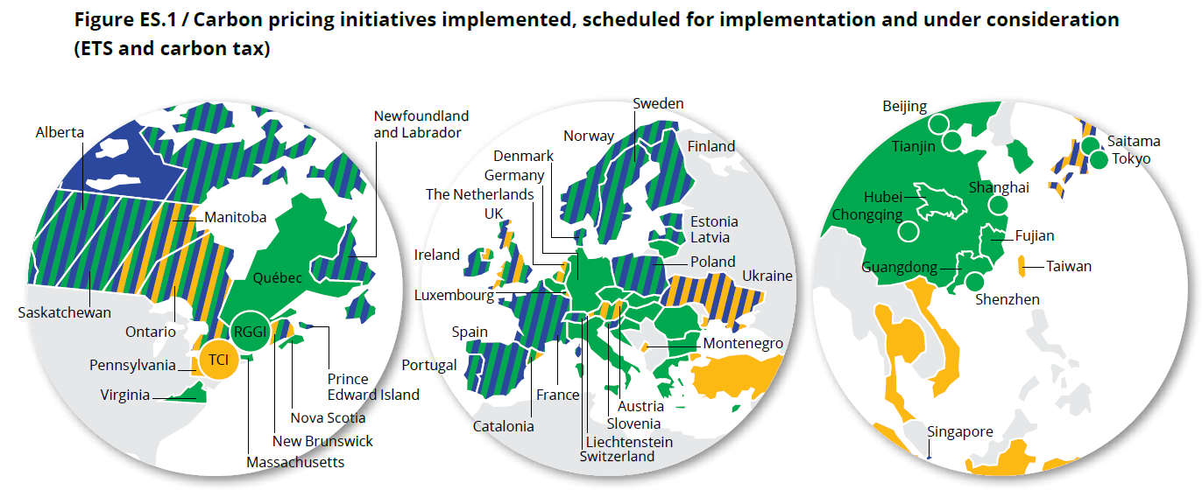
Future Carbon Price
World Bank(2020): €30/tCO2 to €125-150/tCO2 in 2030.
H-vision: €86-146/tCO2 ETS price to make the business case NPV neutral.
Netherlands: ETS implemented or scheduled for implementation
Source: World Bank Group. State and Trends of Carbon Pricing 2020

Slide 10
Policy Agenda
Legislation and regulation: i.e., use of the existing gas grid
Cost reduction and scaling up green hydrogen, i.e., support schemes for research, scaling up and rolling out; blending obligation
Sustainability of final consumption: i.e., ports and industry clusters
Supporting and flanking policy: i.e., international strategy; regional policy

Slide 11
Application

Slide 12
Global Hub Comparison
Policy Comparison
Sectors
Advantages
Challenges

Slide 13
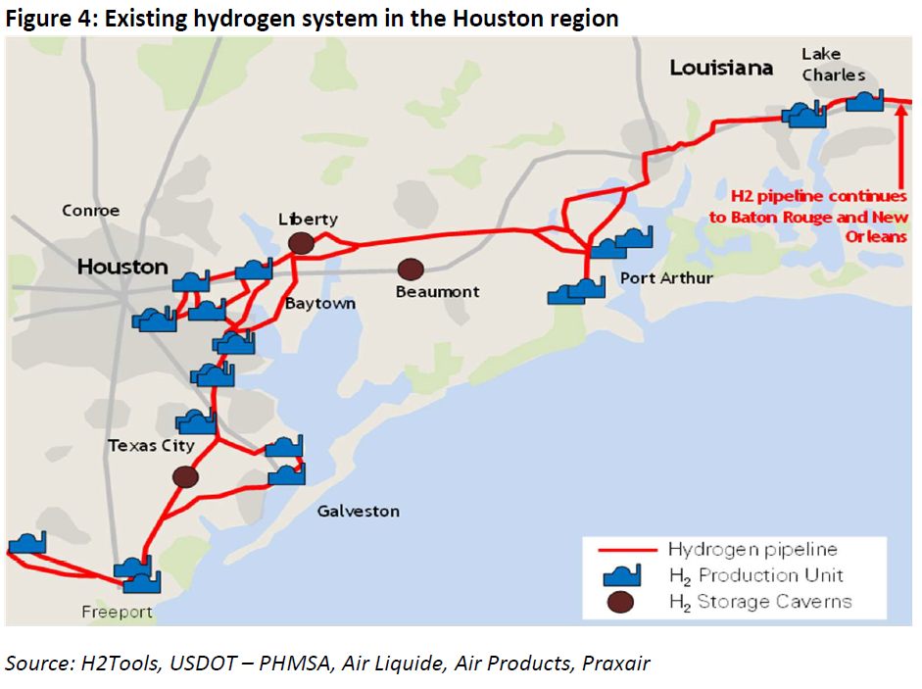
Houston Hub-2020
TX Gulf Coast H2 system:
Over 900 miles H2 pipelines (32% of global)
3.44MMt of H2 produced annually largely through stem methane reformation(8.5x Rotterdam)
48 H2 Production plants
World’s largest storage caverns for H2
Source: https://www.centerforhoustonsfuture.org/energy

Slide 14
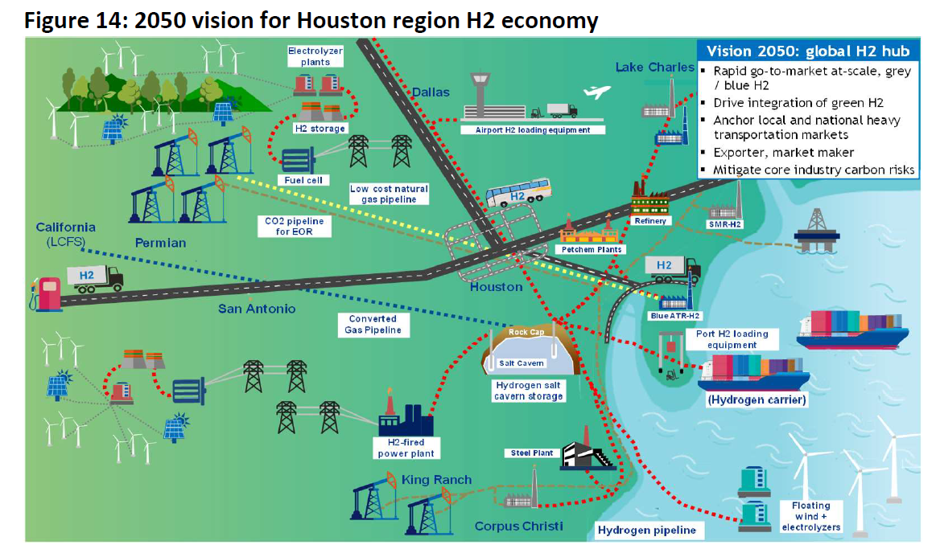
Houston Hub-2050
In the future, Houston Hub would be a global H2 hub
Local and national heavy transportation markets
Exports and market maker
Decarbonize industrial process heat and power
Leverage captured CO2 for EOR
Source: https://www.centerforhoustonsfuture.org/energy

Slide 15
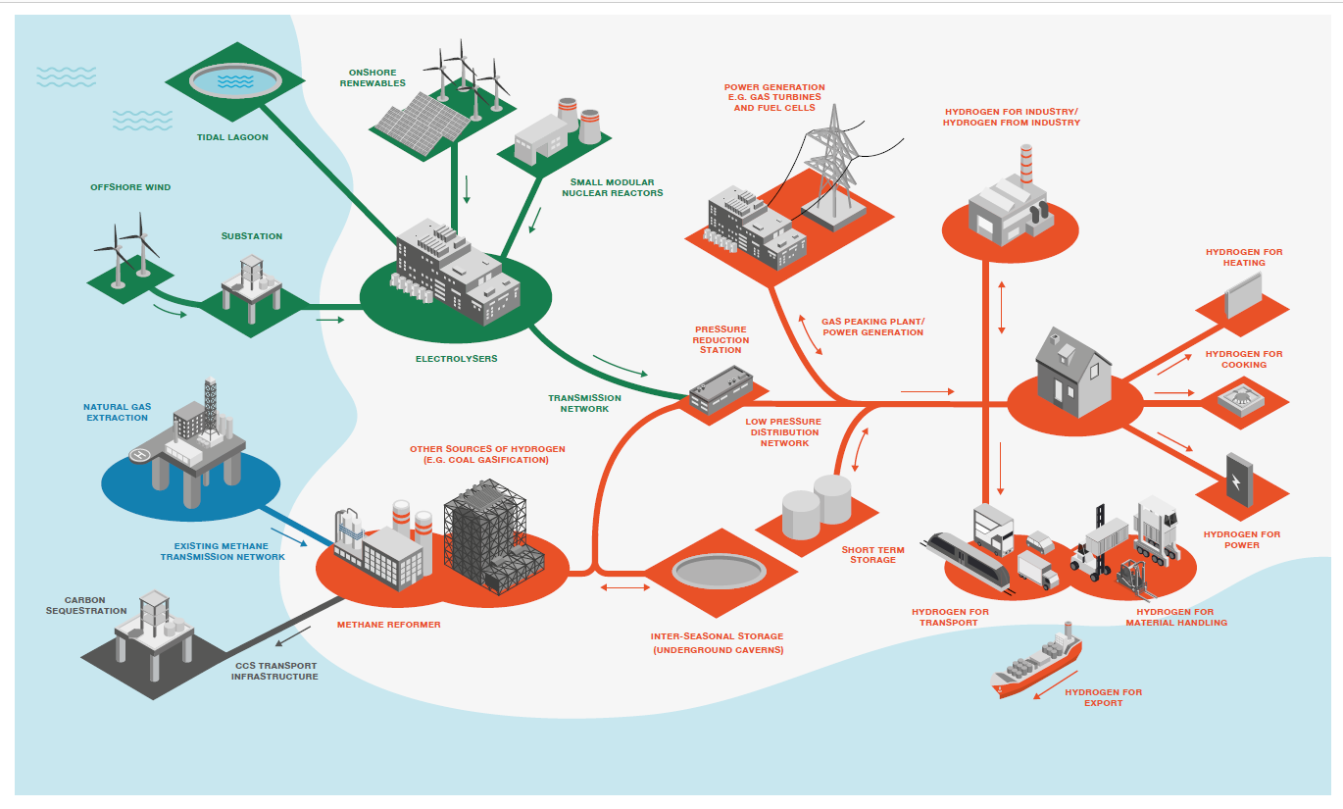
UK
Production: electrolysis via renewables; reformation from methane+CCS (mainly)
Demand: Transportation; Industry; households.

Slide 16
Policy Comparison
Policy | Netherlands | US(Houston Hub) | UK
National Hydrogen Strategy | Hydrogen Strategy and Policy Agenda (2020) | Center for Houston’s Future(2019)(1) | No National yet; The Ten Point Plan for a Green Industrial Revolution (2020)
Investment support | Mainly on research funding | DOE announced $64 million for 18 projects in Texas (2) | £1bn for CCS by 2025
Electrolysis | 3-4 GW by 2030 | 600MW by 2030 (3); Scale offshore wind and electrolyzer production by 2040-2050 | 5 GW in 2030
RES based Hydrogen | SMR/CCS and RES based
CCUS based Hydrogen | bridging technology
Import/Export | Exports
Governance | H2 Platform | / | Hydrogen Advisory Council
Source:
https://www.centerforhoustonsfuture.org/energy
(2) https://www.powermag.com/doe-backed-hydrogen-project-underway-in-texas/
(3) https://www.offshorewind.biz/2021/03/23/offshore-wind-could-meet-166-of-texas-electricity-demand/

Slide 17
Sectors
Sector |  | Netherlands | US(Houston Hub) | UK
Industry | Targets | CCS; H2 use for high temperature heat | CCUS; industrial process heat | CCS
 | Policy Support |  |  | Clean Steel Fund
Transportation | Targets | 15,000 FCEV by 2025, 300,000 FCEV by 2030 | Focus on heavy duty trucks, regional chemical trucks; 1205 trucks converting diesel to H2 by 2036 | Focus on BEV rather than FCEV
 | Refuelling infrastructure | 8 hrs(2020) Target 50 hrs by 2050 |  | 13 hrs(2019)
 | Policy Support |  |  | Hydrogen for transport programme
Household | Targets |  |  | Hydrogen village heating trail by 2025
Infrastructure(Grid& Storages) |  | Parallel methane and hydrogen networks | Large scale H2 storage caverns | up to 20% H2 blending

Slide 18
Some Details
Items | Netherlands | US(Houston Hub) | UK
Progress | first phase(research) | planning | planning
Scales | regional | global | UK
Policy Support | National | not yet | no national yet
Type | 75% green+25% blue | Mainly by Blue | Methane reforming with CCUS
Production Capacity | 3-4 GW in 2030 | 48 H2 production plants | 5 GW by 2030
CO2 Storage Capacity (Mt CO2) | 2,340 | 500,000 | 14,400
Investment | 27.02 Billion Euro(estimated) | ExxonMobil Floats $100B CO2 Storage Project (2021) | £1 billion up to 2025 to facilitate the deployment of CCUS; $238 million in five hydrogen projects
Demand | 2.7MMt | 43.5MMt | 200TWh by 2050
Pipelines | 275km | 1448km(already exist) | 2000km(planned) by 2030
CO2 Reduction | 4.3 Mt in 2031 | 40 Mt by 2030, 100 Mt by 2040 | 10 Mt from 2030

Slide 19
Advantages & Challenges
Items | Netherlands | US(Houston Hub) | UK
Progress
Scales
Policy Support
Type
Production Capacity
CO2 Storage Capacity
Investment

Slide 20
Conclusion
Currently, not a global hydrogen hub is established, everything is under planning and construction.
Challenges for all the hubs, how to make cost effective, scaling up, globalization or other ways.
For the specific hub, Houston hub has pre-advantages, since it already installed a lot of wind capacity, pipelines, hydrogen plants, and relative heavy industries, etc.

Slide 21
Reference
Fuel Cell and Hydrogen, 2019. A Sustainable Pathway for the European Energy Transition. Retrieved from https://www.fch.europa.eu/sites/default/files/Hydrogen%20Roadmap%20Europe_Report.pdf
Mulder, M., Perey, P., Moraga, J.L. (2019). Outlook for a Dutch hydrogen market: economic conditions and scenarios, Centre for Energy Economics Research, CEER Policy Papers 5 - University of Groningen, The Netherlands - March 2019.
Martin Lambert, Simon Schulte, 2021. Constrasting European hydrogen pathways: an analysis of differing approaches in key markets. OIES, March, 2021.
CEER, 2019. Regulatory Challenges for a Sustainable Gas Sector, Public Consultation Paper, 22 March 2019, Ref: C18-RGS-03-03.
IRENA, 2018, Hydrogen from renewable power: Technology outlook for the energy transition, Report 978-92-9260-077-8
H-vision, 2019, Blue hydrogen as accelerator and pioneer for energy transition in the industry, Feasibility study report, July 2019.
IRENA, Hydrogen: A renewable energy perspective (2019)
Letter dated 8 November 2019, House of Representatives Annexes to Proceedings 665
CEFIC, Vision on Hydrogen (2019)
VNCI, Navigant, Berenschot, Roadmap for the Dutch Chemical Industry towards 2050 (2018)
VEMW, Decisions on the Industrial Energy Transition (2017)
https://www.centerforhoustonsfuture.org/energy
https://www.powermag.com/doe-backed-hydrogen-project-underway-in-texas/
https://www.enr.com/articles/51634-exxonmobil-floats-100b-co2-storage-project-for-houston-industrial-zone
https://www.climateaction.org/news/green-hydrogen-project-launched-in-uk-to-reduce-industrial-carbon-emissions
https://www.spglobal.com/platts/en/market-insights/latest-news/electric-power/031721-uk-to-fund-hydrogen-ccs-projects-outline-industrial-carbon-price-plan
https://ijglobal.com/articles/154386/going-green-the-dutch-clean-hydrogen-vision
https://cockrell.utexas.edu/news/archive/9160-texas-poised-to-become-leader-in-hydrogen-production-energy-and-policy-leaders-say

Slide 22
Thanks for your attention!

