Slide 1
IAEE 2021 ………………………………………… Policy Development for Solar Water Heaters in the Mediterranean; A Case Study
Olusola Bamisile, Lucille Aba Abruquah, Sandra C. Obiora, Tamas Csordas, Mustafa Dagbasi
University of Electronic Science and Technology of China

Slide 2
Content
Introduction
Problem Statement
Materials and Method
Results and Discussions
Conclusion

Slide 3
Introduction

Slide 4
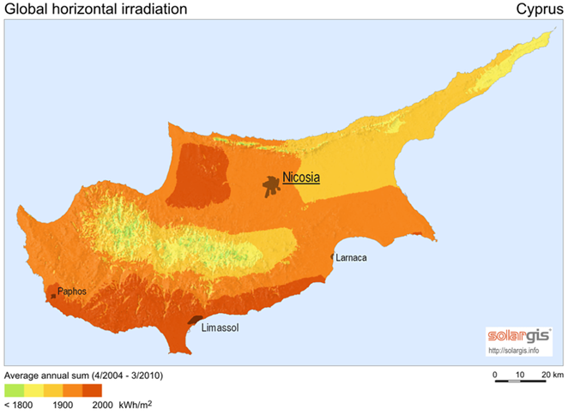
Introduction
1
2
3
4
5
Cyprus is the third largest island in the Mediterranean in terms of landmass and the third largest island in the eastern part of the Mediterranean in terms of the population.
Cyprus has a great potential to domesticate solar energy because of its climatic advantages and geographic positioning.
The average daily solar radiation of Cyprus is 5.4 kWh/m² on the horizontal surface. The mean daily solar radiation varies from 2.3 kWh/m² to 7.2 kWh/m².
SWH technology is one of the most mature solar energy application technologies. The commercial application of this technology has been available in the market for over 40 years.
Cyprus is the third in terms of global per capita SWH systems installation with Barbados and Austria claiming first and second positions.

Slide 5
Problem Statement
In this research, the Binary logit regression model is used to check the willingness of Cypriots to accept a policy that enforces SWH for each building.
Chi-square crosstab analysis is employed to analyze the current status of SWHs.
Determinants to the acceptance of this policy will also be identified and the prospects of the policy in the nearest future will be considered.
Primary data from 1000 residences in Cyprus is collected and used for the analysis in this research.
The main contribution of this paper is the determination of factors that encourages SWH policy based a primary data.
Despite the huge amount of SWH systems installed in Cyprus, it is quite intriguing to know that there has never been a policy that mandates the installation of solar water heaters.
The only SWH policy available in Cyprus is a subsidy policy for SWH and this is still at the planning stage.
In existing literature, there was no in-depth research into the current status, utilization, and policy of SWH systems in Cyprus.
Therefore, there exists a gap in literature regarding the utilization and policy of SWH on this Island.

Slide 6
Materials and Method

Slide 7
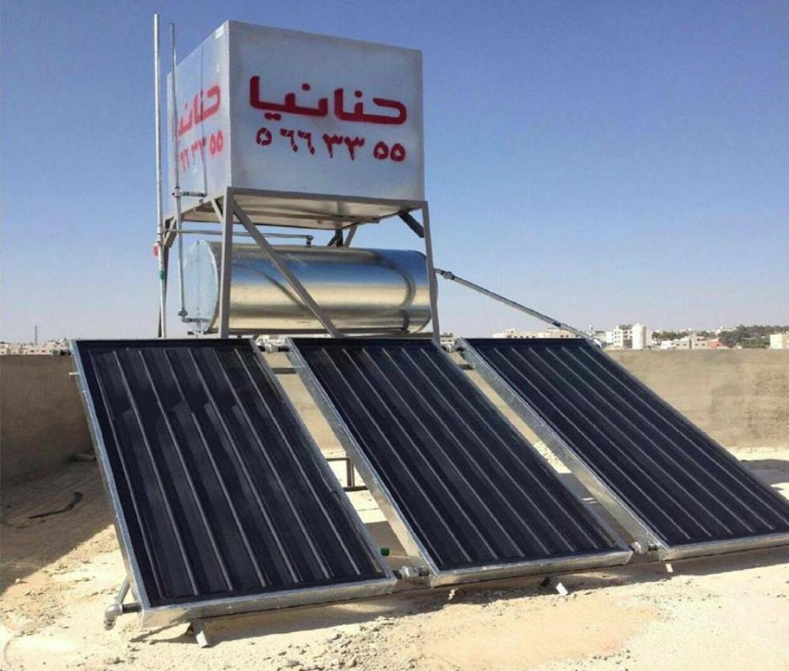
Data Collection
A standardized quantitative survey was used to collect data on 1000 housing units in Cyprus through a random sampling method.
The types of housing units were classified under studio apartments/dormitories (55%), 2 or 3 bedroom apartments (28%), duplex (12%), and others (5%).
Respondents in these housing units were asked questions about the use of SWH systems, willingness to recommend SWH systems to neighbors, and support for SWH policy enforcement throughout Cyprus.
Respondents were also asked about the number of years they have used SWH systems, the functionality of the system, the sufficiency of hot water produced daily, and knowledge regarding SWH insulation pipes.

Slide 8
Method
One of the objectives of this study is to ascertain the determinants of solar water heating installation policy enforcement in Cyprus.
Respondents were asked whether they would support a policy that enforces SWH installation in all houses in Cyprus.
This dependent variable was measured on a binary scale where 1 denotes their support for such a policy and 0 otherwise.
The statistical analyses usually adapted for a dichotomous dependent variable are the binary logit or probit, regression models.
Since the logit and probit models produce similar partial effects, we adopt the binary logit model based on the assumption that errors adhere to a standard logistic distribution instead of a standard normal distribution in the probit model.

Slide 9
Results and Discussion

Slide 10
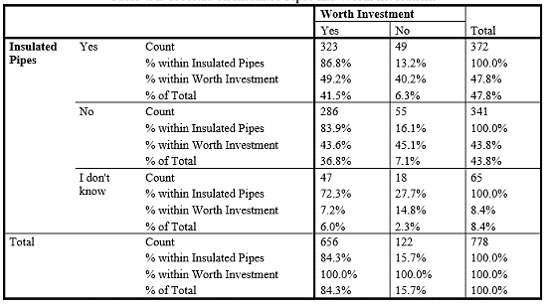
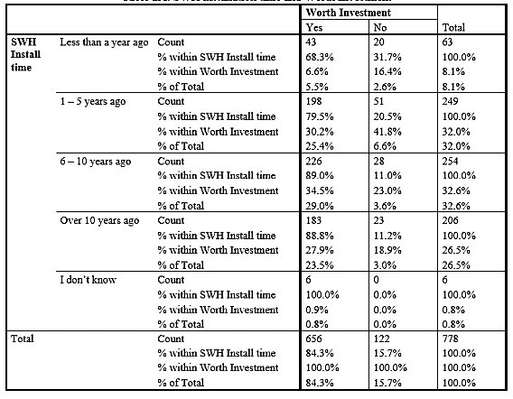
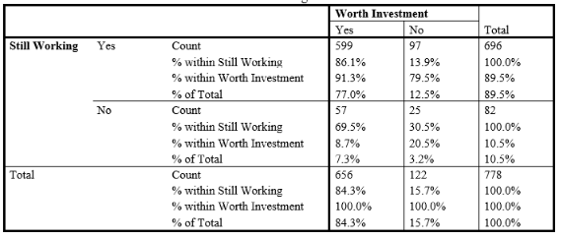
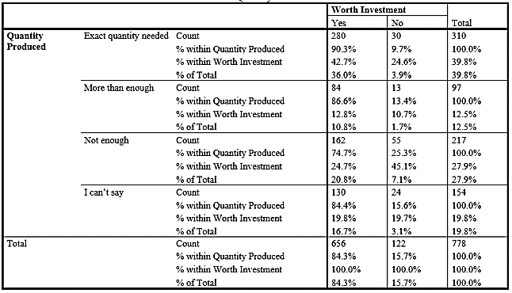
Application

Slide 11
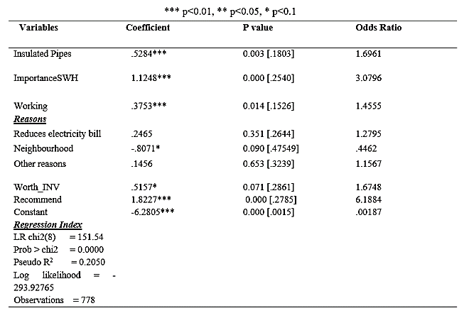
Determinants of SWH Policy Enforcement in Cyprus
The likelihood of recommending the SWH system also depicted a highly significant positive correlation with support for the enforcement of the SWH installation policy.
In essence, the more the respondent is likely to recommend SWH to others, the more likely they are to support the policy that mandates that all homes install SWH across Northern Cyprus.
Not only is the location of Cyprus one of the most suitable environments for the enforcement of a SWH policy, but it is also positively received in general as 81.75% of all 1000 observations supported the enforcement of such a policy.

Slide 12
Odds Ratio Analysis
The Odds ratio analysis provides significant insights into the study.
In the odds ratio column, we see that the odds ratio for insulated pipes is 1.69. This indicates that a one-unit increase in insulated pipes installation increases the odds of a respondent supporting the SWH policy in North Cyprus by 69%.
In the case of how important respondents feel the SWH system is important to their buildings (ImportanceSWH), the odds ratio is 3.08. This indicates that a one-unit increase in ImportanceSWH perception increases the odds of supporting the SWH policy by about 208%.
Where the working consistency of the installed SWH system is concerned (Working), the odds ratio is 1.455, indicating that a one-unit increase in Working increases the odds of supporting the SWH policy by 45%.
We observe the odds ratio of WorthINV (Worth the investment) to be 1.67 indicating a 67% increase in the odds of supporting the policy with every one-unit increase of WorthINV.
The highest odds ratio value we observe belongs to the Recommendation (Worth recommending to others to install) variable with a 6.19. It implies that a one-unit increase in Recommendation produces a 519% increase in the odds that they will also support the SWH policy in Northern Cyprus.

Slide 13
Conclusion & Recommendations
1
2
3
4
5
This paper takes a sample of 1000 Cypriot housing units and investigates the determinants to the likelihood of supporting a SWH enforcement policy.
The application, utility, and durability of currently installed systems were also investigated in this research.
It was found that having consistently working SWH systems especially with the presence of insulated pipes, the perception of the SWH system being worth the investment, and considering the system as an integral part of their buildings were all positively correlated determinants of supporting the SWH policy enforcement.
Factors such as the stage in years of the installation, whether the installed system still works, whether the pipes installed are insulated in nature, and whether the quantity of hot water finally produced all affect the respondent’s perception that the SWH system is worth the investment.
we find that respondents are more likely to support the SWH policy enforcement if they themselves see the benefit of the system, and consider the installation of SWH good enough to recommend to others.

Slide 14
Conclusion & Recommendations
1
2
3
4
5
we have some recommendations to make. If the Cyprus government hopes to mandate the SWH installation policy, they need to consider the following factors.
First, people are only willing to install and support such policy’s if it indeed works consistently and they are able to maximize its benefits.
Secondly, people are more likely to support such a policy if it presents itself as a good enough investment.
The installation should also be able to produce enough hot water especially at times when they are most needed.
In essence, the design, the cost, and the value of installing a SWH system should be clearly outlined before the citizens can be expected to embrace the enforcement of a SWH policy in Cyprus.

Slide 15
Thanks for your attention ~ 谢谢

