Slide 1
Effects of electric pumps on farm-level agricultural production and groundwater use in West Bengal
Marie-Charlotte Buisson, Soumya Balasubramanya, David Stifel
International Association of Energy Economics
43rd Conference
7 June 2021
Concurrent Session 17: Climate Change Mitigation - Case Studies
Photo credit: ACIAR-SDIP | Conor Ashleigh
Notes:
This template is to be used for a WIDE screen like LED TVs or newer projection screens.
If preparing a presentation for a STANDARD screen or older projection screen then please use the 4x3 format presentation template instead.
All templates are available on the IWMI INTRAnet at https://intranet.iwmi.org

Slide 2
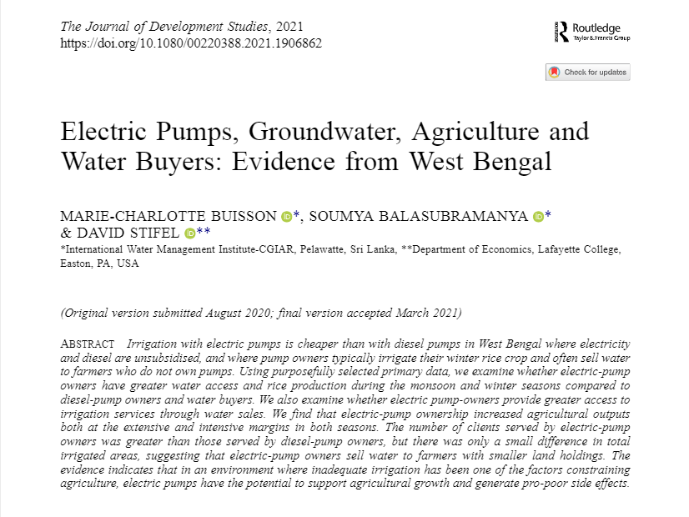
Take away messages
In an environment where inadequate irrigation has been one of the factors constraining agriculture, electrification of irrigation has the potential to support agricultural growth and generate pro-poor side effects:
Electric-pump owners benefitting from cheaper irrigation cultivated larger areas of monsoon and winter rice, and irrigated plots a greater number of times and for longer durations than diesel pump owners.
Monsoon rice yields and value added were higher for electric pump owners than diesel pump owners.
Electric-pump owners sold water to farmers with smaller land holdings than diesel-pump owners did.
A one-time fixed cost subsidy is an efficient alternative to energy tariff subsidies that are applied in most Indian states (major financial burden on governments + risk of groundwater resources depletion).
Solarization of irrigation would potentially yield the same type of welfare effects plus helps mitigating climate change.

Slide 3
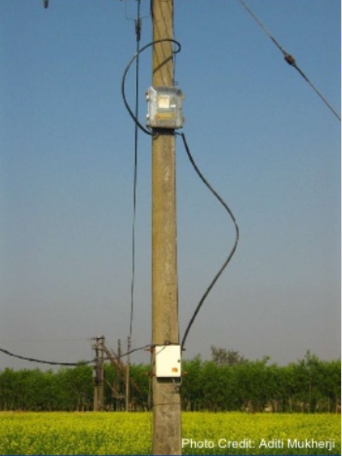
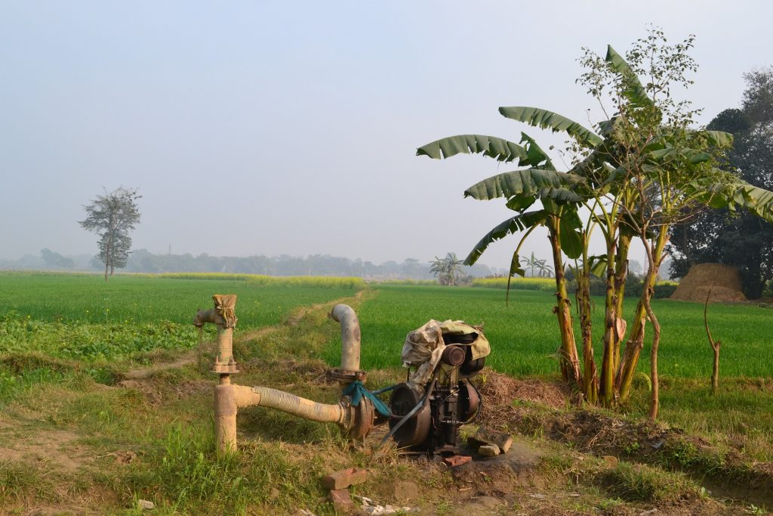
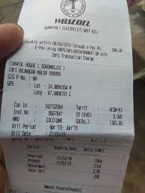
1. Context – Agricultural growth in West Bengal
Subsidy One Time Assistance for Electrification of Agricultural Pump-sets
Lumpsum 8,000 Rs
Metering Shift from flat tariff to time of the day tariffs based on meters reading (Mukherji and Das, 2014)
2012
Development of private irrigation Land reform
Ushering in of Green Revolution
(Shah and Raju 1989, Modak and Bakshi, 2017)
2007
2000s
2011
1980-2000
Energy squeeze
Agricultural stagnation
(Modak and Bakshi, 2017)
Removal of permits Amendment of the Groundwater Act
Farmers in ‘safe’ groundwater blocks don’t need permits from the SWID
(Shah and Chowdhury, 2017)
Fig 1 - Area and production of winter rice (boro)

Slide 4
1. Context - Electrification of agricultural tubewells
Removal of permits
Energy squeeze
Subsidy
Metering
2000s
2012
2007
2011
Development of private irrigation
216,000 tubewells permanently electrified from 2011 to 2019
1980-2000
Fig 2 - Number of shallow tubewells permanently electrified and yields of winter rice (boro)

Slide 5
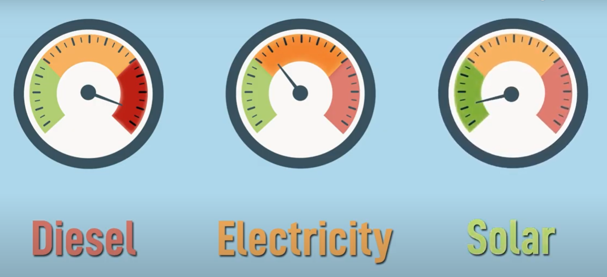
2. Research question and conceptual framework
Two hypothesis: (a) Electric pumps affect agricultural outcomes of pump owners.
(b) Electric pumps benefit to non-pump-owners through water market.
Electrified pumps considered as a composite good
Attributes as compared to diesel pumps
Lower operational cost
Lower repair and maintenance cost
Less labor intensive
Higher energy efficiency
Permanently fixed
Direct effect on pump owner’s agricultural outcomes:
Agricultural choices: cropping intensity, cropping patterns
Profitability of the farm: yields, value added
Irrigation practices
Indirect effect on water buyers
Literature from the Water-Energy-Food nexus
Easing the access to energy for agriculture (mostly through subsidies on electricity tariffs) tend to increase:
Farm value-added (Bardhan et al., 2014)
Cultivated area allocated to water-intensive crops (Badiani and Jessoe, 2018)
Groundwater use (Birner et al. 2011; Janakarajan and Moench, 2006; Moench, 2007; Sarkar, 2011; Somanathan and Ravindranath, 2006; Balali et al. 2011).
→Net effect can be limited when social and environmental effects are accounted for. (Kahil et al. 2015).

Slide 6
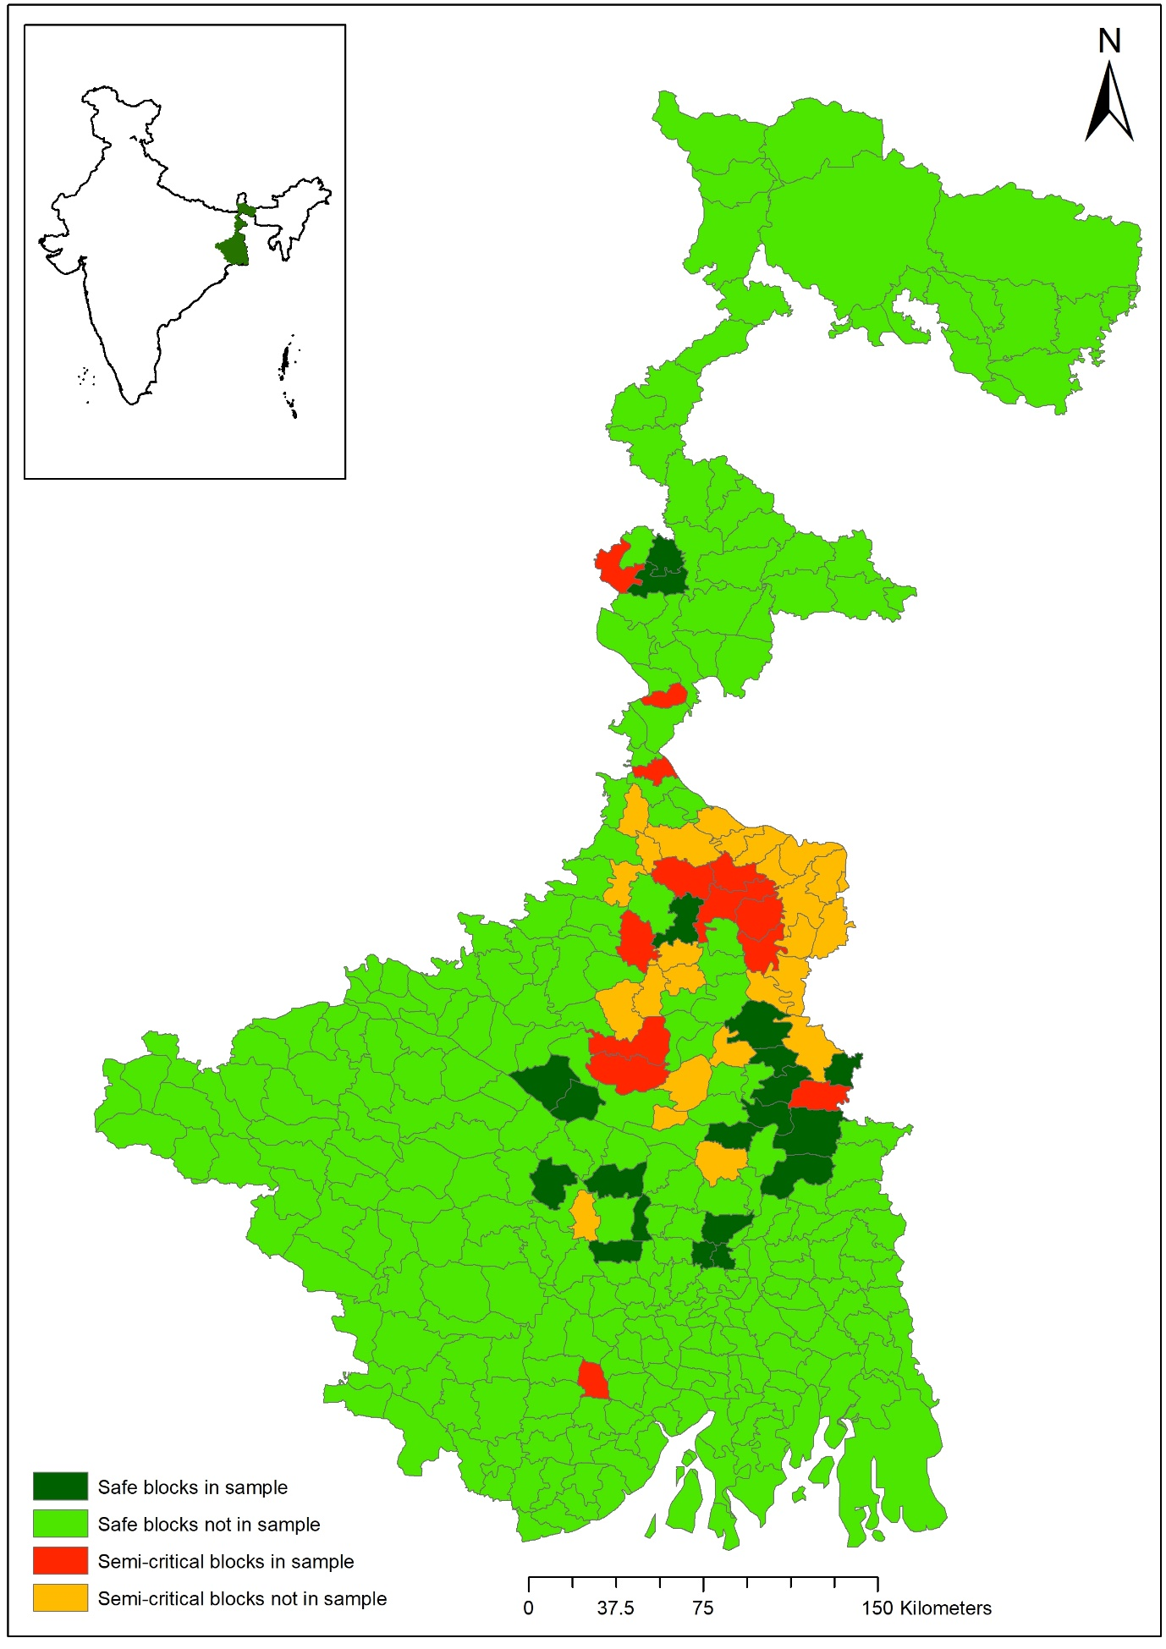
3. Data
Sample of 1396 farming households from 93 villages
14 safe blocks, 10 semi-critical blocks purposively selected
Village census of electric and diesel pump owners used for a proportional random sampling in each village:
26.5% electric pump owners
28.5% diesel pump owners
45.0% water buyers
Survey conducted in May and June 2013 with detailed crop economics questionnaire:
Information on three cropping seasons
One plot per household with easiest access to irrigation (42% of the total cultivated area)
Fig 3 – Map of blocks categorization in 2009 and sample selection

Slide 7
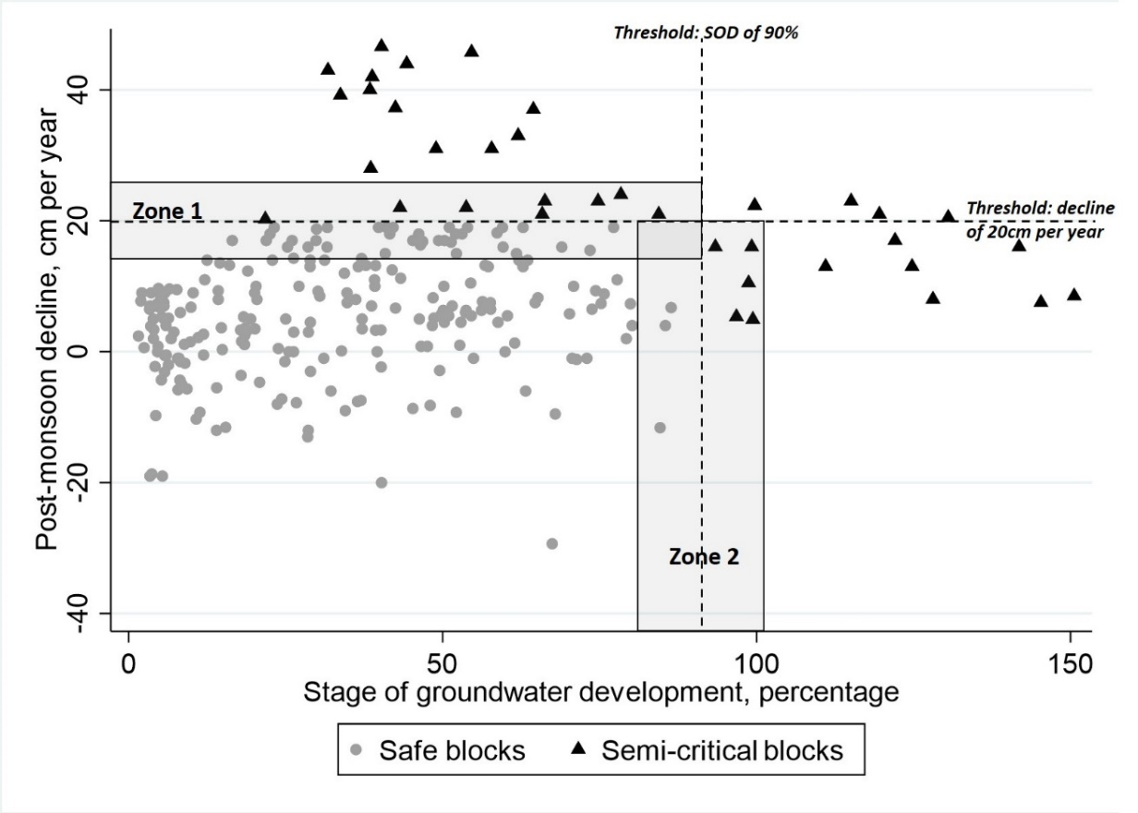
4. Empirical strategy – Non-random electrification policy
Endogeneity bias at block level
Non-random relaxation of permit requirement and provision of capital cost subsidy
Discontinuity used sample selection
Selection of blocks just above and just below the hydrological thresholds that separates ‘safe’ from ‘semi-critical’ blocks
Farmers with similar hydrological conditions but exogenous differences in access to electric-pump ownership
Fig 4 – Categorization and selection of the blocks

Slide 8
4. Empirical strategy – Non-random pump ownership
TESTS
Conditional independence
Durbin-Wu-Hausman test
Rosenbaum-bound significance levels (Rosenbaum, 2002)
Common support
Kernel density distributions show large overlapping support
Less 1% of the observations dropped (Heckman et al., 1997)
Balancing tests
Minimal and non-significant differences on observable characteristics between electric pump owners and other farms after matching
Limited standardized percentage bias after matching (Imbens and Wooldridge, 2009)
Robustness test: Weighted OLS (Chen, Mu and Ravallion, 2009; Lechner, 2001)
Test for multiple hypothesis (Bonferroni, 1935; Holm, 1979; List et al., 2016)
Propensity score matching to account for non random electric pump ownership (Rosenbaum, 2002)
Model of treatment
Agricultural and economic wealth
Social capital
Environmental and technical feasibility
Distance to cut-off indicators
Matching using propensity score, probability of owning an electric pump
Method
5 nearest neighbors, caliper 0.01
Sensitivity analysis

Slide 9
5. Results – Cropping patterns
Tab 1– Effects of Pump Ownership on Cropping Patterns
Note: ATE = Average Treatment Effect, OLS = Ordinary Least Squares. Figures in parentheses are analytical standard errors for the ATE and standard errors for the weighted OLS. The entire list of control variables was included in the weighted OLS regressions but results are omitted here. *** stands for 1% of significance, ** for 5% and * for 10%.
Higher cropping intensity
Electric pumps owners use their land more intensively, +17.2 percentage point on crop intensity
Electric pump owners allocate 7.7 percentage points more of their net cultivated area to monsoon rice and 21 percentage points more to winter rice.
More water intensive crops

Slide 10
5. Results – Yields and value-added
Tab 2– Effects of Pump Ownership on Rice Yields and Value-Added
Note: ATE = Average Treatment Effect, OLS = Ordinary Least Squares. Figures in parentheses are analytical standard errors for the ATE and standard errors for the weighted OLS. The entire list of control variables was included in the weighted OLS regressions but results are omitted here. *** stands for 1% of significance, ** for 5% and * for 10%.
Higher monsoon rice yields and value added
Monsoon season rice yields of electric-pump owners are 126.8 kg per acre greater than for diesel-pump owners, values added are USD 27 per acre greater.
Access to lower energy-cost electric pumps allows more flexibility to irrigate monsoon rice in case of late or limited rains.

Slide 11
5. Results – Irrigation practices
Tab 3– Effects of Pump Ownership on Irrigation Practices
Note: ATE = Average Treatment Effect, OLS = Ordinary Least Squares. Figures in parentheses are analytical standard errors for the ATE and standard errors for the weighted OLS. The entire list of control variables was included in the weighted OLS regressions but results are omitted here. *** stands for 1% of significance, ** for 5% and * for 10%.
More frequent and longer irrigations
In monsoon, electric pump owners conduct 4.8 more irrigations on their rice plots on average, they also irrigate their rice plots for a total of 33.8 more hours per acre as compared to other farmers.
In winter, electric pump owners have 7.7 additional irrigations and irrigate 45.8 more hours as compared to diesel pump owners and water buyers.
However, quantity of water unknown.

Slide 12
5. Results – Water selling
Tab 4– Effects of Pump Ownership on Water Selling
Note: ATE = Average Treatment Effect, OLS = Ordinary Least Squares. Figures in parentheses are analytical standard errors for the ATE and standard errors for the weighted OLS. The entire list of control variables was included in the weighted OLS regressions but results are omitted here. *** stands for 1% of significance, ** for 5% and * for 10%.
Higher number of buyers and larger areas served
As compared to diesel pump owners, electric pumps owners serve 6.6 additional buyers in monsoon and 4.1 in winter season.
Larger areas are irrigated by electric pump owners than diesel pump owners through water selling.
Indirect effect through water selling, larger effects than only on the pump owners, effects on rural economy in general.

Slide 13
6. Summary of findings
Context of massive electrification of tubewells in West Bengal supported by revised policy and capital subsidy.
Electric pumps affect agricultural outcomes of pump owners.
Higher cropping intensity and larger share of cultivated land allocated to water intensive crops
Higher yields and value-added, especially for monsoon rice
More frequent and longer irrigations
Electric pumps benefit to non-pump-owners through water market.
Spillover effects through water selling with larger access to irrigation
Back to the envelope calculation
+ 7970 INR / year for electric pump owners in value added
Equivalent to the 8000 INR subsidy for capital cost transferred to the farmer
Yet don’t include incomes from water selling and aggregated effects for the water buyers
Rationale for subsidizing fixed costs of electric connections, as a pro-smallholder strategy in a context of financial constraint and abundant and renewable groundwater resources.

Slide 14
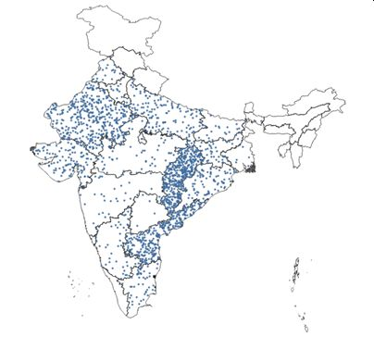
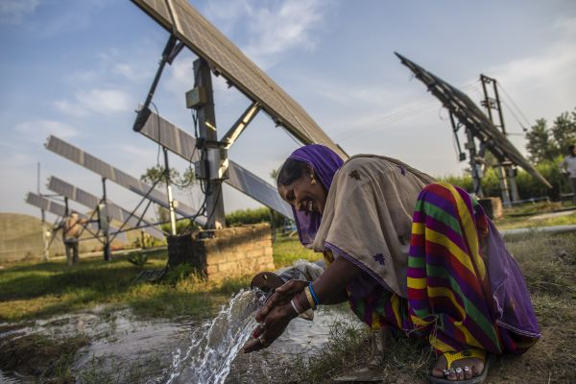
7. Discussion: Implications for climate change mitigation
Fig 5 – Distribution of SIPs in India
(1 dot = 100 pumps)
Conversion from diesel to electric is not a climate change mitigation strategy in this context: 93% of electricity generation from thermal sources in West Bengal.
But learning from electrification in lowering the cost of irrigation inform us on the potential welfare effect of the solarization of irrigation.
Solar Irrigation Pumps in India from 4,000 units in 2010 to 200,000 in 2020.
World’s largest agri-solarization program: Pradhan Mantri Kisan Urja Suraksha evam Utthan Mahabhiyan (PM-KUSUM) program: US$ 5.2 billion and target capacity of 27 GWp.
Huge potential for South Asian agriculture
Near zero marginal cost of operation + More reliable effortless irrigation
Climate change mitigation, contribute to NDC commitments to reduce greenhouse gas (GHG) emissions
Right incentives needed to avoid groundwater further depletion: grid connection with excess of power selling or net metering.
Solar Irrigation for Agricultural Resilience in South Asia (SoLAR-SA) project - https://solar.iwmi.org/ Bangladesh, India, Nepal and Pakistan

Slide 15
Thank you.
Acknowledgements: The work presented in this paper received support from the CGIAR Research Program on Water, Land and Ecosystems (WLE), the CGIAR Standing Panel on Impact Assessment (SPIA) and the Australian Centre for International Agricultural Research (ACIAR).
For more information, questions and comments,
contact Dr Marie-Charlotte Buisson (m.buisson@cigar.org)
Marie-Charlotte Buisson, Soumya Balasubramanya & David Stifel (2021):Electric Pumps, Groundwater, Agriculture and Water Buyers: Evidence from West Bengal, The Journal of Development Studies. DOI: 10.1080/00220388.2021.1906862

