Slide 1
A REVIEW OF LESSONS FROM COMBINED MODELLING APPROACHES IN ASSESSING ENERGY AND CLIMATE POLICIES
Presented by Nastaran Arianpoo, PhD., Research Associate
Research team: Kamaria Kuling, Dr. Andrew S. Wright, Dr. Taco Niet
ΔE⁺ Research Group
Simon Fraser University (SFU)
June 2021

Slide 2
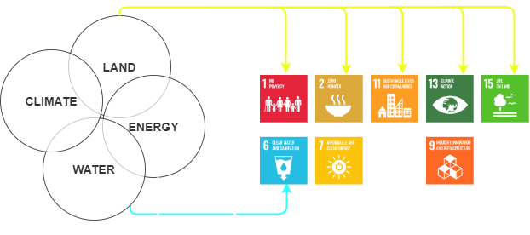
Motivation

Slide 3
Energy Transition & Low-carbon Economy
Main Gaps in Existing Models:
Limitation in representing an energy system with a high penetration of intermittent renewable resources.
Inadequate incorporation of the nexus concept into energy systems’ analysis.

Slide 4
Energy Modelling Paradigms
Analysis domain
Policy
Output
Low spatial & temporal resolution
Forecasting scenario analysis and policy impact studies
Energy-Economy Modelling domain
Input
Market
Investment in capacity expansion and technologies in given energy system
Output
Medium spatial & temporal resolution
Capacity Expansion Modelling domain
Input
Utilities
Output
High spatial & temporal resolution
Electricity market simulator
Power system Modelling domain
Input
Engineering & Services

Slide 5
Combined Modelling Approaches
Combined the Capacity Expansion and Power System Models
Combined Energy-Economy and Capacity Expansion Models

Slide 6
Combining the Capacity Expansion & Power System Models
Misleading the flow of investment
Inaccurate estimation of technical curtailment
Inconsistency in calculation of the CO₂ emissions reductions.
Underrate the importance of system flexibility (namely storage)

Slide 7
Combining Energy-economy & Capacity Expansion Models
Overestimation of the value of the baseload technologies
Overly optimistic results about the flexibility of the power system
Underestimation of the overall cost of meeting long-term emissions deductions targets
Underestimating the value of flexibility measures such as demand response, and storage options

Slide 8
What is the “Nexus”?
The term “NEXUS” refers to the interactions among interdependent systems.
The GOAL OF MODELLING NEXUS systems is to safeguard the resiliency of the whole system by creating feedback mechanism between its components

Slide 9
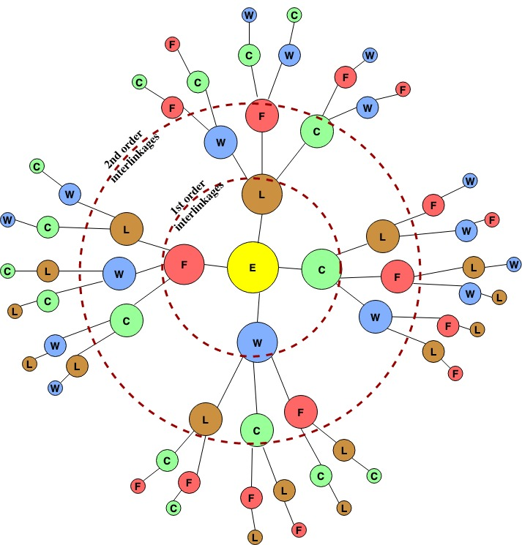
Representation of Nexus Concept in the Existing Models
Figure adopted after: C.S. Laspidou, D.T. Kofinas, N.K. Mellios, M. Witmer, Modelling the Water-Energy-Food-Land Use-Climate Nexus: The Nexus Tree Approach, Proceedings. 2 (2018) 617. https://doi.org/10.3390/proceedings2110617.

Slide 10
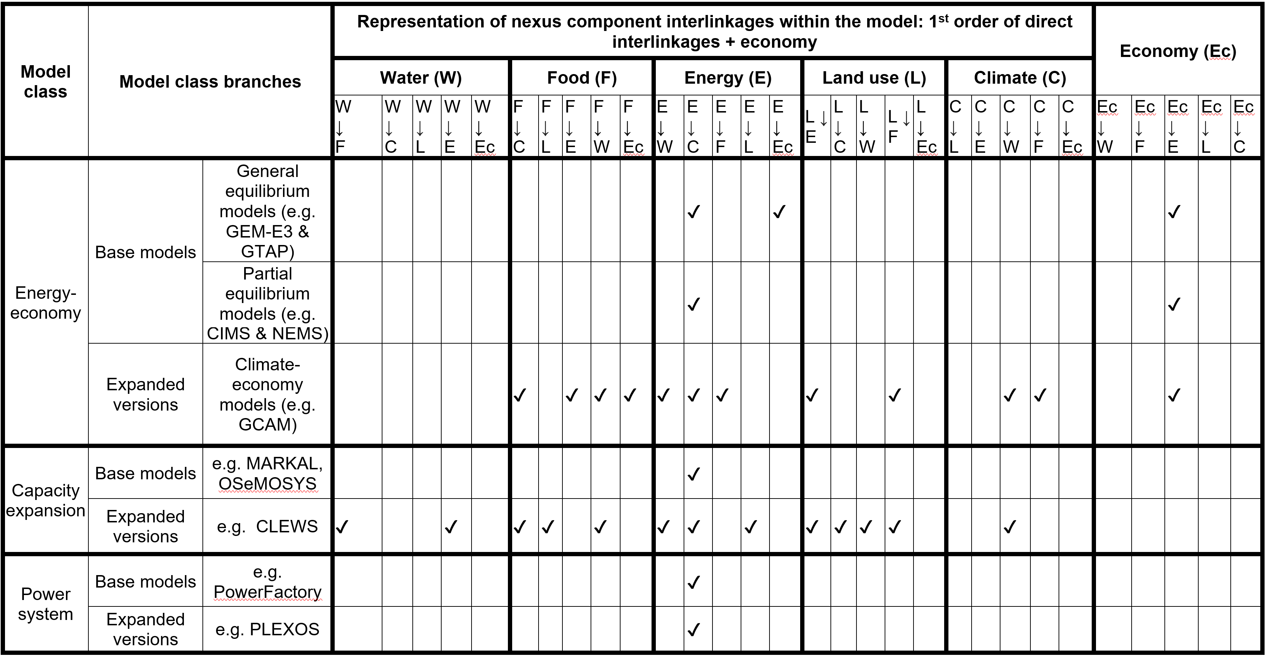
1st order of direct Nexus linkages

Slide 11
Conclusion on Combining modelling techniques
Manageable computational
Creating feedback loops to test the accuracy of energy-related assumptions and simulations.
Missing feedback between the energy economy and capacity expansion models.
Cross-disciplinary interactions of energy domain with factors such as water, food, and natural securities remain relatively underrepresented in existing models.
Combining modelling techniques can be beneficial in addressing modelling limitations in representing the nexus concept.

Slide 12
More information on the Topic
Niet, T., N. Arianpoo, K. Kuling, A.S. Wright (2021). Increasing the Reliability of Energy System Scenarios with Integrated Modelling: A Review. SSHRC Knowledge Synthesis Grant 872-2019-1009 final report. March 17, 2021.
The Canadian Social Sciences and Humanities Research Council (SSHRC) Grant 872-2019-1009.
Includes the report on a series of expert elicitation workshops to gain insight from energy modelling domain experts who use combined models

Slide 13
Update: BC Nexus of Water, Food, Energy, Climate Model
Climate
Resource Systems
Demand
Energy
CO₂
Energy System
Power Sector
Water
Crop
Water System
CO₂
Land System
Figure adopted after: Sridharan, V., Shivakumar, A., Niet, T., Ramas P. E., Howells, M. (2020). Land, energy and water resource management and its impact on GHG emissions, electricity supply and food production- Insights from a Ugandan case study. Environment Research Communication
Agriculture Sector
CO₂

Slide 14
Thank you!
Thank you

