Slide 1
NUDGING OCCUPANTS’ BEHAVIOUR TOWARDS LESS ENERGY CONSUMPTION IN BUILDINGS
Rabab Akkouche, Sandrine Selosse, Gilles Guerassimoff MINES ParisTech, PSL Research University, Centre for Applied Mathematics, Sophia Antipolis
09/06/2021

Slide 2
General Context

Slide 3
General Context
1
Source : calculs SDES, d’après les sources par énergie

Slide 4
General Context
1
The building
Active Energy Efficiency
Performance of the envelope
Insulation
Architecture
« Bioclimatic » Design
Performance of materials
Technological solutions
Monitoring
Energy consumption regulation and control
Improve energy efficiency in buildings
Efficient equipments

Slide 5
General Context
1
Occupant behavior
Indoor Comfort
Crucial factors influencing real energy consumption in buildings
Understand
Model
Predict
Change
Evaluate
Survey
Data Collection
Dynamic Thermal Simulation
Behavioural models
NUDGES
Data Collection
Dynamic thermal simulation

Slide 6
General Context
1
Nudges
Experimentation
Dynamic Thermal Simulation
Dynamic Thermal Simulation (DTS) is used to predict the way a building responds when subject to external environmental factors
It is also a way to prove the energy performance of buildings and achieve certain ratings.

Slide 7
Dynamic Thermal Simulation: Case study: Office building

Slide 8
Dynamic thermal Simulation
2
Office building
3 floors
1 meeting room
1 kitchen
34 Offices
Localisation: Nice, France
50 Occupants

Slide 9
Dynamic thermal Simulation
2
Increasing energy performance of the building:
Performance of materiels
Efficient Equipements ( Heating + Cooling )
Perfomance of Windows
Insulation
19% of energy consumption reduction

Slide 10
Behaviour Change | Heating | Cooling | Lighting | Devices
Base case | 21 C° Winter | 23 C° Summer | Lighting ON all day: 8h – 18h | Phone Computer + 2 Screens ON: 8h – 18h STAND BY after work hours
Intervention 1 | Night / Weekend Mode: 16 C° Absence more than 2 days: 8 C° | No cooling at night Open windows at night | - Switching off lighting when leaving office | - Switching off computers when leaving office
Intervention 2 | - Turn off heating if a window is open | Open windows in the morning with no cooling Using shutters
Intervention 3 | Close shutters in winter evenings Turn Off Heating 1 hour before the office

Slide 11
Dynamic thermal Simulation
2

Slide 12
Dynamic thermal Simulation
2

Slide 13
Dynamic thermal Simulation
2
Energy saving interventions applied to all the offices
Heating : 50% of reduction
Cooling : 7% of reduction
Lighting : 45% of reduction
Total : 28 % of reduction
In South Offices:
Total Reduction of : 10%
In North Offices :
Total Reduction of: 8%

Slide 14
Experimentation

Slide 15
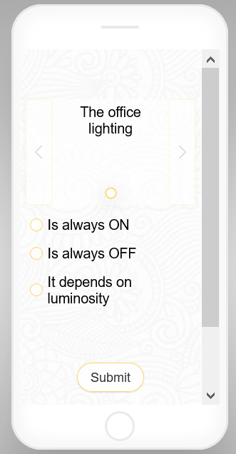
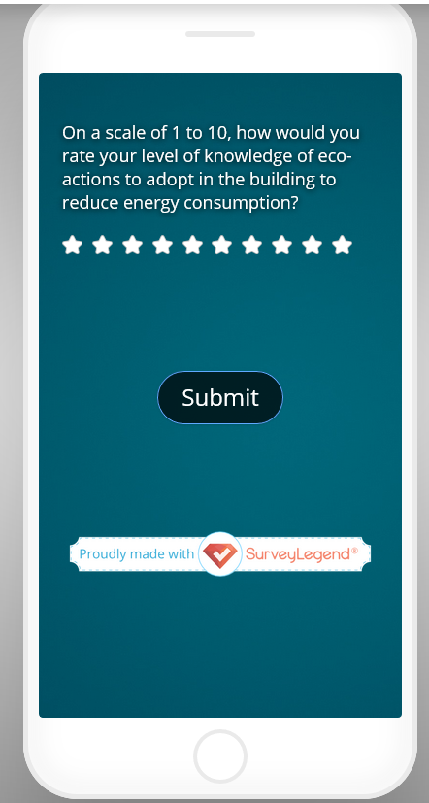
Survey
3
Collect information about occupants
Understand occupant’s interaction with the building and energy use
Identify energy consuming behaviours
Understand the gap between intentions and actions
Understand energy reduction importance for occupants
Comfort perception and actions
Understand occupants motivations to change behaviours
Draw occupants profiles
Tell me about YOU
Building and YOU
Comfort and YOU
Energy and YOU
Intentions VS Actions

Slide 16
Data collection
3
Data Collection
Door opening
Window opening
Temperature set point
Occupancy
Energy consumption

Slide 17
NUDGES
4
NUDGE
A low cost solution
Use of cognitive biases
No use of financial incentives or order
Doesn’t affect choices based on explicit preferences
Transform incentives to actions by making individuals choose the wished decision
“To count as a mere nudge, the intervention must be easy and cheap to avoid. Nudges are not mandates. Putting fruit at eye level counts as a nudge. Banning junk food does not.” [Thaler et Sustein , 2008]

Slide 18
NUDGES
4
Peer to peer comparison
Giving suggestions in order to reduce consumption
Feedback
Giving feedback to occupants about their energy use
Moral appeal
Messages expressing a responsible consideration and human consequences of global warming
Using pictures
Comparing occupants’ consumption to their colleagues
Benchmarking eco-friendly behaviours of other occupants
Tailored messaging
Social reviews
Defining right behaviors adopted by the majority
Applying different types of Nudges to different offices
Adapting Nudges to energy consumption evolution

Slide 19
Conclusions and perspectives

Slide 20
Conclusion and Perspectives
5
Importance of changing occupants’ behaviors in reducing energy consumptions in tertiary buildings
Impact of offices location in reducing energy consumption
Importance of identifying occupants profiles for more energy reductions
Integrating behavior models in order to have more accurate results in predicting energy consumptions
Defining occupants’ patterns depending on experimental results in order to quantify the impact of Nudges
Suggesting the type of Nudges to use depending on occupant’s response to the different intensives used

