Slide 1
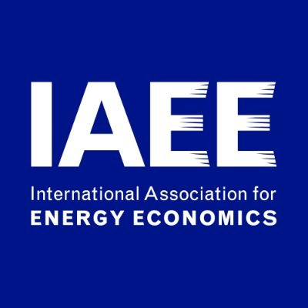
Gauging Energy Poverty in India: A Multidimensional Approach
Mohammad Faizan Ahmad¹, Ramna Thakur²
¹ Ph.D. Scholar, School of Humanities and Social Sciences, Indian Institute of Technology Mandi, Kamand Campus, Himachal Pradesh, India-175075. Email: faizanrafs@gmail.com
²Assistant Professor, School of Humanities and Social Sciences, Indian Institute of Technology Mandi, Kamand Campus, Himachal Pradesh, India-175075. Email: ramna@iitmandi.ac.in
^{Presenting at}
43rd Annual Conference of International Association for Energy Economics (IAEE)
7th June, 2021
The 1st IAEE Online Conference

Slide 2
Introduction
Access to clean fuels is vital for the development and wellbeing of any household.
Developing Countries like India still lag behind significantly in providing clean energy access to the population where around 80% in rural and 25% in urban areas is dependent on biomass for cooking.
Deprivation of clean and modern energy services makes it difficult for the population to improve their wellbeing and keeps them away from the new opportunities of the development.
In these countries, most of the population is dependent on traditional biomass such as fuelwood, charcoal, and animal waste for their daily needs of cooking, lighting, and space heating. Globally 13% of the population lack access to electricity and 40% of the total population is still dependent on the traditional biomass for their cooking needs.
In India, 51 per cent of the population could not access clean cooking fuel in 2018 when compared to 54 per cent in Pakistan, 28 per cent in China, 72 per cent in Sri Lanka and more than 80 per cent in Bangladesh.
The energy situation in developed countries is very different than developing countries (Day et al., 2016) where billions of people are dependent on the traditional biomass for their daily needs which are having adverse effects on their health.

Slide 3
Cont..
The lack of access to modern sources of energy services has been defined as energy poverty.
It is mostly attributed to the people with low income, energy inefficiency, and no access or limited access to modern fuels.
Energy poverty as an issue of concern got prominence in nineties when more than 80 percent of the population in the developing countries lacked access to sufficient and sustainable energy supply.
Over the years, the situation has marginally improved, but the lack of access to clean fuels for cooking and lighting stills lies in billions..
However, the notion of energy poverty is well accepted around the world but the difference in the context of energy poverty still exists in the North and global South. The definition of energy poverty is vital to understand the scale and nature of the problem and formulate strategies and policies to minimise the same.

Slide 4
Energy poverty in developed and developing countries
Energy poverty is also called as fuel poverty in developed countries.
UK is one of the first country to talk of energy poverty as as early as 1970s.
‘Fuel Poverty: From Cold Homes to Affordable Warmth’ Brenda Boardman (1991)
Hills (2012) developed ‘Low-Cost High Income’ approach.
The UK Fuel Poverty Strategy’ “A fuel poor household is one that cannot afford to keep adequately warm at a reasonable cost. The most widely accepted definition of a fuel poor household is one which needs to spend more than 10% of its income on all fuel use and to heat its home to an adequate standard of warmth. Generally, this is defined as 21ºC in the living room and 18ºC in the other occupied rooms - the temperatures recommended by the World Health Organisation (WHO)”(BEIS, 2001).
Over the years, this approach of energy poverty got accepted in other European countries like France and Ireland and was used in the UK until 2013.

Slide 5
Cont..
On the other hand there are several other approaches which are used in developing countries to measure energy poverty.
Uni-dimensional measures.
Physical energy or expenditure.
Income or expenditure based.
Multidimensional measures
Multidimensional energy poverty (MEPI).
Correlation Sensitive Energy Poverty Index (CSEPI).
Energy poverty index (EPI).
Total Energy Access (TEA).

Slide 6
Rationale of the study
Key elements which affect energy poverty are household income (per capita income), the cost of fuels and the type of energy consumed by the households which is affected by the energy efficiency of the fuels used.
The studies conducted on developing countries especially on India have not considered all these elements together.
Unavailability of efficient energy and technologies for cooking, lighting and space heating households with inability to pay deny the basic opportunities of health, education and various other opportunities to a household.
By realizing the importance of these elements, we have created an index to understand the effect of all these elements on the outcome of energy poverty in this study. Energy poverty is multidimensional like general poverty; hence, this study has analysed the multidimensionality of energy poverty by developing the multidimensional scores of the households.

Slide 7
Methodology
Dimension | Indicator (Weight) | Variable | Deprivation Cut-off (poor if..)
Cooking | Modern Cooking fuel (0.4) | Primary source of energy used by the households for cooking | Any fuel except LPG, electricity, natural gas, solar
Lighting | Access to electricity (0.15) | Primary source of energy used by the households for lighting | Any fuel except electricity and LPG
Access to basic energy services | Quantity of energy consumption (0.20) | Per Capita daily energy consumption | Per capita daily kWh consumption is less than threshold (0.792) [Report of Advisory Board on Energy (1984) Government of India]
Consumption on energy services | Percent of income spent to get energy services (0.15) | Income spent to get energy services | Income spent on energy services is >10% (Boardman 1991)
Services through
Household Appliances | Household appliance ownership (0.033) | Has fridge/electric fan/AC/Cooler/Washing machine) | No
Entertainment | Entertainment/education appliances ownership (0.033) | Has a radio/TV/Tape recorder) | No
Communication | Telecommunication means (0.033) | Has a mobile phone/Landline | No

Slide 8
Mathematical Model
MEPI measures energy poverty in d variables across a population of n individuals.
${Y=y}_{ij}$ represents the n× d matrix of achievements for i persons across j variables.
$y_{ij}>0$ therefore denotes the individual i achievements in the variable j; thus, each row vector $y_{ij}=y_{i1}y_{i2}……..,y_{in}$ represents the individual i achievements in the different variables, and each column vector $y_{j}=y_{1j},y_{2j}……..,y_{nj}$ gives the distribution of achievements in the variable j across individuals.
Weighting is defined as $\sum_{j=1}^{d}{w_{j}}=1$
$z_{j}$ is the deprivation cut-off in variable j.
Let ${g=g}_{ij}$ be the deprivation matrix where $g_{ij}$ is defined by $C$ = $w_{j}$ when $y_{ij}$ < $z_{j}$ and $g_{ij}$ = 0 when $y_{ij}$ ≥ $z_{j}$.
After this, we construct a column vector where the i^{th} entry $ci\sum_{j=1}^{d}{g_{ij}}$ represents the sum weighted deprivations suffered by person i.
We then identify the persons multidimensionally energy poor by defining a cut-off k > 0 and applying it across column vector and consider a person as energy poor if her weighted deprivation count $ci$ exceed k. Therefore $ci$(k) is set to 0 when $ci$ ≤ k and equals $ci$ when $ci$ > k. Thus c (k) represents censored vector of deprivation counts.
Finally we count headcount ratio H, which represents the proportion of people that are considered energy poor.; $H=q/n$ where q is the number of energy poor ($ci$ > k)and n the total population, representing incidence of multidimensional energy poverty.
$A=\sum_{i=1}^{n}{{Ci\text{(}\text{k}\text{)}}/q}$ is the average of the censored weighted deprivation counts $ci$(k) represents intensity of the multidimensional energy poverty A.
The MEPI captures the information on both the incidence and the intensity of energy poverty and is defined as MEPI=H×A

Slide 9
Results
Detailed results for all states: Headcount ratio and intensity of energy poverty, and the composite MEPI, as well as HDI.
State | Head Count | Intensity | MEPI | HDI
A&N Islands | 0.314 | 0.515 | 0.162 | NA
Andhra Pradesh | 0.500 | 0.544 | 0.272 | 0.473
Arunachal Pradesh | 0.599 | 0.736 | 0.441 | NA
Assam | 0.761 | 0.652 | 0.497 | 0.444
Bihar | 0.901 | 0.821 | 0.739 | 0.367
Chandigarh | 0.101 | 0.665 | 0.067 | NA
Chhattisgarh | 0.890 | 0.667 | 0.594 | 0.358
D&N Haveli | 0.614 | 0.586 | 0.360 | NA
Daman & Diu | 0.176 | 0.555 | 0.098 | NA
Delhi | 0.102 | 0.616 | 0.063 | 0.75
Goa | 0.148 | 0.513 | 0.076 | 0.617
Gujarat | 0.584 | 0.606 | 0.354 | 0.527
Haryana | 0.576 | 0.619 | 0.357 | 0.552
Himachal Pradesh | 0.695 | 0.510 | 0.355 | 0.492
Jammu & Kashmir | 0.594 | 0.539 | 0.320 | 0.529
Jharkhand | 0.872 | 0.686 | 0.598 | 0.376
Karnataka | 0.617 | 0.564 | 0.347 | 0.519
Kerala | 0.625 | 0.482 | 0.301 | 0.79
Lakshadweep | 0.666 | 0.466 | 0.311 | NA
Madhya Pradesh | 0.785 | 0.707 | 0.555 | 0.375
Maharashtra | 0.460 | 0.638 | 0.293 | 0.572
Manipur | 0.549 | 0.644 | 0.354 | NA
Meghalaya | 0.765 | 0.563 | 0.431 | NA
Mizoram | 0.372 | 0.618 | 0.230 | NA
Nagaland | 0.355 | 0.543 | 0.193 | NA
Odisha | 0.893 | 0.664 | 0.593 | 0.362
Puducherry | 0.126 | 0.562 | 0.071 | NA
Punjab | 0.495 | 0.645 | 0.320 | 0.605
Rajasthan | 0.764 | 0.624 | 0.477 | 0.434
Sikkim | 0.391 | 0.588 | 0.230 | NA
Tamil Nadu | 0.394 | 0.540 | 0.213 | 0.57
Tripura | 0.862 | 0.498 | 0.429 | NA
Uttar Pradesh | 0.822 | 0.778 | 0.639 | 0.38
Uttarakhand | 0.597 | 0.530 | 0.316 | 0.573
West Bengal | 0.781 | 0.694 | 0.542 | 0.492
India | 0.681 | 0.678 | 0.462 | 0.467
Source: Based on author’s calculations from NSS 68th round.

Slide 10
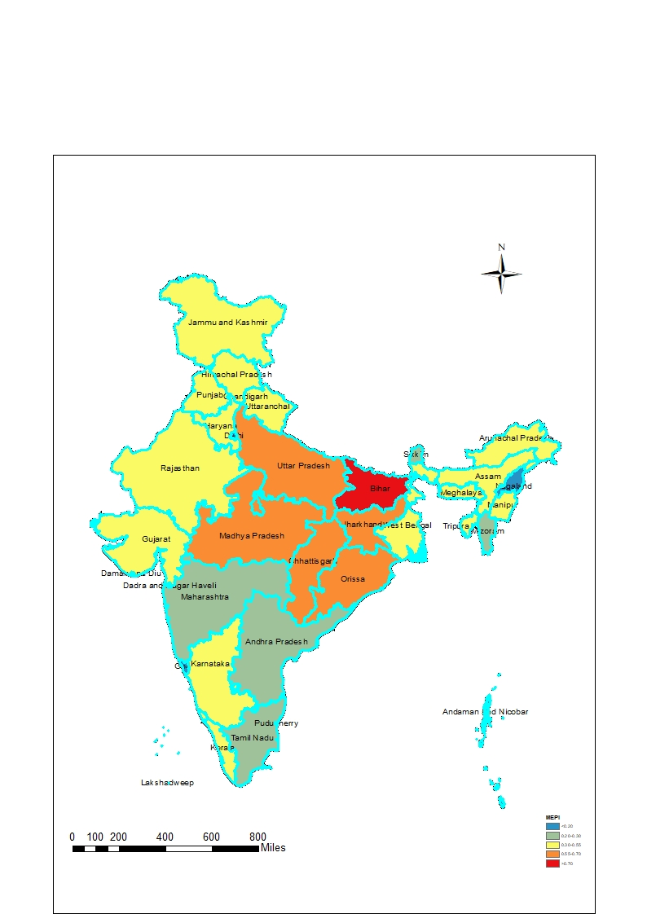
Cont.…
Fig 1: MEPI scores across various states in India
Bihar has the highest MEPI with 0.74 score
It is followed by other Economically Empowered Group States like Uttar Pradesh, Chhattisgarh, Jharkhand, Madhya Pradesh, Odisha
Lowest or No Energy Poverty States are Delhi, Chandigarh, Goa, Daman & Diu, Dadra Nagar Haveli, A&N Islands
Source: Based on author’s calculations from NSS 68th round.

Slide 11
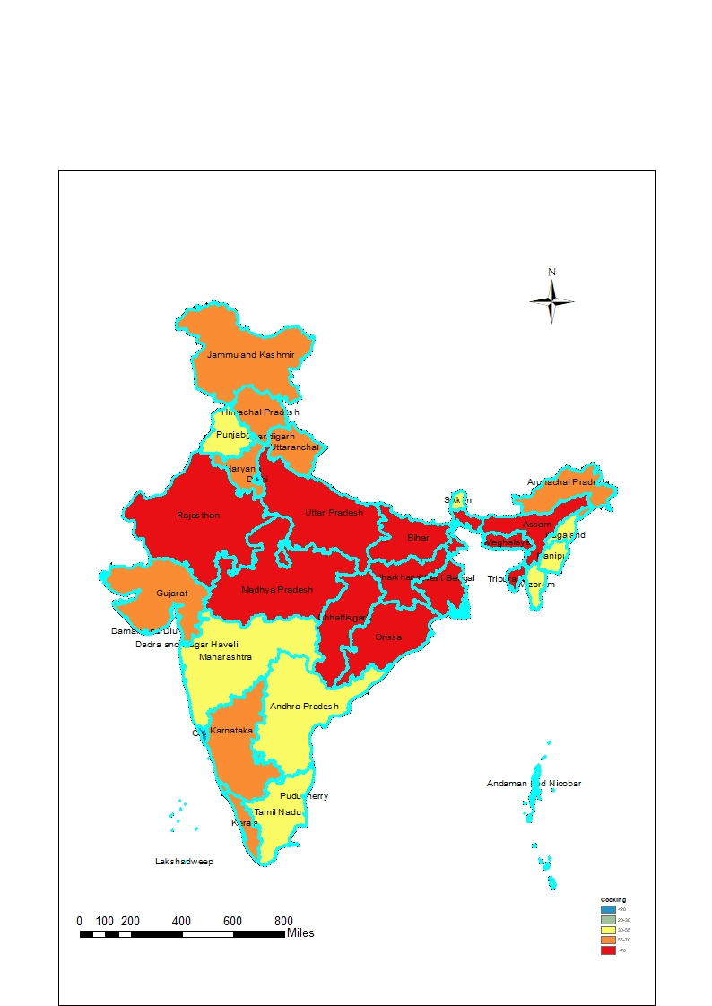
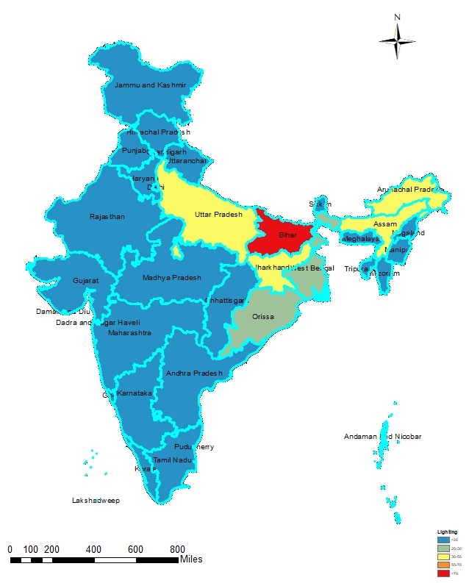
Fig 2: Lack of access to clean fuel for cooking
Fig 3: Lack of access to clean fuel for lighting
Source: Based on author’s calculations from NSS 68th round.
All EAG states have highest percentage of population without access to clean fuels.
Followed by the Himalayan states of J&K, Himachal, Arunachal Pradesh. Also, Gujarat, Karnataka, Kerala have more than 55% of population dependent on solid fuels
Bihar has the highest percent of population which lacks access to clean fuels for lighting
Followed by Uttar Pradesh, Jharkhand, Assam & Arunachal Pradesh.
All other states have very minimal percent of population lacking access to clean fuel for lighting

Slide 12
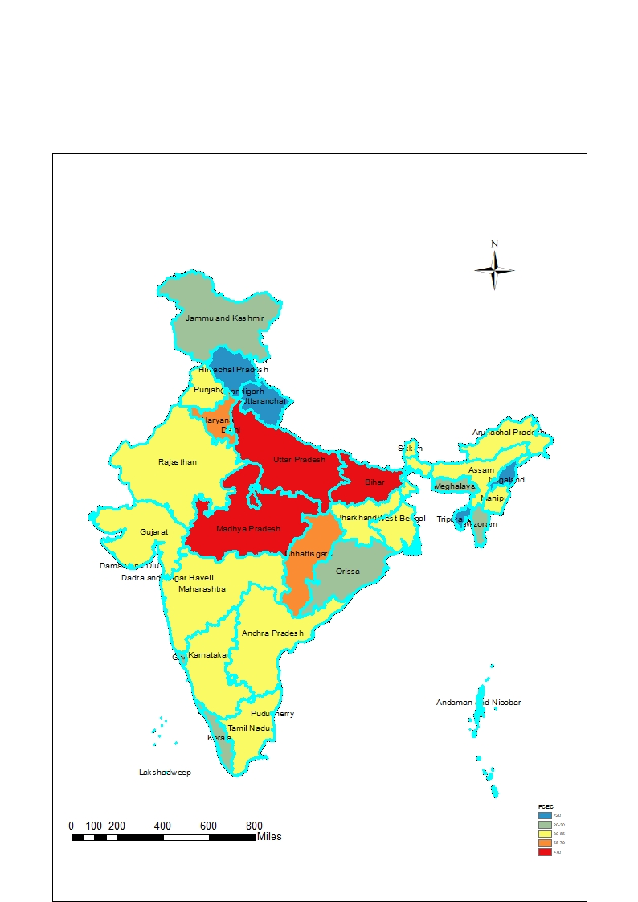
Fig 5: Lack of access to sufficient energy consumption
Fig 6: Consumption on energy more than 10%
Source: Based on author’s calculations from NSS 68th round.
Bihar, Uttar Pradesh and Madhya Pradesh have the highest population which lacks access to minimum energy consumption i.e., 0.792 kWh pcpd. Followed by Chattissgarh.
Other states which lie between 30-55% bracket are Gujarat, Manipur, Maharashtra, Punjab, Andhra Pradesh, Chandigarh, Karnataka.
Odisha, Madhya Pradesh, Punjab, Arunachal Pradesh, Chhattisgarh, Manipur have more than 55% of population consuming more than 10% of their expenditure on energy expenses.
Followed by D&N Haveli, Bihar, West Bengal, Uttar Pradesh (more than 50%) Jharkhand, Assam etc.

Slide 13
Source: Based on author’s calculations from NSS 68th round.

Slide 14
Source: Based on author’s calculations from NSS 68th round.
States where poverty is high but energy poverty is less; Delhi, Chandigarh, Puducherry.
Low Poverty but High MEPI: Himachal, Haryana, Himachal, Gujarat, Kerala etc.

Slide 15
Sensitivity Analysis
Table 3: Pairwise correlation test of MEPI for change in multidimensional cut-off
k | 0.3 | 0.35 | 0.4 | 0.5
0.3 | 1.00
0.35 | 1.00* | 1.00
0.40 | 0.9924* | 0.9924* | 1.00
0.50 | 0.9669* | 0.9669* | 0.9541* | 1.00
Table 4: Spearman Rank Correlation test of MEPI for change in multidimensional cut-off
k | 0.3 | 0.35 | 0.4 | 0.5
0.3 | 1.00
0.35 | 1.00* | 1.00
0.40 | 0.9496* | 0.9496* | 1.00
0.50 | 0.8857* | 0.8857* | 0.8420* | 1.00
Table 5: Kendall Rank Correlation test of MEPI for change in multidimensional cut-off
k | 0.3 | 0.35 | 0.4 | 0.5
0.3 | 1.00
0.35 | 1.00* | 1.00
0.40 | 0.9992* | 0.9992* | 1.00
0.50 | 0.9853 | 0.9853 | 0.9824* | 1.00
Source: Based on author’s calculations from NSS 68th round.

Slide 16
Conclusion
Accessibility and affordability of clean energy sources in any household is essential given the hazards of using biomass on health and environment.
The results corroborate that energy poverty is a multidimensional phenomena and needs to be evaluated using comprehensive approach such as MEPI.
The insights from this study can provide policymakers with the possibility of choosing a group of population which needs intervention and be targeted in specific policies.
This index can also be used to monitor and evaluate public policies regarding energy poverty.
This study lays a basis for further development of the energy poverty indicators to improve the access to clean and modern energy services.

Slide 17
Thank You

