Slide 1
APPLYING CLUB THEORY IN ACHIEVING REGIONAL CARBON NEUTRAL TARGET: ABATEMENT GAME IN CHINESE PROVINCES
Ye Fan (Tsinghua University)
Ming Fan (China University of Petroleum)
Yongda Yu (Tsinghua University)

Slide 2
Modification
WHO WILL BE THE BENEFICIARIES OF RENEWABLE ENERGY SUBSIDIES IN
CHINA? AN ANALYSIS FROM THE PROVINCIAL LEVEL IN CHINA
to
APPLYING CLUB THEORY IN ACHIEVING REGIONAL CARBON NEUTRAL TARGET: ABATEMENT GAME IN CHINESE PROVINCES

Slide 3
Background
Theory
Model
Results
Conclusion

Slide 4
Background
China is experiencing severe climate change problems with the development of the economy, which is predominantly the result of increasing greenhouse gases (GHGs) in the atmosphere from fossil fuel consumption.
It is generally accepted that carbon dioxide (CO2) is the main inevitable pollution externality that causes global warming.
China's carbon dioxide emissions increased rapidly from 3515.8 million tons in 2002 to 9866 million tons in 2017, with a 2.8-fold increase. Meanwhile, China's annual air temperature has risen by more than 1.0 °C in the past three decades, higher than the global average
In a situation like this, China faces growing domestic and foreign pressure to control its domestic carbon dioxide emissions.

Slide 5
Background
Recently, China's leaders have laid out detailed rules for reducing carbon dioxide emissions. In September 2020, at the 75th Session of the United Nations General Assembly, China announced two crucial goals of reaching a carbon peak by 2030 and being carbon neutral by 2060.
Different efforts to control carbon dioxide emissions in China have been well discussed in perspectives of the carbon tax (Liu, Wang et al. 2015) cap-and-trade (Liu, Guan et al. 2013, Pan, Yang et al. 2019) Clean Development Mechanism (CDM) (Resnier, Wang et al. 2007, Wang 2010, Maraseni 2013, Zhao, Li et al. 2014).
All the policy tools listed above are adopted effectively to limit domestic CO2 emission under the existing trading system. Still, importantly, a system combining regional economic development and GHGs emissions is not well discussed, which affects regional equity of development.
Therefore, this study introduces club theory inside China by applying provincial data to discuss a potential alliance mechanism to deal with climate change.

Slide 6
Theory
Fundamental problem of climate change – public good or externality
Cost of extending the climate benefit to additional person is zero
Impossible to exclude individual from enjoying it
Economic growths, technology, production, consumption
Emissions, CO2, GHGs
Concentrations, Radiative forcing
Socio-economic impacts
Direct impacts (forests, ecosystems)
Temperature rise and climate change
Fig. 1. Integrated Carbon Cycle Model

Slide 7
Theory
Free-riding occurs on international agreement on climate change, as a result, limited success in dealing with global economic externalities
United Nations Framework Convention on Climate Change (UNFCCC);
Kyoto Protocol was initially signed by 84 countries in 1999-1999 without the US and with Canada quit in December 2011, which leads to less global impact nowadays.
Then the 2015 Paris Agreement attracted the world's primary carbon dioxide contributors limiting the globe towards 2 degrees of warming goal. The US quit (2020) and back (2021)
A potential solution – climate club (Nordhaus, 2015)
A voluntary group deriving mutual benefit
A public-good-type resource that can be shared
Cooperative arrangement, including costs or dues
Non-members can be excluded or penalized
No one wants to leave

Slide 8
Theory
For decades, all Chinese government decisions subject to Cost Benefit analysis
An analysis to weigh the benefits and costs of making a decision
For example, if gov wants to implement a new health care plan, they have to perform cost benefit analysis
If a project needs to get a loan from a bank, they need cost benefit analysis
CO2, Carbon Dioxide was not included in government required cost benefit analysis so far

Slide 9
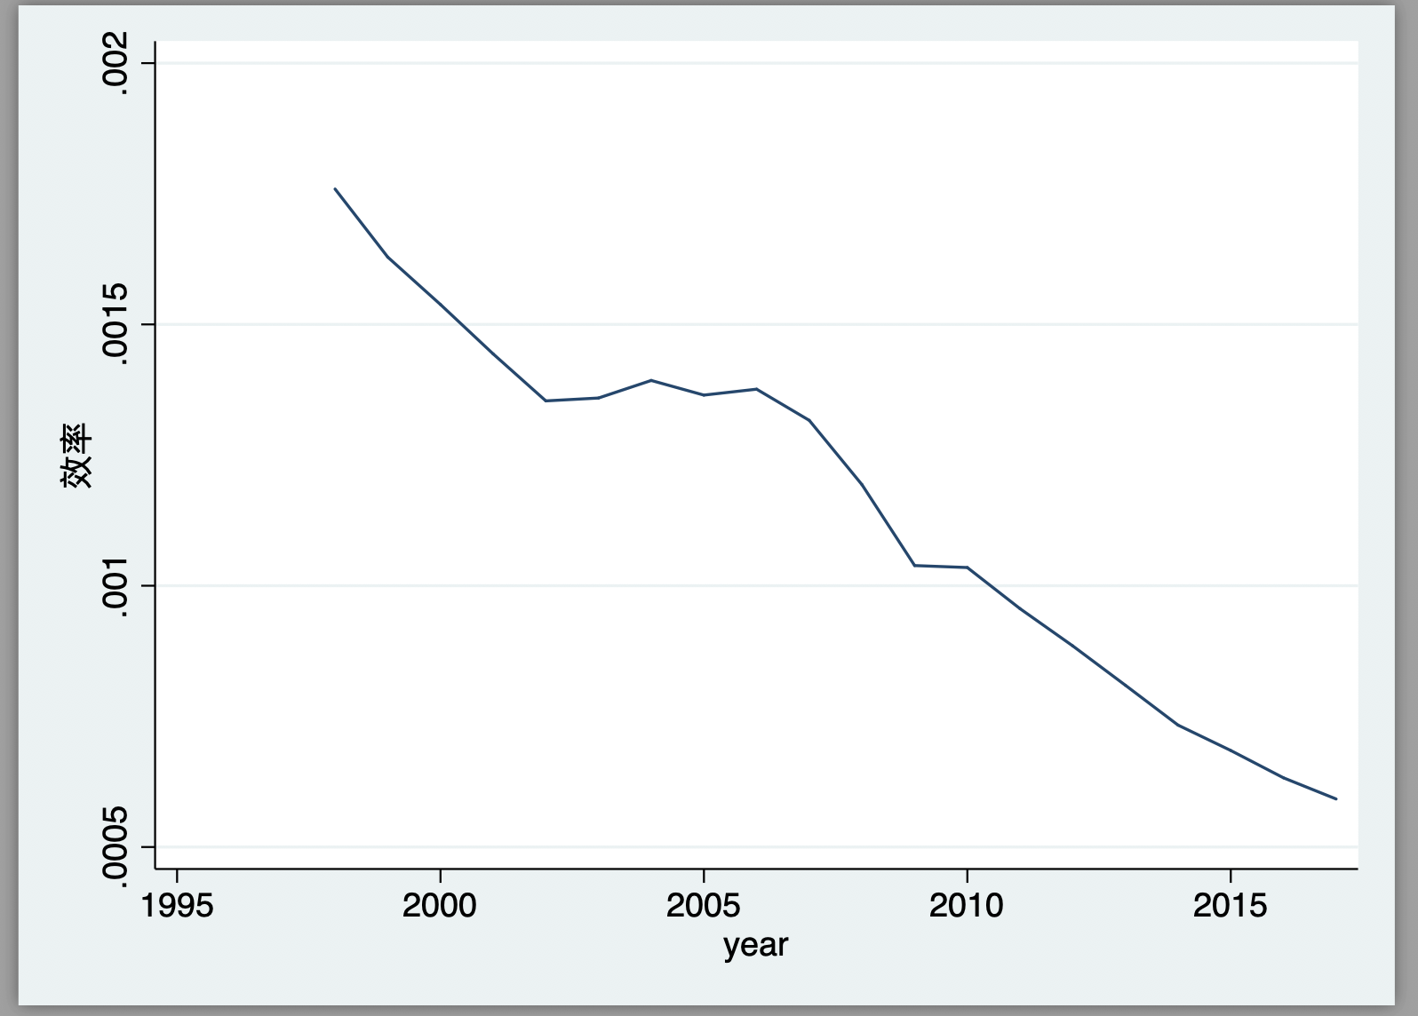
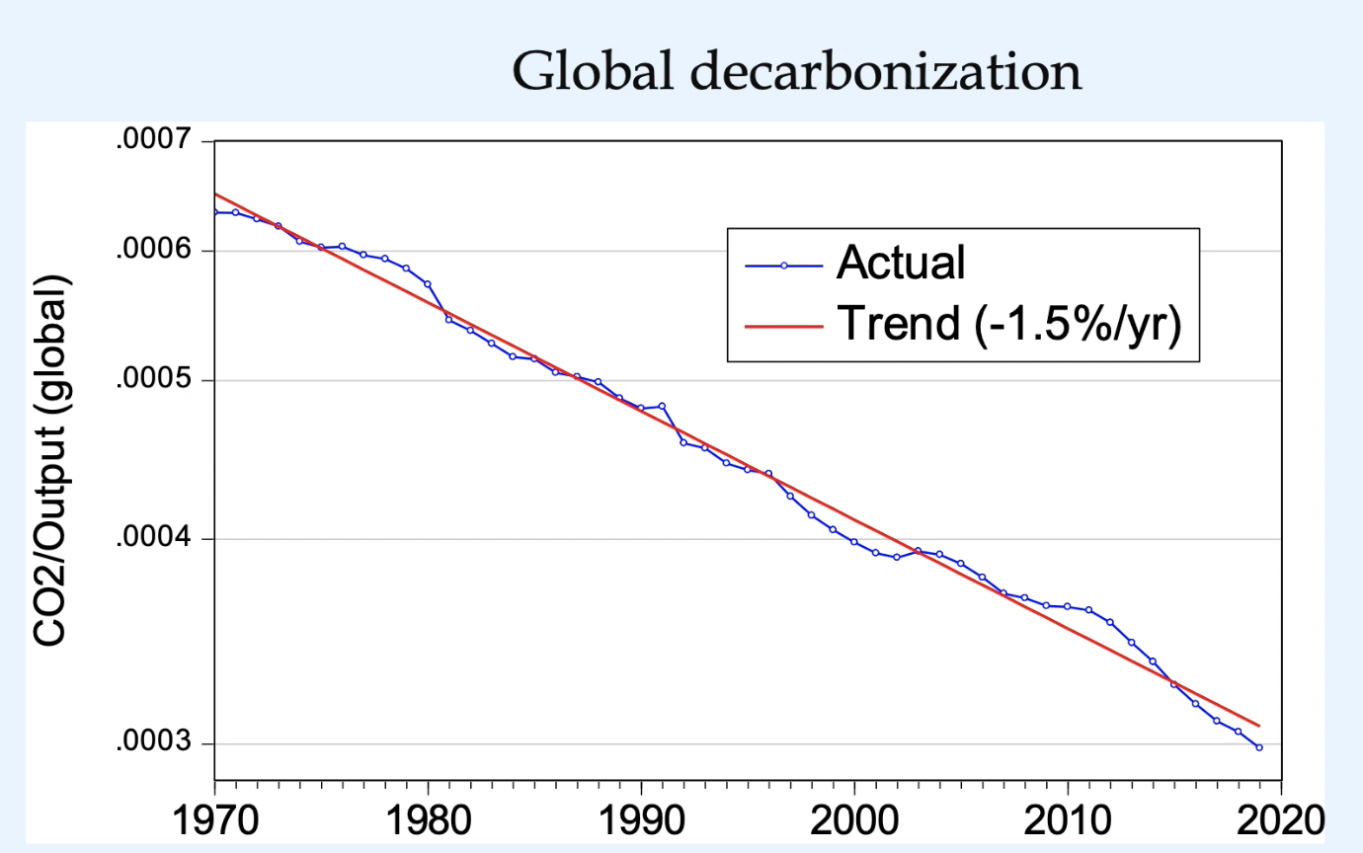
Model – building climate club system in China
Decarbonization trends
Chinese Decarbonization (Trend -3%/annual).
Global Decarbonization (Trend -1.5%/annual). From Nordhaus (2019).

Slide 10
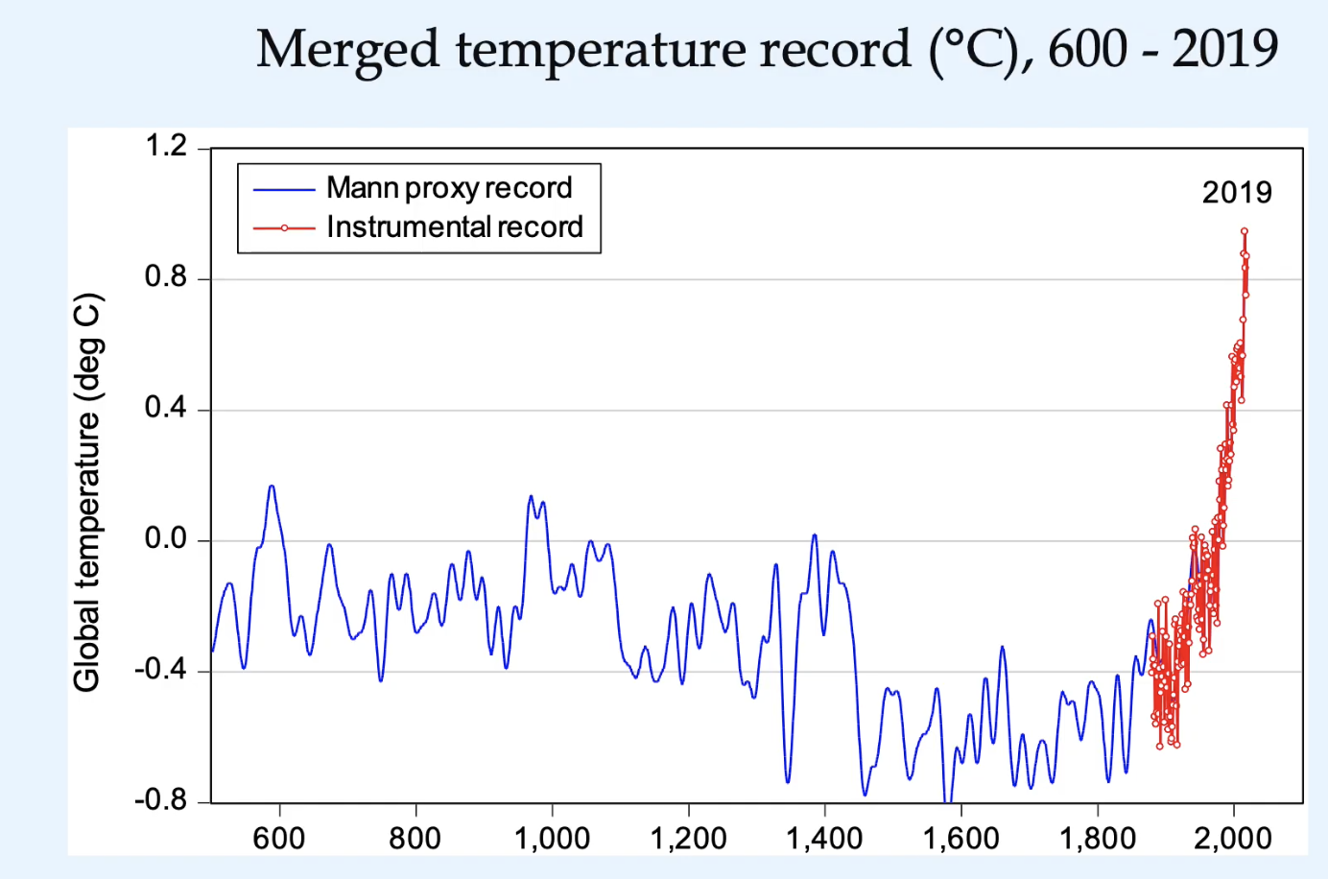
Model – building climate club system in China
Carbon emission trends and temperature
Carbon Emission and Temperature from 1997-2017
Global trend of temperature growth. From Nordhaus (2019).

Slide 11
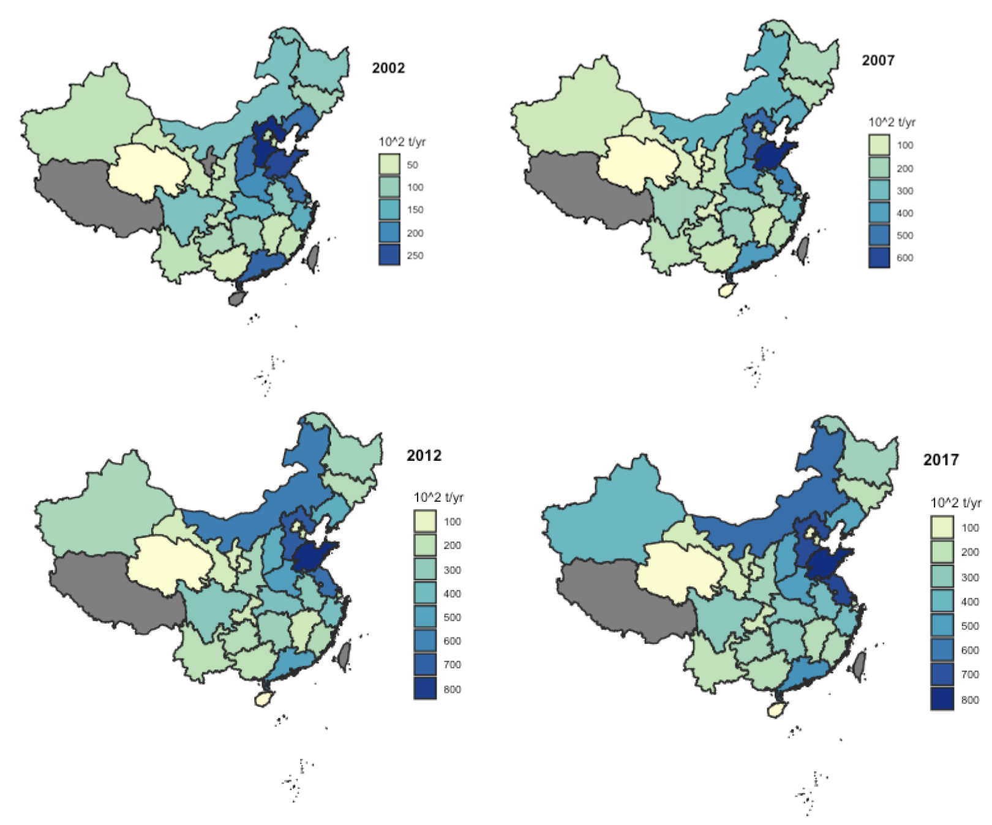
Model – building climate club system in China
Distribution of carbon dioxide emissions in China

Slide 12
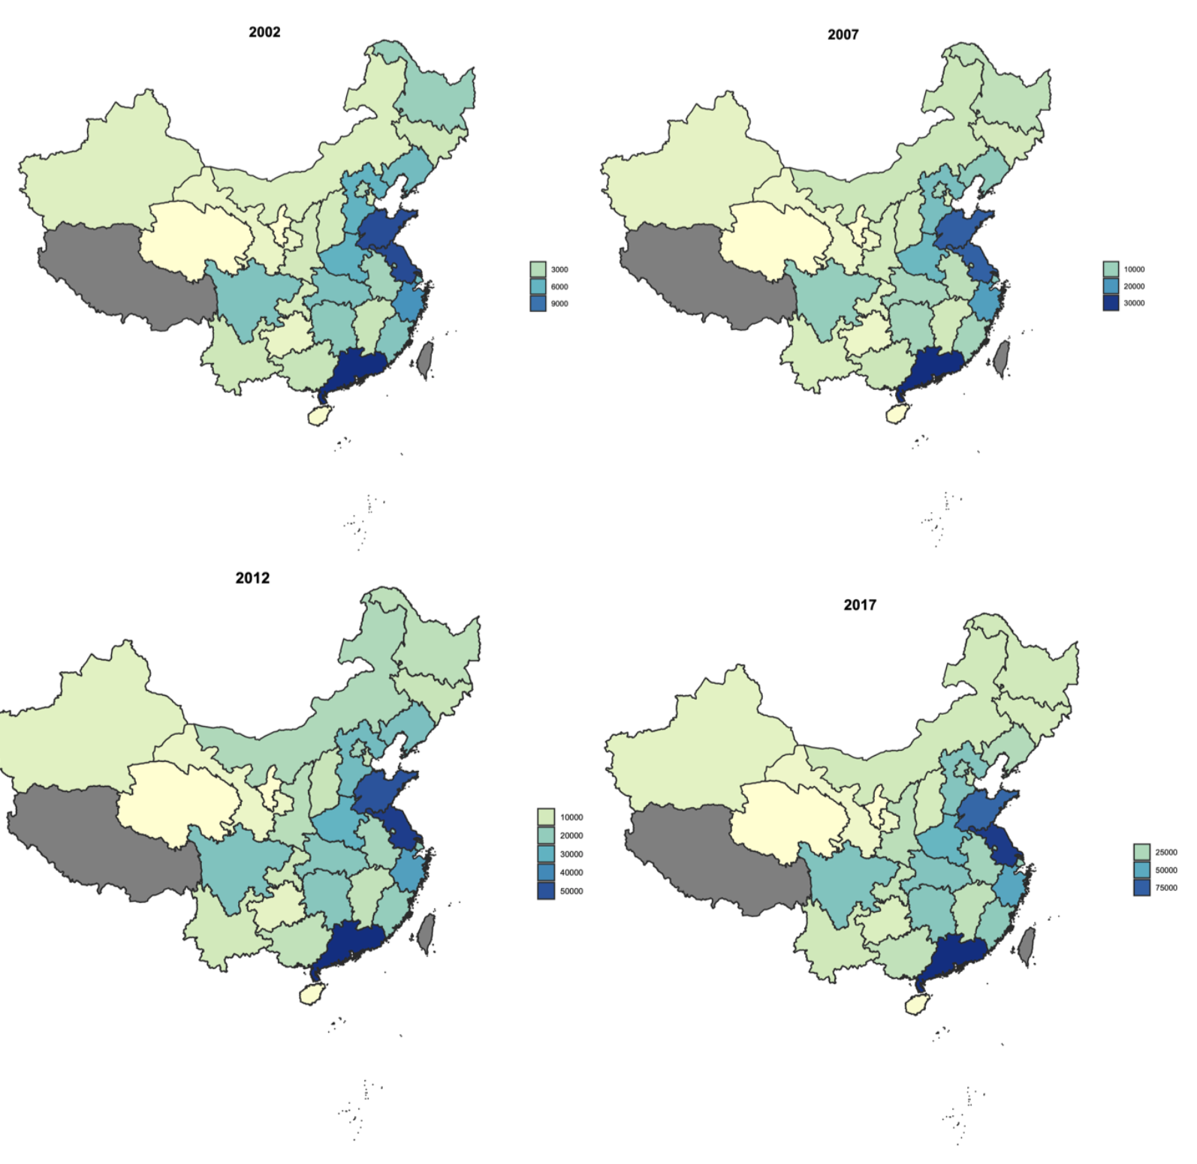
Model – building climate club system in China
The distribution of provincial GDP in China

Slide 13
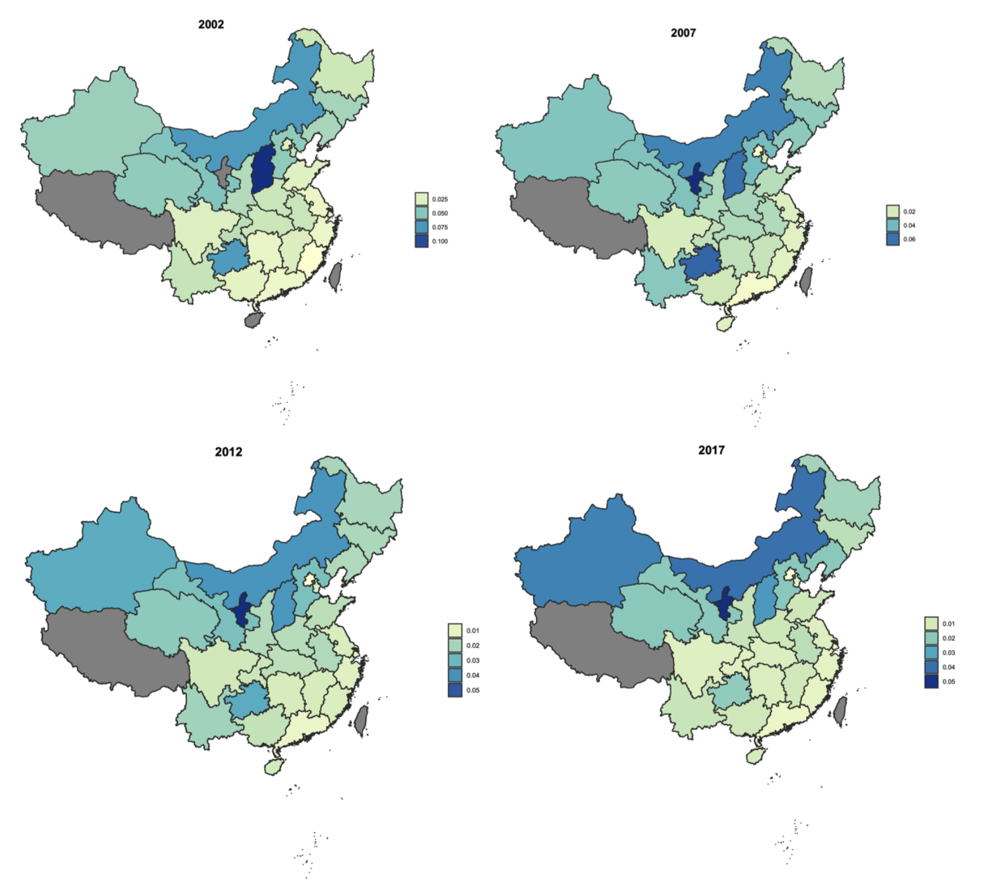
Model – building climate club system in China
Distribution of carbon dioxide emission intensity in China (CO2 emissions/GDP)

Slide 14
Model – building climate club system in China
Base
China has the characteristics of multi-region, which is similar to the nature of multi-country in the world.
The phenomenon of free-riding in the international climate governance also exists inside China at the provincial level, but it has not attracted widespread attention
China's carbon dioxide emissions vary in different regions and at varying levels of economic development
The border carbon tariff can be modeled in Chinese provinces for the socialist system gives a large government the possibility of coordinating public resources to improve the overall welfare of society
Using the border carbon tariffs to invest in carbon-neutral development can solve green funding sources
Social awareness of the environmental externalities arising from the consumption of goods is gradually increasing

Slide 15
Model – building climate club system in China
The model we prompt encouraging reluctant regions to become members if their payoff inside the club is greater than outside as free-riders, but for the enthusiastic club members, they stay in the club for the benefit is greater than withdrawal and abandon it only if staying generates negative net private benefits compared to the scenario without any club at all.
The data for Chinese provincial carbon emissions and regional trade volume data are collected from CEADs (Carbon Emissions Accounts and Datasets for emerging economies, https://www.ceads.net.cn). Chinese provincial Gross Demastic Productions data and dgraphic Data are collected from China Statistical Yearbook.

Slide 16
Model – building climate club system in China
We use non-cooperative game model:
Suppose there are a total of N regions in China, i(i =1,2,...,N) represents the ith region.
To simplify, the utility of each region can be divided into four parts, economic output, trade tariff rewards and punishments brought by the club, abatement cost, and damage caused by the environment to the region. Specifically, the total utility of each area can be expressed as:
Where Qi is the economic output of region i, which equals the GDP of region i. Ci is the decision variable of whether area i joins the club, Ci = 1 means it joins the club, and it is equal to 0,
means not joining. Because it is a single-period game, this article assumes that a region that has joined the club has no additional penalty for exiting. Therefore, a region is not a club member originally, and it should have the same effect as joining and then exiting. In other words, the utility of an area is only related to its current club membership status and has nothing to do with whether he was a club member before.

Slide 17
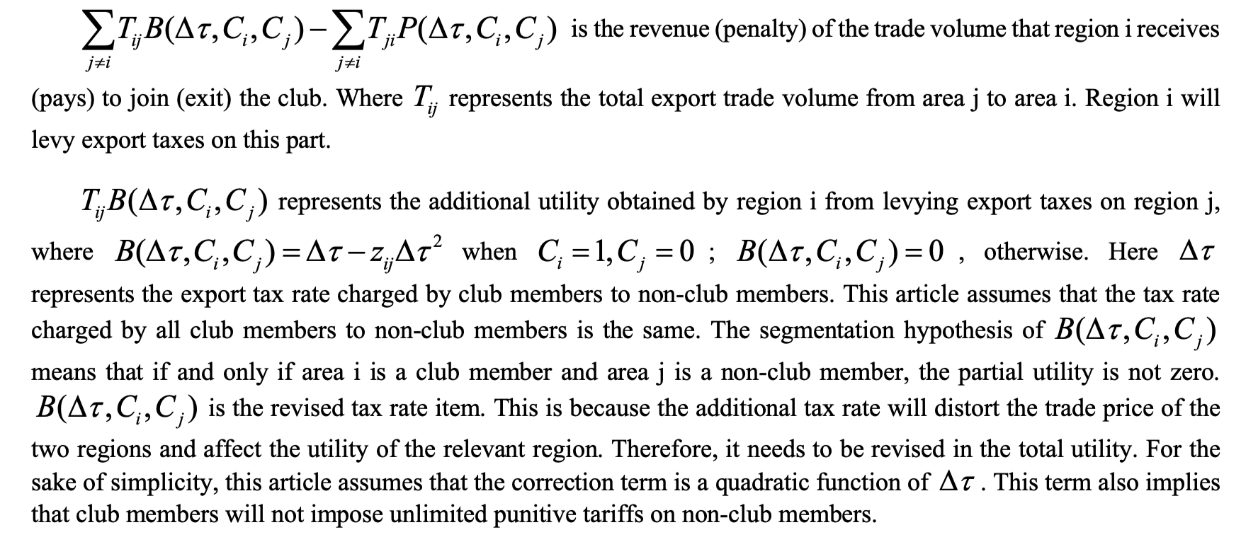
Model – building climate club system in China

Slide 18
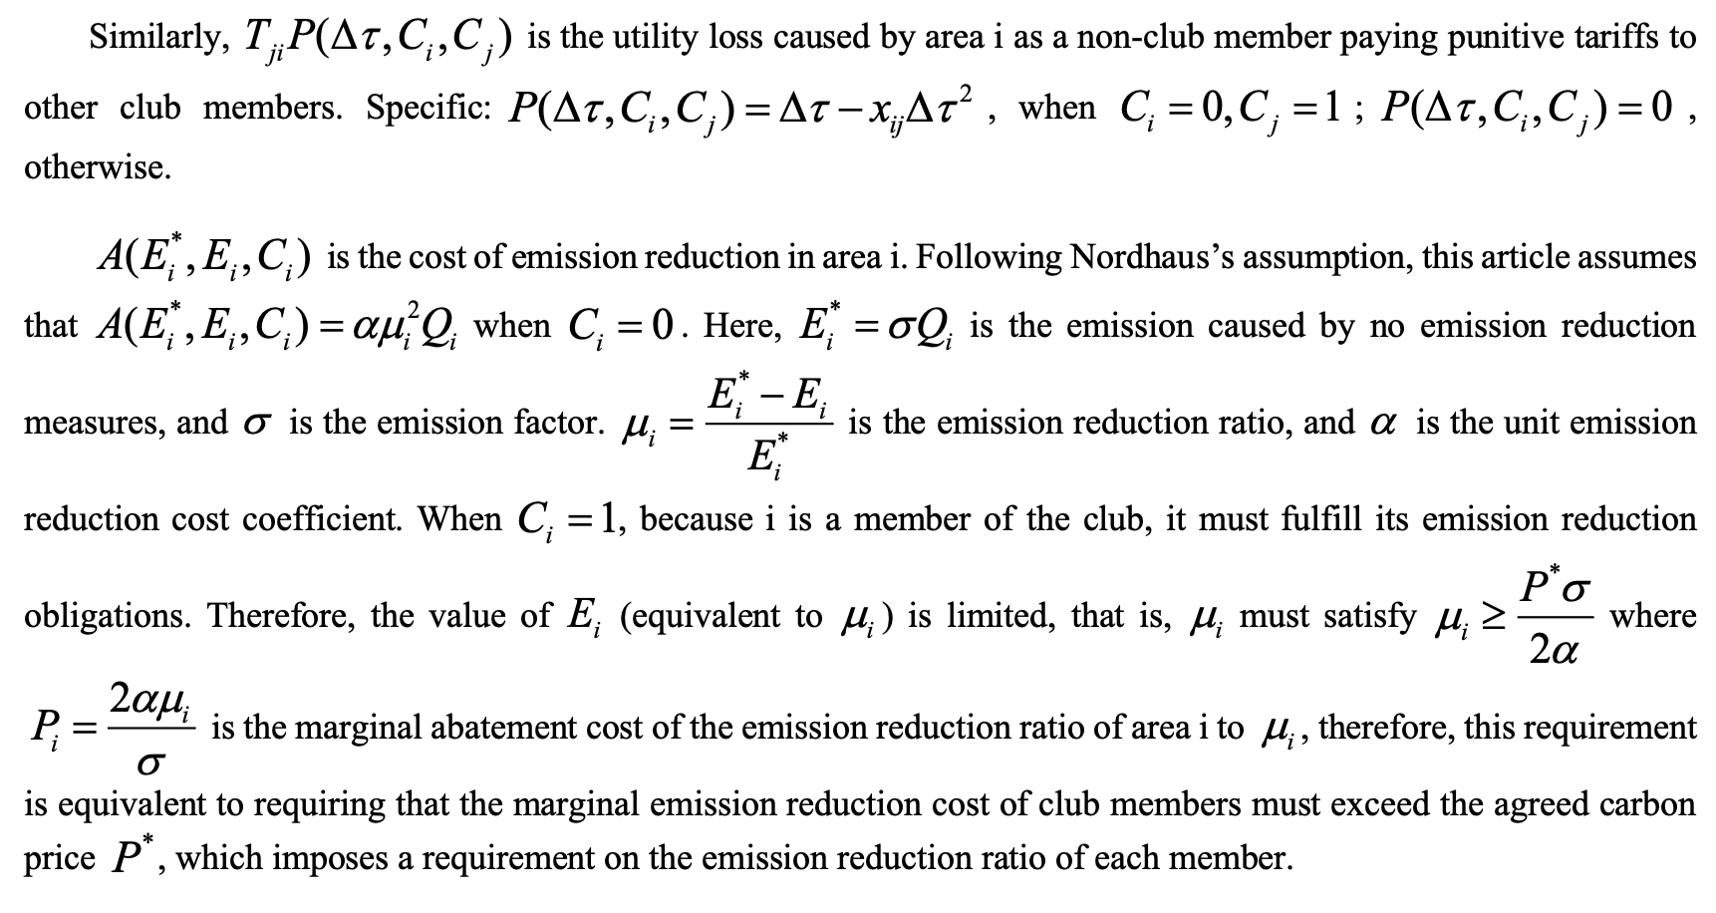
Model – building climate club system in China

Slide 19
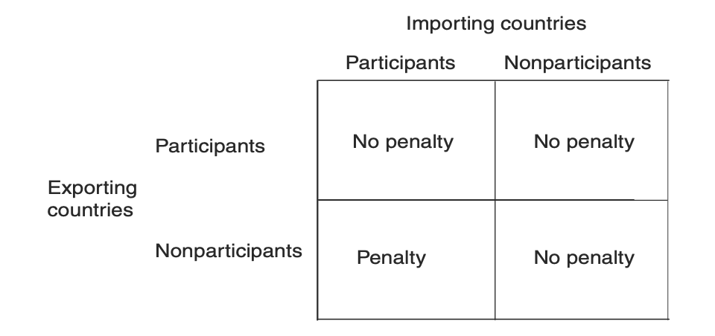
Model – building climate club system in China

Slide 20
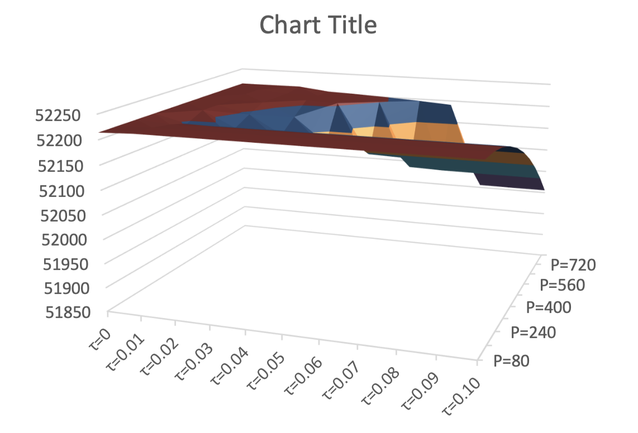
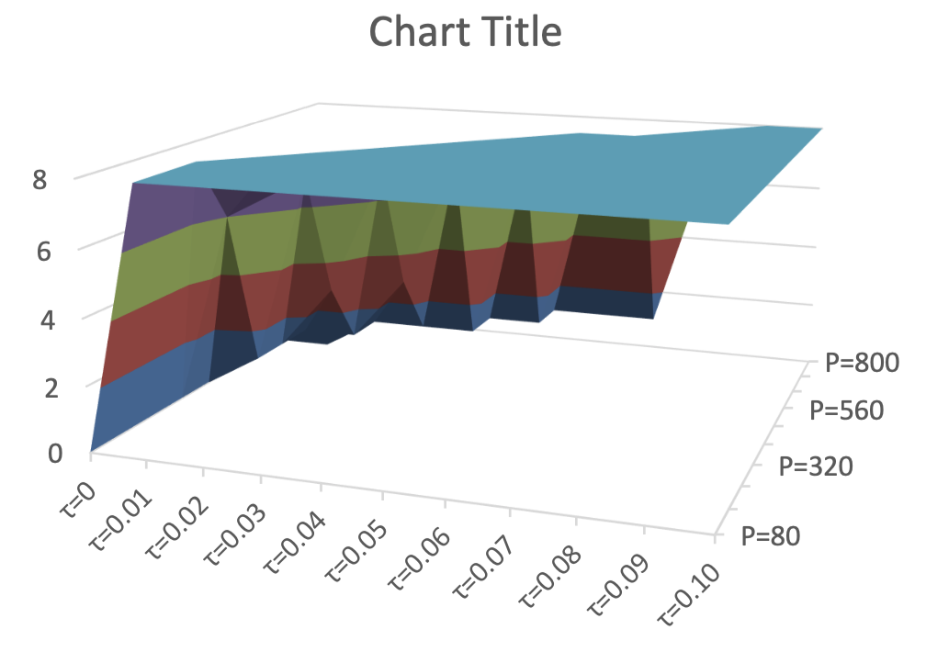
Results

Slide 21
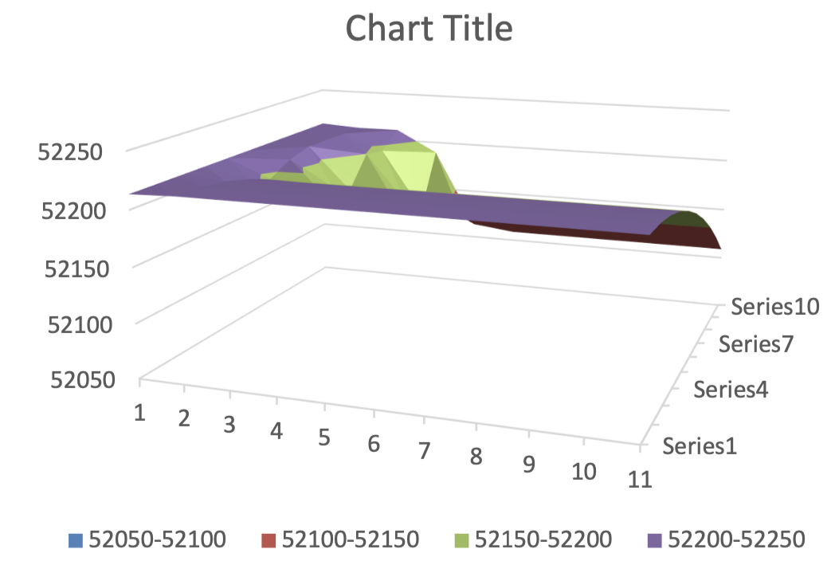
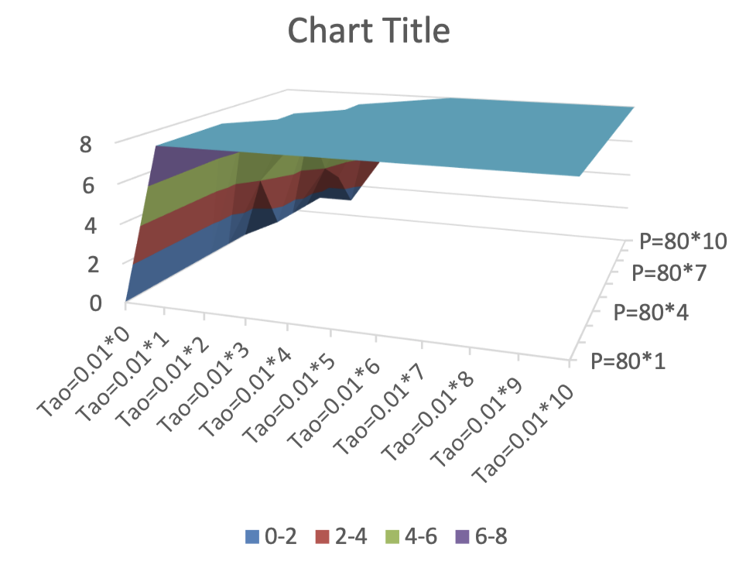
Results

Slide 22
Conclusions
Discussion on the global climate change
China’s carbon control study
Foundation of climate club system in China
Model setting
results

Slide 23
Thanks
Ye Fan
fanyecup@foxmail.com
+86 15101186516

