Slide 1
INNOVATION ECOSYSTEM OF SECOND-GENERATION ETHANOL
Daniella fartes S. e silva
josé vitor Bomtempo
Flávia Alves

Slide 2
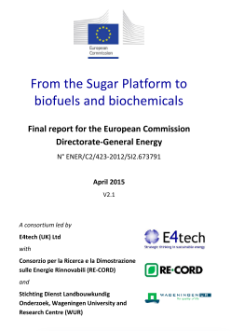
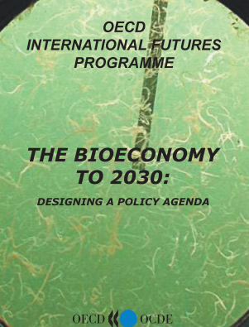
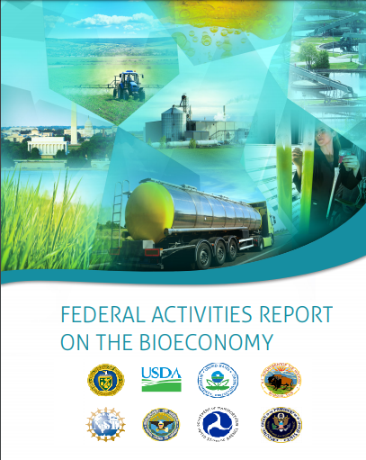
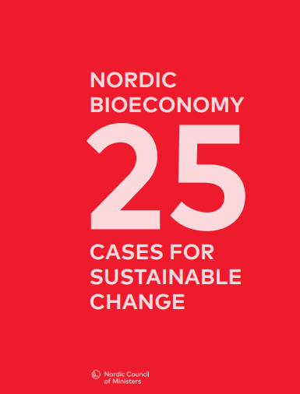
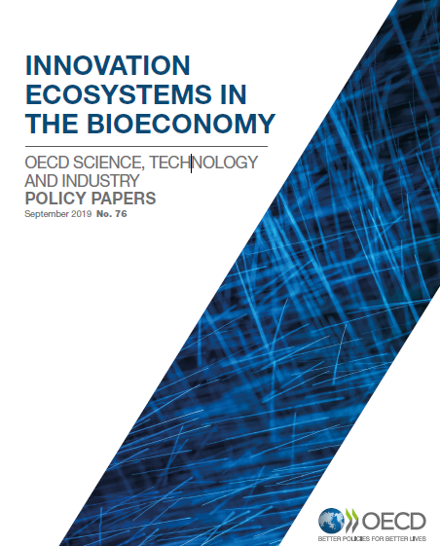
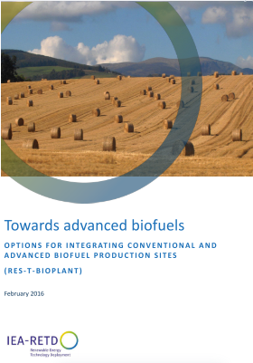
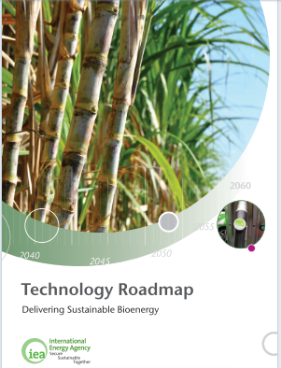
Need for renewable raw materials
Concerns regarding the environmental consequences of GHG emissions have led several countries to redefine their economies to achieve more sustainable goals.

Slide 3
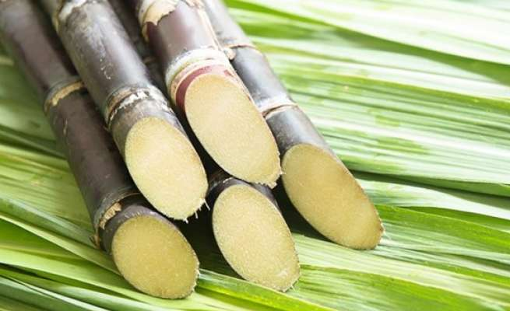
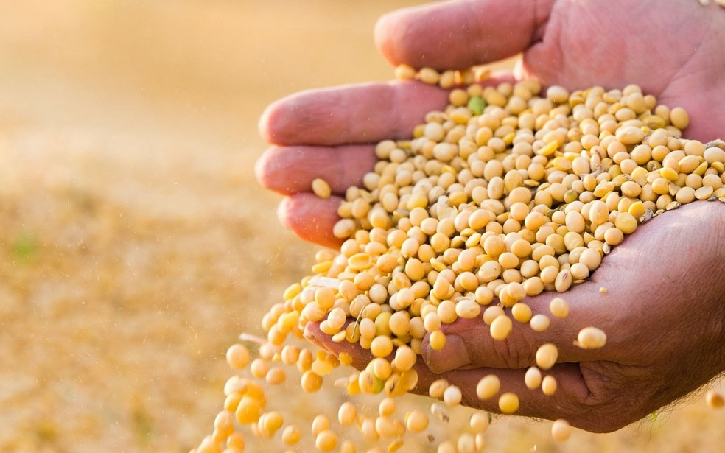
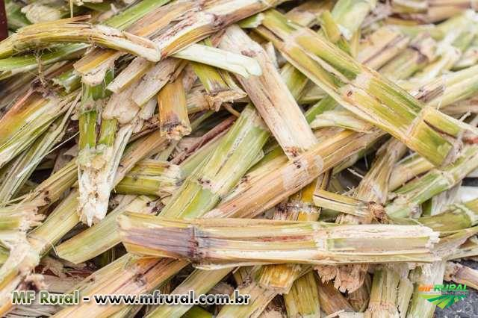
2G Ethanol
2G Ethanol: obtained from non-food raw materials such as sugarcane bagasse and straw.
Juice
(Sugars)
Milling
Fermentation C6
Distillation
Sugars
Milling
saccharification
Fermentation C6
Distillation
Pre-treatment + hydrolysis
Sugars
Fermentation C6+C5
Distillation

Slide 4
2G Ethanol Challenges
Access raw material;
Develop new varieties;
How to transform this material?
Which technology?
How to sell?

Slide 5
2G Ethanol Challenges
“…the goal of this paper is to understand how the structuring process of the 2G ethanol ecosystem has been developing.”
Main challenges
Modes of competition and cooperation
To assist decision makers and entrepreneurs in the development of a low carbon economy

Slide 6
Innovation Ecosystem
“is a set of collaborative and competitive arrangements through which companies from different knowledge domains combine their individual offerings into a coherent customer-focused solution” (Moore, 1993)
No sectoral boundaries;
The focus is on co-evolution between partners from different industries;
New technologies.

Slide 7
Methodology
Case study - 6 commercial projects
413 papers
IE literature review
5 key dimensions
1º round of interviews
Key Dimensions analysis
Partial Result
Data survey
Data analysis
570 (reports, press releases, websites...)
2º round of interviews (validation)
Reassessment of dimensions
Final Result

Slide 8
Results
Granbio | Raízen | Poet-DSM | Beta Renewables | Abengoa | Dupont
S. João dos Milagres, Brazil | Piracicaba, Brazil | Emmetsburg, USA | Crescentino, Italy | Hugoton, USA | Nevada, USA
Capacity (millions of liters/ano)
82 | 40 | 94 | 75 | 95 | 113
CAPEX (millions of dolars)
265 | 100 | 275 | 210 | 500 | 225
Raw Material
Sugarcane straw | Sugarcane bagasse | Corn straw | Wheat straw | Corn straw | Corn straw
Conversion Technologies
Pre-Treatment
Steam explosion | Diluted acid | Diluted acid | Steam explosion | Diluted acid | Alkali
Hydrolysis
Enzymatic (SSFC) | Enzymatic (SSFC) | Enzymatic (SSF) | Enzymatic (SSFC) | Enzymatic (SSF) | Enzymatic (SSF)
Yeast
DSM | Iogen | DSM | Leaf Technologies | Abengoa | Dupont
Status
Active | Active | Active | Deactivated | Deactivated | Deactivated

Slide 9
Results
Individuals - for each Focal Ecosystem (projects)
Timeline
Ecosystem Structure
Value Blueprint
General Ecosystem

Slide 10
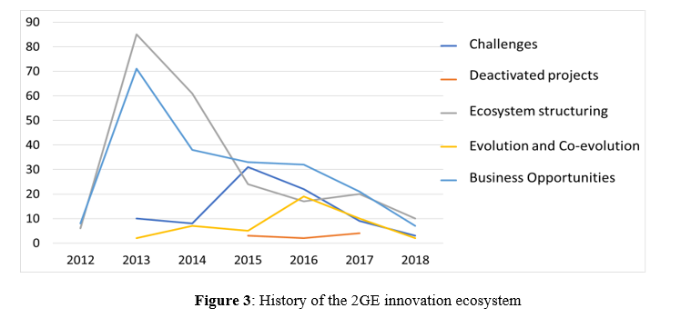
Results
Number of publications

Slide 11
Results
Dimension | Result
Evolutionary Stage | Birth | Cooperation between focal ecosystems played a more relevant role than competition. The companies sought cooperation to solve the main challenges posed by innovation.
Strategies | Focal Ecosystems | Beta Renewables, Granbio, Raízen and Abengoa - keystone. Dupont e Poet-DSM - domination.
Challenges | Components | Favorable to the creation of competitive advantage, considering the overcoming of challenges
Structure | Identification of factors that influences the structure of EIs | The type and origin of companies influence the structure of ecosystems. The role attributed to 2G ethanol varies according to the origin sector of the company.
Value Blueprint | Reconfiguration | Raízen and Granbio - Need for reconfiguration. Poet-DSM just reconfigured its structure.

Slide 12
Results
Competitive Challenge | Firm
Competition between production models - independent plants or integrated production. | Granbio, Beta Renewables and Dupont x Raízen, Poet-DSM and Abengoa
Competition for exclusive suppliers (mainly enzymes and yeasts) | All. Dupont to a lesser extent.
Cooperative Challenge | Firm
Tropicalization of technologies | Granbio and Raízen
Raw material storage challenges (fires) | Granbio and Dupont
Bureaucratic challenges of handling genetically modified microorganisms (especially in the Brazilian case) | Granbio and Raízen

Slide 13
Results
Dimension | Result
Evolutionary Stage | Birth | Cooperation between focal ecosystems played a more relevant role than competition. The companies sought cooperation to solve the main challenges posed by innovation.
Strategies | Ecossistemas focais | Beta Renewables, Granbio, Raízen and Abengoa - keystone. Dupont e Poet-DSM - domination.
Challenges | Components | Favorable to the creation of competitive advantage, considering the overcoming of challenges
Structure | Identification of factors that influences the structure of EIs | The type and origin of companies influence the structure of ecosystems. The role attributed to 2G ethanol varies according to the origin sector of the company.
Value Blueprint | Reconfiguration | Raízen and Granbio - Need for reconfiguration. Poet-DSM just reconfigured its structure.

Slide 14
Results

Slide 15
Results
Dimension | Result
Evolutionary Stage | Birth | Cooperation between focal ecosystems played a more relevant role than competition. The companies sought cooperation to solve the main challenges posed by innovation.
Strategies | Ecossistemas focais | Beta Renewables, Granbio, Raízen and Abengoa - keystone. Dupont e Poet-DSM - domination.
Challenges | Components | Favorable to the creation of competitive advantage, considering the overcoming of challenges
Structure | Identification of factors that influences the structure of EIs | The type and origin of companies influence the structure of ecosystems. The role attributed to 2G ethanol varies according to the origin sector of the company.
Value Blueprint | Reconfiguration | Raízen and Granbio - Need for reconfiguration. Poet-DSM just reconfigured its structure.

Slide 16
Conclusions
Why these results matter?
The results draw attention to the risks of innovation, especially co-innovation
Reaching the commercial plant stage does not necessarily indicate the end of the innovation process
Cooperation plays a key role

Slide 17
INNOVATION ECOSYSTEM OF SECOND-GENERATION ETHANOL
Daniella fartes S. e silva
Daniella.fartes@hotmail.com

