Slide 1
The stakes of nuclear planning optimization in electric systems operation with renewable energy:
Arthur LYNCH, Yannick PEREZ, Sophie GABRIEL, Gilles MATHONNIERE
06/02/2021
1/23

Slide 2
Summary:
1. Background and objectives:
General context
Objective of the paper
Refueling and maintenance outages
2. Method and models:
Methodology
Heuristic nuclear planning optimization model
UC/ED model: Antares-RTE
Case studies
3. Results:
Thermal dispatch
Operational costs and CO2eq emissions
Energy curtailment
Market prices and technology revenues
4. Concluding remarks and limits:
2/23
Arthur LYNCH
06/02/2021

Slide 3
Background and objectives : General context
Variable Renewable Energies (VRE) are expected to answer most of the future electric demand
The integration of a large share of VRE will increase the flexibility required to meet the demand-supply equilibrium
This creates a new paradigm where the flexibility of nuclear will be determining its role
3/23
Arthur LYNCH

Slide 4
Background and objectives :
Due to its high fixed and low variable costs, it is economically optimal to use nuclear in a “baseload” mode. Power plants historically run at full power most of the time. Thus, the literature typically does not finely model the flexibility constraints of nuclear power plants and is either represented as an inflexible technology or a conventional one, like gas.
Our research question is to determine the potential benefits of nuclear flexibility in renewables-driven electric systems considering its physical constraints.
The literature regarding nuclear flexibility, its costs and technical limitations is rich. Aspects such as output ramping speed, Xenon transients, and minimal power level have been considered in papers such as [1] and [2]. However, we found no literature taking into account the nuclear planning seasonality.
Objective of the paper:
The paper aims to evaluate the impact of refueling and maintenance outages that frame nuclear planning in electric systems with renewable energy.
^{[1]} J. Jenkins, Z. Zhou, R. B. Vilim, F. Ganda, F. de Sisternes, and A. Botterud, “The benefits of nuclear flexibility in power system operations with renewable energy,” Appl. Energy, vol. 222, pp. 872–884, Jul. 2018, doi: 10.1016/j.apenergy.2018.03.002.
^{[2]} R. Ponciroli et al., “Profitability Evaluation of Load-Following Nuclear Units with Physics-Induced Operational Constraints,” Nucl. Technol., vol. 200, no. 3, pp. 189–207, Dec. 2017, doi: 10.1080/00295450.2017.1388668.
4/23
Arthur LYNCH

Slide 5
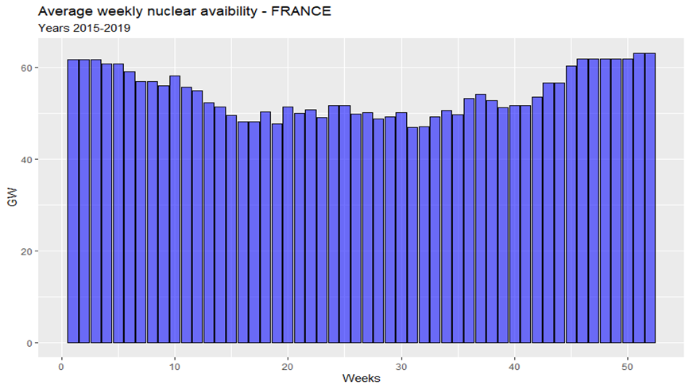
Background and objectives : Refueling and maintenance outages
Refueling and maintenance outages:
Nuclear reactors need to stop for refueling and maintenance operations. The duration of those outages represents about 20% of the total lifetime of reactors.
The irradiation cycle of a nuclear reactor defines the period between two refueling and maintenance outages. The duration of the irradiation cycle is limited according to the reactor’s size and design. Due to human resources and utility requirements constraints, it is impossible to stop all reactors simultaneously. It is then necessary to schedule each reactor’s outages in accordance with the its nuclear fleet.
This results in a «optimized» nuclear availability planning, where nuclear availability is variable throughout the year. The refueling and maintenance outages are scheduled to optimize the nuclear availability when it beneficial for the electric system (see French example).
5/23
Arthur LYNCH

Slide 6
Summary:
1. Background and objectives:
General context
Objective of the paper
Refueling and maintenance outages
2. Method and models:
6/23
Arthur LYNCH

Slide 7
Method and models : Methodology of the paper
To evaluate the stakes surrounding the nuclear planning optimization in electric systems with renewable energy, the paper:
1. Creates a heuristic model to simulate the nuclear planning optimization
2. Simulates a simplified electric system’s operations using the resulting heuristic planning
3. Compares the results with the same electric system using a constant nuclear availability assumption
4. Performs a sensitivity analysis by simulating several different renewables and nuclear capacity cases
7/23
Arthur LYNCH

Slide 8
Method and models: Heuristic planning optimization MILP model:
The model schedules maintenance and refueling outages in low electric demand periods by maximizing nuclear availability in high electric demand periods.
$$Objective function :$$
$$Maximize \sum_{t=1}^{T}{\sum_{i=1}^{N}{{Demand}_{t}∗Pnom_{i}∗U_{it}}}$$
$$where :$$
$$Constrained by :$$
$T:number of week of optimization$
$N:number of reactors$
$$Demand_{i}:Level of the electric demand, week t$$
$Pnom_{i}:Nominal power of reactor i$
$U_{it}: \left\{\begin{aligned}1 if reactor i is available at time t \\ 0 if reactor i is closed at time t\end{aligned}\right.$
$$Irradiation cycle length constraints:$$
$$(1)$$
$$∀ x ∈\left[0;MinimumOn_{i}\right] : U_{i,t+x}≥U_{i,t}−U_{i,t−1}$$
$$(2)$$
$$\sum_{x=0}^{X=MaximumOn_{i}}{U_{i, t+x}} ≤MaximumOn_{i}$$
$$Maintenance and refueling length constraints:$$
$MinimumOn_{i}:Minimum functionning time of reactor i$
$MinimumO{ff}_{i}:Minimum maintenance/refueling time of reactor i$
$MaximumOn_{i}:Maximum functionning time of reactor i$
$MaximumO{ff}_{i}:Maximum maintenance/refueling time of reactor i$
$NBOutagesLimit$: $\text{M}\text{aximum} \text{number} \text{of} \text{nuclear} \text{units} \text{that} \text{must} \text{be} \text{online} \text{simultaneously}$
$$(3)$$
$$∀ x ∈\left[0;MinimumOff_{i}\right] :U_{i,t+x}≤1+U_{i,t}−U_{i,t−1}$$
$$\sum_{x=0}^{X=MaximumOff_{i}+1}{U_{i, t+x}} ≥0$$
$$(4)$$
$$Human ressources and utility requirements constraint:$$
$$\sum_{i=1}^{N}{U_{i,t}}≥NBOutagesLimit$$
$$(5)$$
8/23
Arthur LYNCH

Slide 9
Method and models: Heuristic planning optimization MILP model: Nuclear reactor assumption
Irradiation-cycle and outages lengths hypotheses for all reactors
Design Pressurized Water Reactor
Nominal power 1000 MWe
Cycle Lengths 15 months
Equivalent Full Power Days 400 days
Average availability factor 79,1%
Minimum Outage duration 10 weeks
Maximum Outage duration 14 weeks
Minimum Irradiation cycle duration 56 weeks
Maximum Irradiation cycle duration 66 weeks
9/23

Slide 10
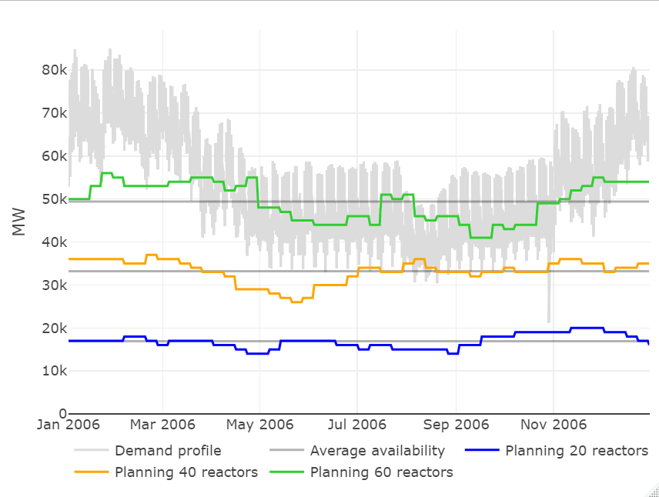
Method and models: Heuristic planning optimization MILP model output:
Fig: Nuclear availability for each nuclear fleet size scenario, resulting from the heuristic planning optimization model.
10/23
Arthur LYNCH

Slide 11
Method and models : Unit-Commitment/Economic Dispatch Model – Antares:
Unit-Commitment/Economic Dispatch model using ANTARES-Simulator (RTE):
$$Objective function :$$
$$Minimize\sum_{s=1}^{52}{\sum_{t=1}^{7∗24}{\sum_{i=1}^{N}{p_{i}∗Q_{i,t,s}∗U_{i,t,s}}}}$$
$$where :$$
$$N:number of generating plants$$
$$p_{i}:marginal cost of generating plant i$$
$$Q_{i,s,t}:generation of plant i at time t in week s$$
$$U_{i,s,t}:binary variable\left\{\begin{aligned}1 if plant i is up at time t in week s \\ 0 if plant i is down at time t in week s\end{aligned}\right.$$
$$Constrained by :$$
$$Demand−Supply Equilibrium constraint :$$
$$\sum_{i=1}^{N}{Q_{i,t,s}∗U_{i,t,s}}≥Demand_{t,s}$$
$$(1)$$
$$\overline{Q_{i,t,s}}: Maximum production capacity of plant i at time t of week s$$
$$\underline{Q_{i,t,s}}: Minimum production capacity of plant i at time t of week s$$
$MinimumUp_{i}: minimum number of hours plant i has to operate$
$before shutting down$
$MinimumDown_{i}: minimum number of hours plant i has to$
$shut down before re−starting$
$$Maximum and minimum production level :$$
$$(2)$$
$$Q_{i,t,s}≤\overline{Q_{i,t,s}}∗U_{i,t,s}$$
$$Q_{i,t,s}≥\underline{Q_{i,t,s}}∗U_{i,t,s}$$
$$(3)$$
$$Minimum Up and Downtime :$$
$$(4)$$
$$∀ x ∈\left[0;MinimumUp_{i}\right] : U_{i,t+x,s}≥U_{i,t,s}−U_{i,t−1,s}$$
$$∀ x ∈\left[0;MinimumDown_{i}\right] : U_{i,t+x,s}≤1+U_{i,t,s}−U_{i,t−1,s}$$
$$(5)$$
11/23
Arthur LYNCH

Slide 12
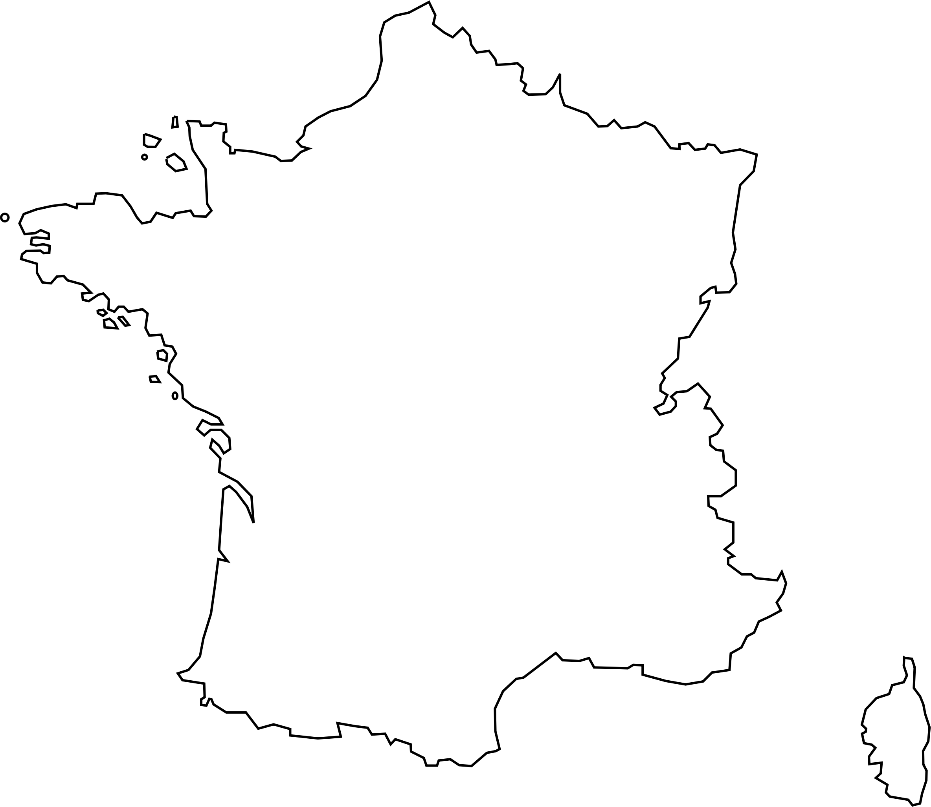
Case studies and results: Overview of the simulated electric system
- One country modeled: France as a copperplate
- One weather year for electric demand^{[1]} and VRE capacity factors^{[2]} data: 2006 (most representative weather year^{[3]})
- Five generating technologies represented: Wind Onshore/Offshore, Solar PV, Nuclear, Gas
- No interconnections
^{[1]} French electric demand, RTE data, www.services-rte.com, 2021
^{[2]} Simulated hourly country-aggregated PV and wind capacity factors for France, renewables.ninja, 2020
^{[3]} B. Shirizadeh, P. Quirion, and CIRED, “Low-carbon options for the French power sector: What role for renewables, nuclear energy and carbon capture and storage?,” Energy Econ., vol. 95, p. 105004, Mar. 2021, doi: 10.1016/j.eneco.2020.105004.
12/23
Arthur LYNCH

Slide 13
Case studies and results: Generating costs, technical and nuclear assumptions:
Cost and technical capacity assumptions OECD NEA, The Costs of Decarbonisation: System Costs with High Shares of Nuclear and Renewables. Paris: OECD Nuclear Energy Agency, 2019. [Online]. Available: https://www.oecd-nea.org/ndd/pubs/2019/7299-system-costs.pdf
Technology | Nominal capacity (MW) | Variable costs ($/MWh) | Minimum Stable Power (%) | Minimum Uptime (hours) | Minimum Downtime (hours) | Start-Up Costs ($/MW/start) | Reserve requirements | Environmental impacts (gCO2eq/kWh) – IPCC (2014)
Wind | - | 0 | - | - | - | - | - | 11
Solar PV | - | 0 | - | - | - | - | - | 41
Nuclear | 1000 | 11.5 | 50% | 8 | 24 | 500 | 10% | 12
Natural Gas | 300 | 96.11 | 25% | 1 | 1 | 50 | 10% | 490
Table: Overview of technology costs, flexibility and environmental impacts
13/23
Arthur LYNCH

Slide 14
Case studies and results: Case studies sensitivity analysis:
The paper simulates 15 capacity mix scenarios, according to the VRE penetration and nuclear fleet size:
• Five VRE penetration scenario: 0%, 20%, 40%, 60%, or 80% of the total electric demand is ensured by variable renewables (if no curtailment occurs)
• Three nuclear fleet size scenario: 20, 40, or 60 standardized reactors are installed in the electric system
• Gas OCGT units ensure the remaining electric demand with a 38% electrical efficiency
VRE penetration scenario | Solar PV (GW) | Wind – Onshore and Offshore - (GW) | Nuclear capacity (GW) |  |  | Gas OCGT (GW)
 |  |  | 20 reactors scenario | 40 reactors scenario | 60 reactors scenario | 20 reactors scenario | 40 reactors scenario | 60 reactors scenario
0% VRE | 0 | 0 | 20 | 40 | 60 | 68.03* | 51.77* | 35.49*
20% VRE | 19.96 | 33.86 |  |  |  | 64.17* | 47.91* | 31.63*
40% VRE | 39.93 | 67.72 |  |  |  | 62.83* | 46.57* | 30.29*
60% VRE | 59.89 | 101.58 |  |  |  | 61.49* | 45.23* | 28.95*
80% VRE | 79.85 | 135.44 |  |  |  | 60.15* | 43.89* | 27.61*
Table 3. Installed capacities for each simulated cases
* Gas capacity necessary to ensure the electric demand-supply equilibrium with no Loss of Load
14/23
Arthur LYNCH

Slide 15
Summary:
1. Background and objectives:
General context
Flexibility constraint of Pressurized Water Reactors (PWRs)
Objective of the paper
2. Method and models:
Methodology
Heuristic nuclear planning optimization model
UC/ED model: Antares-RTE
Case studies
3. Results:
Thermal dispatch
Operational costs and CO2eq emissions
Energy curtailment
Market prices and technology revenues
15/23
Arthur LYNCH

Slide 16
Case studies and results: Simulation results: Thermal dispatch:
The heuristic nuclear planning optimization does not strongly influence the thermal dispatch in cases with low VRE penetration and few reactors installed.
In cases with higher VRE penetration and the number of nuclear reactors in the capacity mix, nuclear planning optimization decreases overall nuclear and gas production.
 | 20% VRE |  | 40% VRE |  | 60% VRE |  | 80% VRE
Technology | Nuclear | Gas | Nuclear | Gas | Nuclear | Gas | Nuclear | Gas
40 reactors | 2.81E+08 (0.31%) | 1.03E+08 (-0.89%) | 2.43E+08 (-0.61%) | 5.22E+07 (-4.56%) | 1.96E+08 (-4.91%) | 2.83E+07 (-8.60%) | 1.55E+08 (-8.65%) | 1.61E+07 (-10.65%)
60 reactors | 3.65E+08 (1.93%) | 1.96E+07 (-27.28%) | 2.92E+08 (-1.39%) | 7.31E+06 (-35.04%) | 2.26E+08 (-7.58%) | 3.36E+06 (-37.36%) | 1.74E+08 (-12.45%) | 1.84E+06 (-38.65%)
Table: Annual thermal energy dispatch – MWhe – in the heuristic planning cases and change relative to the constant planning cases (in brackets)
16/23
Arthur LYNCH

Slide 17
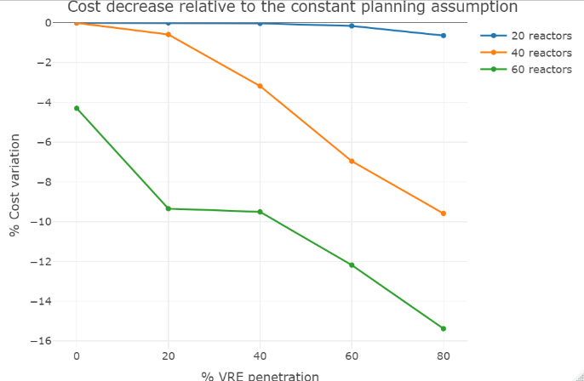
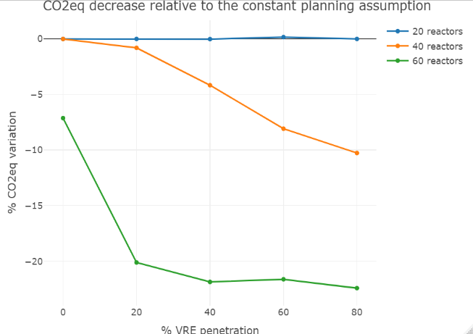
Case studies and results: Simulation results: Operational costs and CO2eq emissions:
As the VRE penetration and number of reactors in the capacity mix increase, the nuclear planning optimization does decrease the operational costs and CO2eq emissions of the simulated electric system.
Fig: Heuristic planning cost and CO2eq changes relative to constant planning case
17/23
Arthur LYNCH

Slide 18
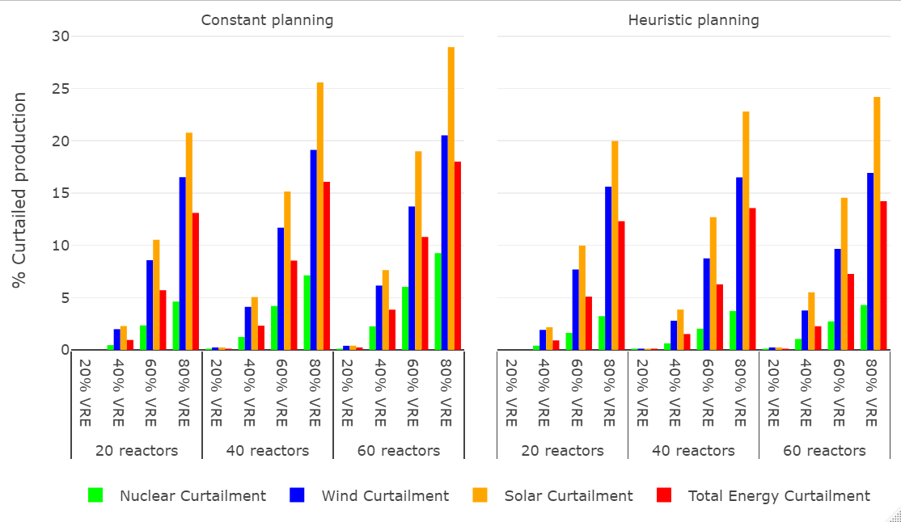
Case studies and results: Simulation results: Energy curtailment:
The heuristic nuclear planning optimization does decrease the overall level of energy curtailment in cases with VRE penetration equal or higher than 40%.
Fig: Curtailed energy for each VRE, nuclear, and nuclear planning assumption case
18/23
Arthur LYNCH

Slide 19
Case studies and results: Simulation results: Market prices and revenues:
The effect of nuclear planning optimization on market prices and technologies’ revenues is ambiguous. It decreases the occurrence of negative prices, but the benefits may be offset by the decreasing use of gas, which lowers market prices and technology revenues.
Illustration using the 40% VRE penetration – 60 reactors case:
Planning assumption | Average market price $/MWh | Number of hours <0 $/MWh | Number of hours >50 $/MWh
Constant | 24.24 | 2026 | 1196
Heuristic | 21.27 | 1402 | 905
Relative change | -12.25% | -30.80% | -24.33%
Table: Market price data: 40% VRE penetration – 60 GW nuclear capacity case
19/23
Arthur LYNCH

Slide 20
Case studies and results: Simulation results: Market prices and revenues:
For each generating technology, the production share sold at negative prices decreases, which increases revenues. However, due to the depleting occurrence of peaking prices, the overall effect of the nuclear planning optimization on revenues may be negative.
Illustration using the 40% VRE penetration – 60 reactors case:
 | Solar |  |  | Wind |  |  | Nuclear
Planning assumption | Revenues per MWh | Output share sold at <0$/MWh | Output share sold at >50$/MWh | Revenues per MWh | Output share sold at <0$/MWh | Output share sold at >50$/MWh | Revenues per MWh | Output share sold at <0$/MWh | Output share sold at >50$/MWh
Constant | 11.11 | 43.95% | 5.51% | 15.11 | 36.19% | 9.18% | 26.68 | 15.03% | 19.98%
Heuristic | 10.82 | 35.78% | 4.05% | 13.73 | 25.89% | 6.15% | 24.19 | 8.21% | 16.12%
Relative change | -2.64% | -18.60% | -26.46% | -9.11% | -28.47% | -32.96% | -9.31% | -45.34% | -19.32%
Table: Average revenues level and profile: 40% VRE penetration – 60 GW nuclear capacity case
20/23
Arthur LYNCH

Slide 21
Summary:
1. Background and objectives:
General context
Flexibility constraint of Pressurized Water Reactors (PWRs)
Objective of the paper
2. Method and models:
Methodology
Heuristic nuclear planning optimization model
UC/ED model: Antares-RTE
Case studies
3. Results:
Thermal dispatch
Operational costs and CO2eq emissions
Energy curtailment
Market prices and technology revenues
4. Concluding remarks and limits:
21/23
Arthur LYNCH

Slide 22
Concluding remarks and limits: Summary:
In cases with low VRE penetration and low nuclear capacity (i.e., cases where nuclear run as “baseload”), the nuclear planning optimization has negligible impact on electric systems operations.
In cases with higher VRE penetration and numbers of nuclear reactors installed (i.e., cases where nuclear power plants do operate flexibly), the nuclear planning optimization:
Decreases the electric system operational costs and CO2eq emissions.
Eases VRE integration in electric systems, with a decreasing level of energy curtailment.
Diminishes the occurrence of negative market prices, but the overall impact on market prices and technologies revenues is undetermined.
Nuclear planning optimization seems to be of primary importance as the flexibility required to nuclear power plants increase.
22/23
Arthur LYNCH

Slide 23
Concluding remarks and limits: Limitations:
Limitations:
• Simplistic model: few generating technologies, one country as one node, one weather year
• Flexibility levers: Thermal generation is the only flexibility lever modeled; no storage capacities (hydraulic or batteries), no Demand-Side Response (DSM), and no interconnections with neighboring balancing areas would lessen the benefits of nuclear planning optimization
• Heuristic nuclear planning optimization model: standardized reactor, no uncertainties on outages’ duration
23/23
Arthur LYNCH

Slide 24
Thanks for your attention arthur.lynch@cea.fr

