Slide 1




Planning Electric Vehicle Charging Infrastructure in a Transitioning Community
Eric Hittinger^{1,2}, Alain Bouscayrol¹, Elodie Castex³
¹ Univ. Lille, Arts et Metiers Institue of Technology, Centrale Lille, Yncrea Hauts-de-France, ULR 2697 – L2EP, F-59000 Lille, France
² Department of Public Policy, Rochester Institute of Technology, Rochester, NY, USA
³ Univ. Lille, ULR 4477 – TVES – Territoires Villes Environnement & Société, F- 59000, Lille, France

Slide 2

Some background on CUMIN and TESS
CUMIN: Campus of University with Mobility based on Innovation and Neutral in carbon
Objective: reduction of the GHG emission due to transport to/within the campus
Motivation: The 22,000 person “Cité Scientifique” campus has a carbon footprint that is ~50% from private commuter vehicles
TESS: Technical Economic Study of Sustainable campuses
Objective: create techno-economic tools to study the costs to commuters and university administration of different vehicle electrification plans
One important part is understanding what infrastructure the university should build and when they should build it

Slide 3
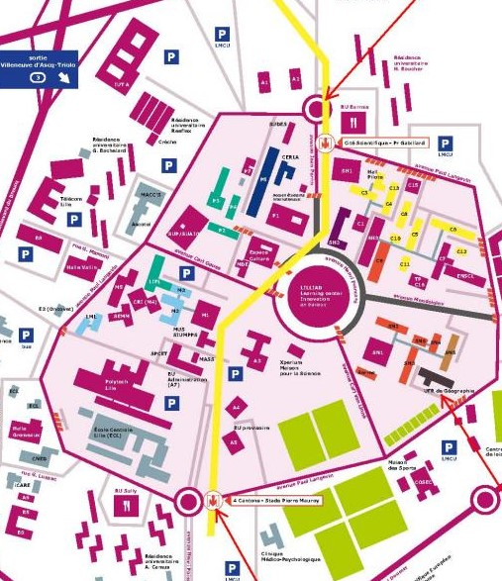
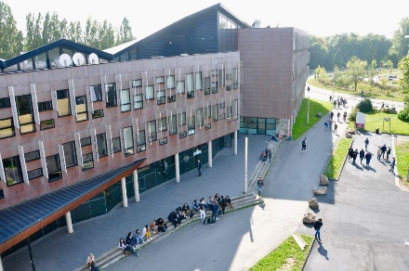
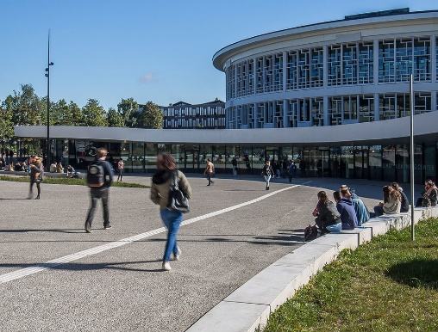

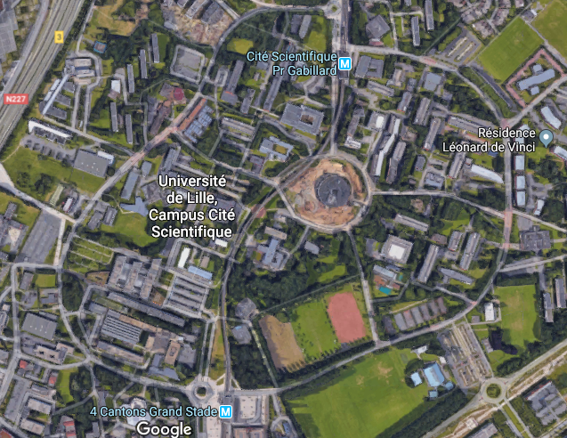
Campus “Cité Scientifique”
Université de Lille – a large suburban campus
22 000 users
80 buildings
110 ha

Slide 4
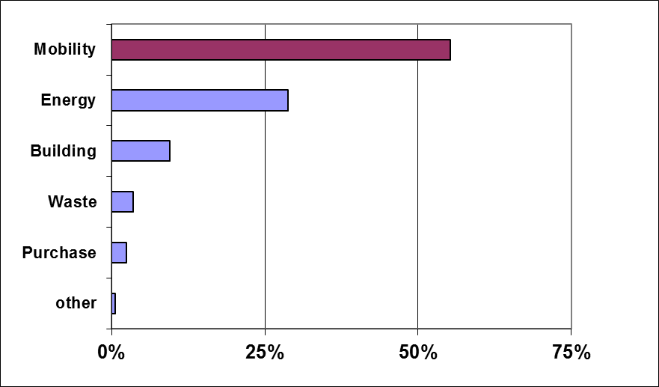

Transportation is the largest source of greenhouse gases for the campus
(ULille, campus Cité scientifique)
56%
97 % home-university trips
[Bilan Carbone, Lille1, COMUE 2015]
Passenger cars: 27% of travel
78% of pollution
local
accommodation?
soft
mobility ?
public
transportation?
electric
vehicles ?
4

Slide 5
The literature around charging infrastructure generally assumes a fixed demand for charging, but this isn’t realistic
There is a large body of literature on EV charging infrastructure, mostly studying one of these:
Optimal operation of a given set of infrastructure
Grid integration possibilities of charging infrastructure
Optimal design of infrastructure needed for a given EV charging demand

Slide 6
Research Question: What infrastructure (charging stations, solar PV, and storage) should the university build in response to a growing EV demand?
What infrastructure should be built and when should we build it, given things like economy of scale and falling costs of new technology?
Is it better to buy clean electricity from grid suppliers or generate it locally?
What business model for charging will attract commuters while raising some income?

Slide 7
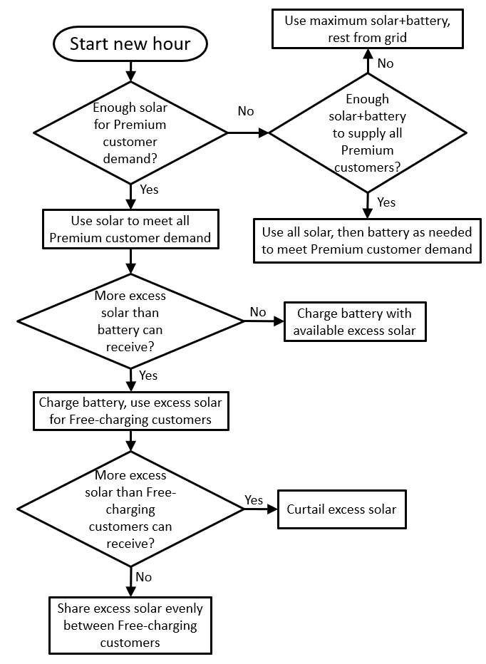
The central part of the model uses an hourly “dispatch model” to route power between energy sources and EVs
Vehicle Parameter | Range of Values
Home-work distance | 0-50 km
Battery Size | 10-90 kWh
Arrival time at work | 6h – 10h
Departure time from work | 16h – 20h
Efficiency | 200 Wh/km
Charge rate | 3.5 kW if battery < 20 kWh 7 kW if battery ≥ 20 kWh

Slide 8
An example week of operation shows the general concept: Premium customers are reliably charged while Free-charging customers receive excess solar energy

Slide 9
Solar PV, battery storage, and EV chargers are modeled with both economy of scale and falling prices over time
Solar PV economy of scale
Solar PV price decline
3.75% per year (after 2018)
kW of PV | $/W (in 2018)
5 | $2.80
50 | $2.00
500 | $1.45
5,000 | $1.05
Battery economy of scale
Battery price decline
6.3% per year (after 2018)
kWh of storage | $/kWh (in 2018)
10 | $1,700
100 | $1,214
1,000 | $900

Slide 10
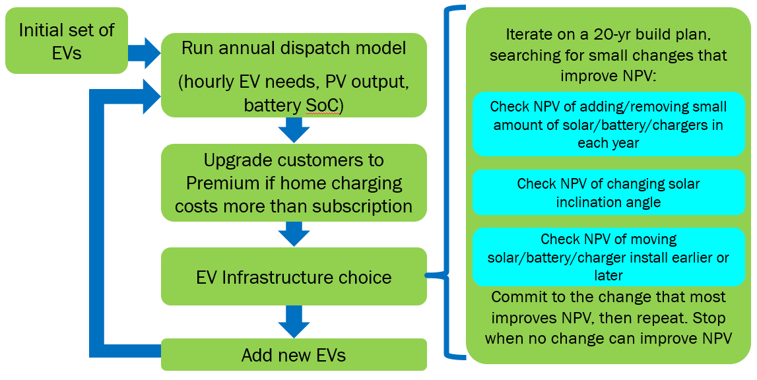
The dispatch model is used within an optimization that searches for the lowest-NPC “buildout plan” for chargers, solar PV, and stationary storage

Slide 11
In a scenario with continual growth in EVs, the optimal strategy is to build chargers and solar PV every ~10 yrs

Slide 12
One feature of the model is how it responds to uncertainty in future demand
Each line is a “buildout plan” for chargers, but the red line shows what was actually built. The model “plans” 20 years out, but only “commits” to next year’s chargers. It can adjust the plan each period.

Slide 13
As changes in demand are observed, the optimization shifts timing and amount of solar PV

Slide 14




Thank You!

