Slide 1
Energy consumption behaviour of Indian households: An application of LA-AIDS
43rd IAEE International Conference
7th-9th June, 2021
Pooja Sankhyayan and Shyamasree Dasgupta
School of Humanities and Social Sciences
Indian Institute of Technology Mandi
Himachal Pradesh, India
Email: d16001@students.iitmandi.ac.in, shyamasree@iitmandi.ac.in

Slide 2
Scheme of presentation
Motivation
Research objectives
Analytical framework
Results
Key findings
Notes:
Some words are capitalized

Slide 3
Motivation
United Nations Development Programme’s 7th Sustainable Development Goal emphasizes on ensuring access to affordable, reliable, sustainable and modern energy for all (UNDP, 2015).
Energy access is defined as, "a household having reliable and affordable access to both clean cooking facilities and to electricity”(IEA, 2019).
Access to energy enables people to augment their income and improve their productivity, enhancing their access to healthcare, water and education and improving their overall well-being. (NITI Aayog, 2019).
India has a significant population with lack of access to clean fuels as ~56% of households still use traditional fuel for cooking purpose and 5% of households are without access to electricity. (NFHS-4, 2015-16).
The policy framework has put forward solutions in terms of providing subsidy and removal of first cost barriers to increase access to clean fuels in Indian households. (Sankhyayan & Dasgupta, 2019).
Notes:
In India, 60% of population used of solid fuel for cooking in 2017 (HEI, 2019).

Slide 4
The slow transition of households from traditional to modern sources of fuels for cooking and lighting has resulted in health and environmental consequences.
The mortality burden of household air pollution in India was ~0.48 million in 2017 and household burning of biomass was responsible for about 24% of outdoor PM_{2.5} concentration in 2015 (HEI, 2019).
The household access to clean and modern sources of fuel in India are found to be positively correlated with Human Development Index (HDI) (Sankhyayan & Dasgupta, 2019).

Slide 5
Data source: 68th Consumer Expenditure Round (2011-12) National Sample Survey Organization Data pertains to food items, energy, clothing, bedding, footwear, construction, education, medical and miscellaneous items. Total number of households surveyed: 101,651 Rural households: 59,693 (59%) Urban households: 41,968 (41%)
Research Objectives
Identifying, whether there is any sign of energy transition in terms of energy ladder/energy stacking hypothesis?
Estimating the behavioural parameters of households with respect to energy demand of both energy and non-energy commodities.

Slide 6
Descriptive statistics of variables (national, rural and urban sectors)
 | National |  | Rural |  | Urban
 | Mean | Std. Dev. | Mean | Std. Dev. | Mean | Std. Dev.
Monthly Per Capita Expenditure (MPCE) (USD in parenthesis) | 2262 (30.34) | 2295 | 1818 (24.79) | 1722 | 2894 (39.46) | 2805
Average household size | 4.6 | 2.2 | 4.8 | 2.3 | 4.3 | 2.2
Female headed households (%) | 11.5 | - | 10.7 | - | 12.6 | -
Average years of education of head of household | 6.38 | 3.66 | 5.61 | 3.49 | 7.5 | 3.62
Monthly Per Capita expenditure on food, energy, clothing-bedding-footwear in INR (USD in parenthesis) | 1412 (19.26) | 1050 (14.33) | 1231 (16.79) | 978 (13.34) | 1669 (22.77) | 1094 (14.93)
Share of expenditure on food in MPCE | 0.54 | 0.12 | 0.57 | 0.11 | 0.50 | 0.13
Share of expenditure on energy in MPCE | 0.08 | 0.04 | 0.08 | 0.04 | 0.07 | 0.03
Share of expenditure on clothing-bedding-footwear in MPCE | 0.07 | 0.03 | 0.07 | 0.03 | 0.07 | 0.03
Monthly household expenditure on energy (E) | 640 (8.73) | 420 (5.73) | 591 (8.06) | 352 (4.80) | 709 (9.67) | 493 (6.73)
Monthly Per Capita expenditure on energy | 158 (2.16) | 110 (1.50) | 138 (1.88) | 84 (1.15) | 187 (2.55) | 135 (1.84)
Share of expenditure on traditional fuel | 0.06 | 0.14 | 0.08 | 0.16 | 0.03 | 0.11
Share of expenditure on firewood and chips | 0.29 | 0.30 | 0.40 | 0.28 | 0.12 | 0.23
Share of expenditure on kerosene | 0.08 | 0.11 | 0.09 | 0.09 | 0.06 | 0.13
Share of expenditure on LPG | 0.22 | 0.26 | 0.14 | 0.23 | 0.34 | 0.25
Share of expenditure on electricity | 0.30 | 0.21 | 0.23 | 0.17 | 0.41 | 0.22
Share of expenditure on other fuel | 0.05 | 0.10 | 0.06 | 0.12 | 0.04 | 0.07

Slide 7
Expenditure shares of different sources of fuel for cooking and lighting for national, rural and urban area and in rural and urban income quartiles

Slide 8
Research Objectives
Identifying, whether there is any sign of energy transition in terms of energy ladder/energy stacking hypotheses?
Estimating the behavioural parameters of household with respect to energy demand of both energy and non-energy commodities.

Slide 9
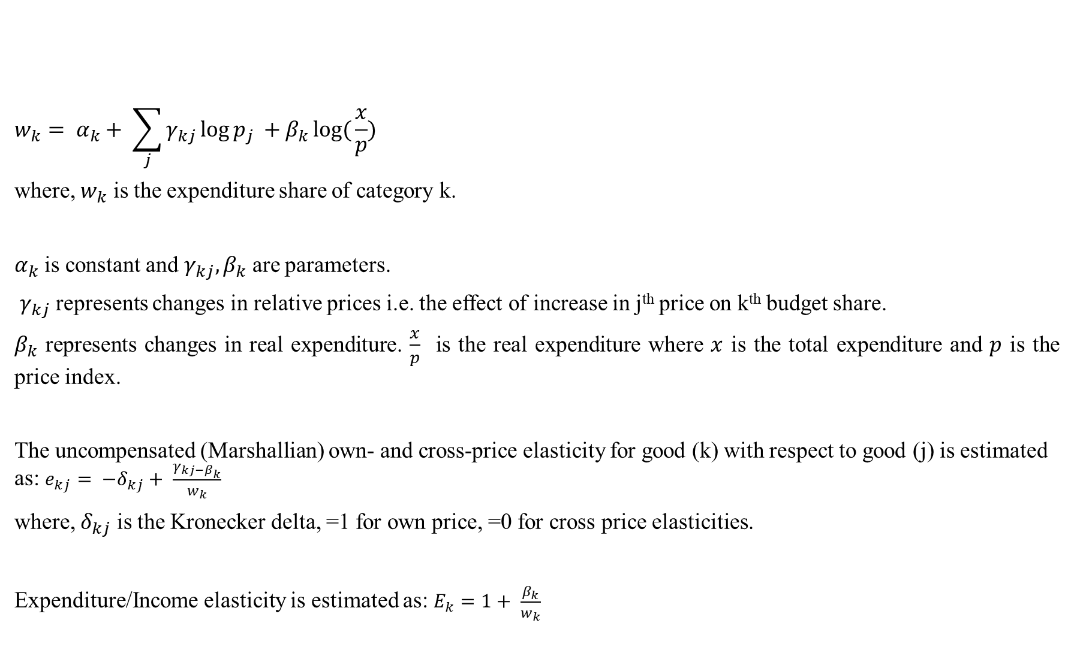
Analytical framework: Linear Approximate Almost Ideal Demand System (LA-AIDS)
$$w_{k}= α_{k}+ \sum_{j}{γ_{kj}\log{p_{j}}} +β_{k}log({\frac{x}{p})}$$
where, $w_{k}$ is the expenditure share of category k.
$α_{k}$ is constant and $γ_{kj}, β_{k}$ are parameters.
$γ_{kj}$ represents changes in relative prices i.e. the effect of increase in j^{th} price on k^{th} budget share.
$β_{k}$ represents changes in real expenditure. $\frac{x}{p}$ is the real expenditure where $x$ is the total expenditure and $p$ is the price index.
The uncompensated (Marshallian) own- and cross-price elasticity for good (k) with respect to good (j) is estimated as: $e_{kj}= −δ_{kj}+ \frac{γ_{kj−β_{k}}}{w_{k}}$
where, $δ_{kj}$ is the Kronecker delta, =1 for own price, =0 for cross price elasticities.
Expenditure/Income elasticity is estimated as: $E_{k}=1+ \frac{β_{k}}{w_{k}}$

Slide 10
Literature
Name | Country | Energy Sources | Methodology | Data | Findings
Chambwera and Folmer (2007) | Zimbabwe | Electricity, fuel wood, kerosene | AIDS | Survey on 500 households in Harare | Electrified Households Share in total energy expenditure: Electricity .096 Firewood -.021 Kerosene -.076 | Un-electrified Households Share in total energy expenditure: Firewood .088 Kerosene -.074
Gundimeda and Kohlin (2008) | India | Electricity, LPG, fuel wood, kerosene | LA -AIDS | NSSO 1999 | Own price elasticities in urban areas: LPG − 1.01, fuel wood − 1.02, kerosene − 0.21 Own price elasticities in rural areas: LPG − 0.98, fuel wood − 1.03, kerosene − 0.75 | Income elasticities in urban areas: LPG 0.94, fuel wood 1.30, kerosene 0.97 Income elasticities in rural areas: LPG 0.96, fuel wood 1.27, kerosene 0.84
Ngui etal (2011) | Kenya | Electricity, LPG, fuel wood, kerosene, charcoal, MSP, AGO, lubricants | LA-AIDS |  | Own price elasticities: LPG − 0.28, fuelwood − 0.62, kerosene − 0.69 | Expenditure elasticities: LPG 0.87, fuel wood 0.93, kerosene 1.06
Sun and Ouyang (2016) | China | Electricity, natural gas(NG), transport fuel(TF) | LA-AIDS | CRECS | Own price elasticity Electricity -0.387 NG -0.7794 TF -0.9601 | Expenditure elasticity Electricity -0.6262 NG 0.7963 TF 1.2381
Irfan etal (2018) | Pakistan | Natural gas, LPG, fire wood, agricultural waste, animal dung, kerosene | LA-AIDS | PSLSMS | Own price elasticity Natural gas -1.4 LPG -0.73 Firewood -0.71 Agricultural waste -0.73 Animal dung -0.90 Kerosene-0.59 | Expenditure elasticity Natural gas 0.88 LPG 0.83 Firewood 0.84 Agricultural waste 0.88 Animal dung 0.91 Kerosene0.90

Slide 11
Model 1 used the data on three expenditure categories: 1) food items 2) energy 3) clothing, bedding and footwear (cbf).
Model 2 constitutes 3 categories of fuel used for lighting and cooking: 1) kerosene (kerosene – PDS (litre), kerosene – other sources (litre)), 2) electricity and 3) LPG.
Model 2.1: 6 categories (Traditional fuel, Firewood and chips, Kerosene, Electricity, LPG, Other)
Model 2.2: 5 categories (Firewood and chips, Kerosene, Electricity, LPG, Other)
Model 2.3: 4 categories (Firewood and chips, Kerosene, Electricity, LPG)
Model 2.4: 3 categories (Kerosene, Electricity, LPG)

Slide 12
Own-price elasticities for national, rural and urban area and rural and urban income quartiles
 | National | Rural | Urban | Rural income quartile 1 | Rural income quartile 2 | Rural income quartile 3 | Rural income quartile 4 | Urban income quartile1 | Urban income quartile 2 | Urban income quartile 3 | Urban income quartile 4
Food | -0.99* | -0.99* | -0.98* | -0.99* | -0.99* | -0.99* | -0.99* | -0.99* | -0.99* | -0.98* | -0.98*
CBF | -0.69* | -0.73* | -0.66* | -0.78* | -0.75* | -0.76* | -0.60* | -0.77* | -0.70* | -0.69* | -0.58*
Energy | -0.95* | -0.95* | -0.90* | -0.99* | -0.95* | -0.92* | -0.89* | -0.93* | -0.86* | -0.82* | -0.73*
Kerosene | -0.13* | 0.38* | -0.50* | 0.94* | 0.80* | 0.44* | -0.03 | -0.12* | -0.42* | -0.61* | 0.02
Electricity | -0.66* | -0.73* | -0.58* | -0.93* | -0.69* | -0.61* | -0.58* | -0.51* | -0.50* | -0.55* | -0.65*
LPG | -1.61* | -1.60* | -1.20* | -0.51* | -1.19* | -1.52* | -1.58* | -1.47* | -1.49* | -0.83* | -0.64*
* Significant at 1% level of significance (p<0.01)
Energy demand is sensitive to price change and more so for the people in lower income quartiles (urban and rural).
Kerosene is found to be a Giffen good.
Demand for LPG is more price responsiveness than demand for electricity.

Slide 13
Expenditure elasticities for national, rural and urban area and rural and urban income quartiles
 | National | Rural | Urban | Rural income quartile 1 | Rural income quartile 2 | Rural income quartile 3 | Rural income quartile 4 | Urban income quartile1 | Urban income quartile 2 | Urban income quartile 3 | Urban income quartile 4
Food | 1.02* | 1.02* | 1.02* | 1.01* | 1.02* | 1.02* | 1.03* | 1.02* | 1.02* | 1.02* | 1.03*
CBF | 0.86* | 0.87* | 0.85* | 0.89* | 0.88* | 0.89* | 0.81* | 0.90* | 0.87* | 0.87* | 0.83*
Energy | 1.00* | 0.99* | 1.00* | 1.01* | 0.99* | 0.97* | 0.96* | 0.99* | 0.96* | 0.96* | 0.95*
Kerosene | 0.18* | -0.08* | 0.40* | -0.47* | -0.29* | -0.05* | 0.12* | 0.35* | 0.47* | 0.55* | 0.45*
Electricity | 0.91* | 0.98* | 0.86* | 1.14* | 0.98* | 0.89* | 0.85* | 0.79* | 0.78* | 0.86* | 0.94*
LPG | 1.70* | 1.75* | 1.47* | 1.27* | 1.57* | 1.78* | 1.67* | 1.46* | 1.58* | 1.22* | 1.06*
* Significant at 1% level of significance (p<0.01)
Energy has high elasticity value which means that the intervention can be made through the channel of income generation.
Kerosene is found as an inferior good.
LPG demand in more sensitive to income change than the demand for electricity.

Slide 14
Key findings
The policy of cross-subsidization of subsidies can benefit the poor more and increase the uptake of clean fuels in poorer households.
Increase in income can lead to higher uptake of clean fuels as fuel use is more responsiveness to income change.
In light of this study, a shift in policies for the promotion of clean fuels can be considered to address the income barrier in enhancing the uptake of modern fuels.
Creation of employment opportunities and increase in rural livelihood can result in generation of income.
The uptake of clean fuels cannot be treated as a standalone issue in the overall development discourse and need to be addressed along with the goals of housing, education, health and employment.

Slide 15
References
Choumert-Nkolo, J., Motel, P. C., & Roux, L. L. (2019). Stacking up the ladder: A panel data analysis of Tanzanian household energy choices. World Development, 115, 222-232.
Deaton, A., & Muellbauer, J. (1980). An Almost Ideal Demand System. The American Economic Review, 70(3), 312-26.
Gundimeda, H., & Kohlin, G. (2008). Fuel demand elasticities for energy and environmental. Energy Economics, 30, 517-546.
Health Effects Institute. (2019). State of Global Air 2019.
Hosier, R. H., & Dowd, J. (1987). Household fuel choice in Zimbabwe: An empirical test of the energy ladder hypothesis. Resources and Energy, 9(4), 347-61.
Kroon, B. v., Brouwer, R., & Beukering, P. V. (2013). The energy ladder: Theoretical myth or empirical truth? Results from a meta-analysis. Renewable and Sustainable Energy Reviews, 20, 504-13.
Lam, N. L., Pachauri, S., Purohit, P., Nagai, Y., Bates, M. M., Cameron, C., et al. (2016). Kerosene subsidies for household lighting in India: what are the. Environmental Research Letters.
Muhammad, I., Cameron, M. P., & Hassan, G. (2018). Household energy elasticities and policy implications for Pakistan. Energy Policy, 113, 633-642.
National Family Health Survey (NFHS-4), 2015-16: India. (2017). International Institute for Population Sciences (IIPS) and ICF, Ministry of Health & Family Welfare.
NSSO. (2007). Energy sources for Indian households for cooking and lighting 2004-05. National sample Survey Organisation, Ministry of Statistics and Programme Implementation, Government of India.
NSSO. (2014). Energy sources of Indian households for cooking and lighting 2011-12. National sample Survey Organisation, Ministry of Statistics and Programme Implementation, Government of India.

Slide 16
NSSO. (2014). Household Consumer Expenditure Survey (2011-12). Ministry of Statistics and Programme Implementation Government of India.
Pachauri, S., & Cherp, A. (2011). Energy security and energy access: distinct and interconnected challenges. Current Opinion in Environmental Sustainability, 3(4), 199-201.
Parikh, J. (2011). Hardships and health impacts on women due to traditional cooking fuels: A case study of Himachal Pradesh, India. Energy Policy, 39(12), 7587-94.
Ruiz-Mercado, I., & Masera, O. (2015). Patterns of Stove Use in the Context of Fuel–Device Stacking: Rationale and Implications. EcoHealth, 12(1).
Saatkamp, B. D., Masera, O. R., & Kammen, D. M. (2000). Energy and health transitions in development: fuel use, stove technology, and morbidity in Jarácuaro, México. Energy for Sustainable Development, 4(2), 7-16.
Sankhyayan , P., & Dasgupta, S. (2019, August). 'Availability' and/or 'Affordability': What matters in household energy access in India? Energy Policy, 131, 131-143.
Singh, S., Gupta, G. P., Kumar, B., & Kulshrestha, U. C. (2014). Comparative study of indoor air pollution using traditional and improved cooking stoves in rural households of Northern India. Energy for Sustainable Development, 19, 1-6.
Smith, K. R., & Sagar, A. (2014). Making the clean available: Escaping India’s Chulha Trap. Energy Policy, 75, 410-14.
United Nations. (2019). SDGs Report 2018. Statistics Division, Department of Economic and Social Welfare United Nations.

Slide 17
Thank you.

