Slide 1


IAEE 2021 Online Conference
Optimal supply chains and power sector benefits of green hydrogen
Fabian Stöckl. Wolf-Peter Schill, Alexander Zerrahn
June 9, 2021
https://arxiv.org/abs/2005.03464
Notes:
Joint work with my great co-authors at DIW Berlin
Outcome of BMBF Kopernikus project

Slide 2
Research questions and contribution
1
Sector coupling as a strategy to
(i) decarbonize other sectors
(ii) provide flexibility to the power sector → often under-represented in models
Focus here: hydrogen
Domestic (German) H₂ production and distribution, use for fuel-cell electric vehicles
We determine least-cost hydrogen supply chains
Considering differences in energy efficiency, investment costs, and storage capabilities
Considering electricity system interactions → main contribution
Notes:
Not particularly convinced that fuel cells are the way to go for vehicles…

Slide 3

Model: extension of DIETER
2
This calls for a numerical model
Extension of open-source model DIETER, co-optimization of power and hydrogen sector
https://gitlab.com/diw-evu/dieter_public/dietergms/-/tree/1.4.0 https://doi.org/10.5281/zenodo.3693306
New hydrogen module
Four channels for distributing H₂ to fuel stations
  Decentral electrolysis
  Central + gaseous H₂
  Central + liquified H₂
  Central + LOHC
Applied to 2030 scenario for Germany
RES shares between 65% and 85%
Hydrogen demand: 0, 5%, 10%, 25% of passenger road traffic (0, 9, 18, 45 TWh_{H2})
https://commons.wikimedia.org/wiki/File:Dibenzyltoluene_V1.svg
Notes:
Who has ever heard about LOHC?

Slide 4
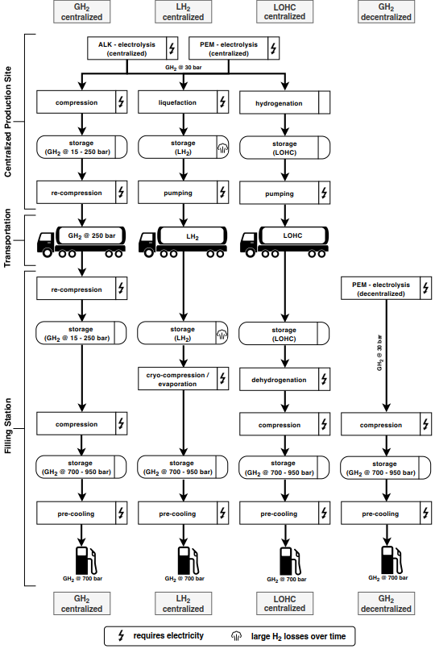
Overview of hydrogen supply chains in the model
2
→ We do not investigate all channels in one model run, but combinations of each centralized with the decentralized channel
Notes:
General picture: three centralised vs one decentralised channel
Always dec+cent for numerical reasons
→ All come with different cost parameters
[PEM vs. ALK: PEM more expensive, but higher efficiency [chlor-alkali]]
LH2: storage loss
LOHC: hydrogenation exothermal
[Different costs of trailers]
LOHC: electricity needed for dehydrogenation
Only PEM for decentralized electrolysis

Slide 5
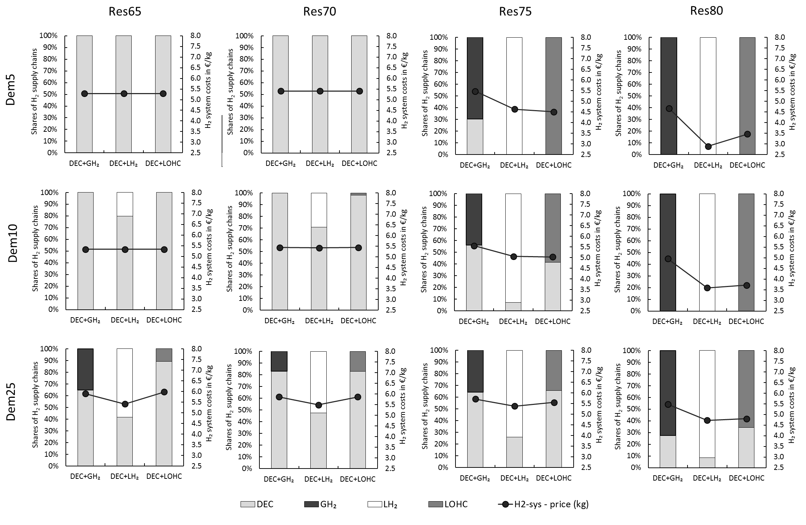
Results: hydrogen supply chains and H₂ supply costs
3
Low RES share, low H₂ demand:
Not much need for additional flexibility
Decentralised H₂ supply dominant because
high energy efficiency matters most
Notes:
How to read this: for each combination of dec-cent, shares; plus H2 system costs (lower is better; calculated by comparing total system costs with baseline)
What happens:
Low Res, low H2 demand: dec
Increasing RES shares (to the right): LH2
Increasing H2 demand: LH2 (or LOHC)
(- H2 system costs decrease with RES, but increase with dem)

Slide 6
Results: hydrogen supply chains and H₂ supply costs
3
High RES share, low H₂ demand:
Higher renewable surplus generation
Temporal flexibility more beneficial
LH₂ (and LOHC) allow cheaper longer-term storage

Slide 7
Results: hydrogen supply chains and H₂ supply costs
3
High H₂ demand:
LH₂ again most beneficial
GH₂: high storage and transportation costs
Notes:
LH2 suffers from boil off (no option for seasonal storage) → LOHC gets relatively better

Slide 8
Effects on generation capacity (vs. baseline without hydrogen)
4
Larger effects with growing hydrogen demand
Smaller effects with growing RES penetration (better utilization)
Hydrogen favors PV deployment
Notes:
Now, changed setup: H2 demand increases to the right, RES share to the bottom

Slide 9
Effects on yearly generation and curtailment (vs. baseline w/o hydrogen)
4
Flexible H₂ supply chains integrate RES that would otherwise be curtailed
LOHC has the largest capability for this
„Mixed blessing of flexibility“:
also helps integrating lignite
Notes:
Benefits in 80% scenario driven by taking up surplus generation

Slide 10
Two complementary metrics of CO₂ emission intensity
4
Additional System Emission Intensity of Hydrogen (ASEIH)
Increase with RES share
(lignite effect)
Average Provision Emission Intensity of Hydrogen (APEIH)
Decrease with RES share
Notes:
ASEIH: Total emission effect vs. Baseline w/o H2 → takes full power system effects into account
APEIH: Average emissions prevailing in hours of production (and distribution)
Careful when interpreting emissions results! Both views are valid.
CO2 price 30 €/t

Slide 11
Two complementary hydrogen cost metrics
4
Average Provision Costs of Hydrogen (APCH)
Slight increase with demand
Difference between APCH and Additional System Costs of Hydrogen
ASCH much smaller for high RES shares
Notes:
APCH: producer / consumer perspective: (ann. H2 infrastr. + yearly electr. costs for H2) / total H2 supply
ASCH: power sector perspective: delta system costs / hydrogen supply → total power sector benefits
Costs are below the uniform retail price of hydrogen in Germany of around 9.5€/kg by 2020

Slide 12
Effects of hydrogen on system costs of electricity (vs. baseline w/o hydrogen)
4
Benefits increase with RES shares because of better use of surpluses
Notes:
Total power sector costs, excluding investment, fixed and (non-electricity) variable costs of hydrogen supply chain → benefits completely attributed to power sector
Calculation: (total system costs – fixed h2 infrastructure costs) / total generation
(→ we assume h2 infrastructure is not made for power system)

Slide 13
Summary and conclusion
5
Trade-off between energy efficiency and temporal flexibility
Energy-efficient decentral electrolysis optimal for lower RES shares
Less energy-efficient but more flexible centralized electrolysis better for higher RES shares
Possible co-benefits of green H₂ for RES integration
Depend on storage capability of supply chain
„Mixed blessing“: additional flexibility may also benefit dirty generators
Different cost metrics raise complementary insights
Limitations
Results driven by renewable surplus, no competing sector coupling options
Limits to RES capacity deployment in Germany (and Europe)

Slide 14
Want to read the full paper?
5
Open-access preprint: https://arxiv.org/abs/2005.03464
Forthcoming gold open access version in Scientific Reports

Slide 15
Dr. Wolf-Peter Schill
wschill@diw.de | @WPSchill

Slide 16
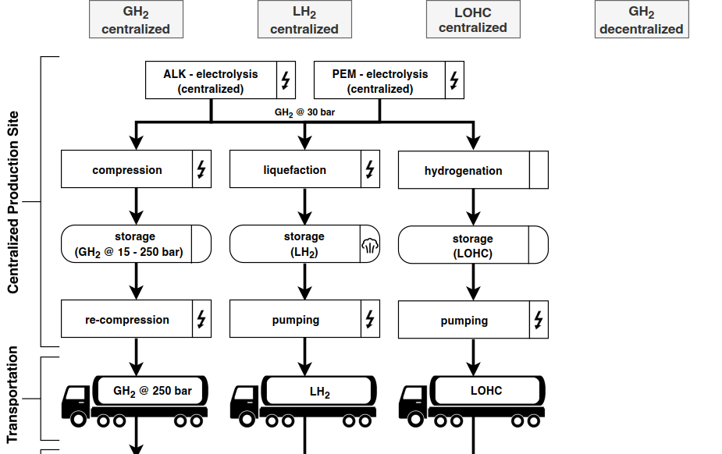

Notes:
PEM vs. ALK: PEM more expensive, but higher efficiency [chlor-alkali]
LH2: storage loss
LOHC: hydrogenation exogenous
Different costs of trailers

Slide 17
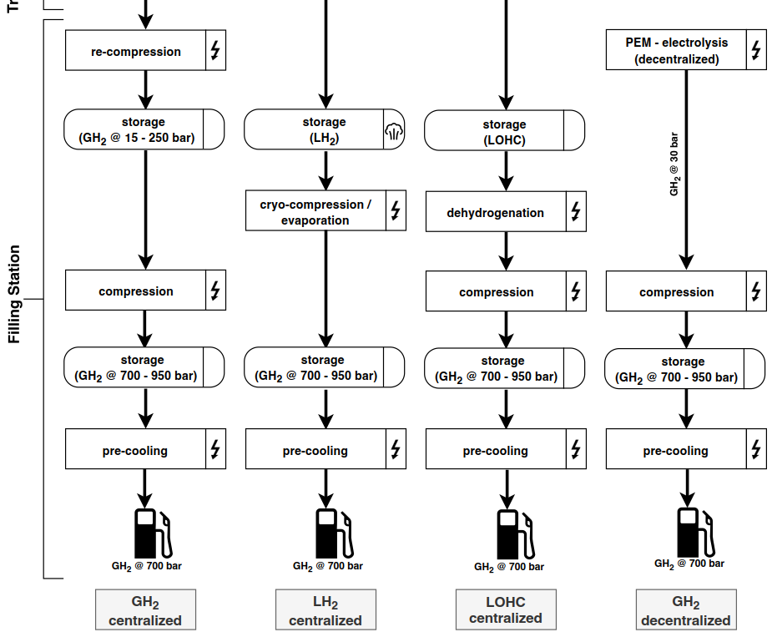
Notes:
LOHC: electricity needed for dehydrogenation
Only PEM for decentralized electrolysis

Slide 18
Data and scenarios
2
Electricity sector
Brownfield scenario for 2030
Capacities bounded by current grid development plan (NEP)
Maximum investment into thermal plants, minimum investments into renewables and storage
Time series provided by Open Power System Data & ENTSO-E
Exogenous minimum renewables share of 65%, 70%, 75%, 80%
Hydrogen infrastructure
Fully „greenfield“
H₂ demand for mobility: 0, 5%, 10%, 25% of passenger road traffic in Germany (0, 9, 18, 45 TWh_{H2})
General assumptions: each fuel station can only offer H₂ from one channel
Notes:
NEP 2019, scenario B
Lower bounds for vRES and storage
Upper bounds for conventional, bio and pumped hydro

Slide 19
Background
1
Some intuition:
potential drivers of results

Slide 20
Drivers I: Tradeoff between overall efficiency and flexibility
3
more energy efficienct
more flexible
Notes:
DEC: most efficient, but highest electricity demand at the time of re-fueling
Other options: more flexible, but less energy efficient
LOHC dominated → you would not expect to be part of the solution

Slide 21
Drivers II: Fixed investment and transportation capacity costs
3
Only 3% spread between cheapest and most expensive supply chain
Transportation costs highest for GH₂ , low effective load capacity of GH₂ trailer

Slide 22
Drivers III: Storage costs (and losses)
3
Substantially lower storage costs for LH₂ and LOHC
Expensive high pressure storage at the filling station → only buffer storage
LH₂ also suffers from boil-off
→ Intuition not so clear → Analysis with numerical optimization model required
filling station

