Slide 1
Democracy and Electricity: Institutions, Industrial Representation and Technology Deployment Rates
Zeynep Clulow and David Reiner,
z.clulow@jbs.cam.ac.uk

Slide 2
Focus
Context
Theoretical approach
Research design
Results
Conclusions

Slide 3
1. Context
Decarbonisation and net-zero targets
  Electricity generation and consumption account for 75% of global GHGs (Ritchie and Roser 2020)
  Energy transition can provide 39% of required mitigation from energy (IRENA 2019)
Yet transition in the power sector has been slow

Slide 4
2. Theoretical Approach
Democracies are better than non-democracies at environmental provision (Barrett and Graddy 2000; Burnell 2012,2014; Battig and Bernauer 2009; Bohmelt et al. 2015)
Democracies are more conducive to greener energy (Marques et al. 2010; Cadoret and Padovano 2016; Brown and Mobarek 2009)
Or not? (Yi and Feiock 2014; Stepping and Banhlzer 2017; Held and Hervey 2007)

Slide 5
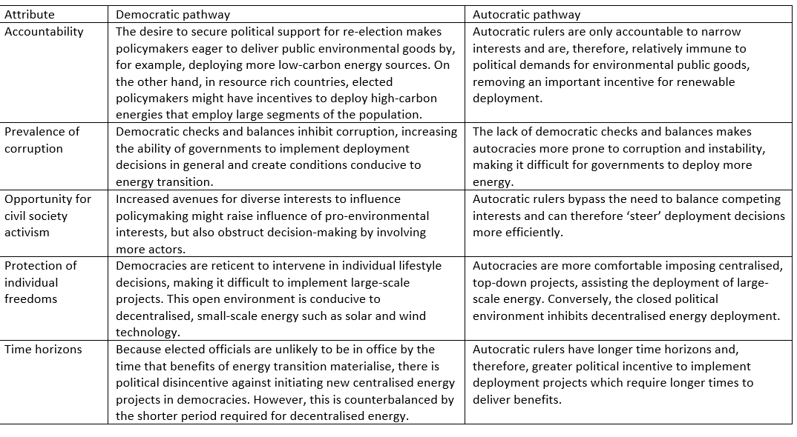
Regime pathways to energy sources

Slide 6
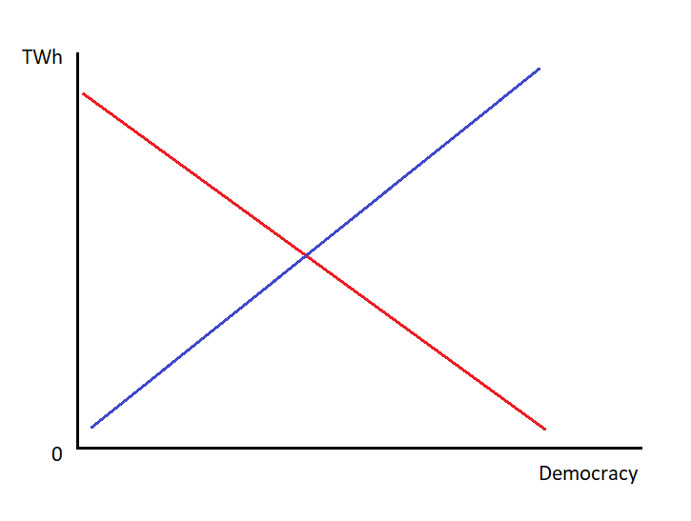
Hypothesis 1
GWh
H1A: Marginal deployment (GWh) of energy sources for electricity generation increases as the level of democracy in a country rises, ceteris paribus.
H1B: Marginal deployment (GWh) of energy sources for electricity generation declines as the level of democracy in a country rises, ceteris paribus.

Slide 7
Interest group politics
Interest group conflicts → policy outcomes (Beuno de Mesquita et al. 2001)
Energy policy (Henisz and Zelner 2006)
Industry:
  54% energy consumption (IEA 2018)
  Energy security = industrial energy intensity? (Sovacool 2011)

Slide 8
Industrial interests towards energy
A fossil fuel bias?
Reliability concerns over renewables (Lucas et al. 2016; Sovacool 2009)
Fossils cheaper, at least for now
Renewables can be integrated into centralized systems. Diversified hybrid energy can increase security (Burke and Stephens 2018; Kuzemko et al. 2016)
Government involvement; renewables reduce sensitivity to fuel prices (Lucas et al. 2016)

Slide 9
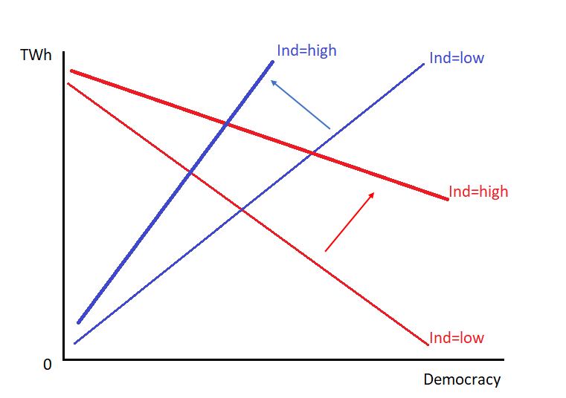
Hypothesis 2:
H2: As industrial representation in a country rises, the effect of democracy on the marginal deployment of energy sources for electricity generation (TWh) increases.

Slide 10
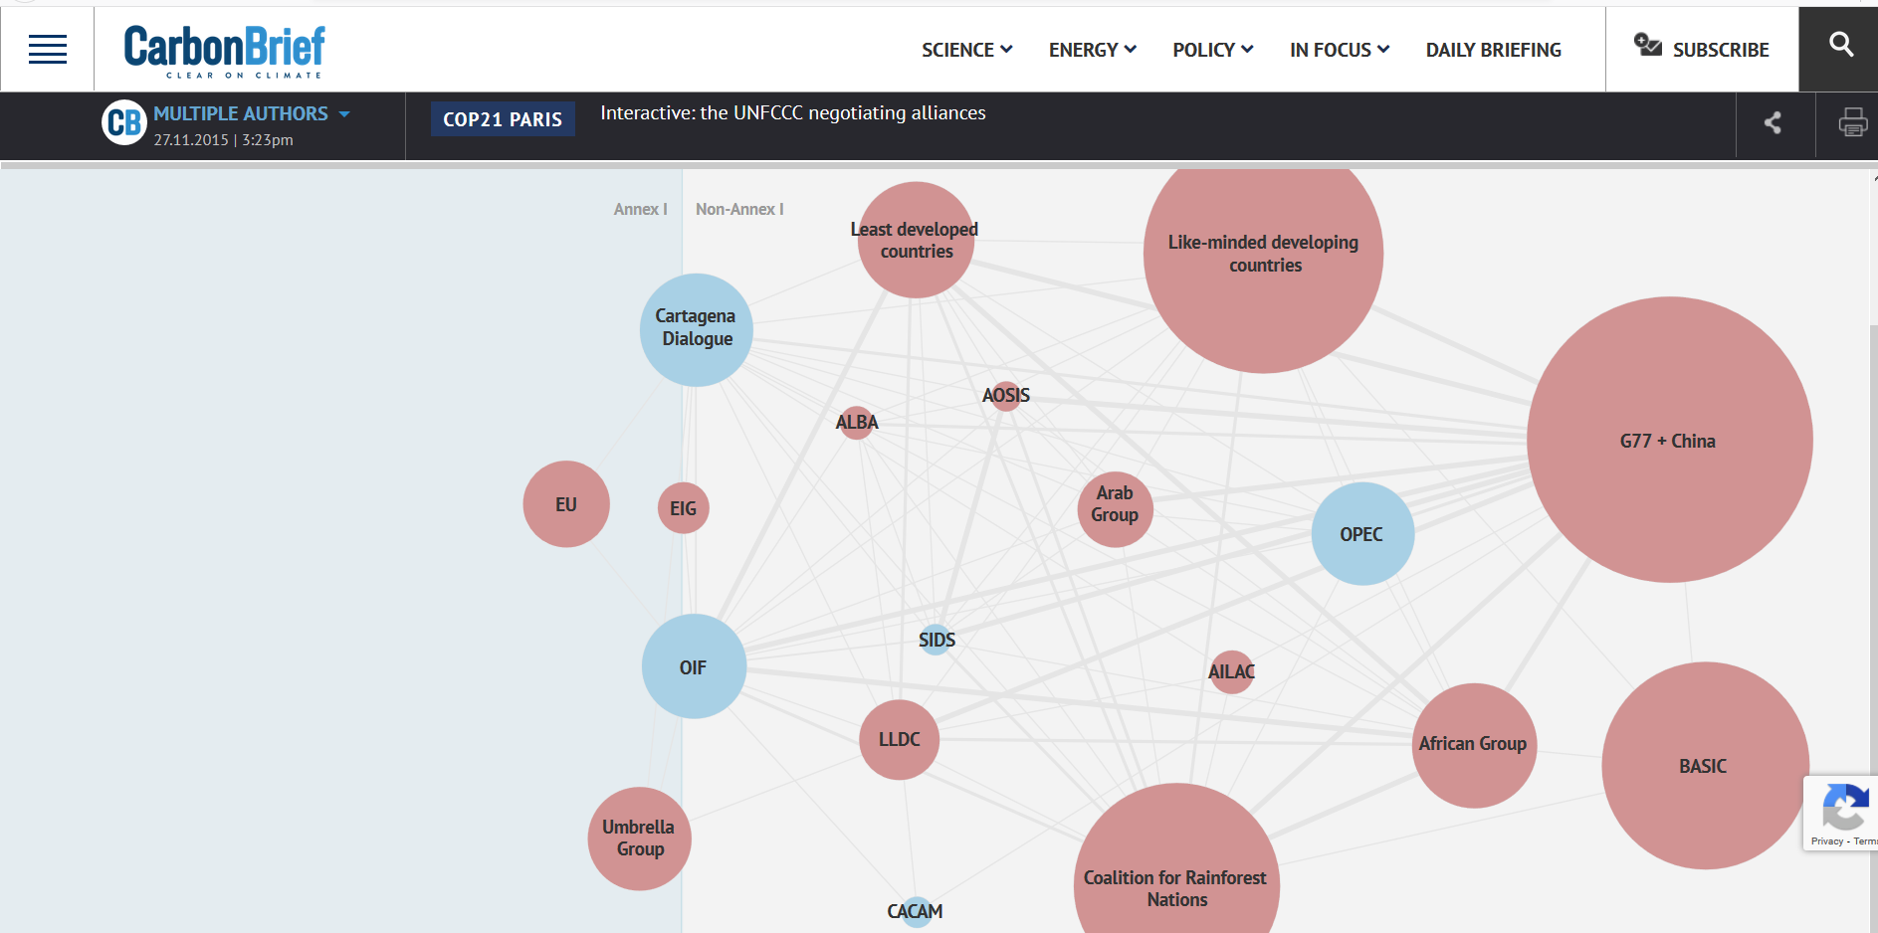
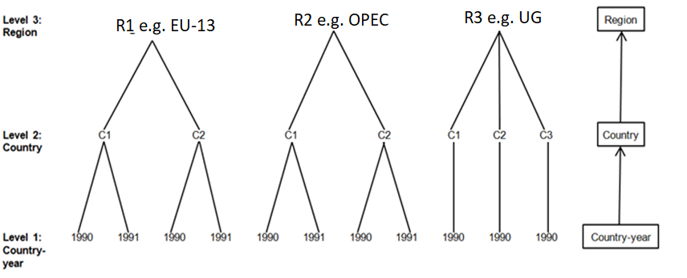
3. Research design
136 countries spanning 19 regions (Carbon Brief UNFCCC negotiating alliances)
1990 to 2018 → 3,994 observations
Energy sources: coal, oil, gas, nuclear, geothermal, hydro, solar & wind

Slide 11
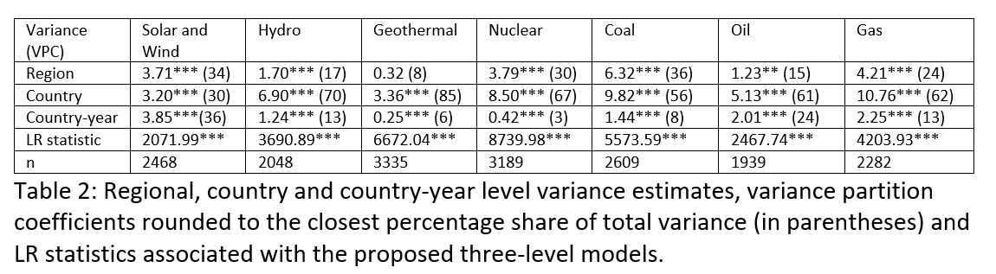
The rationale for a mutlilevel approach

Slide 12
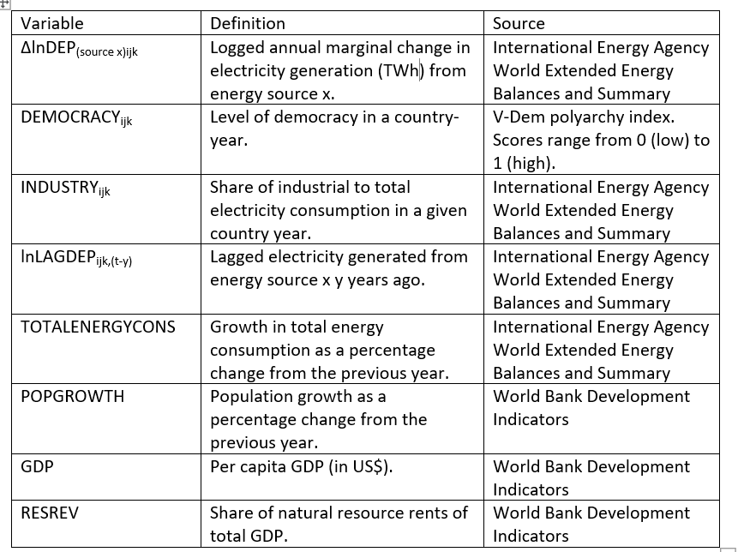
Variables

Slide 13
Our core specification
∆lnDEP _{(source x)ijk} = β₀ + β₁DEMOCRACY_{ijk} + β2lnLAGDEPijk_{,(t-y)} + β₃TOTALENERGYCONS_{ijk} + β₄POP_{ijk} + β₅GDP_{ijk} + β₆INDUSTRY_{ijk} + β₇RESREV_{ijk} + β₈INDUSTRY_{ijk}XDEM_{ijk} + β9lnLAGDEPijk_{,(t-x)} X DEMOCRACY_{ijk} + β10lnLAGDEPijk_{,(t-x)} X INDUSTRY_{ijk} + β11lnLAGDEPijk_{,(t-x)} X DEMOCRACY_{ijk} X INDUSTRY_{ijk} + u_{1jk}DEMOCRACY_{ijk} + v_{k} + u_{jk} + e_{ijk}
where DEP _{(tech)ijk} is the change in deployment of energy source x for electricity generation (GWh) in country-year i (i = 1,…,3,808) in country j (j = 1,…,136) in region k (k = 1,…,33) and v_{k}, u_{jk} and e_{ijk} denote country-year, country and regional residual error respectively.

Slide 14
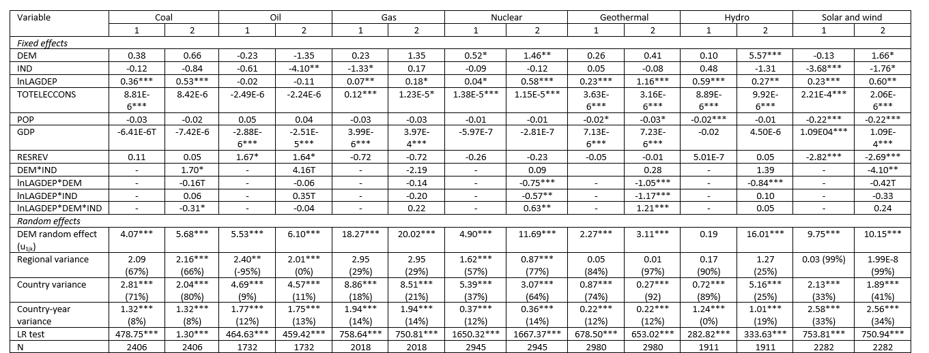
4. Results: Hypothesis 1

Slide 15
Country-specific democracy effects

Slide 16
Hypothesis 2: The democracy-industry interaction

Slide 17
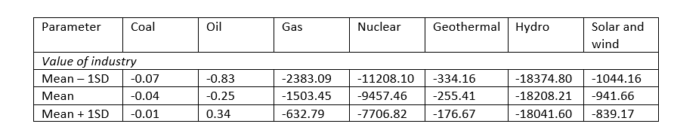
Industry’s role in moderating the democracy effect
lnDEP_{(source x)ijk} = β₁ + β₈INDUSTRY + β₉LAGDEP_{ijk,(t-x)} + β₁₁LAGDEP_{ijk,(t-x)} X INDUSTRY_{ijk}
at different levels of industrial representation;

Slide 18
GWh

Slide 22
5. Conclusions
Core hypotheses:
  H1B>H1A: democracy inhibits energy deployment:
    Low-carbon & fossil fuel sources
    Centralised & decentralized options
  H2: industrial strength counteracts the negative democracy effect
  Robustness checks: V-Dem & democracy dimensions
Generalisations:
  Energy sources:
    Democracy effect: all energy sources
    Interaction effect: coal, nuclear, geothermal, solar & wind
  Cross-country variation
    Democracy effect → random effects matter
Empirical implications
  Change in democracy likely to have different effects depending on industrial representation

Slide 23
Thanks!
z.clulow@jbs.cam.ac.uk

