Slide 1
Building Infrastructures for Fossil- and Bioenergy with Carbon Capture and Storage
Insights from a cooperative game-theoretic perspective
Emma JAGU Olivier MASSOL
(CentraleSupelec & IFPEN) (IFP School & City U. London)
2021 IAEE Online Conference – 09 June 2021

Slide 2
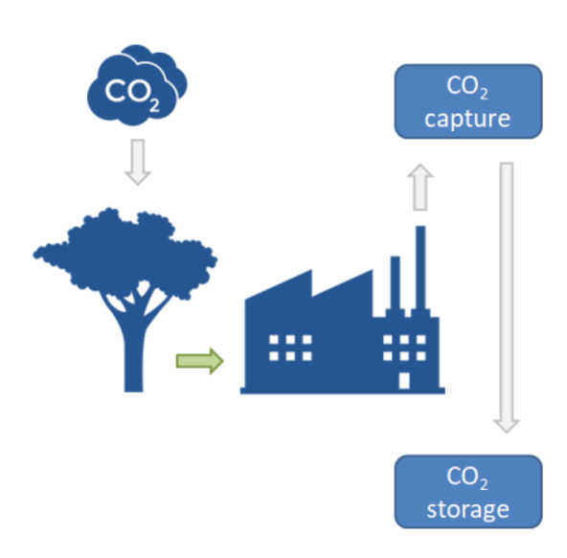
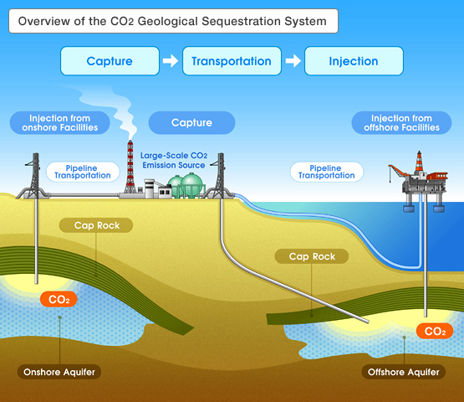
Background: Carbon Capture and Storage
Fossil Energy CCS Bio-Energy with CCS
Source: Japan Exploration Company, Ltd.,
Source: Smith et al., 2016

Slide 3
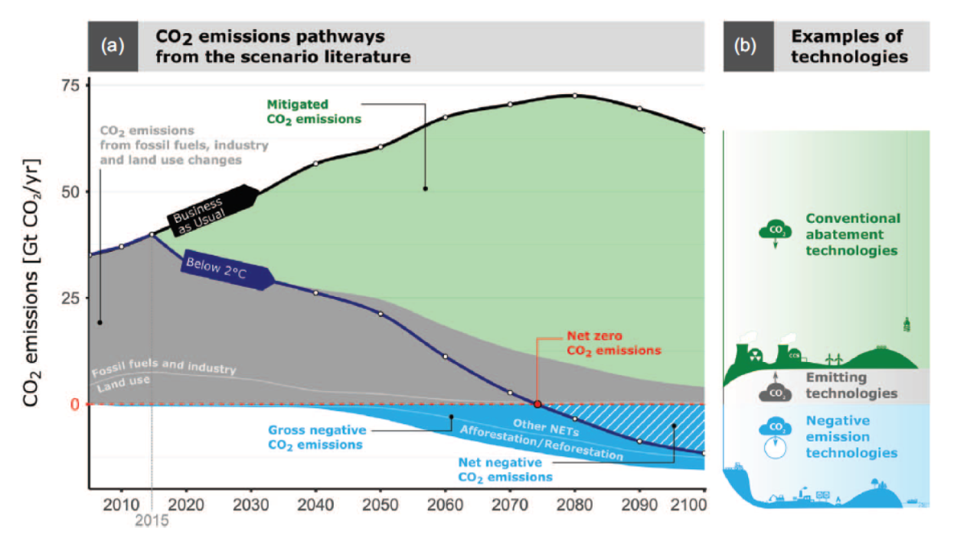
Background: Negative Emission Technologies
RCP2.6. scenario. Source: Nemet et al. (2018)
Challenge: scaling up global NET sequestration capacity from 1 MtCO₂/y in 2020 to 1 GtCO₂/y in 2050
i.e., achieving the installation of ≈200 MtCO₂/y of new capacity in 2050. (Nemet et al., 2018)

Slide 4
The overlooked economics of CO₂ Transportation
CO₂ transportation is often overlooked in climate scenarios (Butnar et al., 2020)
H. Herzog (2011) on CO₂ pipeline and CO₂ capture :
CCS value chain is comprised of heterogenous agents and complementary markets, but most models adopts an aggregated approach that doesn’t account for potential interdependencies. (Ricci, 2012; Tsiropoulos et al., 2017; Cox and Edwards, 2019…)

Slide 5
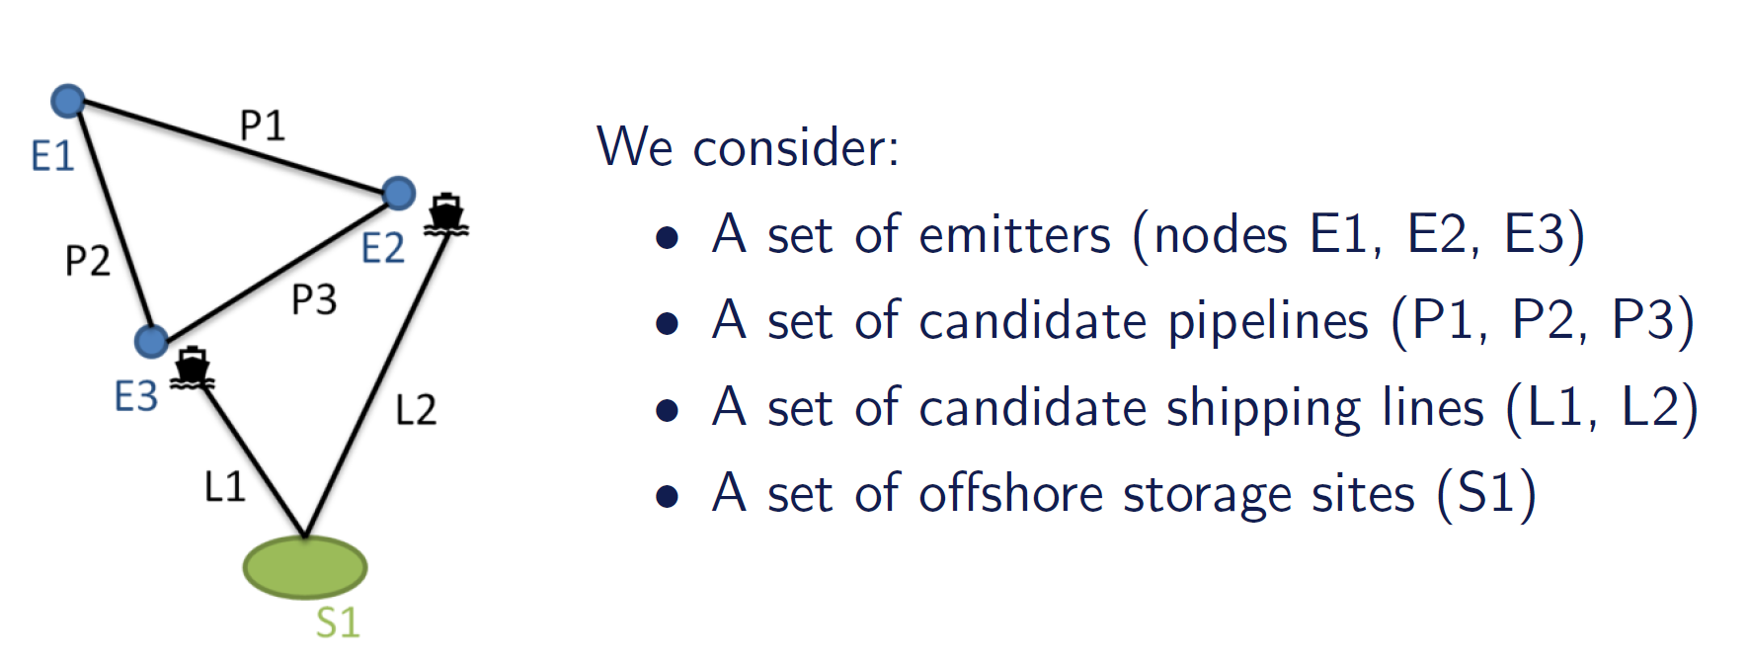
Accounting for a possibly complex logistics (with onshore and maritime components)
Under which conditions does this set of emitters adopt the technology and join a shared infrastructure ?
Secondary research question:
Should we grant a monopoly to a single operator controlling the whole CO₂ logistics?
How should we reward BECCS plants? (no incentives exist for negative emissions yet)

Slide 6
Assumptions on the infrastructure operator
Assumptions on the infrastructure operator
Subadditive cost function - monopolistic operation of CO₂ transporation (Berg and Tschirhart (1988))
The pipeline monopoly can set discriminatory prices. (Massol et al.(2015)) The shipping operator can only set discriminatory prices if it is vertically integrated with the pipeline operator
Carbon efficiency of a BECCS plant. Source: Fajardy and Mac Dowell (2017)

Slide 7
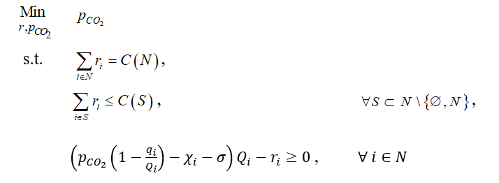
Methodology: a cooperative game-theoretic approach
The conditions for which emitters accept to join the infrastructure:
The infrastructure operator charges mutually acceptable prices: no subgroup of emitters faces a higher infrastructure cost than its stand-alone cost. (the core of the game is non-empty)
Individual non-negative benefit: the revenue from carbon price exceeds capture, transport and storage cost.
We get a break-even price $p_{CO_{2}}^{∗}$, the lowest CO₂ price for which both conditions hold.
(i)
(ii)

Slide 8
Benchmarking with a welfare maximizing approach
We then calculate the least costly infrastructure and the break-even CO₂ prices for each subset of the infrastructure (e.g. only E2 and E3)
We then consider a Social Cost of Carbon (SCC) that we let increase and find a sequence of optimal infrastructures
We benchmark these welfare maximizing infrastructures with the ones that would be feasible in the cooperative approach
NB : Welfare is here:
$$SCC \sum_{i}{A_{i}} −C_{infrastructure} −\sum_{i}{C_{capture_{i}}}$$
Where $A_{i}$ is the quantity of abated emissions at plant $i$

Slide 9
Extensions: vertical integration
Two scenarios on the infrastructure operators:
Case 1: Vertically integrated: the cost of shipping and of pipeline are aggregated and prices can be discriminatory.
Case 2: Separated operator: the cost of shipping is fixed beforehand. Either through:
Average costs
Two-part tariffs
Carbon efficiency of a BECCS plant. Source: Fajardy and Mac Dowell (2017)

Slide 10
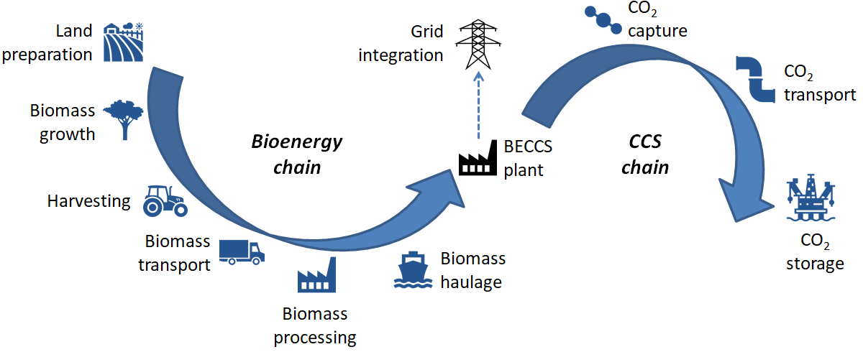
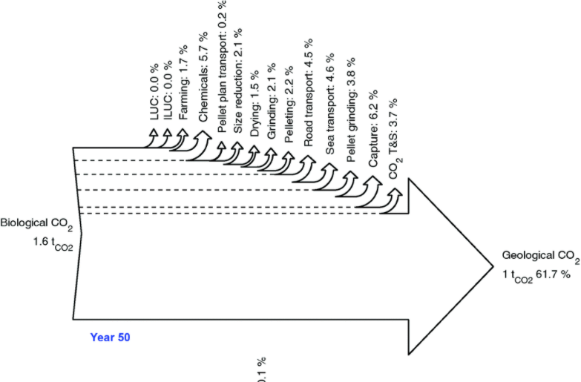
Extensions: negative emissions
Two scenarios on how to reward BECCS:
No economic incentives for negative emissions yet! Biogenic emissions are not taxed
Case 1: BECCS can auction « carbon credits » for their volume of abated emissions - The BECCS plants gets$p_{CO_{2}}∗1 tCO_{2}$
Case 2: BECCS can auction « carbon credits » for their volume of negative emissions
→ Negative emissions should take into account upstream CO₂ emissions. The BECCS plants gets $p_{CO_{2}}∗0.4 tCO_{2}$
Why Case 2?
To avoid perverse effects. Upstream emissions could be higher than stored emissions.
Carbon efficiency of a BECCS plant. Source: Fajardy and Mac Dowell (2017)

Slide 11
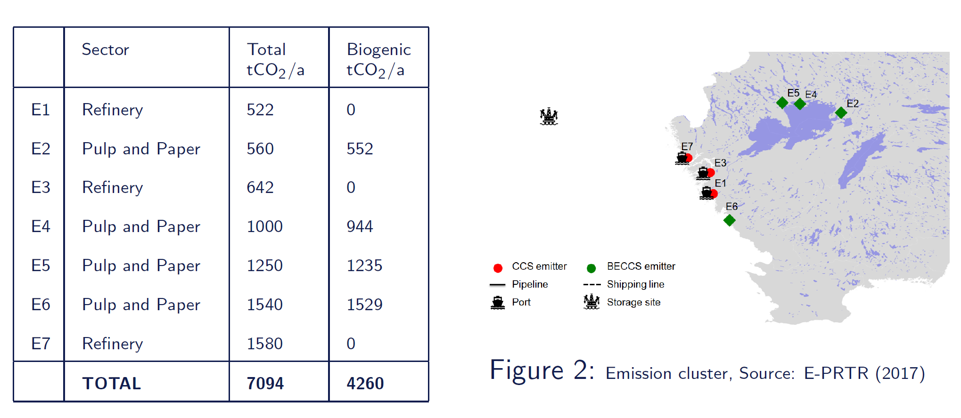
Application: a Swedish case inspired from the Northern Lights project
Based on techno-economic data from Johnsson et al. (2020) and Roussanaly et al. (2014)

Slide 12
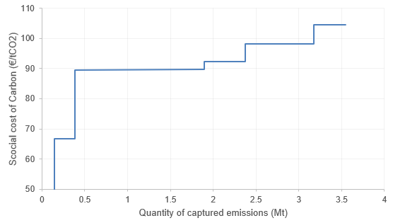
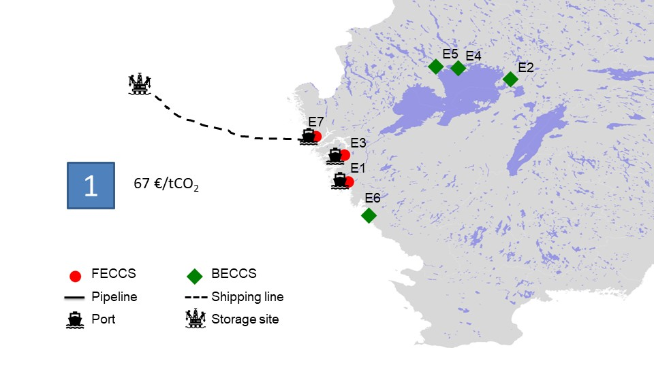
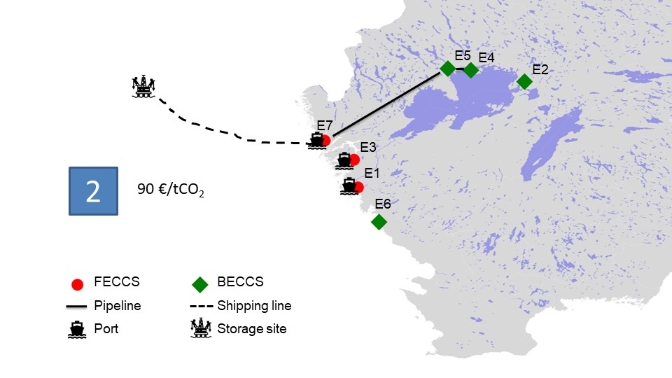
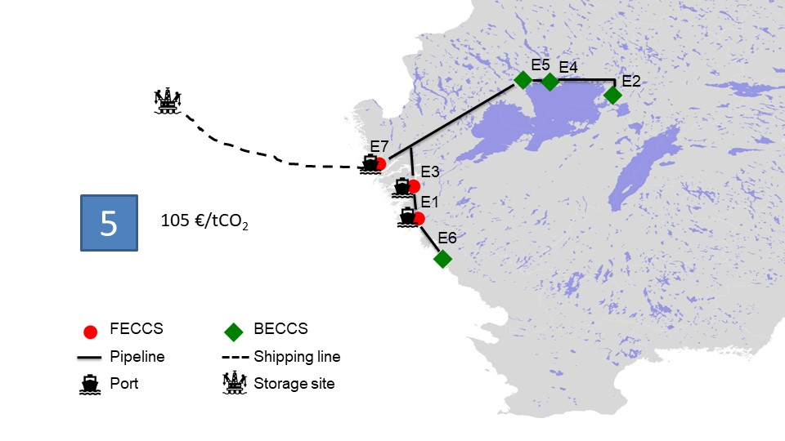
Welfare maximizing infrastructures
5
4
2
3
1
“First-best” coalitions under increasing SCC
Largest optimal infrastructure
Some remarks:
Positive welfare starting with 99 €/tCO₂ (coalition 4)
For low SCC (<90€/tCO₂), only a single coastal emitters adopts carbon capture
The main parameters that influence whether a plant is in the optimal infrastructure are: its marginal capture cost (hence, its size) and its incremental infrastructure cost (hence, its geographical location)

Slide 13
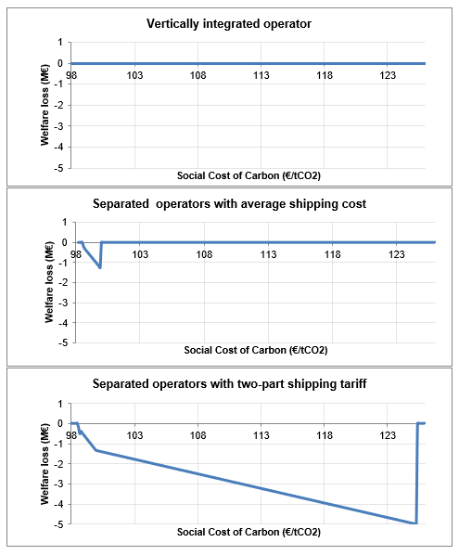
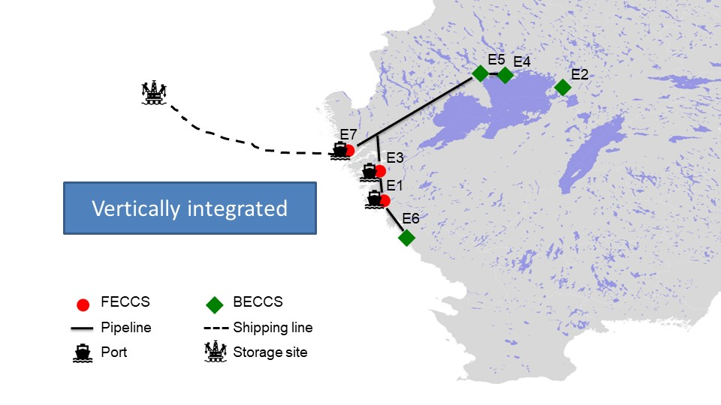
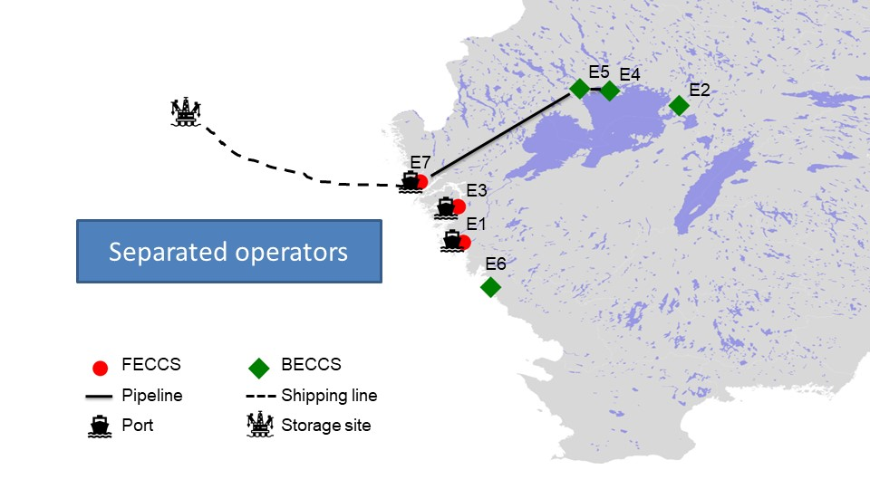
The impact of the cooperative perspective
For a CO₂ price of 99€/tCO₂:
Cooperative perspective:
The CO₂ price needed to build the infrastructure may be higher than the Social Cost of Carbon
Vertical integration with discriminatory prices is equivalent to first best
There is some welfare loss for the vertically separated cost with average cost shipping tariff (i.e. a smaller coalition is achieved than in the first best case), but it is better than a two-part tariff

Slide 14
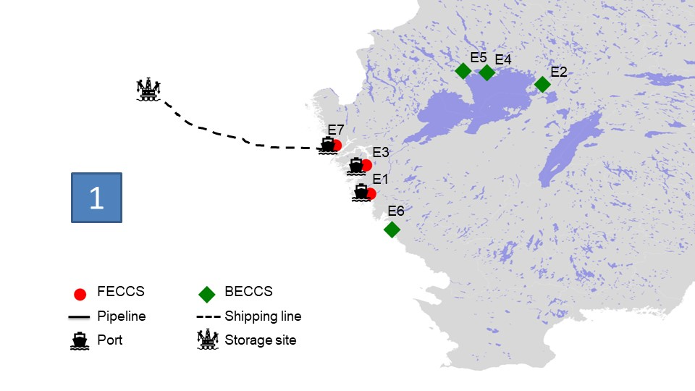
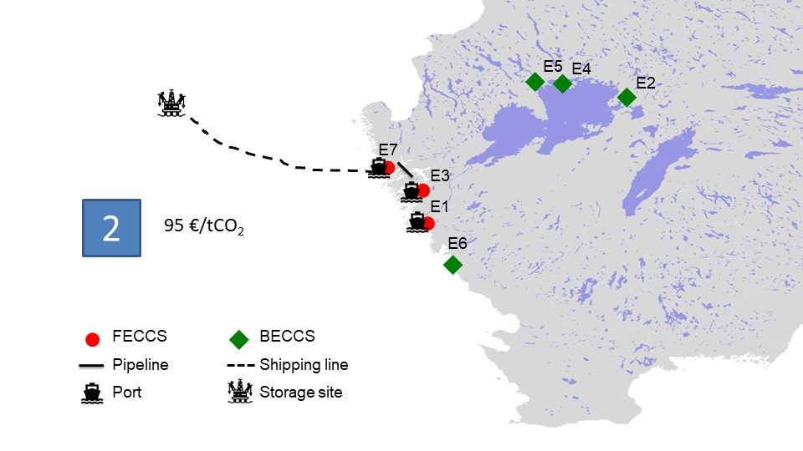
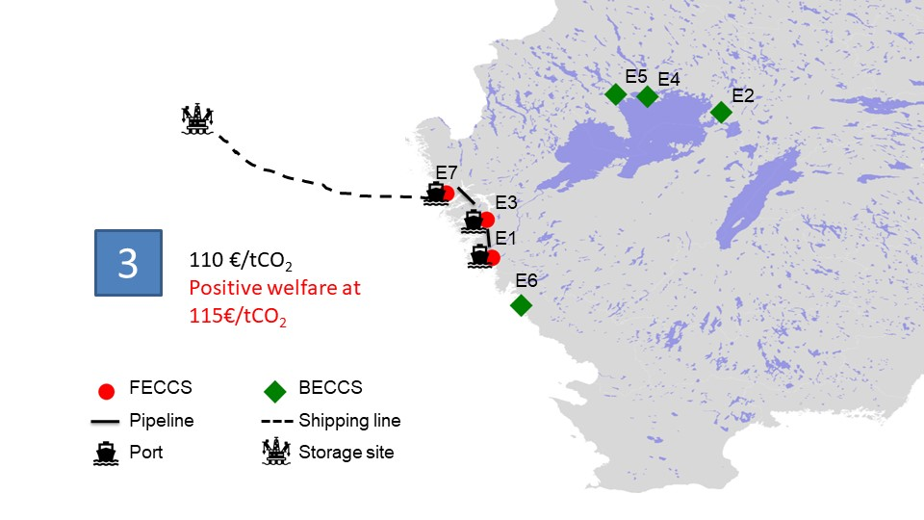
The impact of negative emissions accounting
6
4
5
2
3
1
Some remarks:
Positive welfare starting at 115€/tCO₂ instead of 99€/tCO₂
First BECCS plants join the infrastructure at 222€/tCO₂

Slide 15
Main results
The first infrastructure with positive welfare could be built at 99€/tCO₂. The Swedish carbon tax is at 110€/tCO₂, why is it still not built?
1. The nature of the operator under cooperative assumptions | The welfare maximizing infrastructure can be built if: - Vertically integrated operator - Discriminatory prices In the case of a separated operator that can not completely set discriminatory prices, the CO₂ value needed is higher
2. The absence of negative emissions accounting frameworks | There are still no incentives for carbon capture at bio-fuelled plants Without the BECCS plants, positive welfare is reached at 115€/tCO₂ Under an abated emissions framework, the first BECCS plants would join at 99€/tCO₂ Under a negative emissions framework, the first BECCS plants would join the infrastructure at 222€/tCO₂
Additionally, this study does not take into account some variables that could affect the plants decision to invest:
e.g., political risks, transaction costs, public acceptance…

Slide 16
Conclusions
The deployment of a CCS infrastructure seems to be feasible in a country like Sweden with high carbon taxes if BECCS plants can be subsidized or included in the carbon tax framework.
Without a framework to reward BECCS, there is a risk of lock-out of BECCS plants
A vertically integrated operator that can set discriminatory prices allows to reach the welfare maximizing infrastructure
But as it is most likely that a separated firms would operate pipelines and shipping lines, an average cost shipping pricing is preferred.
The question of how negative emissions should be accounted must be answered:
Is it realistic to account for upstream emissions?
How can we make sure that the biomass used for BECCS is low carbon and renewable ? Regulation on sustainable biomass certification could be a lead.

Slide 17
Thank you for your attention!

