Slide 1
Regional Impact of India’s Renewable Energy Mandates: An Application of E3-India Model
Authors: Kakali Mukhopadhyay, Professor, Gokhale Institute of Politics and Economics, Pune, India and Adjunct Professor and Senior Fellow, McGill University, Montreal, Canada
Vishnu S. Prabhu, PhD Scholar, Gokhale Institute of Politics and Economics, Pune, India

Slide 2
Overview of the presentation
Background
Objectives
Modelling Framework - E3-India model
Scenario Development
Results and Discussions
RE Roadmap 2030

Slide 3
Background
India is steadily transitioning towards accommodating higher share of Renewable Energy Sources in its electricity mix through adoption of carbon-neutral or decarbonization policies.
India is endowed with 5,000 trillion kwh of solar energy incident over India’s landmass and 302 GW of wind energy potential (NITI Aayog, 2015; MNRE, 2021).
Simultaneously, ensuring energy security to meet the power demand of 1.25 billion population still remains an overwhelming challenge.
India has witnessed multifold increase in per capita electricity consumption, from 15.6 kWh in 1950-51 to 1,206 kWh in 2019-20 with two-thirds of this power demand being supplied from fossil fuel sources.

Slide 4
Background
Ensuring 24x7 Power for all is one of the key national goals pursued by the government of India which is complemented with adoption of Renewable Energy Sources.
At the international level, India has committed its Nationally Determined Contribution (NDCs) in the Paris Climate Agreement of reducing emission intensity to GDP by 33-35% as well as undertaking responsibility of achieving the Sustainable Development Goal (SDG) 13 of taking action against climate change by 2030 (GOI, 2018).
The government of India in 2015 had set an ambitious target of achieving 175 GW installed electricity capacity through Renewable Energy Sources (RES) by 2022 along with 450 GW RE target by 2030 (NITI Aayog, 2015).
Solar constitutes the largest share with 100 GW, followed by 60 GW wind, 10 GW biomass and 5 GW small hydro (Government of India).

Slide 5
Background
The major obstacles to transitioning towards cleaner energy sources is the dominance of thermal power plants in India’s electricity mix and the slow pace of RE capacity installation.
Feb-2021
Sr. no. | Source | Target (in GW) | Installed capacity (in GW) | Balance to be achieved (in %)
1. | Solar | 100 | 39.1 | 60.9%
2. | Wind | 60 | 38.8 | 35.4%
3. | Biomass | 10 | 10.3 | target achieved
4. | Small hydro | 5 | 4.8 | 4.3%
5. | Total | 175 | 93.0 | 47.1%

Slide 6
Background
To this end, the government has adopted a decentralized approach in achieving the RE target where seven states on the western belt of the country constituting 58% of solar and wind allocations will be at the forefront in its effort at the regional level.
The seven states are also considered as ‘RE rich states’ by NITI Aayog.
All states are expected to achieve their respective capacity allocation targets by 2022.

Slide 7
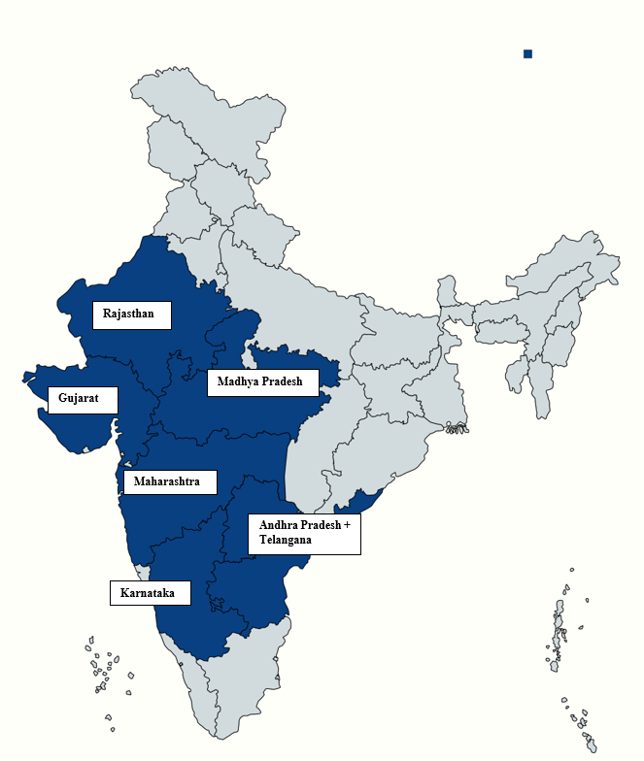
Background

Slide 8
Rationale
With 47% of RE capacity yet to be installed at the national level, it is highly unlikely that the 175 GW target will be achieved within one year, especially due to the periodic economic lockdowns arising from the COVID-19 pandemic.
Furthermore, the government intends to increase the indigenous manufacturing capacity of solar PV equipment and wind turbines.
To this end, the Ministry of New and Renewable Energy, Government of India incentivizes solar PV equipment manufacturing by providing 30% of the total project cost as subsidy and 40% accelerated depreciation for new wind turbines can be availed by domestic manufacturers (Jai, 2016; MNRE, 2019).

Slide 9
Objectives of the study
The study evaluates the effectiveness of government incentives for 100 GW solar and 60 GW wind capacity on India’s transition towards cleaner energy sources in the long run.
The year of achievement of the target is estimated at the national and regional level and the policy impact on macro-economic variables has been analyzed.
The study further addresses the impact on the environment by estimating CO2 emissions as a result of additional RE capacity in the long run.
The methodology adopted for this study is an integrated macro-econometric dynamic simulation model named as E3-India model.

Slide 10
Modelling Framework - E3-India model
E3-India model is designed to capture Economy, Energy and Environment (E3) inter-linkages at the national and state level (Cambridge Econometrics, 2020).
It provides information that policy makers need when assessing the merits of new or existing policy proposals.
The focus on policy-making at the state level is one of the biggest advantages of E3-India. This helps us to develop an understanding of what might happen in response to a new or existing policy, why it might happen and the scale of the effect across various states in the country.

Slide 11
E3-India key features
DETAILED COVERAGE
- 32 Indian states and union territories.
- 38 economic sectors.
- 21 users of 5 different energy carriers.
- CO₂ emissions by 21 users.
MULTI-DIMENSIONAL
- Whole energy, environment and economy system.
- Two ways feedbacks between each module.
- Many policy instruments.
MACRO-ECONOMETRIC FRAMEWORK
- Based on System of National Accounting
- Input-Output Tables
- Keynes-Leontief-Klein Framework.
FORECASTING TOOL
- Annual projections to 2035.
- Future Technology Transformation (FTT) model
- Ex-ante scenario analysis (ex-post is also feasible).
Source: Cambridge Econometrics, (2020)

Slide 12
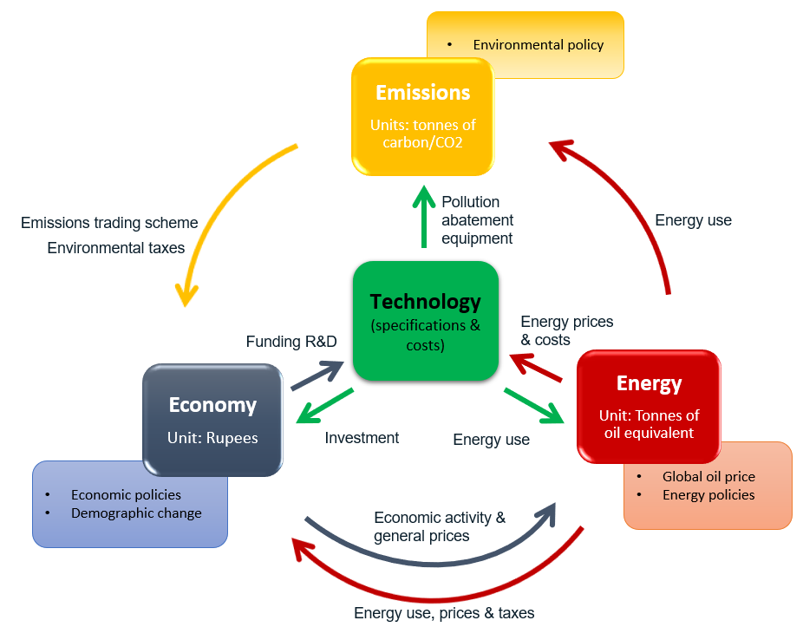
E3-India: Energy-Economy-Environment
Source: Cambridge Econometrics, (2020)

Slide 13
Scenario Development
We prepare two scenarios:
The Business-As-Usual (BAU) scenario for 100 GW solar and 60 GW wind capacity as forecasted by the E3-India model.
The RE scenario for 100 GW solar and 60 GW wind capacity constructed on the basis of the targeted govt. incentives of 30% solar subsidy and 40% Accelerated Depreciation (AD) for wind industry as announced by Ministry of New and Renewable Energy (MNRE), Government of India.

Slide 14
Results – Timeframe of completion (National-level)
The solar subsidy has no impact on the pace of capacity installation.
For the wind industry, AD assists in reaching the target by only one year compared to the BAU scenario.
Overall, the govt. incentives do not significantly impact the capacity installation target.

Slide 15
Results – Timeframe of completion (State-level)
Only three states achieve the target by 2022.
The Solar Subsidy and AD for wind energy does not translate into faster capacity addition to reduce the timeline of completion.

Slide 16
Results – Capacity Installation
Wind capacity installation witnesses higher growth compared to solar energy.
Madhya Pradesh (central landlocked state) and Andhra Pradesh (coastal state) which is predominantly a coal-bearing states witnesses the highest increase in wind capacity installation simultaneously with large decrease in coal capacity as well.
Karnataka (coastal state) which is considered to constitute one of the highest RE potential state in India also shows significant improvement in wind capacity installation.
This is one of the significant indicators of state-level contribution towards adopting cleaner energy sources.
The aforementioned states also observe multi-fold increase in onshore wind investment as well.

Slide 17
Results – Operational costs
The Levelized cost of electricity which is a measure of lifetime costs of electricity generation is observed to be dropping for wind power generation.
Cost-effectiveness of wind power generation is one of the factors contributing to higher investment in wind energy.

Slide 18
Results – Indirect Sectoral Impact
Capital goods sectors
Metal goods
Electrical equipment
Basic Metals
Banking and insurance services

Slide 19
Results – Environmental Impact
Madhya Pradesh and Karnataka are set apart from the rest of the states due to faster wind capacity installation with simultaneous decrease in coal capacity.
At the national level, the pace of capacity installation is low due to which the impact on CO2 emissions is insignificant.

Slide 20
Results
Overall, the results show that the wind industry is a better performer compared to solar industry due to its strong foundation of domestic manufacturing capacity.
As a result, the wind industry is able to reap the benefits of government policy of accelerated depreciation with faster manufacturing and installation of wind turbines.
In comparison, due to high costs of domestic solar module manufacturing, developers are dependent on cheap imports from China and Malaysia (Gupta, 2020) and as a result, the solar subsidy impact is insignificant.

Slide 21
Alternative scenario
In this context, looking at the results we propose an Alternative Scenario where the capacity targets are reversed.
Wind energy is allocated 100 GW capacity target and solar is allocated 60 GW along with the government incentives given in the RE scenario.
Similarly, the state-wise solar and wind capacity targets are reversed.

Slide 22
Alternative Scenario Results

Slide 23
Alternative scenario results
By switching the capacity targets, we find that the year of completion has also been reversed with wind energy achieving the target in 2029 and solar in 2025.
However, in the course of its completion the wind industry will contribute positively to the national and state-level economy as we have seen for economic indicators such as energy investment, sectoral output and LCOE.
On the other hand, the solar capacity target will be achieved largely through import of solar modules with minimal contribution to the national and state-level economy.

Slide 24
RE Roadmap 2030
India has set an ambitious target of 450 GW RE capacity to be achieved by 2030 for which the capacity allocation is given below (Aggarwal, 2021; Balachandar, 2021),
280 GW – Solar energy
140 GW – Wind energy
30 GW – Small Hydro and Biomass
Given our results, we propose the following strategies for India’s RE sector.
Solar subsidy should continue for the next 5-6 years to encourage capacity building in the solar PV industry.
States which have achieved the target by 2022 should continue with their high annual installation levels in order to balance the capacity installation that is lagging in other states.
Wind energy should be at the forefront of transitioning towards the RE sector due to its strong foundation in the Indian economy as proven from our results.

Slide 25
RE Roadmap 2030
To this end, higher allocation for wind energy along with the existing financial support will lead to efficient allocation of resources.
Moving beyond solar and wind, the government of India should also consider higher allocation for large hydro projects (greater than 25 MW) since it has also been categorised as a Renewable Energy source (GOI, 2019).
Such a strategy will ensure a balanced RE growth trajectory in India.
State-specific policy interventions are necessary since different states respond to government incentives according to their distinctive energy and economic endowments.
India’s international commitment to SDG goals and Paris climate Accord can be met if a decentralized approach is adopted where states play a more pro-active role in transition towards cleaner energy sources.

Slide 26
References
Aggarwal, M. (2021). [Charts] A long road to 2030 for India’s import-heavy solar power sector. Retrieved from Mongabay: https://india.mongabay.com/2021/05/graphs-a-long-road-to-2030-for-indias-import-heavy-solar-power-sector/?mc_cid=bc365a90be&mc_eid=4a562e0920
Balachandar, G. (2021). Govt may miss 2022 wind capacity target. Retrieved from The Hindu Business Line: https://www.thehindubusinessline.com/news/govt-may-miss-2022-wind-capacity-target/article34163489.ece#:~:text=The%20government%20has%20also%20shared,including%20140%20GW%20of%20wind
Cambridge Econometrics. (2020). E3-India manual 2020. Cambridge: Cambridge Econometrics. Retrieved from https://www.camecon.com/how/e3-india-model/
Gupta, N. (2020). India to Impose 40% Customs Duty on Imported Solar Modules. Retrieved from My Sun: https://www.itsmysun.com/india-impose-40-customs-duty-imported-solar-modules/
GOI. (2018). India's Intended Nationally Determined Contributions - Towards Climate Justice. New Delhi: Ministry of Environment, Forest and Climate Change, Government of India. Retrieved from http://moef.gov.in/wp-content/uploads/2018/04/revised-PPT-Press-Conference-INDC-v5.pdf
GOI. (2019). Standing Committee on Energy (2018-2019). New Delhi: Lok Sabha Secretariat, Government of India. Retrieved from http://164.100.47.193/lsscommittee/Energy/16_Energy_43.pdf

Slide 27
References
Jai, S. (2016). Budget 2016: Wind sector to take a hit as accelerated depreciation tax benefit capped at 40%. Retrieved from Business Standard: https://www.business-standard.com/budget/article/budget-2016-wind-sector-to-take-a-hit-as-accelerated-depreciation-tax-benefit-capped-at-40-116022900591_1.html
MNRE. (2019). Annual Report 2018-19. New Delhi: Ministry of New and Renewable Energy, Government of India. Retrieved from https://mnre.gov.in/img/documents/uploads/file_f-1608040317211.pdf
MNRE. (2021). Solar Energy. Retrieved from Ministry of New and Renewable Energy, Government of India: https://mnre.gov.in/solar/current-status/
NITI Aayog. (2015). Report of the Export Group on 175 GW by 2022. Retrieved from National Institution for Transforming India (NITI Aayog), Government of India: https://niti.gov.in/writereaddata/files/175-GW-Renewable-Energy.pdf

Slide 28
THANK YOU

