Slide 1

Assessment of Regional Energy Storage System Deployment for Energy Transition in Taiwan
Presentation: Yi-Ya Yang
Authors: Yi-Ya Yang1, Yun-Hsun Huang2, Jung Hua Wu2
1 Industrial Technology Research Institute(ITRI),Industry, Science and Technology
International Strategy Center.
2 National Cheng Kung University, Taiwan.
2021 June 08. The 1st IAEE Online Conference.

Slide 2
OUTLINE
01
Introduction
Energy Status in Taiwan, the Duck Curve, Research Purpose
02
Model Establishment
Linear Programming Model construct, Data Processing
03
Empirical Results
Model Simulation Validation and Main Findings
04
Results and Discussion
EES Deployment, Power Supply Curve, Suggestions
#Short-term power dispatch model
#Linear programming
#Energy storage deployment
#Energy Transition
Copyright ITRI 工業技術研究院 版權所有 Source: ITRI/ISTI Research Contact Author: yiyayang2030@gmail.com

Slide 3
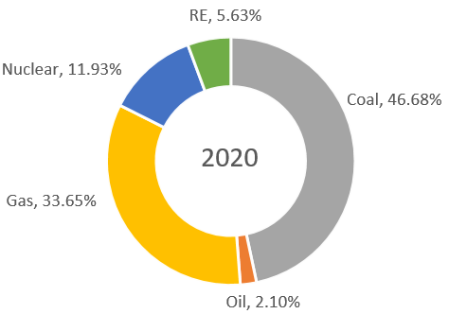
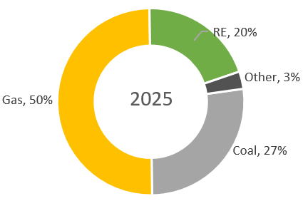
01
Introduction Main Power in Taiwan: Coal
Taiwan Electricity mainly relies on thermal power.
And imports 98% fuels for generation.
Energy Transition Target
Nuclear-free
20% RE
Fig.1 Power portfolio in 2020
Fig.2 Power portfolio target in 2025
Source: MOEA, Taiwan (https://www.moeaboe.gov.tw/wesnq/Views/B01/wFrmB0101.aspx)

Slide 4
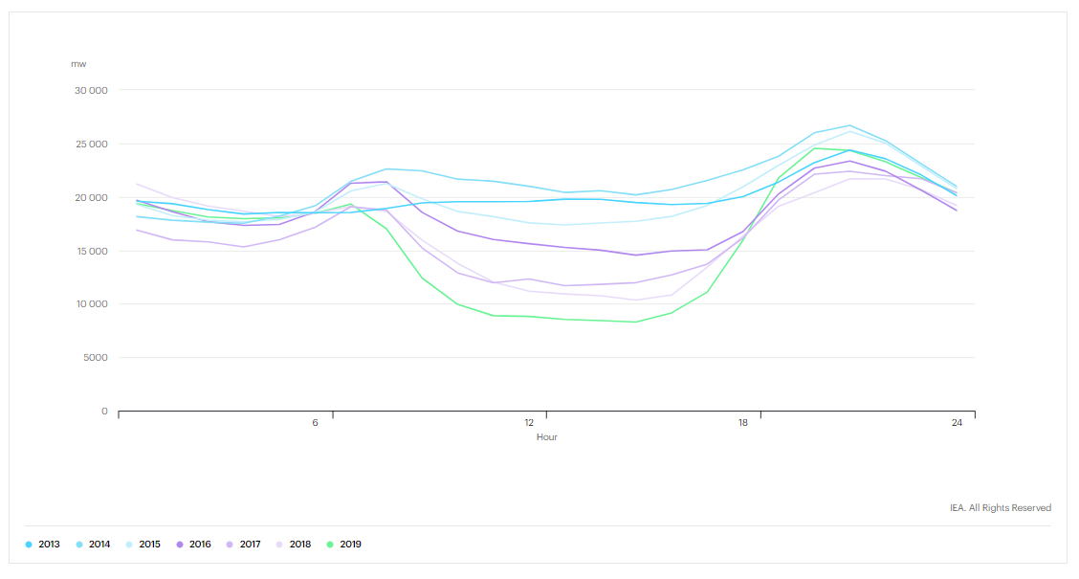
01
Introduction California Case: Duck Curve
The ratio of VRE(Variable Renewable Energy) higher,
the duck curve more obvious.
Fig.3 The California Duck Curve (IEA, 2019)
Source: IEA, The California Duck Curve, IEA, Paris https://www.iea.org/data-and-statistics/charts/the-california-duck-curve

Slide 5
01
Introduction Research Purpose and Limitations
Construct a short-term power dispatch model.
Simulate the actual operation of future ESS.
Future ESS deployment suggestions.
Main Purpose
Only power grid in Taiwan is considered.
Stability, operational problems and emergency events related to the system are excluded.
The costs of power transmission and distribution operations are excluded.
Limitations
Copyright ITRI 工業技術研究院 版權所有 Source: ITRI/ISTI Research Contact Author: yiyayang2030@gmail.com

Slide 6
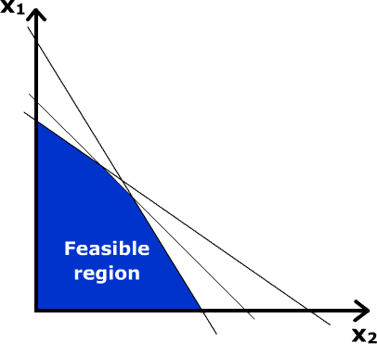
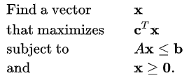
02
Model Establishment Linear Programming Model
Linear programming is a technique for the optimization of a linear objective function.
Can be expressed in canonical form as:
Fig.4 Linear programming example (wiki, 2021)
Source: Example image from https://zh.wikipedia.org/wiki/%E7%BA%BF%E6%80%A7%E8%A7%84%E5%88%92

Slide 7
02
Model Establishment Objective and Constrain Functions
Objective function: Economy of power (Costs Minimization)
Constraints:
  1. Satisfying electricity power demand
  2. Constraint: Policies
  3. The production constraints of the generator sets
  4. Energy storage settings
    (1) Mechanism of ESS
    (2) Energy conservation and efficiency
    5. Nonnegative and integer restrictions
Copyright ITRI 工業技術研究院 版權所有 Source: ITRI/ISTI Research Contact Author: yiyayang2030@gmail.com

Slide 8
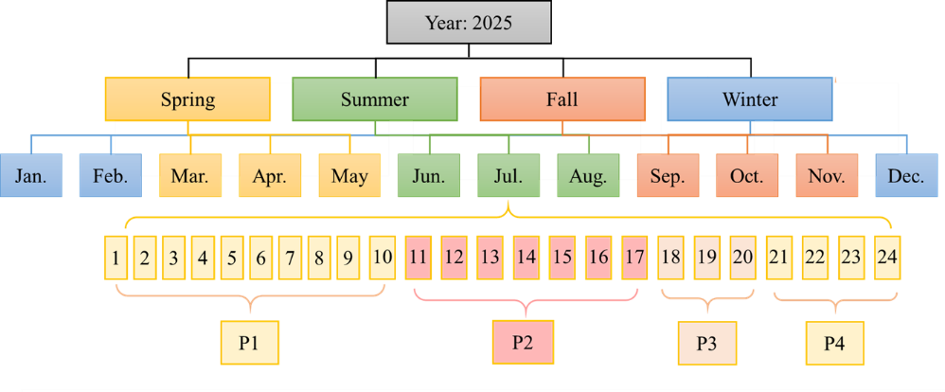
02
Model Establishment Time period setting
Fig.5 The time slice of the model.
Copyright ITRI 工業技術研究院 版權所有 Source: ITRI/ISTI Research Contact Author: yiyayang2030@gmail.com

Slide 9
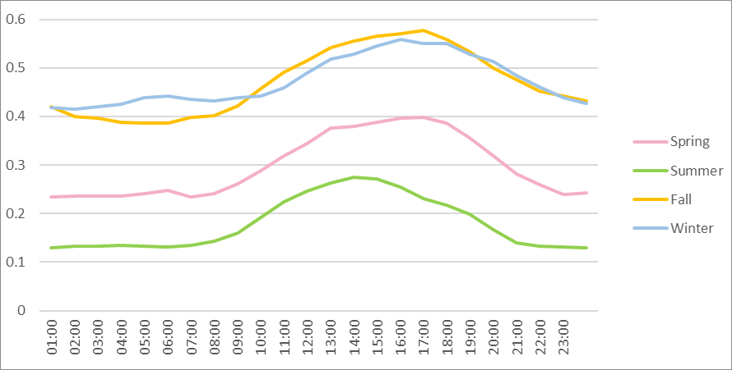
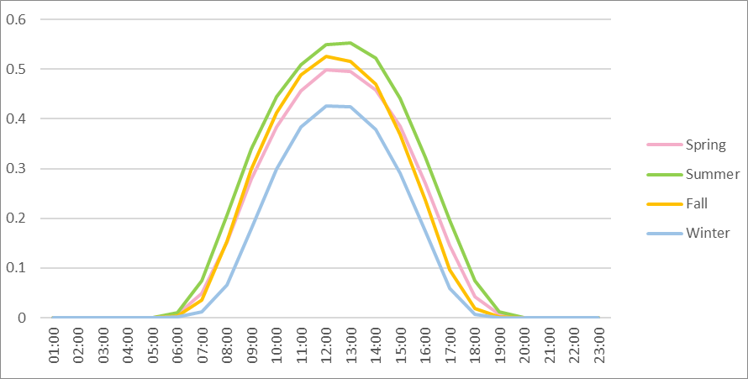
02
Model Establishment Availability Ratios and Costs
Traditional Power
  Taipower Co.
  Fuel price prediction
DRE
  Taipower Co.
VRE
  FIT rates
  JRC prediction
Fig.6 Capacity Factors of Offshore Wind in Different Seasons
Fig.7 Capacity Factors of Solar Power in Different Seasons
Copyright ITRI 工業技術研究院 版權所有 Source: ITRI/ISTI Research Contact Author: yiyayang2030@gmail.com

Slide 10
03
Empirical Results 2025 Power Supply
Fig.8 Power Supply Curve in a day of August (2025)
Copyright ITRI 工業技術研究院 版權所有 Source: ITRI/ISTI Research Contact Author: yiyayang2030@gmail.com

Slide 11
03
Empirical Results 2025 Power Supply
Fig.9 Proportion of power generation energy in a day of August (2025)
Copyright ITRI 工業技術研究院 版權所有 Source: ITRI/ISTI Research Contact Author: yiyayang2030@gmail.com

Slide 12
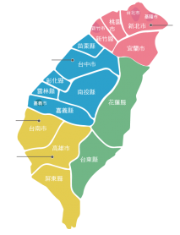
04
Results and Discussion ESS Deployment for PV
8 MW
The southern part of TW will need more ESS to cooperate with PV.
The mechanism design for contacting ESS and the grid will be critical.
The existing facility of PSH can facilitate over 800GWh.
34 MW
578 MW
Fig.11 ESS Deployment Suggestion in Taiwan
Copyright ITRI 工業技術研究院 版權所有 Source: ITRI/ISTI Research Contact Author: yiyayang2030@gmail.com

Slide 13
04
Results and Discussion The Duck Curve in Taiwan
The Duck curve shall appear when RE rise to 20%.
Due to peak-load-transfer, the power supply issue in evening become crucial.
Fig.12 Residual Load Curve in a day of August (2025)
Copyright ITRI 工業技術研究院 版權所有 Source: ITRI/ISTI Research Contact Author: yiyayang2030@gmail.com

Slide 14
Yi-Ya Yang yiyayang2030@gmail.com
IT IS, IRTI, Taiwan
Thank you!
謝謝 Merci Gracias
ありがとう
감사합니다

Slide 15
05
References (1/2)
Alexander Zerrahn, Wolf-Peter Schill and Claudia Kemfert (2018), On the economics of electrical storage for variable renewable energy sources, European Economic Review, Volume 108, Pages 259-279.
Bureau of Energy, MOEA (2019), The Electric Power Supply and Demand Report of Taiwan2018, Taiwan. Availible at: https://www.moeaboe.gov.tw/ECW/english/content/ContentLink2.aspx?menu_id=965&sub_menu_id=8674
Energy Bureau of the Ministry of Economic Affairs (2019), Introduction of Taiwan's Energy Policy, Taiwan. Avalible at: https://tpludemo.files.wordpress.com/2019/01/1080124_%E6%88%91%E5%9C%8B%E8%83%BD%E6%BA%90%E6%94%BF%E7%AD%96%E4%BB%8B%E7%B4%B9_%E7%B6%93%E6%BF%9F%E9%83%A8%E8%83%BD%E6%BA%90%E5%B1%80%E6%9D%8E%E5%89%AF%E5%B1%80%E9%95%B7%E5%90%9B.pdf
Energy Indicators of Taiwan, Bureau of Energy (2019), Ministry of Economic Affairs, R.O.C., Taiwan. Avalible at: https://www.moeaboe.gov.tw/ECW/english/content/ContentDesc.aspx?menu_id=1552
Energy Statistics Query System, Taiwan. Avalible at: https://www.moeaboe.gov.tw/wesnq/
Hans-Werner Sinn (2017), Buffering volatility: A study on the limits of Germany's energy revolution, European Economic Review, Volume 99, Pages 130-150.
Hsin Lee (2019), The Impact of Taiwan's Energy Transformation Policy on Power Supply Planning, National Cheng Kung University master's thesis, Taiwan.
IEA (2018), Status of Power System Transformation 2018, Paris: OECD.Avalible at:https://webstore.iea.org/status-of-power-system-transformation-2018
IEA (2018), World Energy Outlook, Paris: OECD. Avalible at: https://www.iea.org/reports/world-energy-outlook-2019
IRENA (2017), Electricity storage renewables: costs and markets to 2030, United Arab Emirates. Avalible at: https://www.irena.org/publications/2017/Oct/Electricity-storage-and-renewables-costs-and-markets

Slide 16
05
References (2/2)
IRENA (2018), Power system flexibility for the energy transition, United Arab Emirates. Avalible at: https://www.irena.org/publications/2018/Nov/Power-system-flexibility-for-the-energy-transition
Joint Research Centre (2018), Cost development of low carbon energy technologies, EU. Avalible at https://ec.europa.eu/jrc/en/publication/cost-development-low-carbon-energy-technologies-scenario-based-cost-trajectories-2050-2017-edition
Lazard (2018), Lazard's levelized cost of storage analysis-version 4.0, New York. Avalible at: https://www.lazard.com/
Li Ko, Chia-Yon Chen and Voon-Chean Seow (2014), Electrical power planning and scheduling in Taiwan based on the simulation results of multi-objective planning model, Electrical Power and Energy Systems, 55, 331-340.
Shiwei Xia, K.W. Chan, Xiao Luo, Siqi Bu and Zhaohao Ding, Bin Zhou (2018), Optimal sizing of energy storage system and its cost-benefit analysis for power grid planning with intermittent wind generation, Renewable Energy, Volume 122, Pages 472-486.
Yu-Hui Wang (2011), The CO2 Emission Reduction Benefit Assessment of the Supply-Side Policies for Taiwan Power Sector, National Cheng Kung University master's thesis, Taiwan.
Chen, J.-S., Chang, Y.-J., & Cho, C.-H. (2019). Evaluation of Electrical Energy Storage Requirements for Renewable Energy Policy in Taiwan. Journal of Taiwan Energy, 6, 313-334.
IEA, The California Duck Curve, IEA, Paris https://www.iea.org/data-and-statistics/charts/the-california-duck-curve

