Slide 1


国立研究開発法人
NATIONAL INSTITUTE FOR ENVIRONMENTAL STUDIES
国立環境研究所
Impact assessment of willingness to pay on the installed and transmission capacities of renewable energy resources in Japan
Lu GAO, Yuki HIRUTA and Shuichi ASHINA
Center for Social and Environmental Systems Research,
National Institute for Environmental Studies (NIES)
The 1st IAEE Online Conference
JUNE 7th-9th, 2021
ACKNOWLEDGMENT: This research was supported by Environment Research and Technology Development Fund (2-1711) of Environmental Restoration and Conservation Agency and Ministry of the Environment Japan.

Slide 2

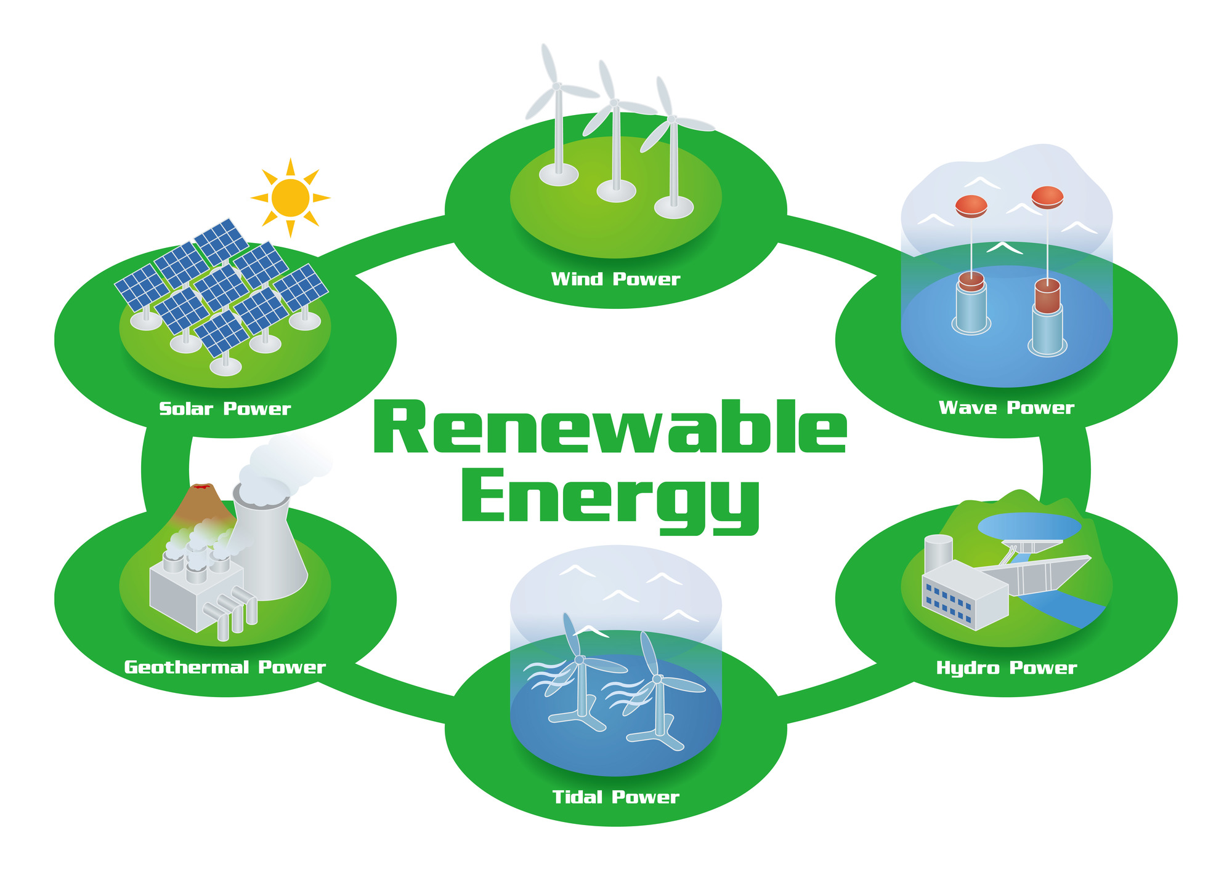


Background
Renewable energy
Energy Use Model
Wang (2014)
Fourth Strategic Energy Plan
22% to 24%
Geographic Information
(2030)
Shiraki (2014)
Weather Conditions
User Preference for RE
1

Slide 3

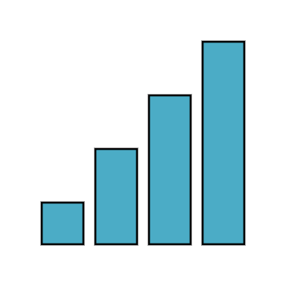



Background
Willingness to pay
Renewable energy
Goto (2010)
Fourth Strategic Energy Plan
22% to 24%
Japan, 6.5 USD/month
(2030)
Guo (2014)
China,2.7-3.3 USD/month
Lee (2016)
Korea,3.2 USD/month
2

Slide 4
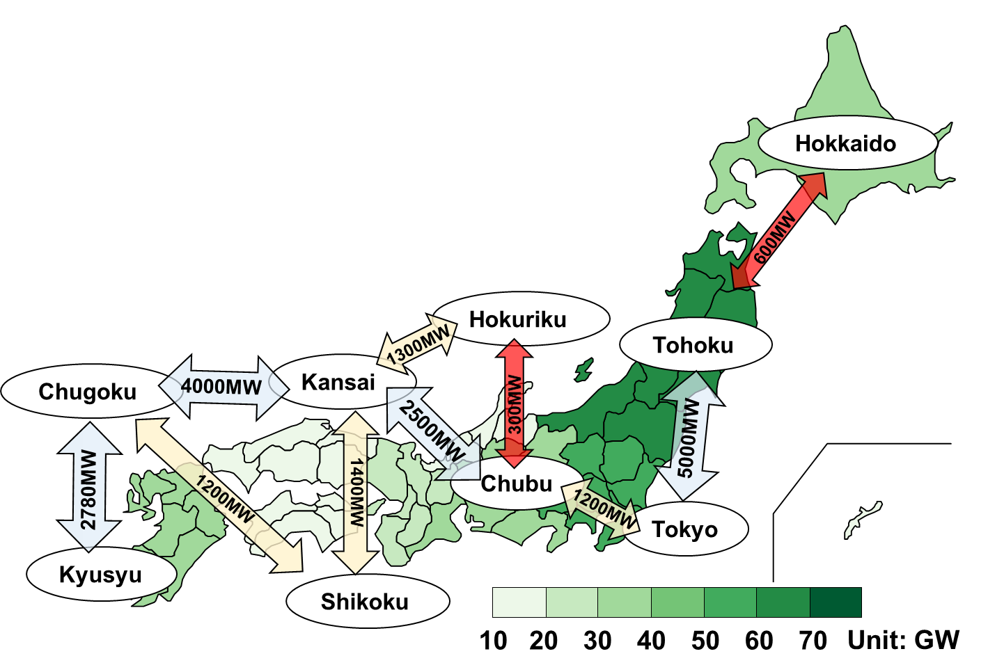
Background
Wakiyama and Kuriyama (2018)
Renewable energy potential
Transmission capacities
3

Slide 5
Objective
How well WTP impact on generation and transmission of electricity from renewable energy resources ?
Incorporating WTP into a multi-regional optimal generation planning model
Japan
10 Regions
Up to 2050
4

Slide 6
Framework
WTP model
Forecast Median Willing to pay
Build Acceptability Curve
Energy using model
Objective function: Min (Cost + Max (RE_{cost}))
Subject to :
Renewable energy potential
Economic condition
Natural condition

Slide 7

Framework
WTP model
Forecast Median Willing to pay
Build Acceptability Curve
Energy using model
Objective function: Min (Cost + Max (RE_{cost})
Subject to :
Renewable energy potential
Economic condition
Natural condition

Slide 8


Methodology _ WTP function
Data for Developed Statistic Models （17 observation）
Author | Survey Year | Survey Area | Median WTP JPY/(household·month) | Object analyzed
Nomura and Akai (2004) | 2000 | Japan | 1956 | WTP for promoting renewable
Baba and Tagashira (2002) | 2001 | Kagoshima | 239 | WTP for promoting green electricity
… | … | … | … | …
(1)
Using meta-regression analysis to forecast the WTP
WTP_{med}$=a+ β_{1}∗Gender+β_{2}∗Income+ε$
Percentage of female share within total population (%)
Gender:
Income:
Annual average household income (JPY)
5

Slide 9

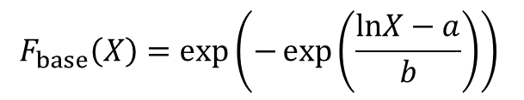


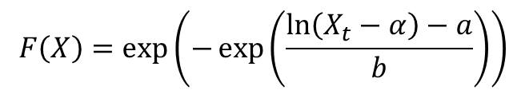
Methodology _ Acceptability curve
① Baseline (Weibull distribution)
Y: Acceptability
$$F_{base}\left(X\right)=\exp\left(−\exp\left(\frac{lnX−a}{b}\right)\right)$$
(2)
Y(%)
F(X)
F_{base}(X)
Where F_{base} (X) is the base acceptability function, X is WTP in JPY/(household·month). a and b are assumed to 6.505 and 1.065 respectively.
(X_{base},Y_{50%})
(X_{med},Y_{50%})
Y_{50%}
② Shift in acceptability curve
②
①
$$F\left(X\right)=\exp\left(−\exp\left(\frac{\ln\left(X_{t}−α\right)−a}{b}\right)\right)$$
(3)
$α=X_{t,50\%}−X_{base}$
X_{base}
X_{med}
X_{t}（WTP）
$$X_{base}=exp{(}a+bln\left(−\ln\left(Y_{50\%}\right)\right)$$
Fig 1. Shift in acceptability curve
$$X_{med}={WTP}_{med}$$
Where, F(X) is the acceptability function, Y_{50%} is acceptability rates in 50%, X is WTP in JPY/(household·month), t is the year
6

Slide 10

Methodology _ Prediction of total WTP
Acceptability curve
Y（WTP）
$$F\left(X\right)=\exp\left(−\exp\left(\frac{\ln\left(X_{t}−α\right)−a}{b}\right)\right)$$
(2)
①
WTP₁
②
③
WTP₂
WTP₃
Total WTP
X₁
X₂
X₃
X (Acceptability, %)
①
Y（TWTP）
TWTP₁=WTP₁×X₁×N
②
TWTP₂
③
TWTP₂=WTP₂×X₂×N
TWTP₃
②
③
TWTP₃=WTP₃×X₂×N
TWTP₁
①
N: The number of household
X₁
X₂
X₃
7
X (Acceptability, %)

Slide 11
Framework
WTP model
Forecast Median Willing to pay
Build Acceptability Curve
Energy using model
Objective function: Min (Cost + Max (RE_{cost})
Subject to :
Renewable energy potential
Economic condition
Natural condition

Slide 12







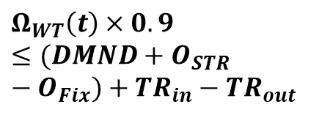




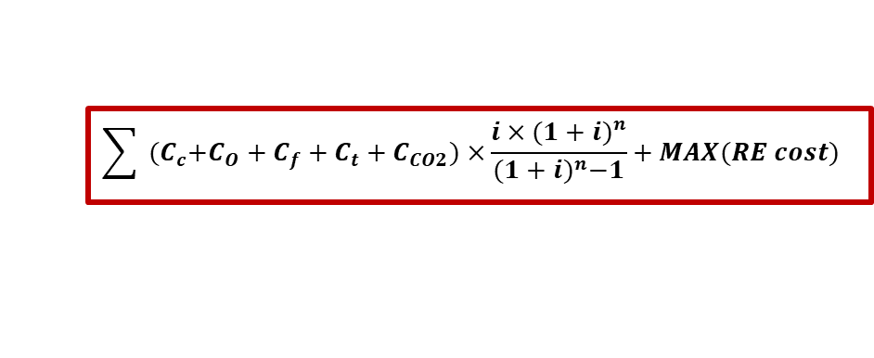

Methodology-Energy use (Model Structure)
Total cost Minimization
$$\sum{{ (C}_{c}+C_{O}+C_{f}+C_{t}+C_{CO2})×}\frac{i×{(1+i)}^{n}}{{(1+i)}^{n}−1}+MAX(RE cost)$$
C_{c}: capital cost, C_{o}: O&M cost, C_{f}: fuel cost, C_{t}: transport cost, C_{CO2} : carbon cost, RE cost: cost for RE
$$Subject to$$
(Ashina et al., 2007)
$$O\left(t\right)=Efficiency×Ω\left(t\right)$$
Nuclear
Hydro
Gas
Oil
Coal
…
Demand
$$=$$
Supply O(t)
Exogenous
$$Λ\left(t\right)≥Ω(t)$$
Cost
$$Υ\left(t\right)$$
Potential
$Λ\left(t\right)$
Capacity
$$Ω\left(t\right)$$
$$Υ\left(t\right)=C_{c}×Ω(t)$$
$$Λ\left(t\right)=F(X)×Λ_{Pot}\left(t\right)$$
$$Ω_{WT}\left(t\right)×0.9≤(DMND+O_{STR}−O_{Fix})+{TR}_{in}−{TR}_{out}$$
$$Υ\left(t\right)+TL(t)<TWTP$$
$$TWTP=F(X)×X_{t}×HH$$
Economic condition
Natural condition
TWTP: Total WTP; X:WTP
F(X):Acceptability function
HH: number of household
TL: transmission lines
DMND: Electricity demand
O: Electricity generation
STR: PH & SB FIX: Nuclear & hydro
TR: Energy transmission
F(X): Acceptability function
ANRE: Agency for Natural Resources and Energy
$Ω_{Pot}$: RE potential, estimated by Shiraki et al., 2011
6
8

Slide 13
Scenario Setting
Ref: Estimation the feasible energy mix without consideration the impact of WTP.
Scenario 1 : Estimation the feasible energy mix with consideration the impact of WTP. WTP is only used for increasing the capacity of renewable energy
Scenario 2 : Estimation the feasible energy mix with consideration the impact of WTP. WTP is only used for increasing the capacity of transmission line
Scenario 3 : Estimation the feasible energy mix with consideration the impact of WTP. WTP is used for increasing both capacity of renewable energy and transmission line (50% WTP for each item).
9

Slide 14
Result _ Prediction of total WTP
(a)
Hokkaido _SSP1
(b)
TWTP in 2015
For example, in Hokkaido, TWTP curve first increase and then decrease
TWTP [ Million JPY / year]
Acceptability rate (%)
(c)
Ref (TWTP=0)
(d)
S1,S2, S3 (TWTP in 2050 )
The TWTP is increased from 491 to 1,388 billion JPY
Unit: Billion JPY/Year
250
60
40
20
10
5
Fig 4. Prediction of WTP from 2015-2050, (a) under SSP2 in Hokkaido by different acceptability rate, (b)-(d) the value of TWTP for different prefectures in the year 2015 and 2050.
9

Slide 15
Result _ Influence of WTP on diffusion of RE in 2050
In S1, the RE capacity is expected to be 15-fold than Ref
In S3, RE capacity is more than half of S1
R3 is higher than other area, which is contributed by the higher income
10
Fig 3. Electricity generation by renewable energy power plants under scenario Ref, 1, 2 and 3 in 2030

Slide 16
Result _ Power transmission capacity in 2050
In S2 and S3, increase of RE transmission capacity, is expected to be 3-24-fold than Ref
Specific from Chugoku to Kansai, suggesting the great potential of increasing renewable transmission capacity in these lines
11

Slide 17
Result _ Carbon emission in 2050
Reduced carbon emission:
S3 ＞ S1 ＞S2
By only RE and transmission, the carbon reduction target is still difficult to achieve in 2050.
12
Fig 5. Carbon emission under scenario 1 , 2 and 3 in 2050

Slide 18
Conclusion
In present work, WTP functions were typically built yet incorporated into energy model for estimation of WTP impacts on energy use and evaluation of optimal energy use pathways.
Total WTP increase from 491 to 1388 billion JPY
The electricity generation from RE and transmission line with considering the WTP is expected to be 15-fold and 24-fold than the Ref scenario, respectively
Both consider the RE and transmission line can future increase the carbon emission reduction

Slide 19

国立研究開発法人
NATIONAL INSTITUTE FOR ENVIRONMENTAL STUDIES
国立環境研究所
Thanks for your attention !
Lu GAO, Yuki HIRUTA and Shuichi ASHINA
ACKNOWLEDGMENT: This research was supported by Environment Research and Technology Development Fund (2-1711) of Environmental Restoration and Conservation Agency and Ministry of the Environment Japan.

