Slide 1
Retail Choice and Consumer Behavior
Derya Eryilmaz, CRA International
Margarita Patria, CRA International

Slide 2
Motivation for this study
In most electricity market structures electricity is delivered to consumers by their local utility. Retail choice option is added in some jurisdictions (for example, in Pennsylvania USA) to increase competition: retail choice option enables energy customers to choose their retail supplier over the local incumbent utility.
Option to switch to another provider creates “load uncertainty” for the utilities and for the retail suppliers. This load uncertainty results in risk premiums that are often passed to the consumers. There is a need for better understanding of the switching behavior.
First research question: How do we explain switching behavior?
It was envisioned that retail choice would benefit consumers. There are multiple studies that look at retail choice impact on prices. We are looking at another benefit of retail choice increased price elasticity.
Second research question: did introduction of retail choice option have an impact on consumer behavior?

Slide 3
Data
Our dataset includes Residential, Commercial and Industrial aggregate load for two Pennsylvania utilities:
Metropolitan Edison Company (“Meted”) [ focus of this presentation ]
Pennsylvania Electric Company (“Penelec”)
from 2008 until the first half of 2019 ( We are updating this study to include more data).
The load is aggregated into two groups
“Served by utility” (non-shopping) and
“Served by a retail choice provider” (shopping)
The load data is hourly
We also have customer counts on the utility's territories. The number of shopping and non-shopping customers by customer class, updated quarterly.

Slide 4
Customer Class
In Meted and Penelec territories, as in most of the US, energy load is divided into three customer classes:
Residential
Commercial
Industrial
The customer class for each consumer or business entity is determined largely by the size of their load. The rates offered to Residential and Commercial class customers by the utilities and retail choice providers are mostly Fixed Cost (FC) rates, and Industrial customers are offered Hourly Pricing (HP) Service.

Slide 5
Regulatory Environment
Retail choice for electricity became available in Pennsylvania after passage of the Electricity Generation Customer Choice and Competition Act of 1996. However, more than a decade elapsed before customers widely switched to a retail provider.
In December of 2008, the Pennsylvania Public Utility Commission (“PA PUC” or “Commission”) approved a final rulemaking order which “adopted reporting requirements regarding electric generation market activity to prevent anticompetitive or discriminatory conduct and the unlawful exercise of market power.” Since then, all retail choice suppliers are required to file an annual activity sales report with the PA PUC.
The first annual “Retail Electricity Choice Activity Report” was issued by the Commission in 2010. 2010 marks a boom in switching activity from utilities to retail choice providers in all customer classes.
However, some customers have since switched back to the local utility from their retail provider. For example, extreme cold weather in January of 2014 led to a spike in energy prices and triggered a noticeable switch back to traditional utilities in multiple states, and switching has been seen in Pennsylvania as well.

Slide 6
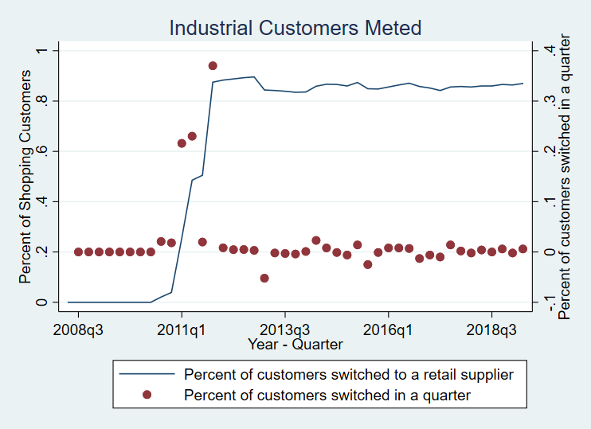
Switching pattern

Slide 7
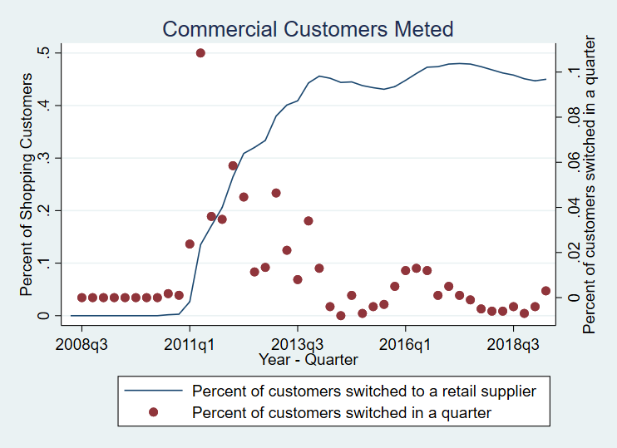
Switching pattern

Slide 8
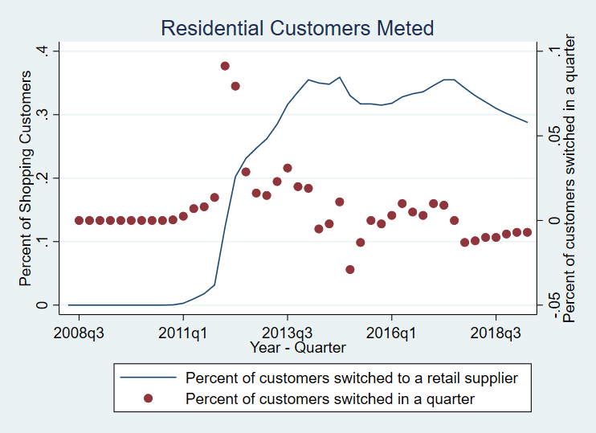
Switching pattern

Slide 9
Customer size
Include table here

Slide 10
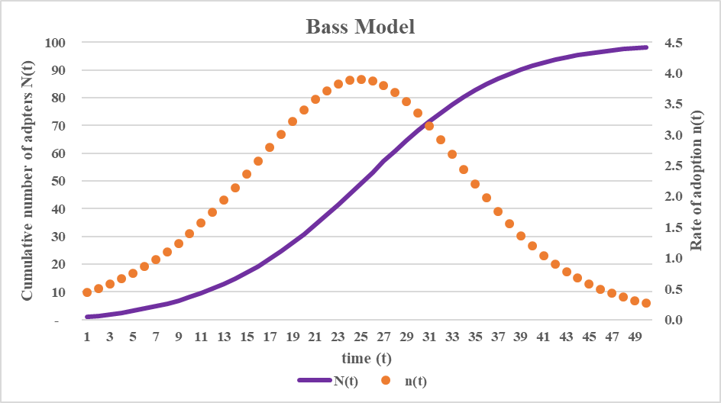
Classic Bass Model
Classic Bass (1969) diffusion model is expressed as the following:
$n\left(t\right)=\frac{dN(t)}{dt}= l[M−N\left(t\right)]+q\frac{N(t)}{M}[M−N\left(t\right)]$
Where
n(t) : the rate of adopters at time t
N(t) : the cumulative number of adopters
M : ultimate number of adopters
$l$ : adoptive influence that is independent of prior adoptions (innovator rate)
q : adoptive influence that depends on imitation
( imitator rate)

Slide 11
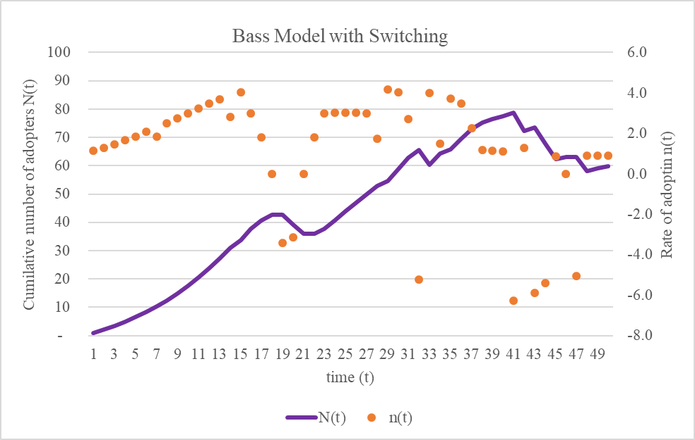
Bass Model with Switching
Allow for consumers that adopted “new technology” (switched to retail provider) an option to switch back
$n\left(t\right)=\frac{dN(t)}{dt}=$
= $l\left(prices\right)\left[M−N\left(t\right)\right]+$
$+q\left(prices\right)\frac{N\left(t\right)}{M}\left[M−N\left(t\right)\right]++k\left(prices\right)N(t)$

Slide 12
Can this be estimated?

Slide 13
Did consumer behavior change?
The demand equation has the following functional form:
${lnD}_{i,t}=$ $β_{0}+{β_{1}lnD}_{i,t−1}+ β_{2}lnP_{i,t}^{e}+β_{3}lnP_{i,t}^{e}∗Post_{i,t}+β_{4}lnW_{i,t}+θ_{i,t}+ε_{j,i,t}$
 | Industrial Penelec | Industrial Meted
Electricity Price ($β_{2}$) | -0.0031** (3.06) | -0.002*** (3.90)
Price * Post Retail Reform ($β_{3}$) | -0.0001 (1.09) | -0.003*** (19.10)
$β_{2}+β_{3}$ | -0.0032** (2.99) | -.0054*** (7.92)

