Slide 1
The Role of Regional Collaborations within China’s Urban Agglomerations in Haze Pollution Abatement
A Spatial-Temporal Decomposition of Central and Peripheral cities
IAEE International Online Conference
Presenter: Liao Xiaojie
Role: Mphil Student
Institution: Huazhong University of Science and Technology, School of Economics
Coauthor: Wang Banban (HUST)
Email address: liaoxiaojie@hust.edu.cn

Slide 2
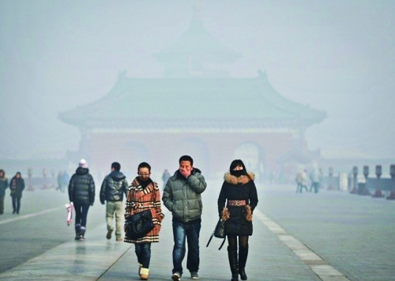
Backgrounds
The Air Pollution Prevention and Control Action Plan (APPCAP) was issued in September 2013;
During 2013—2018，the PM_{2.5} concentration dropped by 39% (nationwide), 57% (in Beijing)

Slide 3
Backgrounds
Haze pollution is connected closely to urbanization process.
Spatial spillover effects will cause Regional Haze pollution.
11th Five-Year Plan (2006-2010)
take Urban Agglomerations as the Primary Form of Urbanization Porcess
PM_{2.5}
City A
City B
Population
Economic
Land
Spillover effects
Regional Haze pollution
Urbanization Process

Slide 4
Regional Collaboration
Regional Cooperation Mechanism
overall regional reduction target & unified standard and supervision
provide economic assistances
share environmental information
Within Urban Agglomerations
Central cities: regional transmission accounts for 20%-40% of haze pollution (Clean Air Asia, 2018)
Need joint efforts of central and peripheral cities

Slide 5
Questions
Does APPCAP alleviate the haze pollution coming along with urbanization, and promote the effect of haze pollution abatement action?
Are there any differences in policy effects between central and peripheral cities?
Does the regional cooperation mechanism coordinate the haze pollution abatement within urban agglomerations?

Slide 6
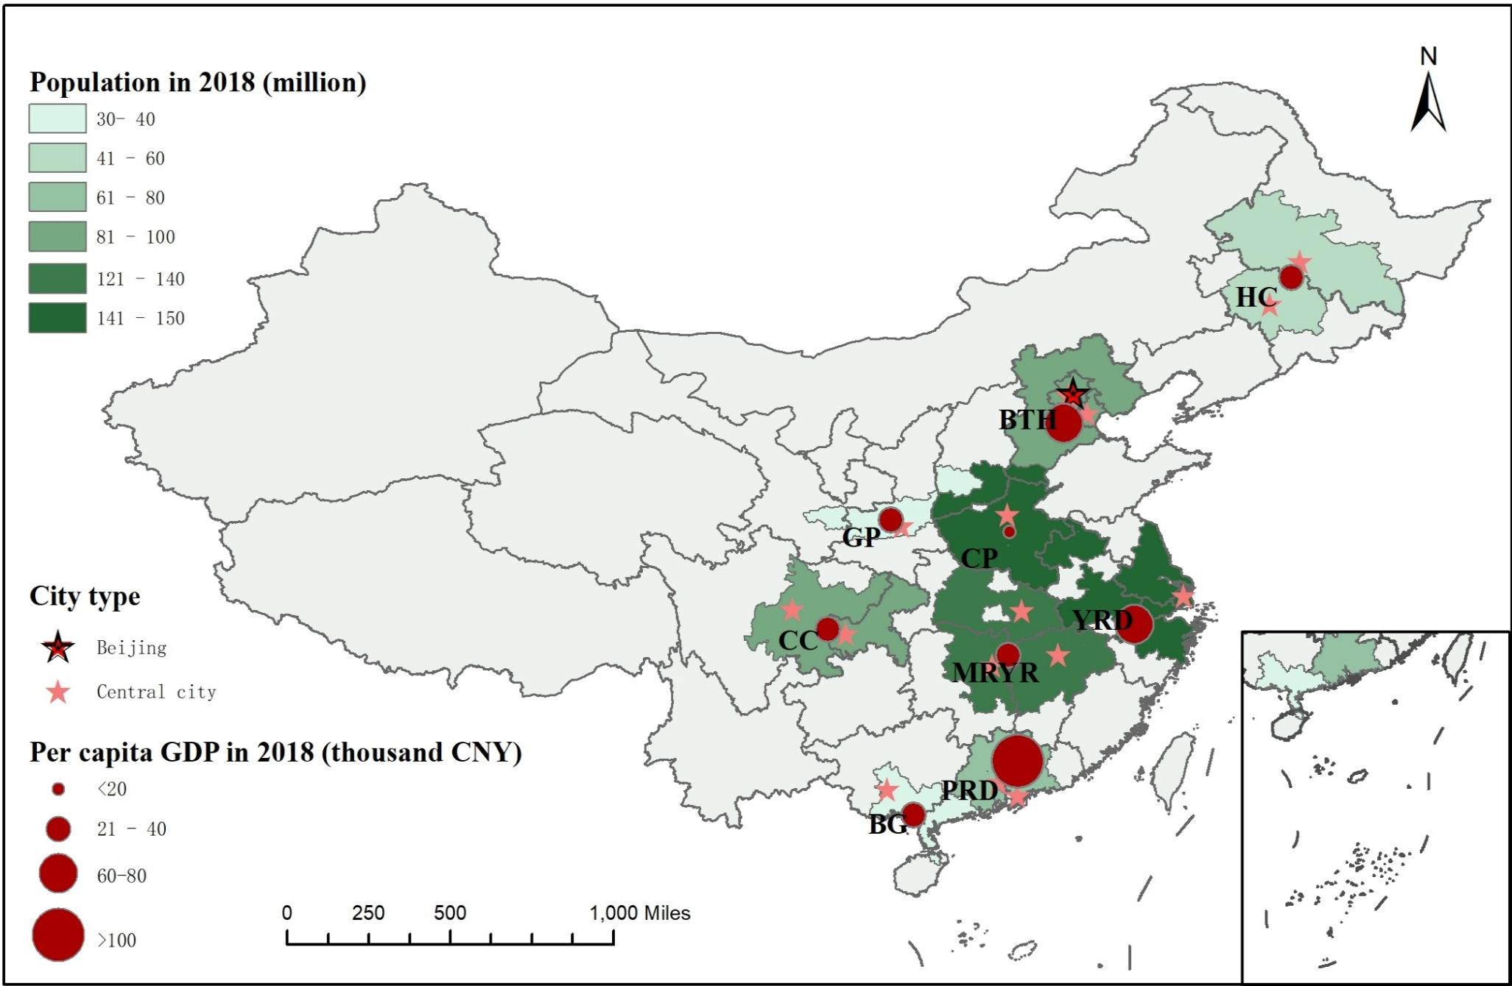
The Locations and Social Economic Situations of UAs
UA | Urban agglomerations
YRD | Yangtze River Delta
BTH | Beijing-Tianjin-Hebei
PRD | Pearl River Delta
MRYR | Middle Reaches of the Yangtze River
CC | Chengdu-Chongqing
CP | Central Plains
GP | Guanzhong Plain
BG | Beibu Gulf
HC | Harbin-Changchun
National
Regional

Slide 7
The Trends of Haze Exposure
Names of Urban Agglomerations: :
YRD: Yangtze River Delta
BTH: Beijing-Tianjin-Hebei
PRD: Pearl River Delta
MRYR: Middle Reaches of the Yangtze River
CC: Chengdu-Chongqing
CP: Central Plains
BP: Guanzhong Plain
BG: Beibu Gulf
HC: Harbin-Changchun
Changes of PM_{2.5} concentration
Period | UAs | Central | Peripheral
2005 - 2013 | + 17% | + 26% | + 11%
2013 - 2018 | - 35% | - 34% | - 35%

Slide 8
Method and Data
Sample: the top nine urban agglomerations in China, including 15 central and 137 peripheral cities, ranging from 2005 to 2018.
Method: Spatial-temporal LMDI (Ang et al., 2016)
$$\overline{P}=\sum_{i=1}^{N}{{\overline{P}}_{i}}=\sum_{i=1}^{N}{\frac{L_{i}}{L}P_{i}}=\sum_{i=1}^{N}{\frac{L_{i}}{L}∙\frac{L_{i}}{A_{i}}⋅\frac{Y_{i}}{L_{i}}⋅A_{i}∙\frac{P_{i}}{Y_{i}}}=\sum_{i=1}^{N}{{PA}_{i}∙{PD}_{i}∙{PY}_{i}⋅{CE}_{i}⋅{EI}_{i}}$$
Population urbanization (PA & PD, population agglomeration & population density)
Economic urbanization (PY, per capita GDP)
Land urbanization (CE, city expansion)
City pollution control (EI, emission intensity)
Analysis Dimensions：before and after the policy, inter and within urban agglomerations.
Data source: PM2.5 concentration: Dalhousie University Atmospheric Composition Analysis Group; City-level social and economic data: China city statistical yearbooks.

Slide 9
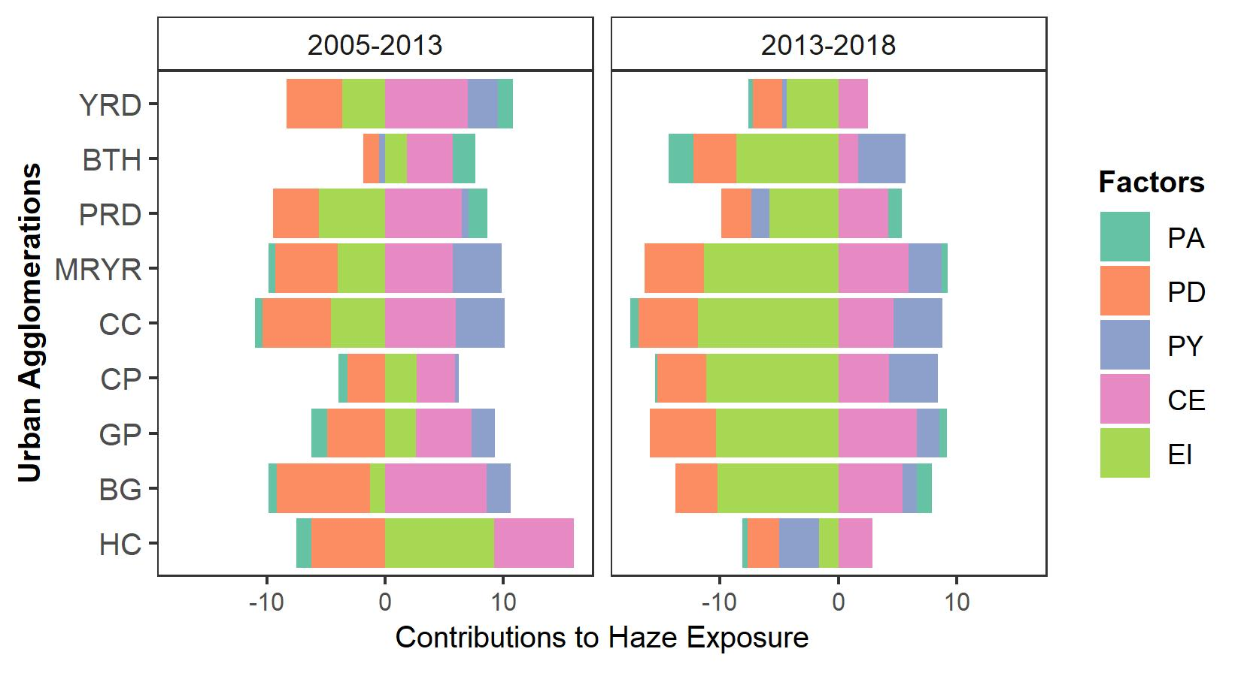
Decomposed Results: UAs
After APPCAP:
Emission Intensity became the leading negative contributor.
The contributions of PA became negative in YRD and BTH but positive in some other UAs.
The total contributions of PY and CE decreased in YRD, PRD and BG.
The Contributions of Factors to Haze Exposure

Slide 10
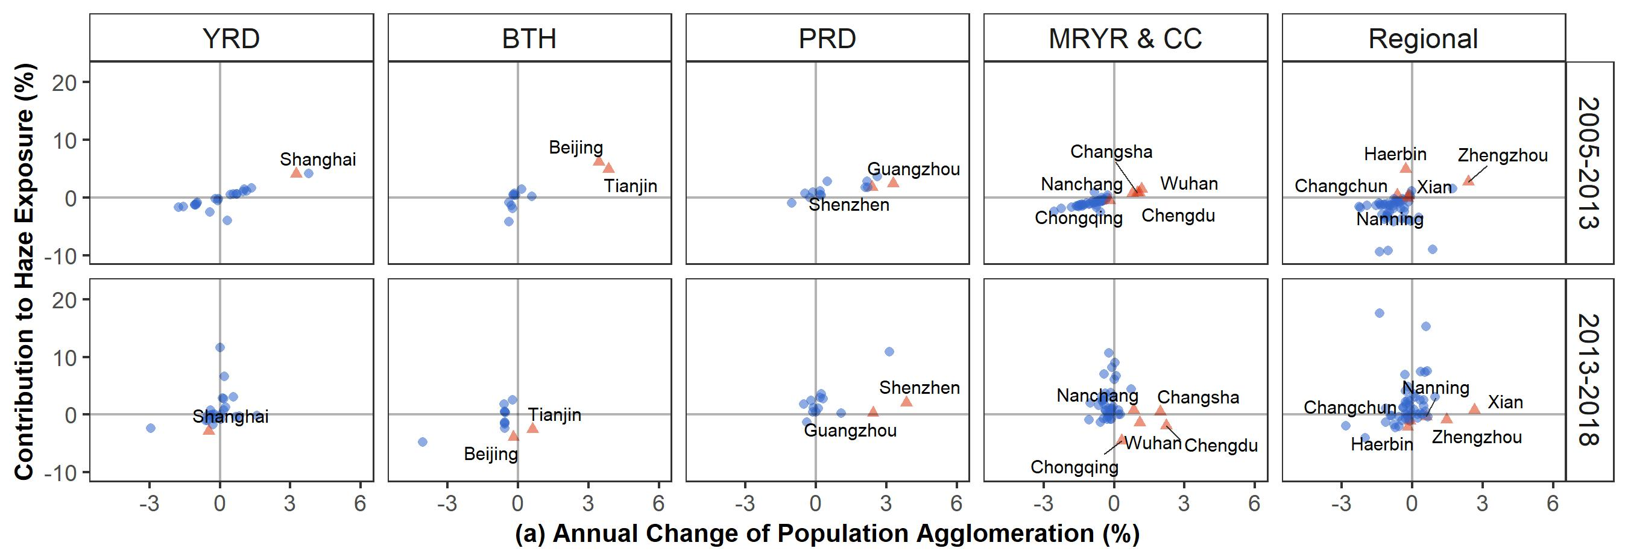
Within UAs: Central and Peripheral Cities
Population Agglomeration
After 2013, many central cities realized Green Population Urbanization;
While in some peripheral cities, PA greatly increased the the risk of haze exposure.

Slide 11
Economic Growth & City Expansion
After 2013, the economic urbanization in central cities no longer pollutes the sky;
But in some peripheral cities, economic growth increased haze pollution.

Slide 12
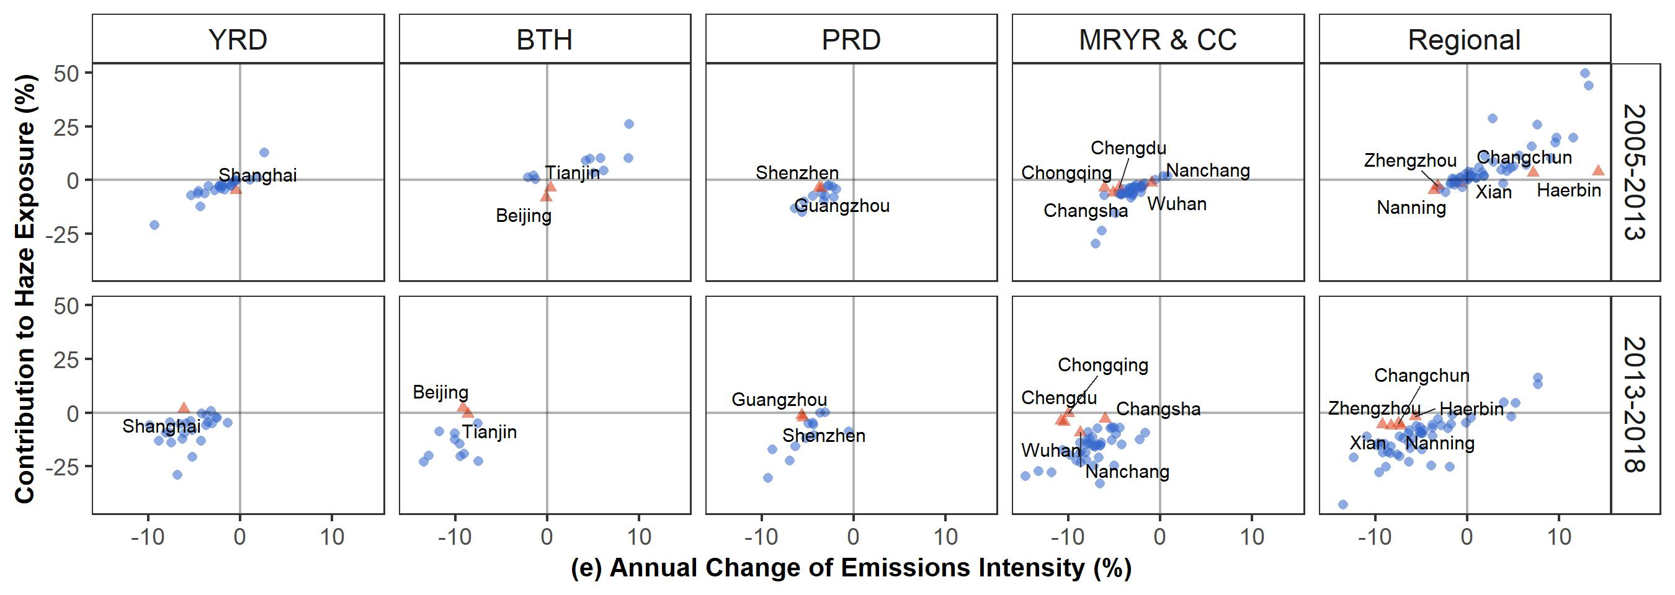
Emission Intensity
After APPCAP, the haze pollution abatement in peripheral cities relieved the haze pollution control pressure of central cities. The regional collaboration mechanism play an important role in achieving clean air goals of UAs.

Slide 13
Summary
After APPCAP:
For Urban Agglomerations:
Emission Intensity in most UAs
Population agglomeration in YRD & BTH
Economic Growth & City Expansion in some UAs
Within Urban Agglomerations:
Population agglomeration: in some Central in some Peripheral
Economic Growth & City Expansion: zero in most Central in most Peripheral
Emission Intensity: zero in most Central in most Peripheral Regional Collaboration

