Slide 1
Bidding strategy of storage hydropower plants in reserve markets
Deman L., Boucher Q., Djebali S., Guerard G., Clastres C.
IAEE 2021 - 08/06/2021
The XFLEX HYDRO project has received funding from the European Union’s Horizon 2020 research and innovation program under grant agreement No 857832

Slide 2
Introduction
Decarbonisation of power mix
Increasing need for reserves
Decrease of supply from gas- and coal-fired power plants
Price signals to incentivize participation of low-carbon and flexible technologies

Slide 3
Motivations
Objective of this paper
Analysis of the incentives of storage hydropower plants to participate in reserve markets in France
Methodology
Deterministic model
Bidding volumes in energy and reserve markets that maximise revenues
4 reserves, distinction between reserve capacity and reserve energy (Deng, Sheng & Sun 2006 ; Schillinger, et al. 2017)
Results
Large participation in reserve markets
Pumped storage plant: higher probability to choose the FCR market + greater responsiveness to incentive measures

Slide 4
Literature
Stochastic vs. Deterministic model: same bidding decisions
Fleten & Kristoffersen, 2007 ; Muche, 2014
Representation of reserve markets: one-stage deterministic model
Deng, Shen & Sun, 2006 ; Paine, et al. 2014 ; Schillinger, et al. 2017
Water reservoir management: setting a reservoir level to attain at the end of optimisation period
Aasgård, et al. 2019 ; Muche, 2014 ; Schillinger, et al. 2017

Slide 5
Reserves
Market design
4 types of reserves (Continental Europe)
Differences: activation time, spinning or non-spinning nature, type of activation
Frequency Containment Reserve
automatic Frequency Restoration Reserve
manual Frequency Restoration Reserve
Restoration Reserve
Reserve capacity vs. Reserve energy

Slide 6
Model
Hypotheses
Price-taker unit
Market prices are known
No upward and downward reserves at the same time
Maximising revenues in energy and reserve markets – start-up costs
Decision variables = volume sold in each market
2 case studies: seasonal storage and pumped storage hydropower plants
Same generation and reservoir capacity, inflows
2019 French prices

Slide 7
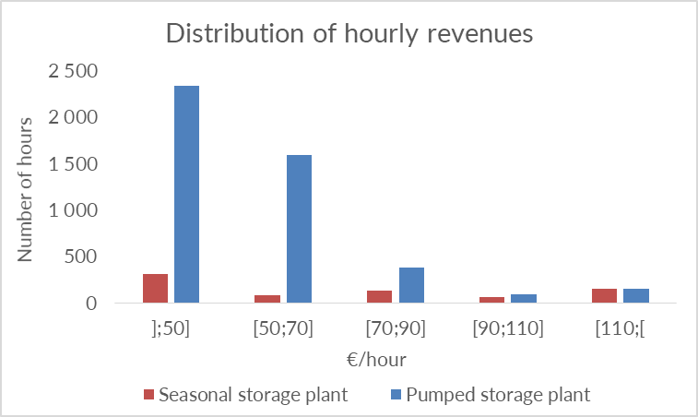
Results
Generation frequency
Seasonal storage plant
Generation 8% of the year
Pumped storage plant
Generation more often (51%)
Majority of additional hours when revenues are lower

Slide 8
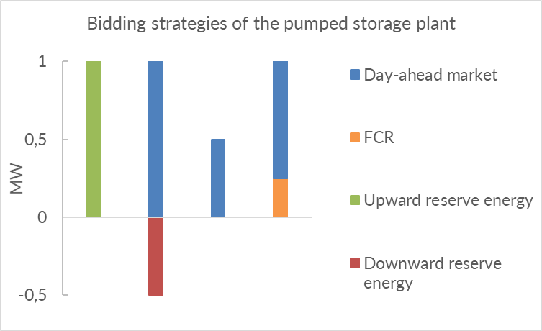
Results
Bidding strategies
Seasonal storage plant
Always participates in reserve markets
Pumped storage plant
Higher generation frequency
→ some hours with lower revenues
→ reserve energy and FCR revenues are closer
→ higher probability to choose FCR market
Bidding strategies of the seasonal storage plant

Slide 9
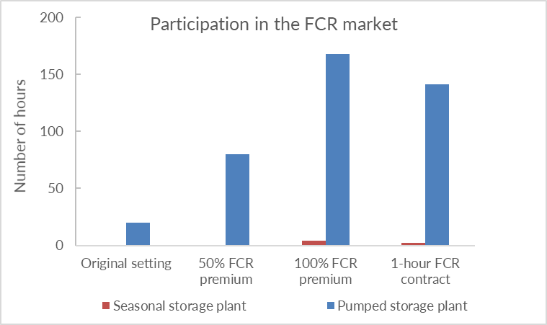
Results
Incentive measures in the FCR market
Pumped storage plant : incentive measures more efficient
Hours with lower revenues
→ measures more likely to modify the trade-off between reserve energy and FCR markets

Slide 10
Conclusion
Two equally-flexible hydropower plants
Different contributions to each reserve market
Different responses to incentive measures
Role of generation frequency in the choice of bidding strategy

Slide 11
Thank you for your attention

