Slide 1
Why the wide range of cost estimates for fulfilling the NDC pledges: A meta-analysis
Sneha Thube and Sonja Peterson
June 8th, 2021
IAEE 2021 Conference

Slide 2
Motivation (1)
EMF-36 study - Carbon Pricing After Paris (CarPri) (Böhringer et al., 2021)
Inter-model comparison study jointly organized by Kiel Institute for World Economy and University of Oldenburg
15 global CGE models (6 static, 9 recursive dynamic)
All models use GTAP9 database with base year 2011 and model a common set of scenarios

Slide 3
Motivation (2)
15 models x 2 baselines x 3 climate targets x 5 cooperation scenarios
CEPE
CGEM
DART
DREAM
EC-MSMR
EDF-GEPA
ENVISAGE
ICES(CMCC)
JRC
SNOW_GL
TEA
TUB
UOL
WEGDYN
ZEW
IEO
WEO
NDC
NDC+
NDC-2degree
REF
ASIA
EURCHN
PARTIAL
GLOBAL
Based on Böhringer et al., 2021

Slide 4
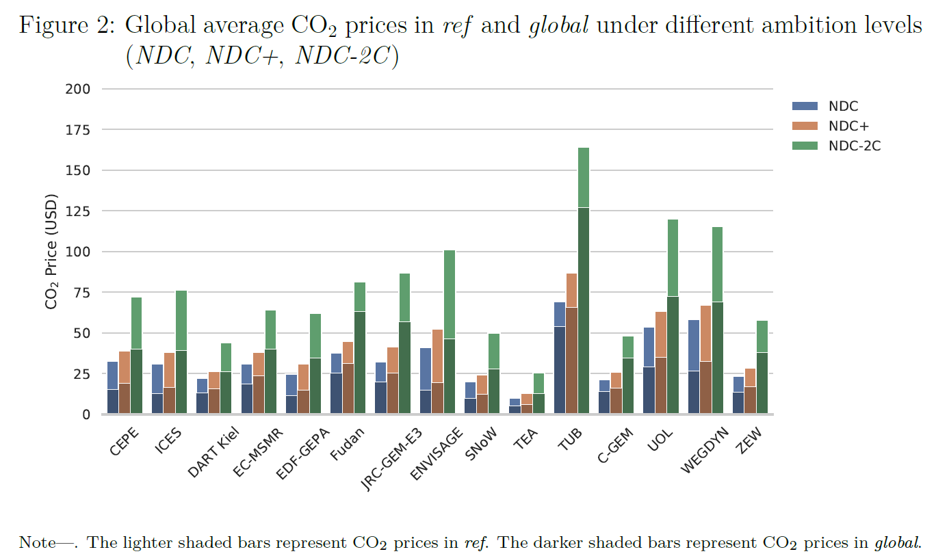
Source: Böhringer et al., 2021

Slide 5
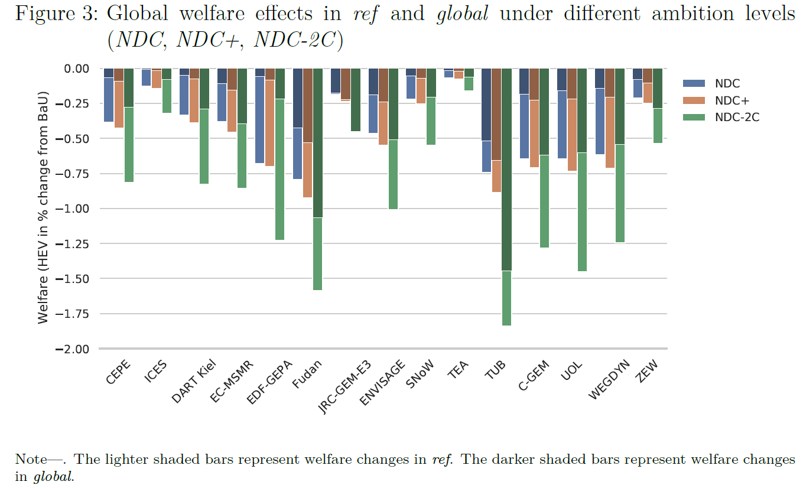
Source: Böhringer et al., 2021

Slide 6
Inter-model comparisons (e.g., EMF, IMCP, USCCSP)
Means to examine both structural and parametric differences between models
Each modelling team produces results from common set of scenarios
Results highlight areas of robust agreement as well as results where there is clear disagreement across models
Understand strengths and limitations of alternative modeling approaches
Difficult to discern the key factors that lead to the range of results across models

Slide 7
Meta-analysis
A body of statistical methods useful in reviewing and evaluating empirical research results
Combines results of independent studies; more insightful and has greater explanatory power than the mere listing of the individual results.
Meta-regression analysis especially designed to investigate empirical research in economics
In a MRA, the dependent variable is a summary statistic drawn from each study, while the independent variables may include characteristics of the method, design and data used in studies
Examples from literature, Repetto and Austin(1997), Fischer and Morgenstern (2006), Kuik et al. (2009)
Notes:
If a number of independent studies have been conducted on a particular subject, using different data sets and methods, then

Slide 8
Description of variables
Dependent variable : log(CO₂ price in 2030) , OLS regression

Slide 9
Database
15 models x 2 baselines x 3 climate targets x 5 cooperation scenarios
CEPE
CGEM
DART
DREAM
EC-MSMR
EDF-GEPA
ENVISAGE
ICES(CMCC)
JRC
SNOW_GL
TEA
TUB
UOL
WEGDYN
ZEW
IEO
WEO
NDC
NDC+
NDC-2degree
REF
ASIA
EURCHN
PARTIAL
GLOBAL

Slide 10
Results : Global
 | (1) | (2) | (3) | (4) | (5) | (6) | (7) | (8) | (9) | (10) | (11) | (12) | (13) | (14) | (15)
 | GLOBAL | AFR | ANZ | BRA | CAN | CHN | EUR | IND | JPN | KOR | MEA | OAM | OAS | RUS | USA
Model variables
regions | 0.80*** | 1.20*** | 0.63*** | 1.56** | 1.10*** | 0.50 | 0.90*** | 0.81*** | 0.75*** | 0.85*** | 0.78* | 1.06*** | 0.95*** | 0.78*** | 0.50**
 | (0.18) | (0.37) | (0.19) | (0.68) | (0.18) | (0.36) | (0.24) | (0.26) | (0.20) | (0.13) | (0.37) | (0.27) | (0.29) | (0.25) | (0.21)
unemp | -0.49*** | -0.76*** | -0.57** | -0.46* | -0.47*** | -0.54* | -0.42** | -0.70** | -0.55** | -0.42*** | -0.47** | -0.60*** | -0.39** | -0.73** | -0.42**
 | (0.16) | (0.24) | (0.22) | (0.25) | (0.12) | (0.27) | (0.18) | (0.24) | (0.19) | (0.13) | (0.18) | (0.15) | (0.17) | (0.27) | (0.14)
endotech | -0.80*** | -0.69** | -0.65*** | -1.05** | -1.01*** | -0.59** | -1.15*** | -0.78*** | -0.89*** | -1.15*** | -0.27 | -0.85*** | -0.84** | -0.29* | -0.78***
 | (0.21) | (0.27) | (0.21) | (0.39) | (0.33) | (0.25) | (0.27) | (0.20) | (0.13) | (0.14) | (0.24) | (0.23) | (0.29) | (0.15) | (0.25)
eletyp | 0.31*** | 0.35 | 0.23* | 0.44** | 0.50*** | 0.14 | 0.50*** | 0.17 | 0.20 | 0.17* | 0.31** | 0.34*** | 0.33*** | 0.14 | 0.34***
 | (0.10) | (0.22) | (0.12) | (0.15) | (0.10) | (0.15) | (0.16) | (0.13) | (0.13) | (0.09) | (0.11) | (0.09) | (0.10) | (0.16) | (0.09)
dynamic | 0.25** | 0.36 | 0.39*** | 0.28* | 0.19* | 0.25 | 0.38** | 0.41*** | 0.56*** | 0.52*** | -0.01 | 0.24** | 0.29** | 0.20 | 0.25***
 | (0.10) | (0.22) | (0.12) | (0.15) | (0.10) | (0.15) | (0.16) | (0.13) | (0.13) | (0.09) | (0.11) | (0.09) | (0.10) | (0.16) | (0.09)
armel | 1.03*** | 1.19** | 0.71*** | 1.79** | 1.40*** | 0.68* | 1.47*** | 1.05*** | 1.24*** | 1.42*** | 0.77* | 1.32*** | 1.09*** | 0.96*** | 0.91***
 | (0.17) | (0.41) | (0.19) | (0.68) | (0.14) | (0.34) | (0.26) | (0.26) | (0.19) | (0.13) | (0.37) | (0.26) | (0.27) | (0.25) | (0.20)
Policy variables
1.Climtarg_NDC+ | 0.21*** | 0.86*** | 0.11*** | 0.06*** | 0.07*** | 0.14*** | 0.08*** | 0.14*** | 0.13*** | 0.07*** | 0.51*** | 0.41*** | 0.57*** | 0.19*** | 0.21***
 | (0.01) | (0.07) | (0.01) | (0.00) | (0.00) | (0.01) | (0.00) | (0.01) | (0.01) | (0.00) | (0.09) | (0.03) | (0.03) | (0.01) | (0.01)
2.Climtarg_NDC2 | 1.10*** | 1.94*** | 1.30*** | 0.89*** | 0.82*** | 1.20*** | 0.88*** | 1.28*** | 1.44*** | 0.73*** | 1.80*** | 1.48*** | 1.34*** | 1.76*** | 1.05***
 | (0.07) | (0.11) | (0.08) | (0.06) | (0.06) | (0.08) | (0.07) | (0.08) | (0.09) | (0.05) | (0.09) | (0.09) | (0.07) | (0.14) | (0.07)
1.coop_ASIA | -0.04*** | -0.03* | -0.01 | -0.07 | -0.01 | 0.24*** | -0.03 | -0.01 | -0.44*** | -0.99*** | -0.16 | -0.07 | -0.05 | -0.03* | 0.01
 | (0.01) | (0.02) | (0.02) | (0.08) | (0.01) | (0.05) | (0.03) | (0.04) | (0.08) | (0.17) | (0.14) | (0.05) | (0.04) | (0.02) | (0.01)
2.coop_EURCHN | -0.05 | -0.06*** | -0.00 | -0.07 | -0.01*** | 0.37*** | -0.44** | 0.01 | -0.01 | -0.03 | -0.14* | -0.07 | -0.05 | -0.10*** | 0.00
 | (0.04) | (0.02) | (0.02) | (0.07) | (0.00) | (0.06) | (0.17) | (0.04) | (0.02) | (0.02) | (0.07) | (0.04) | (0.03) | (0.02) | (0.01)
3.coop_PARTIAL | -0.14 | 0.07** | -0.05 | -0.43*** | -0.21** | 0.60*** | -0.40** | 0.55*** | -0.27*** | -0.86*** | -0.19** | -0.16*** | -0.49*** | 0.54*** | -0.23**
 | (0.08) | (0.03) | (0.06) | (0.13) | (0.08) | (0.08) | (0.16) | (0.07) | (0.07) | (0.14) | (0.08) | (0.04) | (0.08) | (0.10) | (0.08)
4.coop_GLOBAL | -0.59*** | 0.22** | -0.04 | -1.52*** | -1.11*** | 0.98*** | -1.79*** | 0.92*** | -0.45*** | -2.10*** | -0.12 | -0.37*** | -1.03*** | 0.92*** | -0.75***
 | (0.04) | (0.08) | (0.08) | (0.09) | (0.09) | (0.08) | (0.06) | (0.07) | (0.09) | (0.10) | (0.09) | (0.07) | (0.08) | (0.11) | (0.05)
Constant | 0.17 | -2.49 | 0.23 | -1.52 | -0.33 | -0.24 | 0.77 | -1.43 | -0.15 | 1.42** | -0.34 | -1.18 | -0.09 | -1.39 | 1.27
 | (0.71) | (1.44) | (0.78) | (2.50) | (0.67) | (1.38) | (0.97) | (1.04) | (0.76) | (0.50) | (1.34) | (1.00) | (1.07) | (0.99) | (0.82)
Observations | 450 | 448 | 450 | 446 | 450 | 450 | 450 | 450 | 450 | 450 | 444 | 450 | 450 | 442 | 450
R-squared | 0.80 | 0.77 | 0.73 | 0.67 | 0.80 | 0.69 | 0.79 | 0.77 | 0.73 | 0.78 | 0.67 | 0.80 | 0.77 | 0.75 | 0.78
Regions: AFR-Sub-Saharan Africa, ANZ- Australia and New Zealand, BRA- Brazil, CAN-Canada, CHN-China, EUR-EU28 and EFTA members, IND-India, JPN-Japan, KOR-South Korea, MEA-Middle East, OAM-Other Americas, OAS-Other Asia, RUS-Russia, USA-United States

Slide 11
Results: Regional
 | (1) | (2) | (3) | (4) | (5) | (6) | (7) | (8) | (9) | (10) | (11) | (12) | (13) | (14) | (15)
 | GLOBAL | AFR | ANZ | BRA | CAN | CHN | EUR | IND | JPN | KOR | MEA | OAM | OAS | RUS | USA
Model variables
regions | 0.80*** | 1.20*** | 0.63*** | 1.56** | 1.10*** | 0.50 | 0.90*** | 0.81*** | 0.75*** | 0.85*** | 0.78* | 1.06*** | 0.95*** | 0.78*** | 0.50**
 | (0.18) | (0.37) | (0.19) | (0.68) | (0.18) | (0.36) | (0.24) | (0.26) | (0.20) | (0.13) | (0.37) | (0.27) | (0.29) | (0.25) | (0.21)
unemp | -0.49*** | -0.76*** | -0.57** | -0.46* | -0.47*** | -0.54* | -0.42** | -0.70** | -0.55** | -0.42*** | -0.47** | -0.60*** | -0.39** | -0.73** | -0.42**
 | (0.16) | (0.24) | (0.22) | (0.25) | (0.12) | (0.27) | (0.18) | (0.24) | (0.19) | (0.13) | (0.18) | (0.15) | (0.17) | (0.27) | (0.14)
endotech | -0.80*** | -0.69** | -0.65*** | -1.05** | -1.01*** | -0.59** | -1.15*** | -0.78*** | -0.89*** | -1.15*** | -0.27 | -0.85*** | -0.84** | -0.29* | -0.78***
 | (0.21) | (0.27) | (0.21) | (0.39) | (0.33) | (0.25) | (0.27) | (0.20) | (0.13) | (0.14) | (0.24) | (0.23) | (0.29) | (0.15) | (0.25)
eletyp | 0.31*** | 0.35 | 0.23* | 0.44** | 0.50*** | 0.14 | 0.50*** | 0.17 | 0.20 | 0.17* | 0.31** | 0.34*** | 0.33*** | 0.14 | 0.34***
 | (0.10) | (0.22) | (0.12) | (0.15) | (0.10) | (0.15) | (0.16) | (0.13) | (0.13) | (0.09) | (0.11) | (0.09) | (0.10) | (0.16) | (0.09)
dynamic | 0.25** | 0.36 | 0.39*** | 0.28* | 0.19* | 0.25 | 0.38** | 0.41*** | 0.56*** | 0.52*** | -0.01 | 0.24** | 0.29** | 0.20 | 0.25***
 | (0.10) | (0.22) | (0.12) | (0.15) | (0.10) | (0.15) | (0.16) | (0.13) | (0.13) | (0.09) | (0.11) | (0.09) | (0.10) | (0.16) | (0.09)
armel | 1.03*** | 1.19** | 0.71*** | 1.79** | 1.40*** | 0.68* | 1.47*** | 1.05*** | 1.24*** | 1.42*** | 0.77* | 1.32*** | 1.09*** | 0.96*** | 0.91***
 | (0.17) | (0.41) | (0.19) | (0.68) | (0.14) | (0.34) | (0.26) | (0.26) | (0.19) | (0.13) | (0.37) | (0.26) | (0.27) | (0.25) | (0.20)
Policy variables
1.Climtarg_NDC+ | 0.21*** | 0.86*** | 0.11*** | 0.06*** | 0.07*** | 0.14*** | 0.08*** | 0.14*** | 0.13*** | 0.07*** | 0.51*** | 0.41*** | 0.57*** | 0.19*** | 0.21***
 | (0.01) | (0.07) | (0.01) | (0.00) | (0.00) | (0.01) | (0.00) | (0.01) | (0.01) | (0.00) | (0.09) | (0.03) | (0.03) | (0.01) | (0.01)
2.Climtarg_NDC2 | 1.10*** | 1.94*** | 1.30*** | 0.89*** | 0.82*** | 1.20*** | 0.88*** | 1.28*** | 1.44*** | 0.73*** | 1.80*** | 1.48*** | 1.34*** | 1.76*** | 1.05***
 | (0.07) | (0.11) | (0.08) | (0.06) | (0.06) | (0.08) | (0.07) | (0.08) | (0.09) | (0.05) | (0.09) | (0.09) | (0.07) | (0.14) | (0.07)
1.coop_ASIA | -0.04*** | -0.03* | -0.01 | -0.07 | -0.01 | 0.24*** | -0.03 | -0.01 | -0.44*** | -0.99*** | -0.16 | -0.07 | -0.05 | -0.03* | 0.01
 | (0.01) | (0.02) | (0.02) | (0.08) | (0.01) | (0.05) | (0.03) | (0.04) | (0.08) | (0.17) | (0.14) | (0.05) | (0.04) | (0.02) | (0.01)
2.coop_EURCHN | -0.05 | -0.06*** | -0.00 | -0.07 | -0.01*** | 0.37*** | -0.44** | 0.01 | -0.01 | -0.03 | -0.14* | -0.07 | -0.05 | -0.10*** | 0.00
 | (0.04) | (0.02) | (0.02) | (0.07) | (0.00) | (0.06) | (0.17) | (0.04) | (0.02) | (0.02) | (0.07) | (0.04) | (0.03) | (0.02) | (0.01)
3.coop_PARTIAL | -0.14 | 0.07** | -0.05 | -0.43*** | -0.21** | 0.60*** | -0.40** | 0.55*** | -0.27*** | -0.86*** | -0.19** | -0.16*** | -0.49*** | 0.54*** | -0.23**
 | (0.08) | (0.03) | (0.06) | (0.13) | (0.08) | (0.08) | (0.16) | (0.07) | (0.07) | (0.14) | (0.08) | (0.04) | (0.08) | (0.10) | (0.08)
4.coop_GLOBAL | -0.59*** | 0.22** | -0.04 | -1.52*** | -1.11*** | 0.98*** | -1.79*** | 0.92*** | -0.45*** | -2.10*** | -0.12 | -0.37*** | -1.03*** | 0.92*** | -0.75***
 | (0.04) | (0.08) | (0.08) | (0.09) | (0.09) | (0.08) | (0.06) | (0.07) | (0.09) | (0.10) | (0.09) | (0.07) | (0.08) | (0.11) | (0.05)
Constant | 0.17 | -2.49 | 0.23 | -1.52 | -0.33 | -0.24 | 0.77 | -1.43 | -0.15 | 1.42** | -0.34 | -1.18 | -0.09 | -1.39 | 1.27
 | (0.71) | (1.44) | (0.78) | (2.50) | (0.67) | (1.38) | (0.97) | (1.04) | (0.76) | (0.50) | (1.34) | (1.00) | (1.07) | (0.99) | (0.82)
Observations | 450 | 448 | 450 | 446 | 450 | 450 | 450 | 450 | 450 | 450 | 444 | 450 | 450 | 442 | 450
R-squared | 0.80 | 0.77 | 0.73 | 0.67 | 0.80 | 0.69 | 0.79 | 0.77 | 0.73 | 0.78 | 0.67 | 0.80 | 0.77 | 0.75 | 0.78
Regions: AFR-Sub-Saharan Africa, ANZ- Australia and New Zealand, BRA- Brazil, CAN-Canada, CHN-China, EUR-EU28 and EFTA members, IND-India, JPN-Japan, KOR-South Korea, MEA-Middle East, OAM-Other Americas, OAS-Other Asia, RUS-Russia, USA-United States

Slide 12
Results: Regional
 | (1) | (2) | (3) | (4) | (5) | (6) | (7) | (8) | (9) | (10) | (11) | (12) | (13) | (14) | (15)
 | GLOBAL | AFR | ANZ | BRA | CAN | CHN | EUR | IND | JPN | KOR | MEA | OAM | OAS | RUS | USA
Model variables
regions | 0.80*** | 1.20*** | 0.63*** | 1.56** | 1.10*** | 0.50 | 0.90*** | 0.81*** | 0.75*** | 0.85*** | 0.78* | 1.06*** | 0.95*** | 0.78*** | 0.50**
 | (0.18) | (0.37) | (0.19) | (0.68) | (0.18) | (0.36) | (0.24) | (0.26) | (0.20) | (0.13) | (0.37) | (0.27) | (0.29) | (0.25) | (0.21)
unemp | -0.49*** | -0.76*** | -0.57** | -0.46* | -0.47*** | -0.54* | -0.42** | -0.70** | -0.55** | -0.42*** | -0.47** | -0.60*** | -0.39** | -0.73** | -0.42**
 | (0.16) | (0.24) | (0.22) | (0.25) | (0.12) | (0.27) | (0.18) | (0.24) | (0.19) | (0.13) | (0.18) | (0.15) | (0.17) | (0.27) | (0.14)
endotech | -0.80*** | -0.69** | -0.65*** | -1.05** | -1.01*** | -0.59** | -1.15*** | -0.78*** | -0.89*** | -1.15*** | -0.27 | -0.85*** | -0.84** | -0.29* | -0.78***
 | (0.21) | (0.27) | (0.21) | (0.39) | (0.33) | (0.25) | (0.27) | (0.20) | (0.13) | (0.14) | (0.24) | (0.23) | (0.29) | (0.15) | (0.25)
eletyp | 0.31*** | 0.35 | 0.23* | 0.44** | 0.50*** | 0.14 | 0.50*** | 0.17 | 0.20 | 0.17* | 0.31** | 0.34*** | 0.33*** | 0.14 | 0.34***
 | (0.10) | (0.22) | (0.12) | (0.15) | (0.10) | (0.15) | (0.16) | (0.13) | (0.13) | (0.09) | (0.11) | (0.09) | (0.10) | (0.16) | (0.09)
dynamic | 0.25** | 0.36 | 0.39*** | 0.28* | 0.19* | 0.25 | 0.38** | 0.41*** | 0.56*** | 0.52*** | -0.01 | 0.24** | 0.29** | 0.20 | 0.25***
 | (0.10) | (0.22) | (0.12) | (0.15) | (0.10) | (0.15) | (0.16) | (0.13) | (0.13) | (0.09) | (0.11) | (0.09) | (0.10) | (0.16) | (0.09)
armel | 1.03*** | 1.19** | 0.71*** | 1.79** | 1.40*** | 0.68* | 1.47*** | 1.05*** | 1.24*** | 1.42*** | 0.77* | 1.32*** | 1.09*** | 0.96*** | 0.91***
 | (0.17) | (0.41) | (0.19) | (0.68) | (0.14) | (0.34) | (0.26) | (0.26) | (0.19) | (0.13) | (0.37) | (0.26) | (0.27) | (0.25) | (0.20)
Policy variables
1.Climtarg_NDC+ | 0.21*** | 0.86*** | 0.11*** | 0.06*** | 0.07*** | 0.14*** | 0.08*** | 0.14*** | 0.13*** | 0.07*** | 0.51*** | 0.41*** | 0.57*** | 0.19*** | 0.21***
 | (0.01) | (0.07) | (0.01) | (0.00) | (0.00) | (0.01) | (0.00) | (0.01) | (0.01) | (0.00) | (0.09) | (0.03) | (0.03) | (0.01) | (0.01)
2.Climtarg_NDC2 | 1.10*** | 1.94*** | 1.30*** | 0.89*** | 0.82*** | 1.20*** | 0.88*** | 1.28*** | 1.44*** | 0.73*** | 1.80*** | 1.48*** | 1.34*** | 1.76*** | 1.05***
 | (0.07) | (0.11) | (0.08) | (0.06) | (0.06) | (0.08) | (0.07) | (0.08) | (0.09) | (0.05) | (0.09) | (0.09) | (0.07) | (0.14) | (0.07)
1.coop_ASIA | -0.04*** | -0.03* | -0.01 | -0.07 | -0.01 | 0.24*** | -0.03 | -0.01 | -0.44*** | -0.99*** | -0.16 | -0.07 | -0.05 | -0.03* | 0.01
 | (0.01) | (0.02) | (0.02) | (0.08) | (0.01) | (0.05) | (0.03) | (0.04) | (0.08) | (0.17) | (0.14) | (0.05) | (0.04) | (0.02) | (0.01)
2.coop_EURCHN | -0.05 | -0.06*** | -0.00 | -0.07 | -0.01*** | 0.37*** | -0.44** | 0.01 | -0.01 | -0.03 | -0.14* | -0.07 | -0.05 | -0.10*** | 0.00
 | (0.04) | (0.02) | (0.02) | (0.07) | (0.00) | (0.06) | (0.17) | (0.04) | (0.02) | (0.02) | (0.07) | (0.04) | (0.03) | (0.02) | (0.01)
3.coop_PARTIAL | -0.14 | 0.07** | -0.05 | -0.43*** | -0.21** | 0.60*** | -0.40** | 0.55*** | -0.27*** | -0.86*** | -0.19** | -0.16*** | -0.49*** | 0.54*** | -0.23**
 | (0.08) | (0.03) | (0.06) | (0.13) | (0.08) | (0.08) | (0.16) | (0.07) | (0.07) | (0.14) | (0.08) | (0.04) | (0.08) | (0.10) | (0.08)
4.coop_GLOBAL | -0.59*** | 0.22** | -0.04 | -1.52*** | -1.11*** | 0.98*** | -1.79*** | 0.92*** | -0.45*** | -2.10*** | -0.12 | -0.37*** | -1.03*** | 0.92*** | -0.75***
 | (0.04) | (0.08) | (0.08) | (0.09) | (0.09) | (0.08) | (0.06) | (0.07) | (0.09) | (0.10) | (0.09) | (0.07) | (0.08) | (0.11) | (0.05)
Constant | 0.17 | -2.49 | 0.23 | -1.52 | -0.33 | -0.24 | 0.77 | -1.43 | -0.15 | 1.42** | -0.34 | -1.18 | -0.09 | -1.39 | 1.27
 | (0.71) | (1.44) | (0.78) | (2.50) | (0.67) | (1.38) | (0.97) | (1.04) | (0.76) | (0.50) | (1.34) | (1.00) | (1.07) | (0.99) | (0.82)
Observations | 450 | 448 | 450 | 446 | 450 | 450 | 450 | 450 | 450 | 450 | 444 | 450 | 450 | 442 | 450
R-squared | 0.80 | 0.77 | 0.73 | 0.67 | 0.80 | 0.69 | 0.79 | 0.77 | 0.73 | 0.78 | 0.67 | 0.80 | 0.77 | 0.75 | 0.78
Regions: AFR-Sub-Saharan Africa, ANZ- Australia and New Zealand, BRA- Brazil, CAN-Canada, CHN-China, EUR-EU28 and EFTA members, IND-India, JPN-Japan, KOR-South Korea, MEA-Middle East, OAM-Other Americas, OAS-Other Asia, RUS-Russia, USA-United States

Slide 13
Conclusions
Meta-analysis can provide additional insights into the drivers of differences in results
Both model characteristics and policy variables are determiners of results
For global MAC,
positive coefficients for regions, eletyp, dynamic, armel
negative coefficients for unemp and endotech
Effects on regional MACs are different

Slide 14
Thank you for your attention!
Sneha Thube
Junior Researcher and PhD candidate
sneha.thube@ifw-kiel.de

