Slide 1
Direct Current (DC) Technology in Private Households in Germany – Simulation and Policy Implication Xueying Liu¹ and Reinhard Madlener^{1,2} ¹ Chair of Energy Economics and Management (FCN-ECO), School of Business and Economics / E.ON ERC, RWTH Aachen, Germany ² Department of Industrial Economics and Technology Management, NTNU, Trondheim, Norway 1st IAEE Digital Conference (Zoom), June 7-9, 2021

Slide 2
Presentation Outline
Introduction
Aim and Scope
Literature and Original Contribution
Methodology
Data
Simulation Results and Policy Implications
Limitations and Conclusions
Ongoing Research - Forthcoming FCN Working Paper
Liu X., Madlener R. (2021). Direct Current Technology in Private Households in Germany – Simulation and Policy Implication, FCN Working Paper Series, Institute for Future Energy Consumer Needs and Behavior, RWTH Aachen University (in prep.)

Slide 3
1. Introduction
Benefits of DC in buildings
Driving technologies
Improved energy efficiency
Flexible and simple design
Reliability of system
Lower installation costs
Improved safety
Lower capital costs
Generation
Solar PV system
Consumption
EV charging
Consumer electronics
HVAC
LED lighting
Computing (e.g. PCs/laptops, servers)
Storage devices
Battery (Powerwall etc.)
Source: Marchionini and Zheng (2018), adapted

Slide 4
2. Aim and Scope
How does the following parameters affect the savings potential of DC configuration compared to AC configurations in private households?
AC / DC load shares
Household characteristics
Solar PV and battery sizes
Feed-in-tariff (FIT) and electricity prices
Peer-to-peer (P2P) trading
What are the policy implications?
Germany
PV generation implication
Household profile simulated for German household
Electricity price and FIT implication
National legal framework for P2P trading applies
Residential households
Commercial and industrial applications excluded
Focus on savings from improved energy efficiency
Research Questions
Scope

Slide 5
3. Literature and Original Contribution
Vossos et al (2014). Energy savings from direct-DC in US residential buildings
Backhaus et al (2015) DC microgrids scoping study. Estimate of technical and economic benefits
Glasgo, Brock et al (2016). How much electricity can we save by using direct current circuits in homes?
Gerber et al (2018). A simulation-based efficiency comparison of AC and DC power distribution networks in commercial buildings
……
Mainly US context
Generalized results with fixed price and setup
Few policy implications
Does not include P2P trading
Focus on monetary savings from improved energy efficiency due to DC configuration
Applied to German households
Include specific household type and characteristics
P2P trading modeling included
Analysis of various scenarios
Policy implications
Existing Literature
Original Contributions

Slide 6
4. Methodology
Modeling Steps
Household characteristics
Size, Type
Employment situation
Activities (randomized)
System configurations
DC household
AC household
DC household with P2P trading
Load profile simulation
Efficiency calculation
Scenarios: PV, battery size, electricity price, FIT, P2P
Algorithm to maximize self consumption from PV generation
Savings analysis
(net savings compared to equivalent AC system or system without PV/battery)
Derivation of policy implications

Slide 7
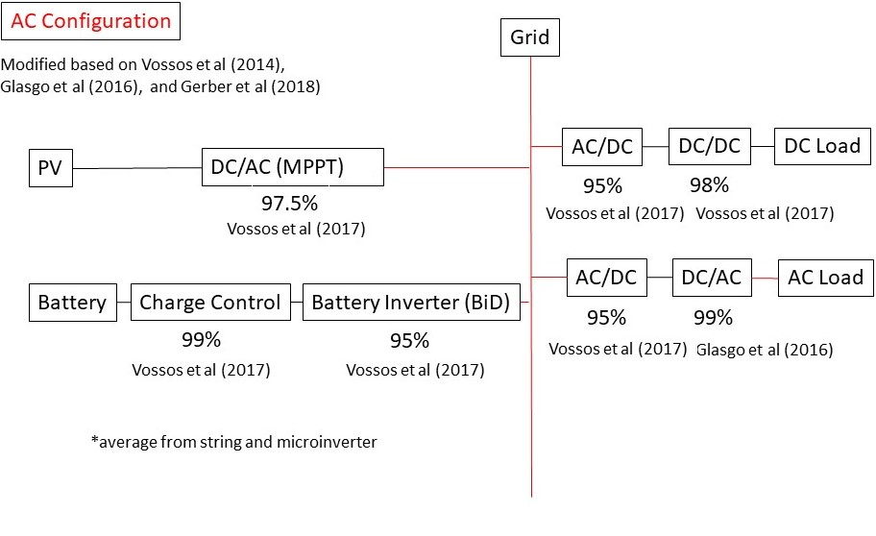
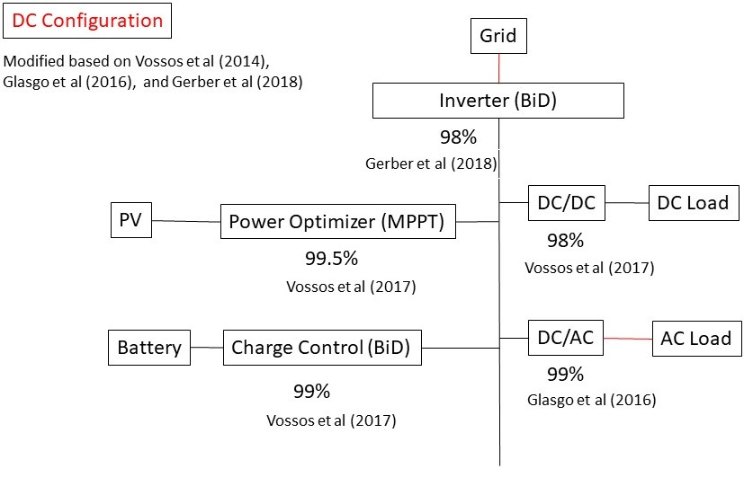
5. Data
Load Profile
Simulated for 600 private households (HH) in Germany, based on HH size and employment situations
AC/DC Configuration and Energy Efficiency Calculation
Price levels
Data sources: Literature (system investment costs), German federal government website, Sensitivity analysis
P2P Community
Based on price calculation methods in Zepter et al. (2019), assuming best-case scenario

Slide 8
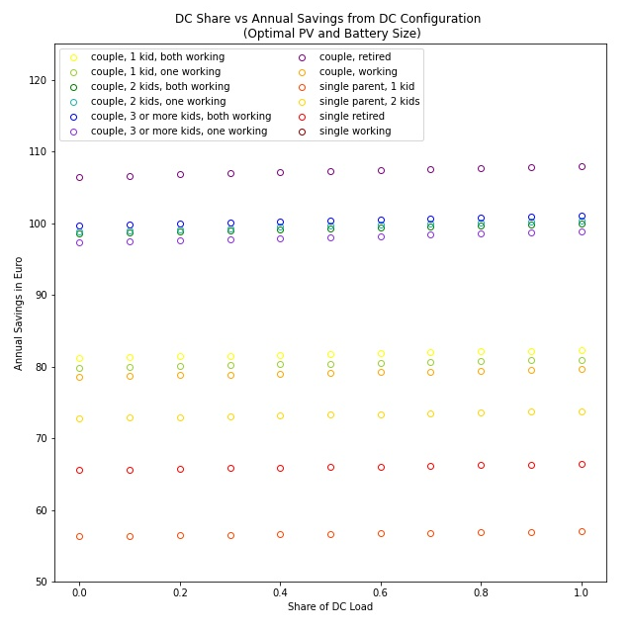
6. Simulation Results and Policy Implications
Load type does not significantly influence energy efficiency
Focus on generation and storage technology (e.g. solar PV, home battery)
Cost savings from improved efficiency alone are insufficient to incentivize the adoption of DC technology configuration
Need to achieve, and advertise, lower investment costs
Shares of DC vs. AC load
Policy Implications

Slide 9
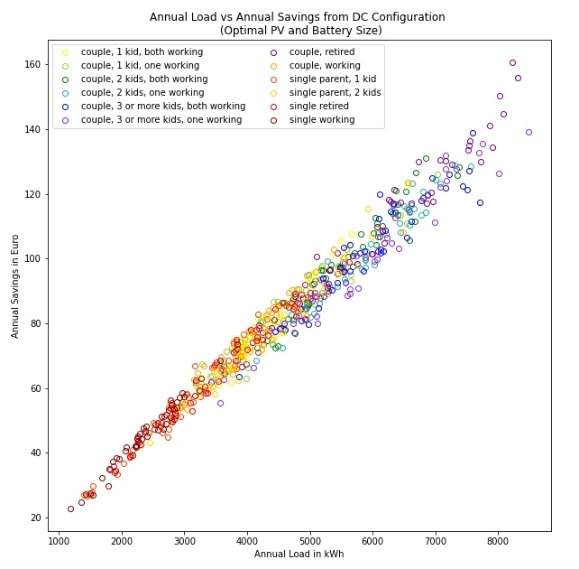
6. Simulation Results and Policy Implications
Annual load highly correlated with annual cost savings
Household characteristics do not play an important role
Focus on consumers with high load (definitely consider larger residential buildings)
Diffusion of electric vehicles facilitates diffusion of DC through increased load
Household characteristics
Policy Implications

Slide 10
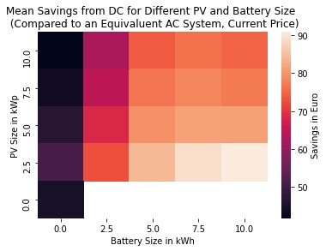
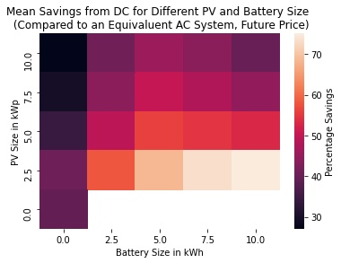
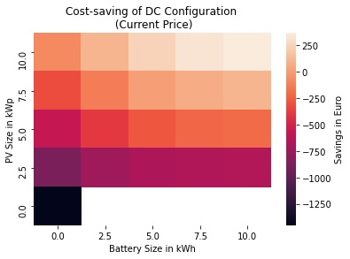
6. Simulation Results and Policy Implications
Savings from DC do not necessarily increase with the increase in PV and battery storage size
Need to balance promotion of PV, home battery, and DC systems
PV and battery sizes
Policy Implications

Slide 11
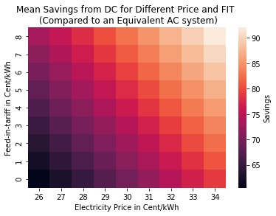
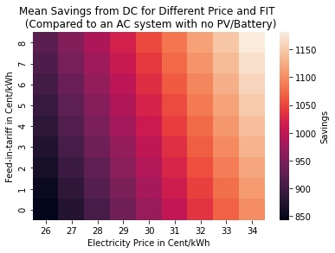
6. Simulation Results and Policy Implications
Savings from DC configuration are maximized with high FIT and high electricity prices
The gradual reduction of FIT levels in Germany could make DC configuration less attractive in terms of cost savings achievable through energy efficiency gains
Feed-in-Tariff (FIT) and electricity prices
Policy Implications

Slide 12
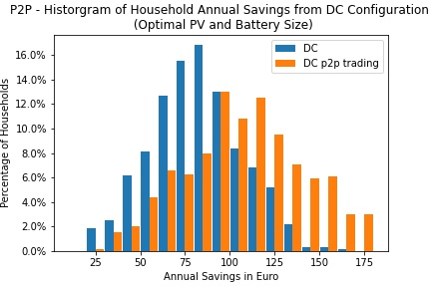
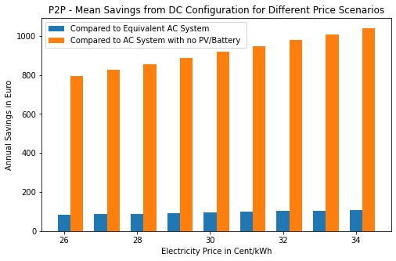
6. Simulation Results and Policy Implications
P2P trading increases cost savings, as the effect of higher FIT outweighs the effect of a lower electricity price
DC household pilot program could be designed to allow the potential of P2P trading to increase cost savings
DC configuration diffusion more likely to start after P2P trading is more widely adopted
Peer-to-peer (P2P) trading
Policy Implications

Slide 13
7. Limitations and Conclusions
Limitations:
Simulated rather than actual data (load profile, PV generation, battery charging pattern)
EVs are not included
Investment costs taken from literature
Scope limited to private households
Assumption of best-case P2P trading scenario
Conclusions:
Improved efficiency results in cost savings of about €90 p.a. → need to reduce investment costs to make DC configuration more attractive
Share of DC load does not impact cost savings a lot → generation / storage more important
Household load profile does not impact cost savings significantly → total load more important
Cost savings do not necessarily increase with larger PV and battery
P2P trading increases cost savings

Slide 14
References
Backhaus, Scott N, Gregory William Swift, Spyridon Chatzivasileiadis, William Tschudi, Steven Glover, Michael Starke, Jianhui Wang, Meng Yue, and Donald Hammerstrom (2015). DC microgrids scoping study. Estimate of technical and economic benefits. Tech. rep. Los Alamos National Lab.(LANL), Los Alamos, NM (United States)
Gerber, Daniel L, Vagelis Vossos, Wei Feng, Chris Marnay, Bruce Nordman, and Richard Brown (2018). “A simulation-based efficiency comparison of AC and DC power distribution networks in commercial buildings”. Applied Energy 210, pp. 1167–1187.
Glasgo, Brock, Ines Azevedo, and Chris Hendrickson (2016). “How much electricity can we save by using direct current circuits in homes? Understanding the potential for electricity savings and assessing feasibility of a transition towards DC powered buildings”. Applied Energy 180, pp. 66–75.
Marchionini, Brian and Shuyu, Zheng (2018) “Direct Current in Buildings – A Look at Current and Future Trends”. NEMA DCP 1-2018
Vossos, Vagelis, Karina Garbesi, and Hongxia Shen (2014). “Energy savings from direct-DC in US residential buildings”. Energy and Buildings 68, pp. 223–231.
Vossos, Vagelis, Karl Johnson, Margarita Kloss, Mukesh Khattar, Daniel Gerber, and Rich Brown (2017). “Review of dc power distribution in buildings: A technology and market assessment”. LBNL Report, Berkeley.
Zepter, Jan Martin, Alexandra Lüth, Pedro Crespo Del Granado, and Ruud Egging (2019). “Prosumer integration in wholesale electricity markets: Synergies of peer-to-peer trade and residential storage”. Energy and Buildings 184, pp. 163–176.

Slide 15
Many thanks for your kind attention. Any questions?
Contact:
Institute for Future Energy Consumer Needs and Behavior (FCN) E.ON Energy Research Center
Mathieustraße 10, 52074 Aachen
Germany
Xueying Liu, Reinhard Madlener
T +49 241 80 49831, -822
rmadlener@eonerc.rwth-aachen.de xueying.liu@eonerc.rwth-aachen.de
http://www.eonerc.rwth-aachen.de

