Slide 1
Business Model Innovation in the EV Ecosystem
Francisco Jose Santos
Dr. Isabelle Nicolai

Slide 2
Overview
Context
Motivation
Business Model Innovation Framework
The case of the EV ecosystem
Conclusions and further studies
References
Business Model Innovation in the EV Ecosystem

Slide 3
1. Context
OEM´s electrification targets
Source: EV Outlook, 2021
Need to decarbonize the automotive industry: a scale-up of EV adoption is forced by regulation.
EV´s are becoming competitive on a total cost of ownership basis (technology).
EV registrations increased in 2020, despite the Covid-19 pandemic.
OEM´s have set electrification targets to comply with the projections of the different sustainable scenarios.

Slide 4
2. Motivation
new electric mobility
Transition requires a fundamental change of the automotive industry.
Commercialization has been ineffective because OEM´s take “business as usual”.
EV´s integrate a diversity of previously independent actors and others that will emerge, and EV´s connectivity will allow new business opportunities.
Classical business models for ICEV´s cannot be transferred to a new electric mobility.

Slide 5
2. Motivation
research question
EV industry faces a critical challenge not from an individual firm but from a more complex, dynamic context.
The business model construct must be enlarged from the perspective of a value chain to a value ecosystem.
The focus of study needs to shift from the focal firm to the constellation of actors; and the level of analysis from firm strategy to the value proposition.
Research question: how to design innovative business models at the interface of the new EV ecosystem?

Slide 6
Source: Elaborated by the author.
Evolution of the BM concept.
Company-centered ecosystem
Business ecosystem
Value-chain

Slide 7
2. Motivation
OBJECTIVE
BM studies for electric mobility mainly consider linear value chain approach (Bohnsack et al., 2014; Kley et al., 2011; San Román et al., 2011).
The multiparty interdependence, the flow of activities, and the realignment of positions of participants are out of scope.
Objective: analyze the EV industry throw the lens of its ecosystem, stepping up from a static ontology of BM and proposing a dynamic process of BM design within the EV ecosystem.

Slide 8
3. Business Model Innovation framework
Business model and business model innovation constructs
We frame that the BM is the architecture of a firm´s value creation, delivery and capture mechanisms (Teece, 2010).
And BMI are “designed, novel, and non-trivial changes to the key elements of a firm's business model and/or the architecture linking these elements” (Foss & Saebi, 2018).
The notion of architecture means the mapping of the set of relations among elements in a system (Simon, 1969), where relations can be characterized in terms as directionality, complementarity/strength, and content.
Complementarity is the key dimension of the BM construct.

Slide 9
3. Business Model Innovation framework
Service-Dominant Logic as a driver for design
Companies in the traditional value chain are pushing to change a service-based mindset.
In SD logic, value is not conceived within the focus of a single company, but from a collaborative process that includes the “value network”.
Companies need to learn more about their customers and work in an ecosystem beyond individual chains, to be better aligned with the customer value proposition.

Slide 10
3. Business Model Innovation framework
Elements that shape the BMI construct
Source: elaborated by the author.
What is new with this BMI analysis?
The interaction between the three value elements is analyzed.
The value network construct is deepened.
Ecosystem strategy: alignment of actors.
As conditions change, this alignment must be maintained - evolution.

Slide 11
3. Business Model Innovation framework
Business ecosystems
The ecosystem is defined by the “alignment structure of the multilateral set of partners that need to interact in order for a focal value proposition to materialize” (Adner, 2017)
Four elements characterize the value “blueprint” of an ecosystem: activities, actors, positions, and links.
An ecosystem strategy is “the way in which a focal firm approaches the alignment of partners and secures its role in a competitive ecosystem”(Adner, 2017).

Slide 12
3. Business Model Innovation framework
Proposed BMI framework
Value proposition
Value creation and delivery
Value capture
Activities
Actors
Position
Links
Strategy
Value proposition
Business ecosystem consequences in BMI
Wide-lens perspective for collective value.
Delivery of the value proposition depends on the ability to align the strategy.
Success of the innovation depends on the complementors.
The ecosystems´ evolution help stakeholders redefine their business models.

Slide 13
4. The case of the EV ecosystem
What is changing?
ICEV´s |  | EV´s
Traditional product-oriented bm Value chain configuration Established auto industry |  | Innovative service-oriented bm Value network configuration Early-stage EV ecosystem Stakeholders from different industries Battery and Charging= critical limitations

Slide 14
Energy
Energy / utilities
Charging infrastructure
Inf. management
C.. S. network mngmt
Energy management
Energy supply
OEM´s
EV aggregators
Grid integration
Battery recycling
EV users
Telematics
Entertainment
Battery manufacturers
MaaS
Vehicles
Services
EV ecosystem

Slide 15
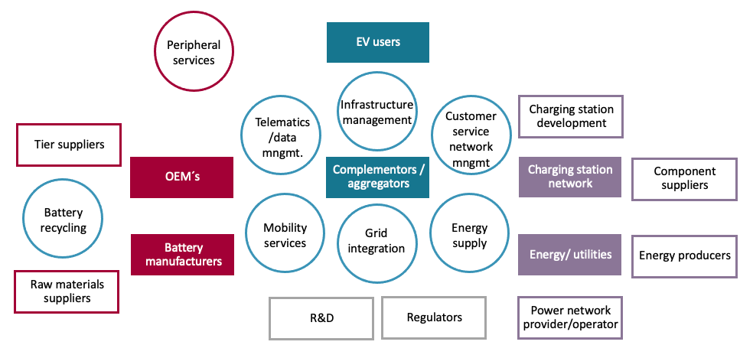
EV ecosystem map – main actors and potential services
Source: elaborated by the author.

Slide 16
4. The case of the EV ecosystem
EV Ecosystem constraints
Range anxiety: the problem of batteries and charging infrastructure.
Battery technology experienced considerable progress.
For the charging infrastructure, government and firms’ efforts have supported initial investments for the vast amount needed.
The problem remains in who owns the value created and how to capture part of value.

Slide 17
4. The case of the EV ecosystem
Application for Ev public street charging
Most charging is done at home and work: roll-out of publicly accessible charging will be critical.
European countries have failed to meet the recommended targets: 1 public charger per 10 EVs in 2020.
Public fast chargers will encourage late adopters without access to private charging and account for longer trips fostering adoption.

Slide 18
Value Proposition: What perceived needs can be satisfied? Public street charging: Charging infrastructure in public areas with public access. |  | d. Positions What are the governance arrangements across the ecosystem? |  |  | e. Links What is the value unit of each transfer? | f. Strategy How can the focal firm align the partners?
 |  | Actor 1 | Trans./ Interaction | Actor2
Activities: What are the actions needed to satisfy these perceived needs? Infrastructure development Network costs and distribution services. Charging services for EV owners. Change on regulations. | Actors: Who should perform each activity? DSO Charging point EVSA EV owner Public authorities | Infrastructure development | → ← | DSO | Infrastructure Money | Tesla development of Super charging net.
 |  | DSO + C.P. | → → ← ←→ | EVSA | Utilization Energy Money Data | OEM´s role of the EVSA.
 |  | EVSA | → → ← ←→ | EV owner | Service Energy Money Data | OEM´s role of the EVSA.
 |  | Public authorities | → → | C.P. | Regulations Money | Who operates the C.P.?
 |  | EVSA | → ←→ | Energy market | Money Data | OEM´s role of the EVSA
 |  | Energy market | → | DSO | Energy
 |  | OEM | → ← | EV owner | Product Money | Bundling EV + charging

Slide 19
Telematics and data
Mobility services
Grid integration
EVC
EMC
OEM: Vehicle + battery
EV users
EVSA
Charging point/station
Public Authorities
SoC
EVM
Product/Infrastructure
Regulations
Financial
Energy
Usage
Data
Electricity market
DSO
C.P. manufacturing and installation
Generation
TSO

Slide 20
EV users
EVC
SoC
EMC
OEM: Vehicle + battery
EVSA
Charging point operator
Public Authorities
EVM
Product/Infrastructure
Regulations
Financial
Energy
Usage
Data
Energy market
DSO
C.P. manufacturing and installation

Slide 21
Tesla
EVC
EMC
OEM: Vehicle + battery
EV users
EVSA
Charging point/station
C.P. manufacturing and installation
SoC
EVM
Product/Infrastructure
Regulations
Financial
Energy
Usage
Data
Electricity market
DSO
Public Authorities
Generation
TSO

Slide 22
5. Conclusions and further studies
Building on Foss & Saebi´s (2018) BMI construct, a SD logic, and Adner´s (2017) business ecosystem structure: descriptive model for systemic design and analysis of BM and definition of ecosystem strategies for the EV ecosystem.
Generic map of the main stakeholders and potential services in the new EV ecosystem.
The proposed BMI framework is exemplified with the case of the EV public street charging.
Further studies: Management of the flows of value for its assessment, and analysis; consideration of its individual importance vs. collective importance.

Slide 23
6. References
Adner, R. (2017). Ecosystem as Structure: An Actionable Construct for Strategy. Journal of Management, 43(1), 39–58. https://doi.org/10.1177/0149206316678451
Bohnsack, R., Pinkse, J., & Kolk, A. (2014). Business models for sustainable technologies: Exploring business model evolution in the case of electric vehicles. Research Policy, 43(2), 284–300. https://doi.org/10.1016/j.respol.2013.10.014
Kley, F., Lerch, C., & Dallinger, D. (2011). New business models for electric cars-A holistic approach. Energy Policy, 39(6), 3392–3403. https://doi.org/10.1016/j.enpol.2011.03.036
San Román, T. G., Momber, I., Abbad, M. R., & Sánchez Miralles, Á. (2011). Regulatory framework and business models for charging plug-in electric vehicles: Infrastructure, agents, and commercial relationships. Energy Policy, 39(10), 6360–6375. https://doi.org/10.1016/j.enpol.2011.07.037
Chen, Y., & Perez, Y. (2018). Business Model Design: Lessons Learned from Tesla Motors. June 2015, 53–69. https://doi.org/10.1007/978-3-319-79060-2_4
IEA. (2021). Global EV Outlook 2021. Global EV Outlook 2021. https://doi.org/10.1787/d394399e-en
Teece, D. J. (2010). Business models, business strategy and innovation. Long Range Planning, 43(2–3), 172–194. https://doi.org/10.1016/j.lrp.2009.07.003
Foss, N. J., & Saebi, T. (2018). Business models and business model innovation: Between wicked and paradigmatic problems. Long Range Planning, 51(1), 9–21. https://doi.org/10.1016/j.lrp.2017.07.006

Slide 24
Thank you!!
Questions?

