Slide 1
Competition under revenue‑cap regulation with efficiency benchmarking: tariff related incentives for gas transmission system operators in merged markets¹
Jann T. Keller, Gerard H. Kuper, Machiel Mulder
Centre for Energy Economics Research
Faculty of Economics and Business
University of Groningen
¹⁾ Keller, J.T., Kuper, G.H. & Mulder, M. 2020, "Competition under revenue-cap regulation with efficiency benchmarking: tariff related incentives for gas transmission system operators in merged markets", Journal of Regulatory Economics, vol. 58, no. 2, pp. 141-165.

Slide 2
Overview
Introduction and motivation
Principles of tariff determination
Theory: Tariff related incentives of gas TSOs under revenue-cap regulation
Empirics: The German case
Conclusions and policy recommendations

Slide 3
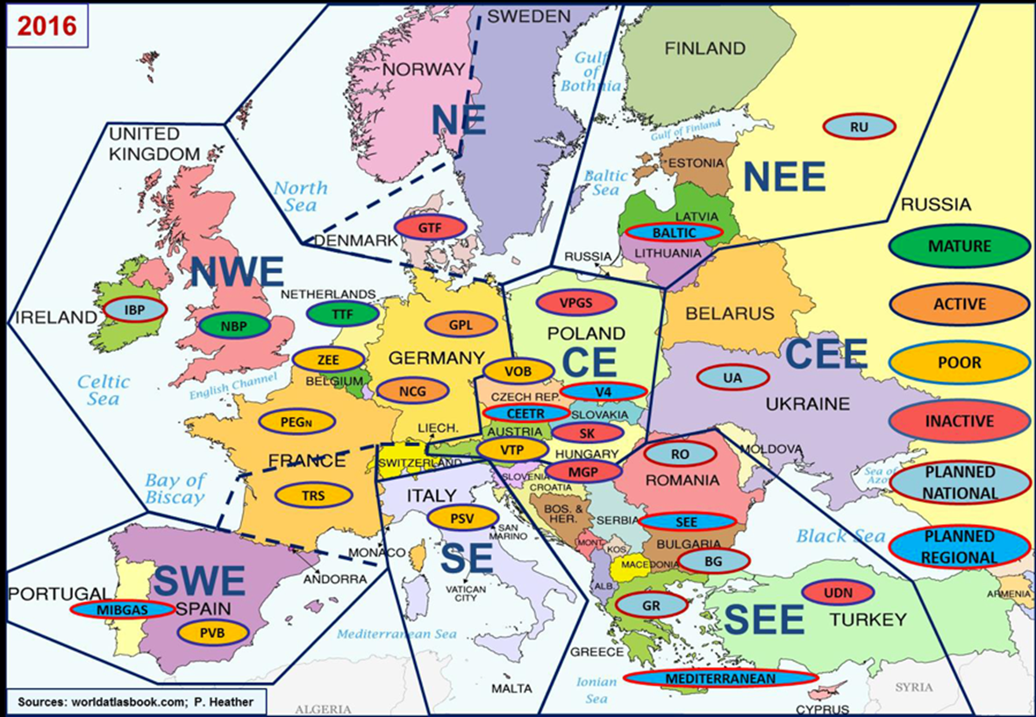
Gas markets and virtual trading points (VTP) in Europe

Slide 4
Transmission networks define gas market areas², and allow for wholesale markets and cross-border trading
market area C
TSO C
C1
VTP
C2
C3
A2
B2
VTP
VTP
B3
A1
B1
A3
B4
²⁾ Note that market areas, wholesale markets, and entry-exit systems are synonyms.
market area A
TSO A
market area B
TSO B

Slide 5
Market mergers aim at improving wholesale markets
market area C
TSO C
market area C
TSO C
C1
C1
VTP
VTP
C2
C3
C2
C3
A2
B2
A2
B2
VTP
VTP
B3
VTP
B3
A1
B1
A3
A3
B4
B4
market area A
TSO A
market area B
TSO B
market area A/B
TSO A and TSO B

Slide 6
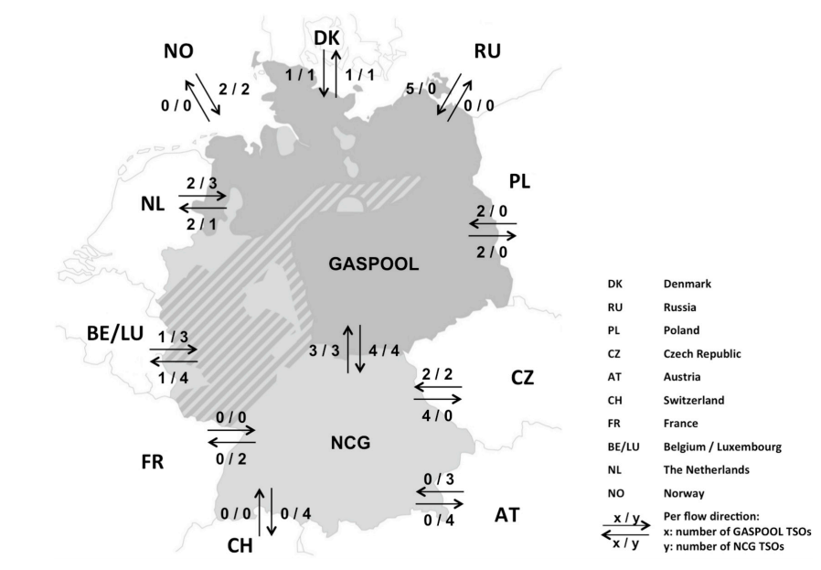
Gas market mergers in practice
Under discussion between
Spain and Portugal,
Croatia and Hungary,
Italy and Austria, and
amongst Baltic States.
Remaining two German markets to merge by 10/ 2021

Slide 7
Interim conclusion and motivation
Market mergers are foreseen to benefit wholesale markets
Commercial impact on TSOs are not in scope
Market mergers take place in practice
Market mergers create gas transport substitutes
Research related questions
What impact do market mergers mean for the regulation of gas TSOs?
Do TSO face competitive pressure from other TSOs being substitutes?
Does the presence of substitutes impact TSOs’ tariff setting?

Slide 8
Theory: tariff related incentives under revenue-cap regime (I)
Revenue-cap regulation is the most common one used for EU gas TSOs
In setting tariffs, TSO may be free but face an allowed revenue constraint:
Revenue-cap regulation is characterised by a regulatory account to shield the TSO against volume revenue risks (and chances), i.e., over- and under recoveries:
→ The presence of a regulatory account, which is essential to revenue-cap regulation, does not set incentives to consider substitute TSOs in setting tariffs.
$$\overline{R}≥\sum_{i=1}^{n}{capacity bookings_{i}^{f}×tariff_{i}}$$
$$RA_{t}=R_{t}−tariff_{t}×capacity booking_{t}$$
$$R_{t+1}=R_{t}+RA_{t}$$
Notes:
Formulas simplified

Slide 9
Theory: tariff related incentives under revenue-cap regime (II)
To simulate competition, an additional efficiency benchmarking can be applied
Idea: compare the productivity of firm i against a benchmark j to obtain an efficiency score (ES), and consider it in setting the (efficient) allowed revenues:
In a merged market, substitute TSO compete for demand: they compete for output.
Whereas a regulatory account shields against volume related under-recoveries, it does not shield the TSO against efficiency losses (would be contradicting).
Hypothesis: Tariffs at multi-TSO borders are expected to be lower as compared to tariffs at border, where only one TSO offers capacity (with no substitutes).
$${\overline{R}}_{i,rp}=TOTEX_{i,rp−1} ×ES_{i,rp−1} ;with ES_{i}\frac{{(output/input)}_{i}}{{(output/input)}_{j}}$$
Notes:
Formulas simplified

Slide 10
Empirically analysis: Are tariffs at multi-TSO borders lower?
Panel data analysis with $i=1,…,35$ and $t=2015,…,2018$
Cross-border tariffs set by German TSOs
Number of TSOs active at a border | Frequency | Percent
1 | 72 | 43.64
2 | 52 | 31.52
3 | 35 | 21.21
4 | 6 | 3.64
Total | 165 | 100
43.64%
56.37%

Slide 11
Empirical model and expectations
$$\ln\left(Tar_{i,t}^{s}\right)=β_{i}^{s}{+β}_{t}^{s}+β_{1}^{s}{dS}_{i,t}+β_{2}^{s}dCo_{i,t}^{f}+β_{3}^{s}ln\left(\frac{\sum_{k=1}^{m}{AR_{k,i,t}^{f}}}{m_{i,t}}\right)+β_{4}^{s}\ln\left(\frac{\sum_{k=1}^{m}{{CB}_{k,i,t}^{f}}}{m_{i,t}}\right)+u_{i,t}^{s}$$
whereby the selected sample s = minimum, maximum, and median tariffs.
Variable | Meaning | Expectation
$$dS_{i,t}$$ | Dummy indicating if more than one TSO is active | $$β_{1}<0$$
$$dCo_{i,t}^{f}$$ | Dummy indicating if border is congested | $$β_{2}<0$$
$$\frac{\sum_{k=1}^{m}{AR_{k,i,t}^{f}}}{m_{i,t}}$$ | Control variable: Average allowed revenues | $$β_{3}>0$$
$$\frac{\sum_{k=1}^{m}{{CB}_{k,i,t}^{f}}}{m_{i,t}}$$ | Control variable: Average capacity bookings | $$β_{4}<0$$

Slide 12
Results
A sensitivity analysis shows that these results are robust to structural differences between transit and meshed networks.
Variable | Expectation | $$ln\left(Tar^{min}\right)$$ | $$ln\left(Tar^{max}\right)$$ | $$ln\left(Tar^{median}\right)$$
$$dS_{i,t}$$ | $$β_{1}<0$$ | -0.5161*** | -0.0783*** | -0.2854***
$$dCo_{i,t}^{f}$$ | $$β_{2}<0$$ | -0.0887 | 0.0028 | 0.0030
$$\frac{\sum_{k=1}^{m}{AR_{k,i,t}^{f}}}{m_{i,t}}$$ | $$β_{3}>0$$ | -0.0176 | 0.2319** | 0.3753***
$$\frac{\sum_{k=1}^{m}{{CB}_{k,i,t}^{f}}}{m_{i,t}}$$ | $$β_{4}<0$$ | -0.1702 | -0.1523*** | -0.2298***
Two-tailed p values: *p < 0.10; **p < 0.05; ***p < 0.01

Slide 13
Conclusions
Tariffs are up to 52% lower in situations, where capacity at a border is offered by more than one TSO.
In a merged gas market, (German) TSOs appear to consider the presences of other TSOs, being a substitute to network users, in setting their tariffs.
The incentive is not based on capping the maximum revenues but is due to efficiency benchmarking
Market mergers increase competitive pressure on TSOs if they are exposed to an efficiency benchmarking, and even if operating under a revenue-cap regime

Slide 14
Policy recommendations for merged gas markets
CBA of market mergers should additionally focus on the impact on TSOs
Discuss the possibility for regulatory changes to allow for enhanced inter-TSO competition
Consider benchmarking in multi-TSO merged markets if not already existing
Consider conducting a market power assessment, which may allow for additional regulatory changes / deregulation

