Slide 1
DUEBE: AN AGENT BASED SIMULATOR FOR SMART RETAIL POWER MARKETS
Stefano Zambotti, Institute for Renewable Energy, Eurac Research, Italy and IHS, Institute for Housing and Urban Development Studies, Erasmus University, Netherlands; stefano.zambotti@eurac.edu
Clarisse Dupont, Ecole Normale Supérieure Paris-Saclay, France; clarisse.dupont@ens-paris-saclay.fr
Mohammad Ansarin, Rotterdam School of Management, Erasmus University, Netherlands; ansarin@rsm.nl
Yashar Ghiassi-Farrokhfal, Rotterdam School of Management, Erasmus University, Netherlands; y.ghiassi@rsm.nl

Slide 2
INTRODUCTION
Retail Power Market
It is the market where intermediaries (i.e. retailers) sell electricity bought on the wholesale market to consumers and prosumers
Consumers and prosumers can usually choose among a default retailer and a few competitive retailers
Consumers may choose among:
Fixed-price tariffs: the price remains fixed during the contract period
Variable-price tariffs: dynamic prices that at least to a certain extent transmit wholesale market signals to customers
1

Slide 3
INTRODUCTION
Retail Power Markets fall short
Retail competition hasn’t resulted in cost reflective end user prices (hardly ever move with wholesale prices)
Retail rate design fails to incentivize energy efficiency (i.g. does not capture the economic value of distributed renewable generation)
This has incentivized the introduction of subsidies (which can cause price distortions), such as Feed-in Tariffs
2

Slide 4
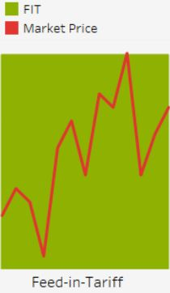
INTRODUCTION
Feed-in Tariff
What is it?
Policy mechanism designed to accelerate investment in renewable energy
(energy-based payment)
Its goal is to offer cost-based compensation to renewable energy producers,
providing price certainty
Criticisms
Often unsustainably high and have frequently failed to track rapidly changing technology costs
FITs are incompatible with competitive markets (it prevents competition between technologies and does not maximize social welfare)
FITs will gradually need to be phased out and give way to Wholesale market prices! …..many experts say
3

Slide 5
AIM OF THE STUDY
Compare FIT with Wholesale market price (WMP) as buy-back price in a smart grid context (highly automated scenarios with high elasticity to prices and fully rational agents)
Provide insights on the impact of different combinations of buy-back prices (FIT and WMP) and metering modes on:
Overall consumption
Peak loads
Average $/kWh
Retail profit
4

Slide 6
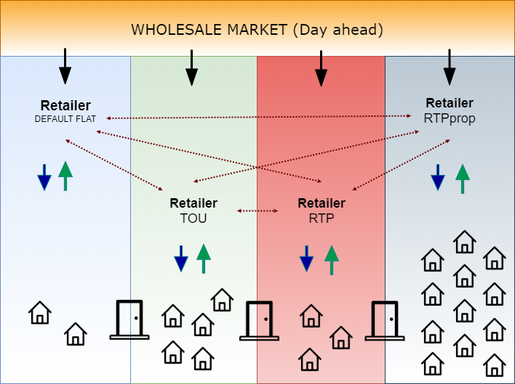
METHODS – ABM MODEL
Arrows: financial transactions
Dotted arrows: information
5

Slide 7
METHODS – TARIFF STRUCTURES
6

Slide 8
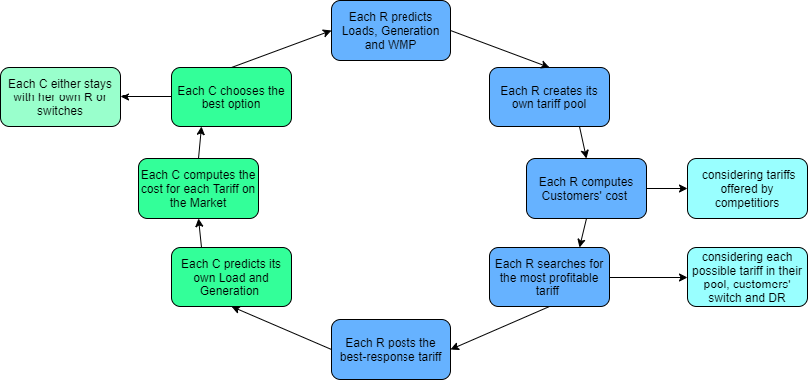
METHODS – ABM MODEL
7

Slide 9
METHODS – DATA
DEMAND AND GENERATION PROFILES
Hourly consumption and generation (PV) for 25 households (Austin, TX, USA) for the full year of 2018
WHOLESALE MARKET PRICE (DA)
Hourly DA market prices from the Electric Reliability Council of Texas (ERCOT), for the full year of 2018
8

Slide 10
METHODS – SETTING OF THE SIMULATIONS
The default retailer: 0.20 $/kWh
Length of the simulation: 100 weeks
Errors in forecasting: we apply a Normal distribution with SD:0.1 and MEAN:0 to measured data
Number of retailers: 1 per tariff structure (ToU, RTP, and RTPprop);
Elasticity to prices: -0.3
Buy-back price - $/kWh: FIT: 0.20, 0.10, 0.05, 0.01, WMP
Metering mode: net-metering, gross-metering
PV penetration: 76% of customers has a PV system
9

Slide 11
RESULTS – Consumption and Peak Loads
General
FIT has a way higher effect on Gross-metering scenarios
Higher volumes to be compensated
Consumption
The lower the FIT, the higher the consumption
Tariffs are lower and therefore consumption is higher
Peak Loads
The lower the FIT, the higher the peak loads in GF scenarios
In NF scenarios, peak loads are quite stable
FIT has a way higher effect on Gross-metering scenarios
WMP
Under Net-WMP, peak loads are the lowest
10

Slide 12
RESULTS – Retail Profit
General
FIT has a way higher effect on Gross-metering scenarios
Higher volumes to be compensated
Retail Profit
The lower the FIT, the higher the Retail profit
Tariffs are lower consumption is higher
WMP
The lowest profit is under Net-WMP
11

Slide 13
RESULTS – Avg $/kWh and Retail Profit
General
FIT has a way higher effect on Gross-metering scenarios
Higher volumes to be compensated
Retail Profit
The lower the FIT, the higher the Retail profit
Tariffs are lower but consumption is higher
WMP
The lowest profit is under Net-WMP
The lowest $/kWh is under Net-WMP
$/kWh
The lower the FIT, the higher the $/kWh
Tariffs are lower but consumption is higher and FIT compensation is lower
12

Slide 14
RESULTS – Avg $/kWh and Retail Profit
General
FIT has a way higher effect on Gross-metering scenarios
Higher volumes to be compensated
Retail Profit
The lower the FIT, the higher the Retail profit
Tariffs are lower but consumption is higher
WMP
The lowest $/kWh is under Net-WMP
The lowest profit is under Net-WMP
$/kWh
The lower the FIT, the higher the $/kWh
Tariffs are lower but consumption is higher and FIT compensation is lower
Profit share
In most cases (90%), RTPprop has the realtive majority of profit share
Followed by TOU
Customers find them relatively more convenient
13

Slide 15
TAKE-AWAY MESSAGES
Retailers’ perspective: low FIT seems to lead to highest profits
Customers’ perspective: the Net-metering with no FIT scenario seems to lead to lowest $/kWh (lowest operational costs)
DSOs’ perspective: high FIT under gross-metering seems to lead to lowest peak loads (unintended effect of )
Net-WMP seems to be the best option overall:
Lowest $/kWh
Second lowest peak loads
Second highest overall consumption
Lowest retail profit (?)
Not studied here but might eliminate unequal redistribution effects (no FIT socialized)
14

Slide 16
THANK YOU FOR YOUR ATTENTION
Stefano Zambotti - stefano.zambotti@eurac.edu
Researcher at Institute for Renewable Energy, Eurac Research (IT) and PhD Candidate at Erasmus University Rotterdam (NL)

