Slide 1
HOW TO COMMUNICATE THE MULTIPLE BENEFITS OF ELECTRIC VEHICLES: RESULTS FROM A CONTROLLED EXPERIMENT
07/06/2021
James Carroll, Trinity College Dublin
Eleanor Denny, Trinity College Dublin
jacarrol@tcd.ie

Slide 2
What is GreenCar?
Objective:
Understanding barriers and enablers of EV adoption in Ireland
Core Hypothesis:
Imperfect information regarding fuel cost/CO2 implications of EV-switch
Core Empirical Exercises:
WP3: Consumer Survey with Car Choice Experiment (2020)
WP4: Field Trial with Hyundai Ireland (2021)

Slide 3
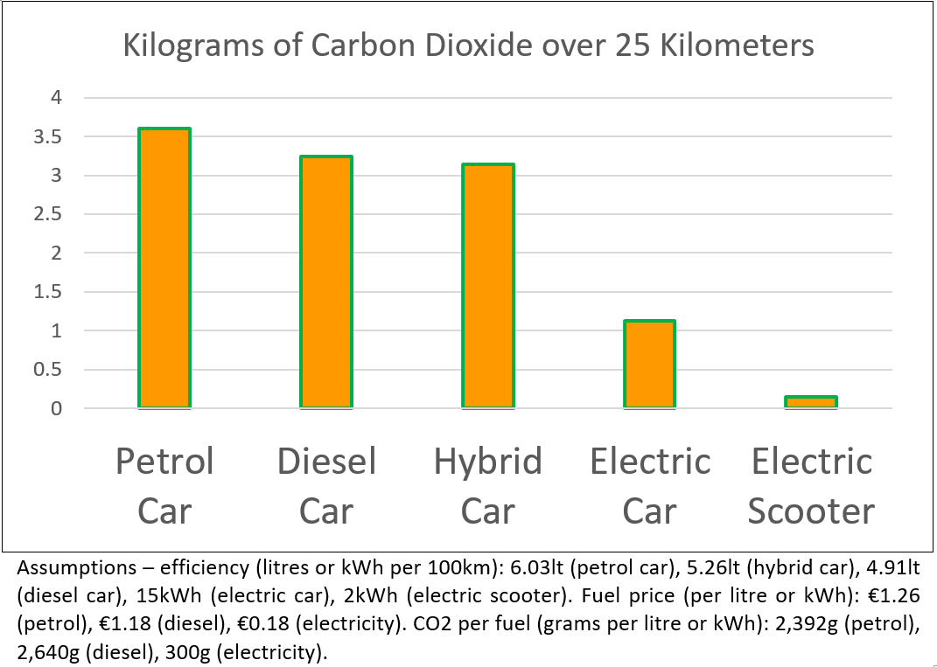
Research Backdrop
Why EVs?
Costs
More expensive (≈ + 20%)
Higher upstream CO₂ (≈ + 30%)
Batteries difficult to recycle
Benefits
Efficiency: CO₂ and energy costs (≈ - 70%)

Slide 4
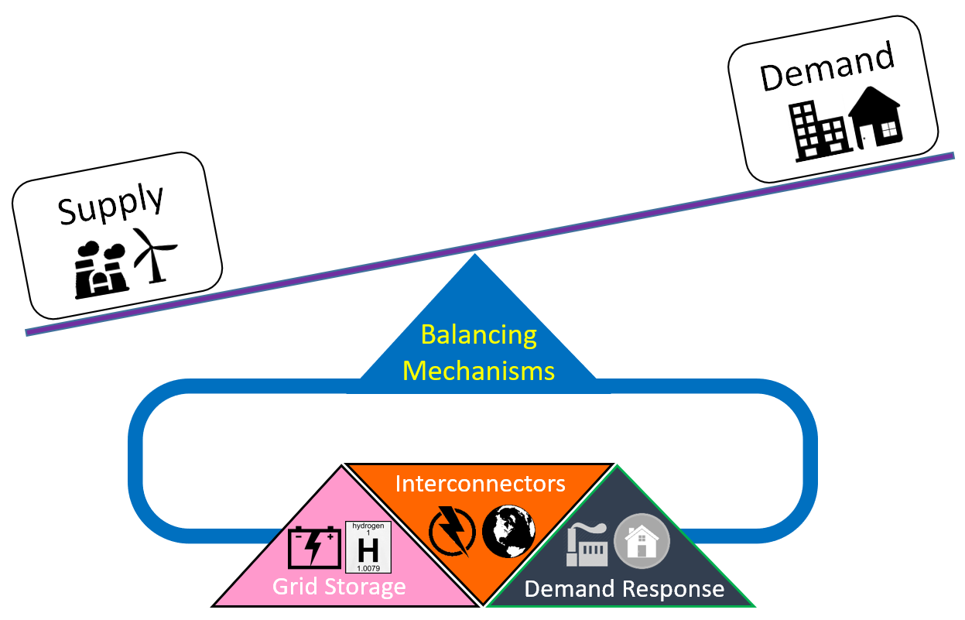
Research Backdrop
Why EVs?
Costs
More expensive (≈ + 20%)
Higher upstream CO₂ (≈ + 30%)
Batteries difficult to recycle
Benefits
Efficiency: CO₂ and energy costs (≈ - 70%)
Grid Balancing

Slide 5
Research Backdrop
Where do we want to be?
EU: Net-Zero CO2 by 2050
IE: 1M EV sales by 2030
Where are we?
Approx. 15,000 sales (since 2015)
Supports
€5,000 grant
€5,000 VRT exemption
BIK exempt
Half-price tolls
€600 home charger grant

Slide 6
Car Labelling Discrete Choice Experiment

Slide 7
Theory and Hypothesis
We already know…
Low awareness of fuel efficiency (Turrentine and Kurani, 2007; Allcott, 2011)
Efficiency not important attribute when investing (OECD and Greene, 2010; Grünig et al., 2010; Codagnone et al., 2013)
Information (labelling) not particularly influential
Effects of fuel efficiency labels unknown
Trust in information is low (OECD and Greene, 2010; Carroll et al., 2014; Haq and Weiss, 2016; Fontaras et al., 2017)
Framing efficiency in monetary terms leads to higher demand (Codagnone et al., 2013; Codagnone et al., 2016; Brazil et al., 2019)

Slide 8
Theory and Hypothesis
How should a household choose between low efficiency (0) and high efficiency (1)?
COSTS $<$ BENEFITS
$${(c}_{1}−c_{0})<\sum_{t=1}^{10}{ \frac{mp\left(e_{0}−e_{1}\right)}{{\left(1+r\right)}^{t}}}$$

Slide 9
Theory and Hypothesis
How should a household choose between low efficiency (0) and high efficiency (1)?
$${(c}_{1}−c_{0})<\sum_{t=1}^{10}{ \frac{mp\left(e_{0}−e_{1}\right)}{{\left(1+r\right)}^{t}}}$$
Fuel
Price
Efficiency
Mileage
Investment cost
Discount Rate

Slide 10
Theory and Hypothesis
How might a household actually choose an EV?
$${(c}_{1}−c_{0})+θ+α+v<\sum_{t=1}^{10}{ \frac{mp\left(e_{0}−e_{1}\right)}{{\left(1+r\right)}^{t}}}+δ+π+ω$$
$∆$ fuelling time
$∆$ depreciation
$∆$
CO2
$∆$ performance
$∆$
driving range
$∆$ comfort

Slide 11
Theory and Hypothesis
How might a household actually choose an EV?
$${(c}_{1}−c_{0})+θ+α+v<\sum_{t=1}^{10}{ \frac{mp\left(e_{0}−e_{1}\right)}{{\left(1+r\right)}^{t}}}+δ+π+ω$$
Imperfect information, bounded rationality (transaction costs)
$∆$ fuelling time
$∆$ depreciation
$∆$
CO2
$∆$ performance
$∆$
driving range
$∆$ comfort
GreenCar

Slide 12
Theory and Hypothesis
Hypotheses
H1a: Providing comparative energy cost information increases demand for EVs
H1b: Framing fuel cost information over longer periods increases demand
H2a: Providing comparative CO₂ information increases demand for EVs
H2b: Framing CO₂ information over longer periods increases demand

Slide 13
Theory and Hypothesis
Hypotheses
H1a: Providing comparative energy cost information increases demand for EVs
H1b: Framing fuel cost information over longer periods increases demand
H2a: Providing comparative CO₂ information increases demand for EVs
H2b: Framing CO₂ information over longer periods increases demand
H3: Interactions?

Slide 14
Methodology
Discrete Choice Experiment
Hypothetical
Stated Preference
Often used for new products or valuation of public goods
Can serve as a benchmark for experimental analysis
Steps
Disaggregate product into attributes (based on prior research and focus groups)
Define attribute levels and bounds
Randomise attributes/levels in choice sets
Pros
Control
Low cost
Cons
Hypothetical bias
GreenCar DCE
2-step “pivot” design
+ 8 experimental groups….

Slide 15
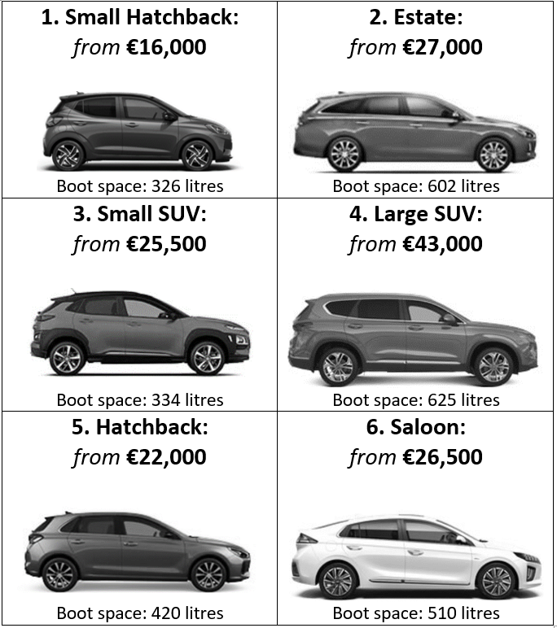
Methodology
Car Choice Experiment
Step 1: Baseline Car Choice (+ colour and engine options (non-EV)… )

Slide 16
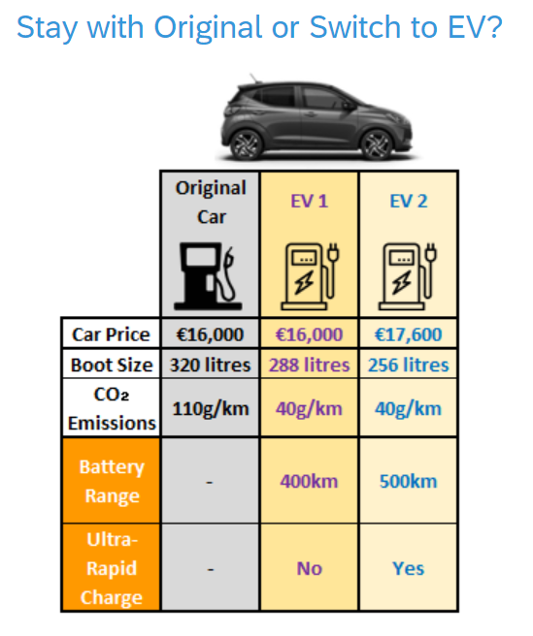
Methodology
Car Choice Experiment
Step 1: Baseline Car Choice (+ colour and engine options (non-EV)… ) | Step 2: Present 2 EV Alternatives (Identical to Baseline except for… )

Slide 17
Methodology
Car Choice Experiment
Step 1: Baseline Car Choice (+ colour and engine options (non-EV)… ) | Step 2: Present 2 EV Alternatives (Identical to Baseline except for… )
Randomised EV Attribute Levels

Slide 18
Methodology
Car Choice Experiment
Step 1: Baseline Car Choice (+ colour and engine options (non-EV)… ) | Step 2: Present 2 EV Alternatives (Identical to Baseline except for… )
Randomised Efficiency Frame…

Slide 19
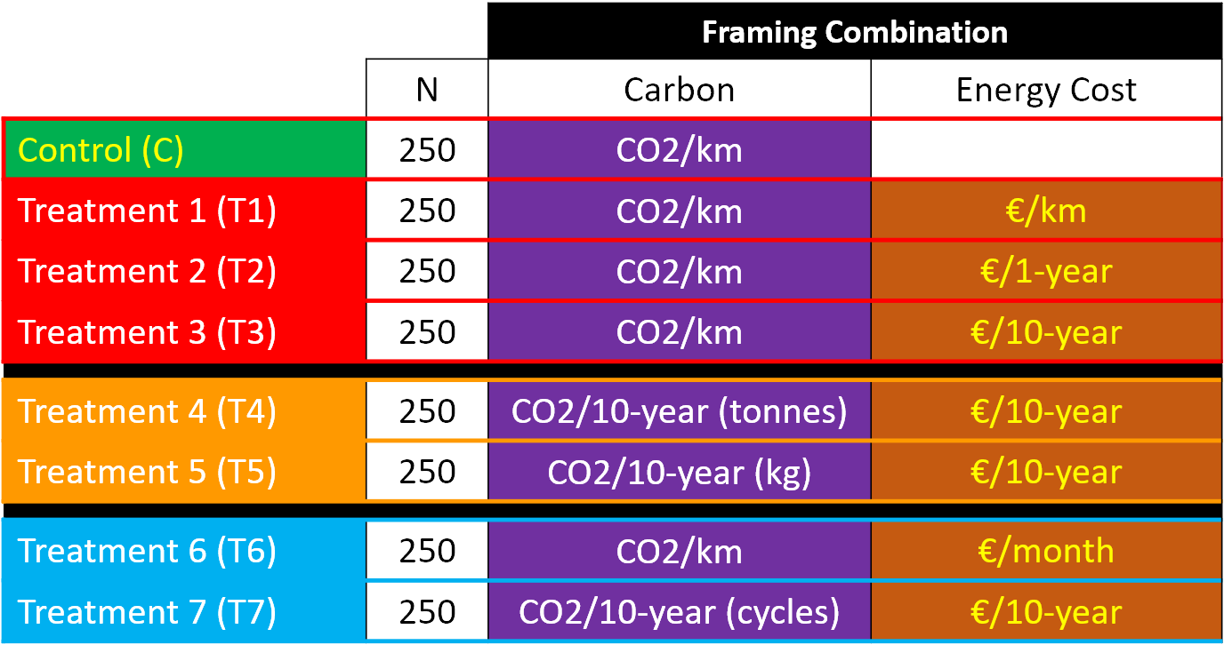
Methodology

Slide 20
Methodology

Slide 21
Methodology

Slide 22
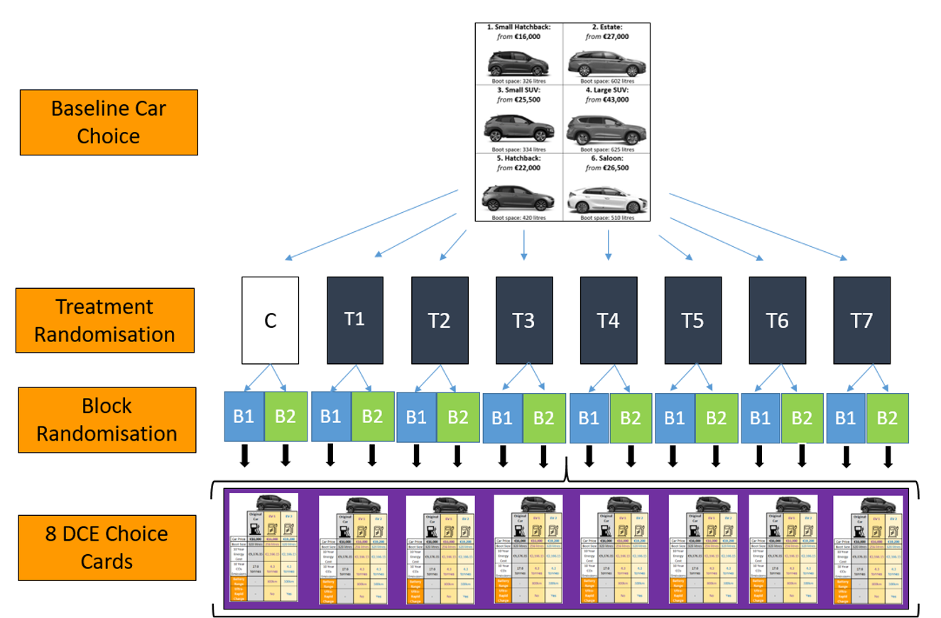
Methodology

Slide 23
Sample
Sampling Strategy
Method: Online (Qualtrics)
Size: 2,000
Quotas: Age (based on UK new car buyer age shares)
Screening: Bought a new car in the past ten years
Sampling Issues
Missed older age quota
Solution: weight

Slide 24
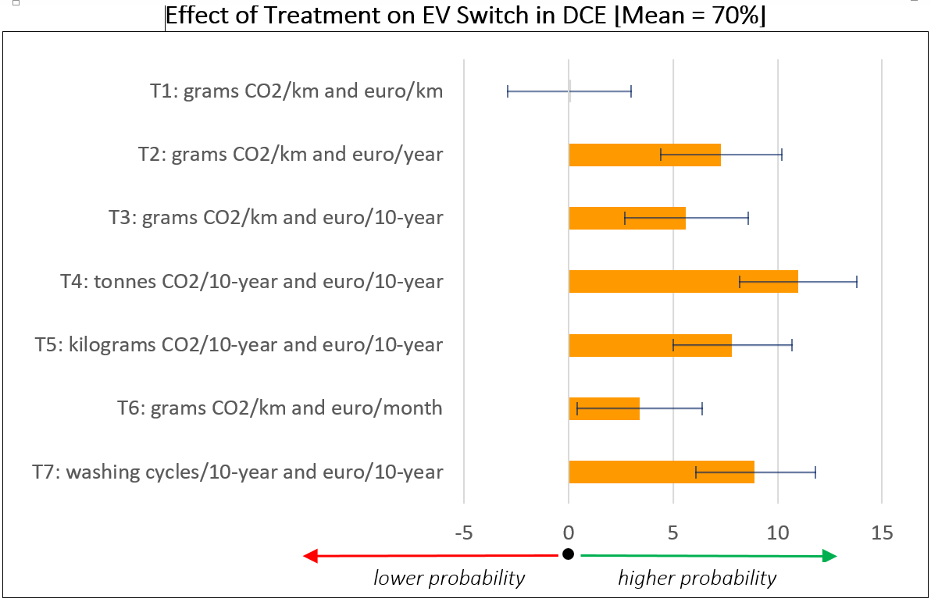
Key Results – Switch Rates Vs Control
Model = Logit; Dependent Variable = Switch to EV; Independent Variable = Treatment Group

Slide 25
Key Results – Switch Rates Vs Control
No Effect

Slide 26
Key Results – Switch Rates Vs Control
€€€ Duration Matters

Slide 27
Key Results – Switch Rates Vs Control
CO2 Duration Matters

Slide 28
Key Results – Switch Rates Vs Control
Monthly Frame less affective

Slide 29
Key Results – Switch Rates Vs Control
Same as “tonnes”

Slide 30
Key Results – Demographic Interactions
Treatment effects are…
lower for highest income group (8 PPs lower)
higher for those very concerned about climate change (7 PPs higher)
higher for households that responded “don’t know” or “uncertain” in relation to monthly fuel costs (11 PPs higher) and current fuel prices (21 PPs higher)

Slide 31
Key Results – Other DCE Attributes
Effect on EV Switch Rate (Average: 70%)…
Price (reference: same as ICE): +10% (↓7.3%), +20% (↓16%), +30% (↓24%)
Range (reference: 500km): 400km (↓4.2%), 300km (↓11.6%), 200km (↓19%)
Ultra-Fast Charging (reference: No): No (↓7.3%)
Boot Size (reference: same as ICE): -10% (↓3.7%), -20% (↓4%)
Model = Mixed Logit; Dependent Variable = Car Choice; Independent Variable = Attributes

Slide 32
Extra – Concerns (Extremely or Moderately)

Slide 33
Conclusion
Framing of fuel efficiency matters in EV switch decisions
BUT other factors more important, particularly
Price
Range

Slide 34
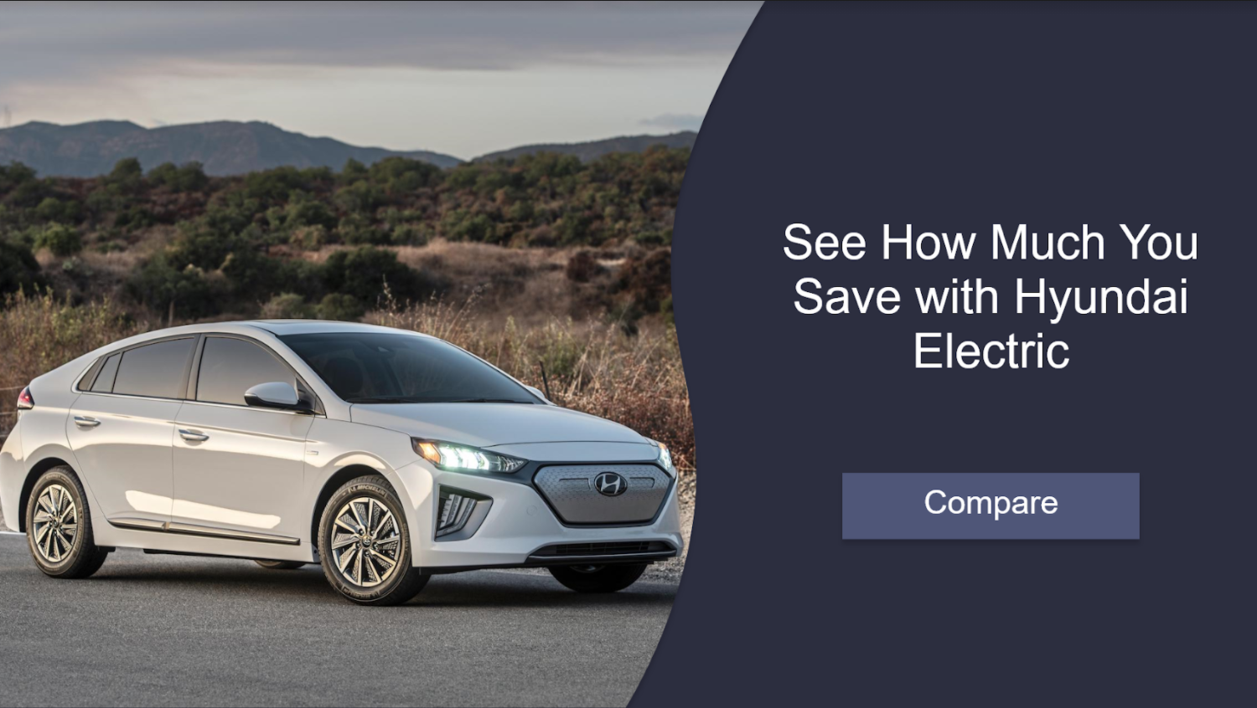
Conclusion
Framing of fuel efficiency matters in EV switch decisions
BUT other factors more important, particularly
Price
Range
Hypothetical bias?
Next step – field trial with Hyundai Ireland

Slide 35
GreenCar
James Carroll
jacarrol@tcd.ie
Eleanor Denny
dennye@tcd.ie

