Slide 1
EU GAS MARKET INTEGRATION 2.0
Mariana Liakopoulou
Energy Security Research Fellow
NATO Association of Canada
1st IAEE Online Conference
June 07, 2021.

Slide 2
PRESENTATION SCOPE

Slide 3
PRESENTATION OUTLINE
1. Introduction
2. Regulatory Overview of Gas Market Decarbonization
3. Securitization in the Gas Decarbonization Process
4. Conclusions

Slide 4
INTRODUCTION
Pillars of Conventional Gas Market Integration
Law-making procedure from the early 90s to date. Time & effort for the internal gas market to shape up… & for the EU to acquire Treaty-based competence to develop energy policy, incl. on gas. → Why? Due to negative spill-overs (Tagliapietra and Zachmann 2016) from national approaches:
Private investment stimulation
Cost-effectiveness of distinct portfolios of flexibility options

Slide 5
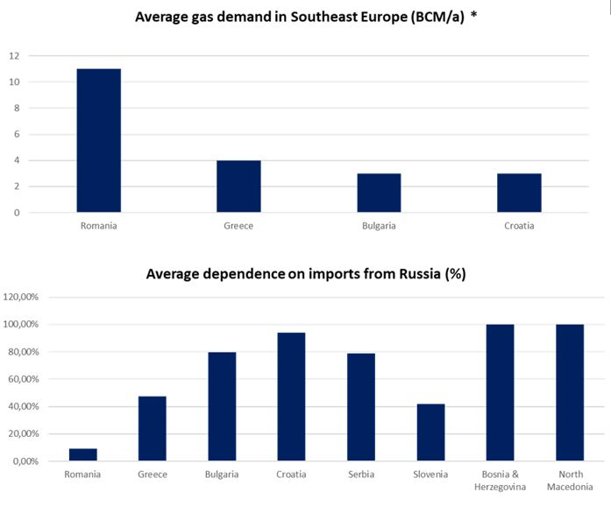
EU gas market liberalization driven by: Treaty-based, risk-sharing perception of SoS as an inter-MS “solidarity” issue (Art. 194 TFEU). Interconnectivity & operational transparency. Incentivization of imports on alternative routes, incl. LNG + reverse flows for inter-MS price convergence. Scope of supply diversification: Easing of tightness in times of gas shortfalls via market-based responses. NWE: Greater integration via reduction of c-b barriers & timely implementation of GOG competition. Importance of the acquis extension to CEE & SEE.
* Turkey excluded, no gas markets in Albania, Kosovo, Montenegro. Sources: BP Statistical Review of World Energy 2020, Energy Community, IEA, Gazprom Export, Statistical Office of the Republic of Serbia, US Department of Commerce, Author’s Analysis.

Slide 6
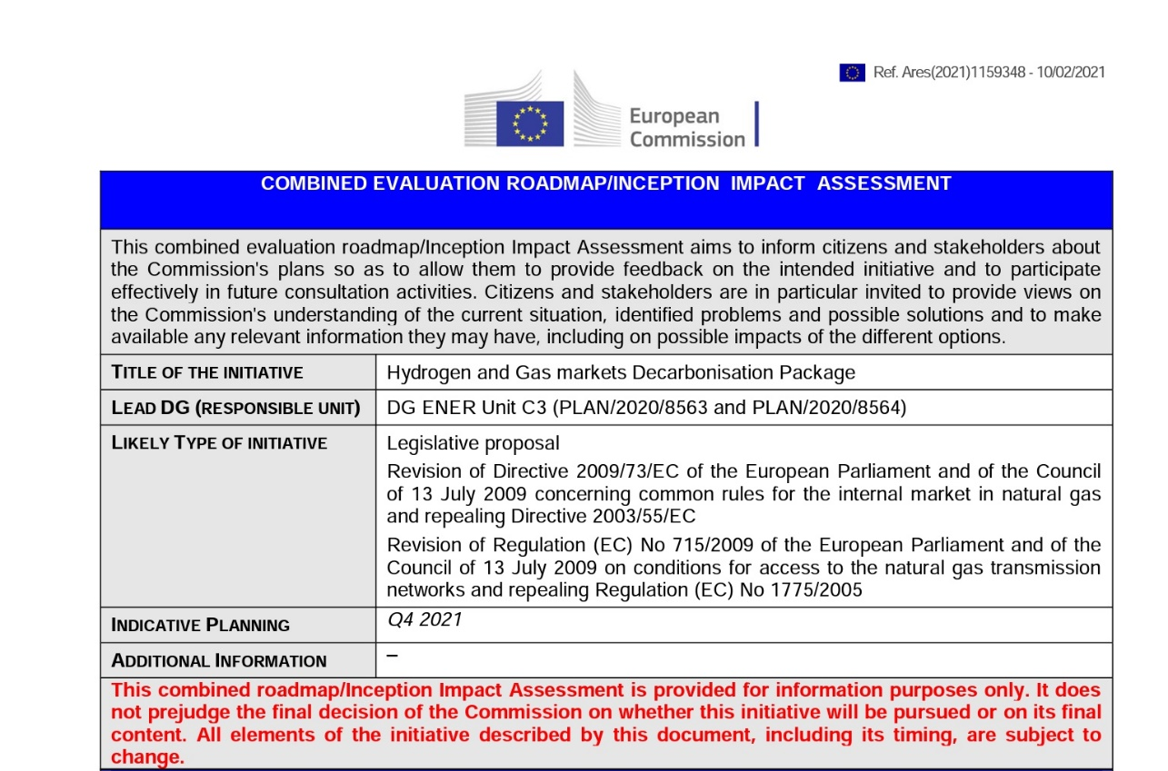
Decarbonization among the five closely related and mutually reinforcing Energy Union dimensions. Gas Sector Decarbonization: Notably constrained incremental capacity; Progressive replacement of unabated gas with higher shares of green gases (biogas/biomethane, NG- and RE-sourced H2, syngas). → EC: “Biogas, biomethane, renewable & decarbonised hydrogen as well as synthetic methane would represent some 2/3 of the gaseous fuels in the 2050 energy mix, with fossil gas with CCS/U representing the remainder.”

Slide 7
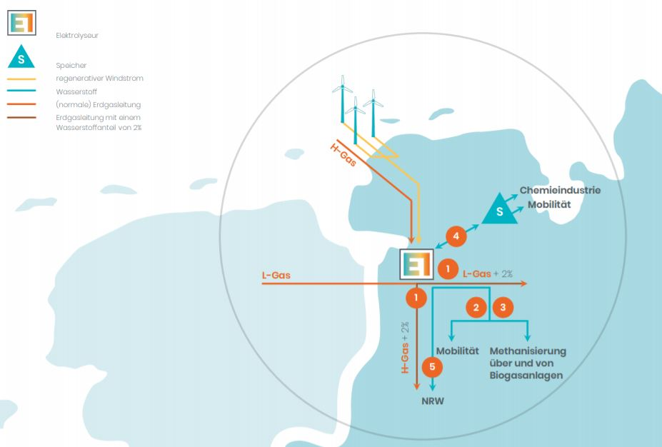
Sector coupling as pillar of energy system integration. Integration of gas & electricity sectors. Value of existing gas infrastructure in transferring energy over long distances and at low energy losses and in providing large seasonal energy storage capacities. P2G: Harmonization of RES temporal profile with energy demand (storage) + RES availability further from consumption centers (interconnectors). 30th Madrid Forum: Dual energy system with a significant role of renewable gas alongside renewable electricity.
The TenneT, Gasunie Deutschland and Thyssengas 100MW pilot P2G plant in Lower Saxony as example of coupling the electricity and gas grids. Source: Tennet.eu

Slide 8
Gas Directive, Art. 1.2: “The rules established by this Directive for natural gas, including LNG, shall also apply in a nondiscriminatory way to biogas and gas from biomass or other types of gas in so far as such gases can technically and safely be injected into, and transported through, the natural gas system.”
Regulation (EC) No 715/2009 & Directive 2009/73/EC to serve establishment of basic future H2 market rules, ensuring sector integration and preventing regulatory silos. BUT: 2050s’ carbon-neutrality not to be met with CH4/H2 admixtures, leading to regulation for dedicated H2 networks and their intra-EU ownership. Path-dependencies & lock-in effects from excessive concentration on the nat. gas framework? Applicability of the Gas Directive to H2 & biomethane blends + c-b trade. Need to tailor existing framework to the de-centralized upstream sector in green gases.

Slide 9
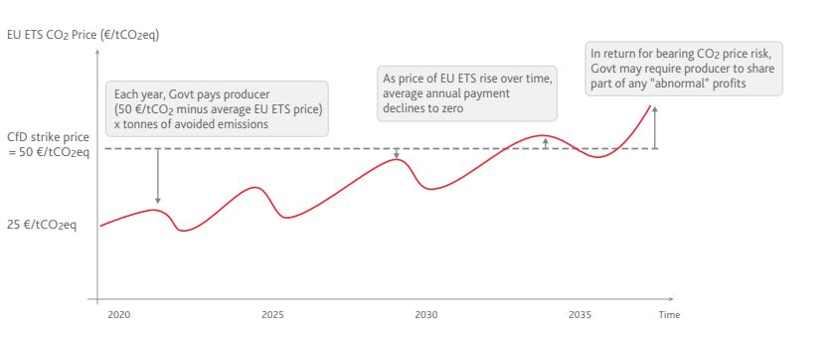
Prioritization of RE-sourced H2, which could take hold if high CH4 prices are coupled with low solar & wind costs. CCfDs → Risk mitigation also for low-carbon H2 investments, assuming that the latter will prove initially cheaper until upscaling of electrolyzers to the case of GWs is achieved. CCfDs based on LTCs between investor & public body compensating the price difference between fossil-based + clean hydrogen production by paying the difference between a mutually agreed CO2 strike price and the EU ETS carbon price (Sartor and Bataille 2019).
Example of how a CCfD could work to support commercial-scale investments in first-of-a-kind decarbonised basic materials production. Source: Sartor, O. and Bataille, C., 2019. Decarbonising basic materials in Europe: How Carbon Contracts-for-Difference could help bring breakthrough technologies to market. IDDRI, Sciences Po.

Slide 10
Relevance of regulated TPA for gas TSO/DSO-operated P2G installations - Directive (EU) 2019/944 foresees P2G investments by electricity TSOs, as part of their involvement in energy storage activities. Two-fold model: 1) Temporary exemptions from ownership unbundling, 2) TSO ownership of the electrolyzer but not of production capacity, which would be auctioned off to the market (Pototschnig 2021), based on the logic of LNG regasification capacity auctions. Overall, such activities should preferably be developed under market conditions by gas producers/suppliers and not regulated monopolies, but operators could equally participate if NRAs can verify the lack of market-based investment options.

Slide 11
Turning green gases into tradable commodities → creation of a market in green gases regardless of origin supported by GOOs. Important to safeguard intra-EU interoperability & conversion from one carrier to another. Directive (EU) 2018/2001: GOOs for biomethane & RE-sourced H2 + intl. agreements (Art. 19.11). As with the electricity market, standardization of GOOs with a view to inter-MS trade, imposition of fuel mix disclosure obligations on gas suppliers & gas residual mix methodology, if GOOs remain a voluntary scheme (Sardi et al., 2020). “RES” vs “normal” GOOs → Where would GOOs (+ intl. agreements) for NG-sourced H2, potentially with the Taxonomy-set GHG threshold [gCO2e/kWh], fit.

Slide 12
Market participants need a clear picture of the whole system price signals, incl. alignment needs between gas & electricity grid tariffs. Level-playing field by technologically-neutral application of tariffication to comparable activities across electricity & gas sectors, “based on the principle of charging for the network services by properly considering the potential offsetting effect and the overall cost impact on the networks.” (ACER 2021). Revision of tariff methodologies on the distribution level may also be needed to reflect injections, incl. to the transmission system, and provision of interruptible services.

Slide 13
TEN-E revision proposal: “smart gas grids” + “future-proof” gas investments. TYNDPs admittedly the only scenario building common to the ENTSOs. But DSO involvement in the decentralized system necessitates greater participation by the EU Institutions would help avert a TSO/DSO conflict of interest (e.g. ACER approval of CBA). Regulatory sandboxes to kick-start innovation at the NRA level. Collaborative support by multiple MS of specific innovation projects as IPCEIs, acc. to EC-set standards.

Slide 14
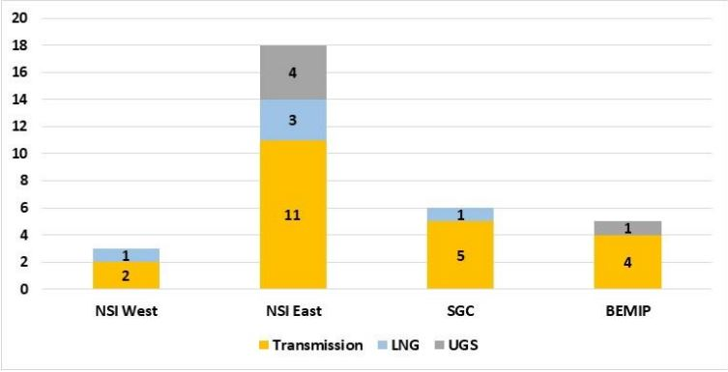
Conventional gas market integration at the software & hardware levels needed prior to and towards decarbonization. Failure to achieve price arbitrage and Union-wide SoS equally detrimental to a single market in green gases. Need for even geographic dissemination of the gas market acquis (market liquidity & competition). Issue of abolishment of PCI status of projects set to foster integration in CEE/SEE.
Number of gas PCIs per priority corridor. Source: EU ACER, 2020. Consolidated Report on the progress of electricity and gas Projects of Common Interest (2020)

Slide 15
Absence of a mature industry in green gases # 20-year liberalization process for NWE’s benchmarks to develop. Regulation conducive to attracting market participants provided it is combined with the simultaneous development of a physical market “servicing an established supply/demand infrastructure” (Heather 2021). Issue of regulation of early-stage GOG competition when green gas feedstock would still be scarce. The EU could profit from global trade in green gases, incl. via re-purposed LNG plants, if cost differences between in-sourced and imported gases become a central consideration.

Slide 16
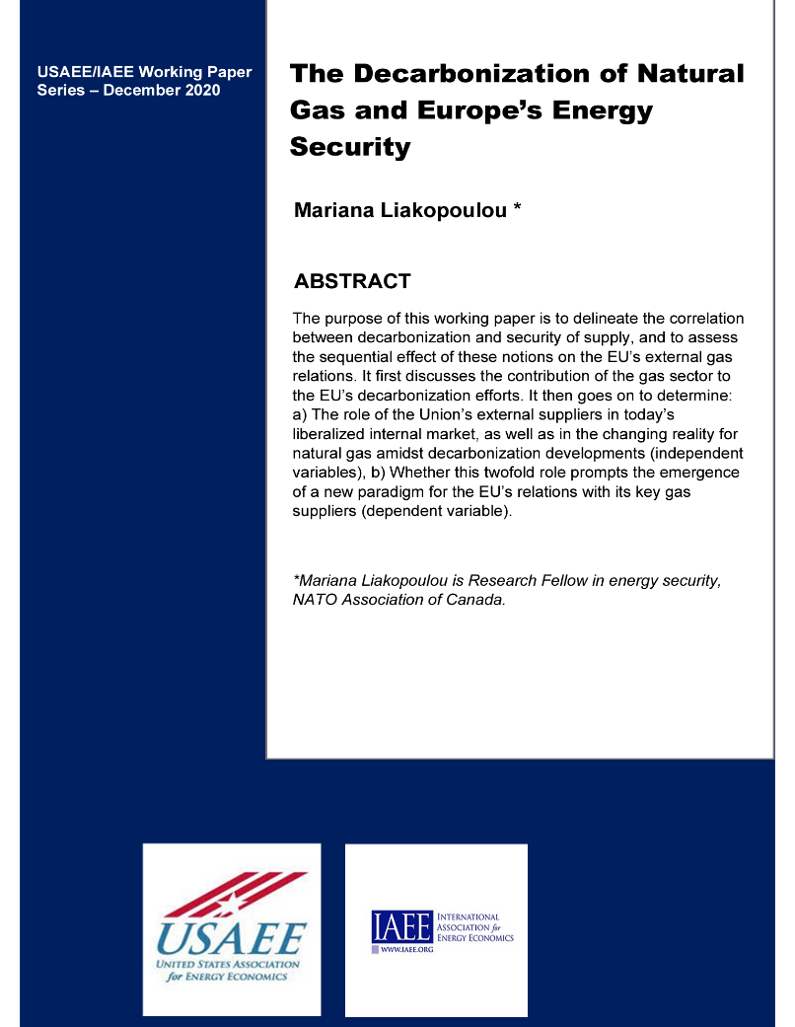
Biomethane & H2 export ambitions of the EU’s key existing and prospective suppliers further analyzed in Liakopoulou, 2021. Production locations, transport technologies, distance from and infrastructure at reception points & availability of EU demand hotspots able to fulfil “hub” functions → factors for countries to assume exporting roles and sustain gas-market-comparable dynamics, incl. likelihood of geopolitical confrontation.

Slide 17
Transition from securitization to decarbonization due to the small-scale/localized feature of green gases? → Council conclusions for the EU H2 market + Hydrogen Europe 40+40GW vision. EC associates the external dimension of the EGD with comparable efforts from the EU neighborhood, with which MS share gas and electricity infrastructure, via the Green Agenda for the Western Balkans and the EnCo Treaty. Hence, sector coupling does curtail the EU’s vulnerability vs supply disruptions… …but insofar as third-country imports of biomethane and hydrogen remain on the table the EU will maintain the rule-based market approach of its external energy policy via both soft law instruments and hybrid energy governance formats.

Slide 18
Transposition of rationale & principles of existing natural gas regulation + exploitation of existing natural gas infrastructure in a sector coupling context to bring EU gas market integration to a whole new level. Absence of a mature industry in green gases to complicate transposition of gas concepts & establishment of a traded market in green gases. Internalization of SoS will not, however, render governance of external gas relations obsolete. For this reason, the EU will have to first complete conventional gas market integration by finalization of strategic infrastructures, symmetrical geographic dissemination of the acquis and smooth depoliticization of gas trade by 2030… …so as to properly forge its external gas policy within a de-centralized system towards the 2050 carbon neutrality.

Slide 19
ACER, 2021. Regulatory Treatment of Power-to-Gas “European Green Deal” Regulatory White Paper series (paper #2) relevant to the European Commission’s Hydrogen and Energy System Integration Strategies. Ljubljana: ACER. ACER, 2020. Consolidated Report on the progress of electricity and gas Projects of Common Interest (2020). Ljubljana: ACER. EC, 2021. Combined Evaluation Roadmap/Inception Impact Assessment [online]. Available at: https://ec.europa.eu/info/law/better-regulation/have-your-say/initiatives/12766-Revision-of-EU-rules-on-Gas-_en Heather, P., 2021. “HOW A TRADED HYDROGEN MARKET MIGHT DEVELOP—LESSONS FROM THE NATURAL GAS INDUSTRY.” In: OIES Energy Forum – The Role of Hydrogen in the Energy Transition. Oxford: OIES. Liakopoulou, M., 2020. “Gas Supply Security and Decarbonization in SEE and CEE.” In: R. M. Cutler, A. Sabadus, M. Liakopoulou, C. Widdershoven, 2020. NATO-Area Energy Security: The Southeast European Flank. Toronto: NATO Association of Canada (NAOC) Webinar Series [online]. Available at: https://www.youtube.com/watch?v=cBShlPbpHGU&t=4404s Liakopoulou, M., 2021. The Decarbonization of Natural Gas and Europe’s Energy Security. Cleveland: USAEE & IAEE. Pototschnig, A., 2021. The Regulatory Approach to Power-to-Gas Facilities. Florence: Florence School of Regulation. Sardi, K., De Vita, A., Capros, P., 2020. ASSET Study on The role of Gas DSOs and distribution networks in the context of the energy transition. Brussels: DG Energy. Sartor, O. and Bataille, C., 2019. Decarbonising basic materials in Europe: How Carbon Contracts-for-Difference could help bring breakthrough technologies to market. Paris: IDDRI, Sciences Po. Tagliapietra, S. and Zachmann, G., 2016. Rethinking the security of the European Union's gas supply. Brussels: Bruegel.

Slide 20
THANK YOU
Email: mariana.liakopoulou@natoassociation.ca Email: liakopouloumariana@gmail.com LinkedIn: https://at.linkedin.com/in/mariana-liakopoulou-b029a9126 Web: http://natoassociation.ca/mariana-liakopoulou/ Web: https://liakopouloumariana.wixsite.com/energy

