Slide 1
Toward an Integrative and sustainable energy transition in the hotels of the Canary islands.
Ivelina Mirkova
FPI Scholarship Researcher in Dpto. de Economía, Contabilidad y Finanzas de la Universidad de La Laguna
Andrés Lorente de las Casas
Departamento de Economía, Contabilidad y Finanzas, Instituto Universitario de la Empresa, Universidad de La Laguna
Francisco J. Ramos-Real
Departamento de Economía, Contabilidad y Finanzas, Instituto Universitario de Ciencias Políticas y Sociales and Centro de Estudios de Desigualdad Social y Gobernanza (CEDESOG), Universidad de La Laguna
June 8, 2021

Slide 2
INDEX
Motivation of the research
Q methodology and its applications
Research design
The survey (Q set)
Participants (P set)
The Q sorting procedure
Results
8. Measures proposed
9. Conclusions

Slide 3
1. Motivation of the research
Tourism on the Canary Islands
European Union
Hotels
35% of GDP and 40.4% of employment
40 % GHG reduction
1% of global carbon emissions
Spain
23% GHG reduction
Canary Islands
Integrative sustainable strategy in the hotel industry of the Canary Islands
21% GHG reduction

Slide 4
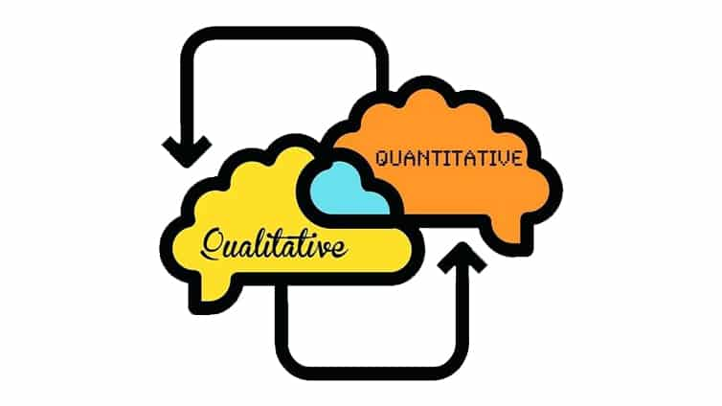
2. Q methodology and its applications
Mixed method:
Qualitative and quantitative
- In person interviews combined with statistical methods
- Designed to study people’s subjective opinions
Applications
- psychology
- transportation
- environmental studies
- political sciences
- health studies
- education
- energy studies

Slide 5
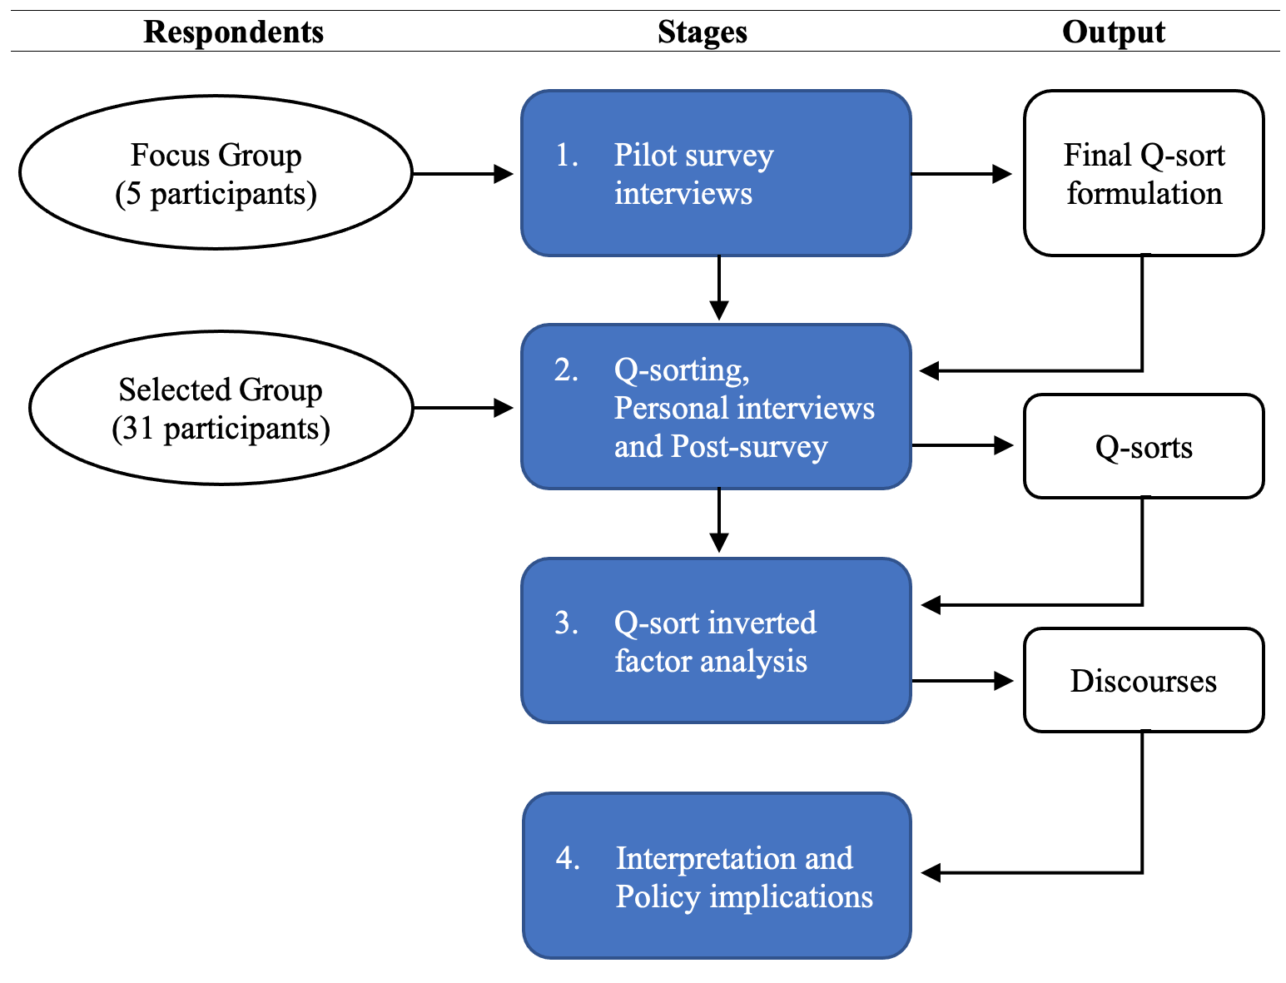
3. Research design
Research design (Adapted from Byrne, R. et al. 2017)

Slide 6
4. The survey (Q set)
30 statements
in 3 theme blocks
Completion time:
20 to 40 min.
Block 1: (13 statements)
GENERAL MEASURES, TAXATION, AND AWARENESS
Block 2: (8 statements)
ENERGY-SAVING MEASURES IN AIR CONDITIONING
AND SANITARY HOT WATER
Block 3: (9 statements)
ENERGY EFFICIENCY

Slide 7
Research design
Research design (Adapted from Byrne, R. et al. 2017)

Slide 8
5. Participants (P-set)
31 participants
Energy sector:
Energy supply companies (6)
Technical enterprises and sector consultancy firms (4)
Energy associations (2)
Hotel industry:
Hotel maintenance technicians (2)
Hotel managers (3)
Hotel associations (2)
Other groups of interest:
Public administrations and political offices (5)
NGOs (3)
University academics (4)

Slide 9
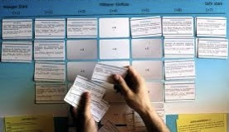
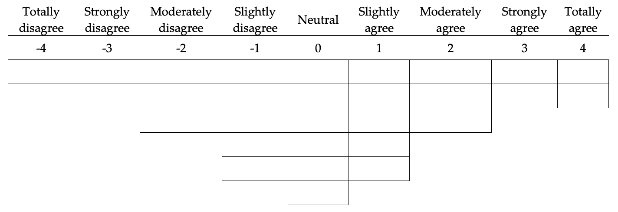
6. The Q sorting procedure
Example of a manual Q-sorting process
Research design (Adapted from Byrne, R. et al. 2017)
Quasi-normal forced distribution for 30 statements

Slide 10
Research design
Research design (Adapted from Byrne, R. et al. 2017)

Slide 11
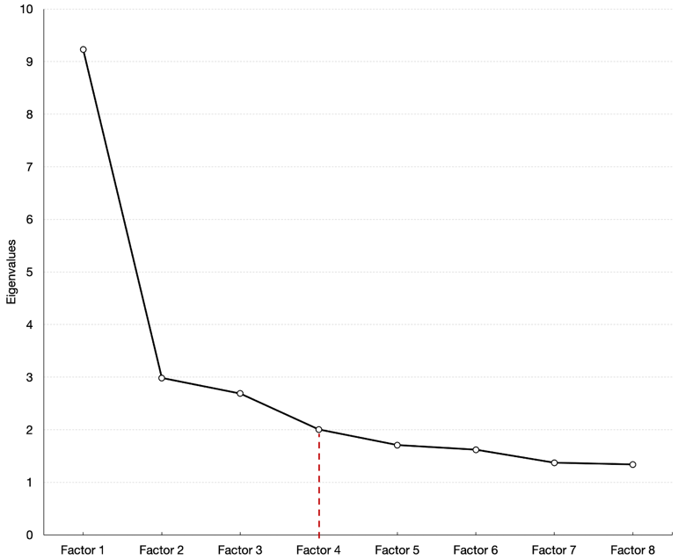
7. Results
7.1 Factor selection
Scree plot

Slide 12
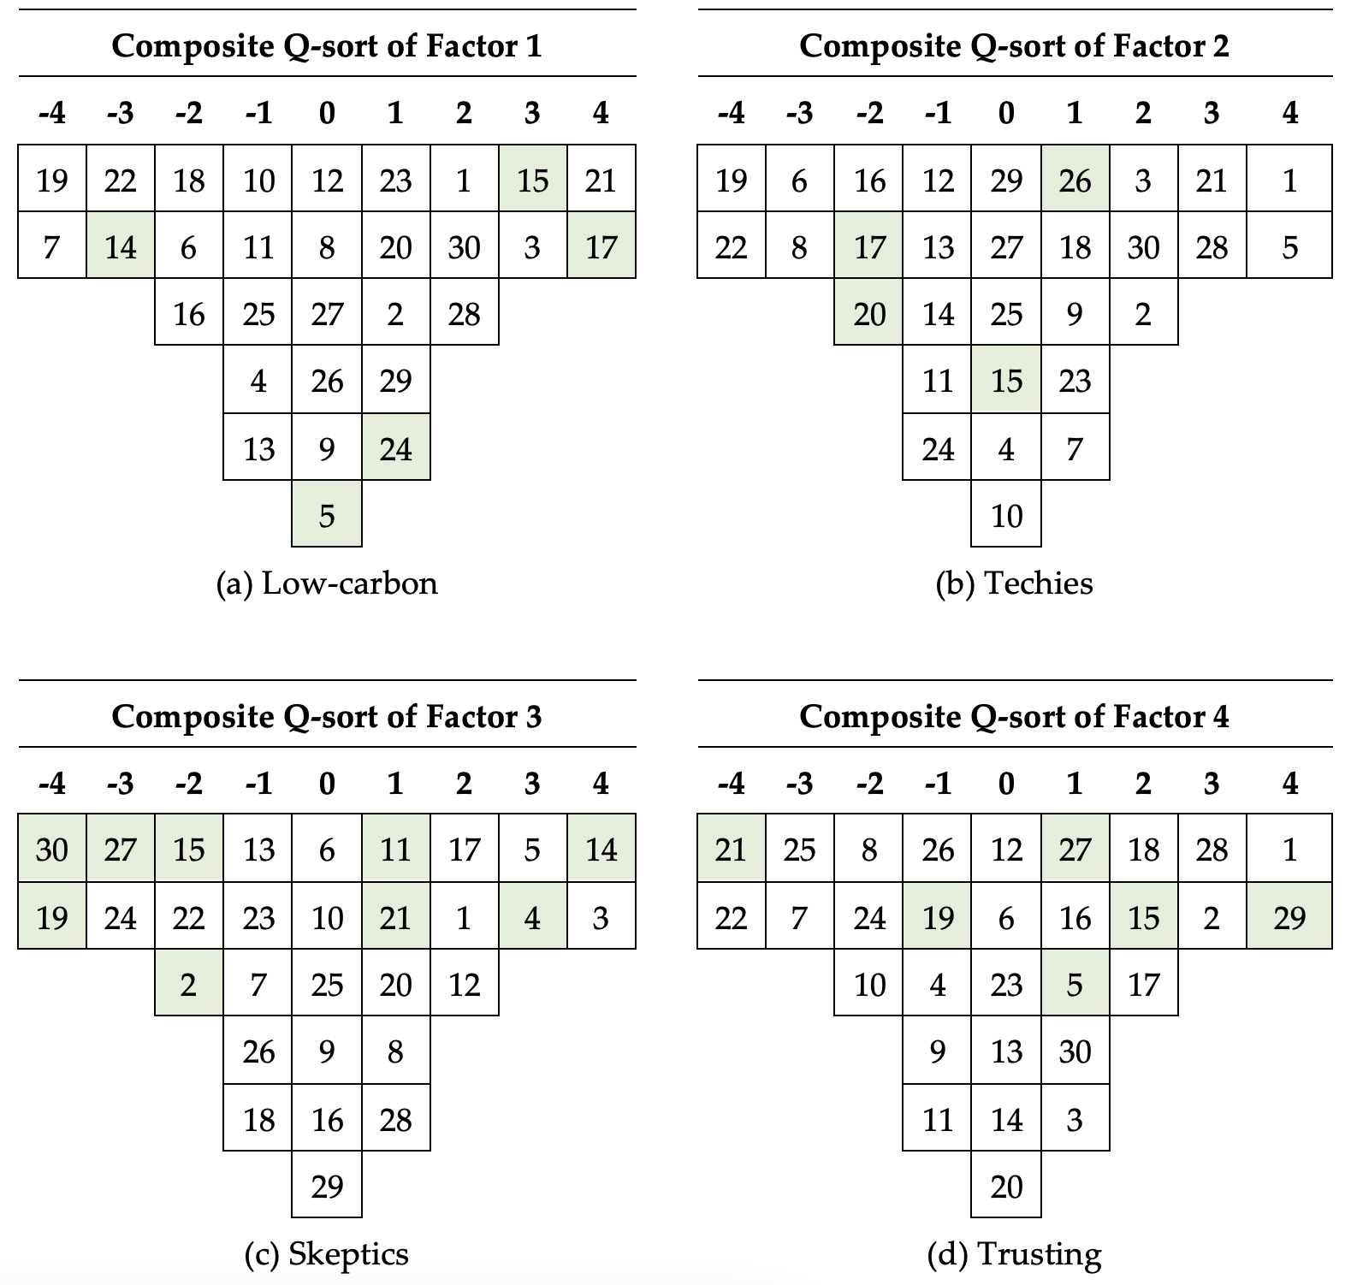
7.2 Composite Q sorts
Composite Q-sorts for four factors and distinguishing statements (green)

Slide 13
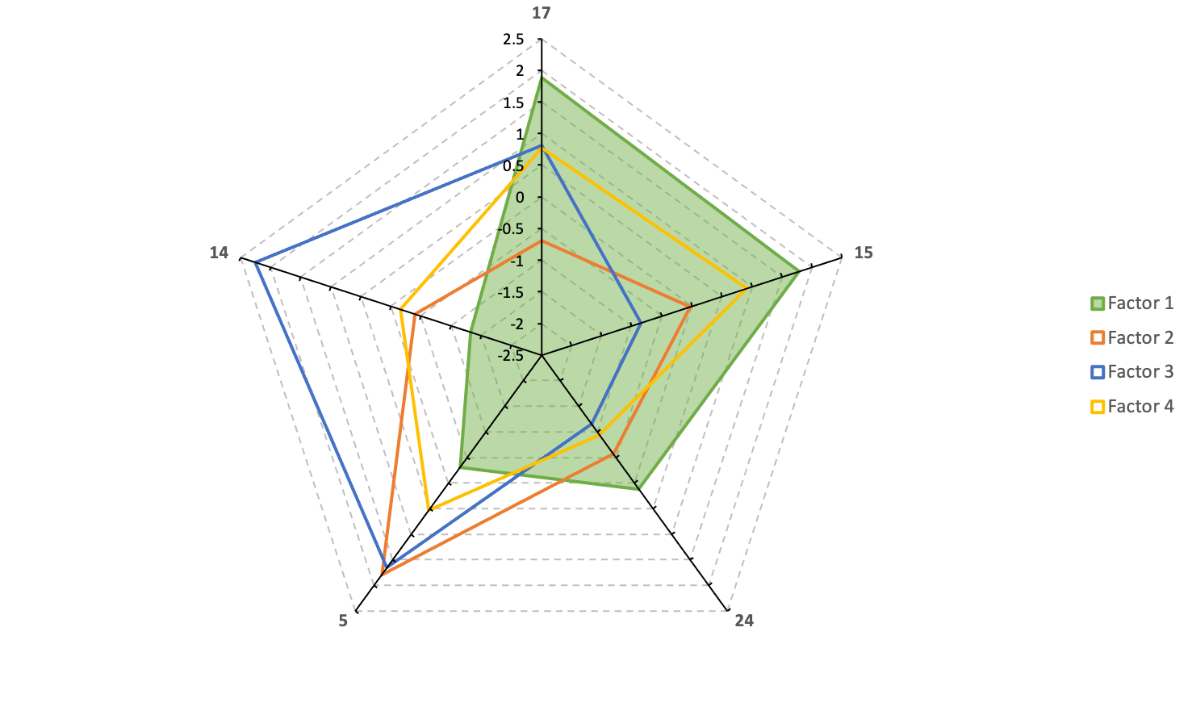
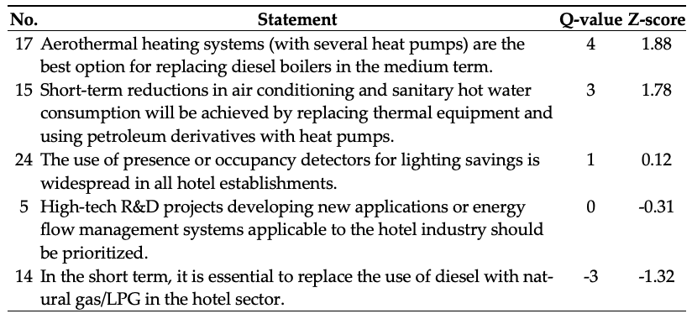
7.3 Mindset formulation (Example: “Low carbon”)
Distinguishing statements for Factor 1
Source: Own elaboration based on the research results

Slide 14
7.4 Descriptive mindset analysis and consensus statements
Defining characteristics of the four mindsets
Low carbon:
Immediate solutions using existing technologies without intermediate steps.
Strongly dislike all energy alternatives associated with CO2 emissions.
Techies:
Trust in technology implementation and future oriented solutions.
Strict: believe in penalizations for carbon emissions (“green taxes”).
Skeptics:
Lack of trust in the institutions due to bureaucratic impediments.
Pragmatic: cautious with investments requiring long time to recover (EVs).
Trusting:
Trust in hotel management and tourists’ behavior.
Reluctance to install photovoltaic infrastructure.
Consensus statements:
Participants from all mindset groups expressed uncertainty, skepticism, lack of knowledge and doubt regarding the post-COVID-19 reality.

Slide 15
8. Measures proposed
Priority objectives comprising the integrative strategy for energy transition in the hotel industry
Self-consumption using renewable energies together with storage systems,
Simplification of the administrative procedures,
Promotion of heat pumps for air conditioning and SHW,
Biomass boilers are not a solution for the Canary Islands,
Regulatory requirements for climate construction of new hotels,
Properly integrate photovoltaic panels in the hotel facility environment,
Conduct training courses for hotel staff to familiarize them with the use of new technologies such as BMS and EMS tools.

Slide 16
9. Conclusions
Q methodology: innovative and pioneer
Uncertainty and skepticism regarding stakeholders' energy behavior in the post-COVID-19 era
Future investigation for a global energy efficiency strategy on the Islands

Slide 17
THANK YOU FOR YOUR ATTENTION!
email: ivelina.mirkova@gmail.com

Slide 18
BACKUP SLIDES

Slide 19
Associations of respondents to specific factors
Respondent Group | Low-carbon | Techies | Skeptics | Trusting | Total
Energy sector
Energy supply companies | 3 |  | 1 | 1 | 5
Technical enterprises and sector consultancy firms |  | 1 | 1 |  | 2
Energy associations | 2 |  |  |  | 2
Hotel industry
Hotel maintenance technicians | 1 | 1 |  |  | 2
Hotel managers |  | 1 | 2 |  | 3
Hotel associations |  |  |  | 2 | 2
Other groups of interest
Public administrations and political offices | 2 | 2 |  | 1 | 5
NGOs |  | 2 |  |  | 2
University academics |  | 2 |  |  | 2
Total | 8 | 9 | 4 | 4

Slide 20
BLOCK 1: General measures, taxation, and awareness
No. | Statement
1 | In order to improve energy consumption management, the installation of self-consumption energy systems using renewable energies, together with demand management and storage systems, is a priority.
2 | The hotel sector is very proactive in adopting energy efficiency measures.
3 | Regulatory requirements and bureaucratic difficulties hinder the installation of infrastructures for self-consumption of electricity produced from renewable energies.
4 | Private hotel investment in energy transition projects is NOT supported by tax deductions that favor returns on these large investments.
5 | High-tech R&D projects developing new applications or energy flow management systems applicable to the hotel industry should be prioritized.
6 | Bonuses and subsidies for energy efficiency and renewable energy usage projects are sufficient and reach all stakeholders in the tourism sector.
7 | “Green” taxes (eco-taxes) should be imposed on tourists in order to raise funds for the decarbonization of the islands.
8 | “Green” certificates awarded to hotels for using clean electricity and for their efficient use of energy are a decisive factor in customers’ choices when booking a hotel.
9 | Green-room apps (which inform customers about their energy-efficient usage) fail to change customers’ behavior despite the benefits they offer.
10 | Informative energy-saving campaigns that aim to raise awareness among tourists fail to change their behavior.
11 | The European “Next-Generation” funds dedicated to boosting the green economy in the post–COVID-19 era will be sufficient to support the investment projects presented by the tourism/hotel industry.
12 | In the post–COVID-19 reality, projects to decarbonize the hotel sector will be delayed because public spending and investment in other sectors is a priority.
13 | New post–COVID-19 tourists will be more aware of the environmental impacts of their energy behavior in hotel establishments.

Slide 21
BLOCK 2: Saving measures in air conditioning and sanitary hot water
No. | Statement
14 | In the short term, it is essential to replace the use of diesel with natural gas/Liquified Petroleum Gas (LPG) in the hotel sector.
15 | Short-term reductions in air conditioning and sanitary hot water consumption will be achieved by replacing thermal equipment and using petroleum derivatives with heat pumps.
16 | In the short term, it is a priority to boost the use of propane-air (LPG-air) to reduce energy consumption in hotels.
17 | Aerothermal heating systems (with several heat pumps) are the best option for replacing diesel boilers in the medium term.
18 | Cogeneration from renewable sources is the best solution for medium-term energy savings.
19 | Residual biomass boilers (pellets, olive bone, etc.) are a reasonable medium-term solution to reduce energy consumption in hotels.
20 | In the medium term, it is a priority to use low-enthalpy (low-temperature) geothermal energy for sanitary hot water production.
21 | The installation of photovoltaic power panels is the best medium-term solution for reducing energy consumption in hotels.
BLOCK 3: Energy efficiency measures
No. | Statement
22 | Efficient climate construction does NOT generate significant energy savings.
23 | Air conditioning savings can be achieved by using sensors (smart meters) that disconnect air conditioning or heating when they detect that windows are opened to prevent power wasting.
24 | The use of presence or occupancy detectors for lighting savings is widespread in all hotel establishments.
25 | Outdoor lighting systems (facades, gardens, etc.) must use photovoltaic panels.
26 | Intelligent water leak detection sensors are essential in cases of older, unrenovated hotels.
27 | The installation of showers with flow reducers, thermostats, and timed flow taps is a priority for the reduction of sanitary hot water use.
28 | In order to optimize medium-term energy consumption, it is a priority to install energy management systems for the building (Building Management Systems (BMS)/Environmental Monitoring Systems (EMS)) for better control and to obtain information for decision-making.
29 | It is a priority to reduce the thermal losses of the entire installation through adequate insulation and maintenance.
30 | Hotels must install charging points for electric vehicles.
25 | Outdoor lighting systems (facades, gardens, etc.) must use photovoltaic panels.

Slide 22
Rotated factor matrix and factor characteristics
Category Group | Participant | Factor 1 | Factor 2 | Factor 3 | Factor 4
Energy supply companies | 14 | 0.8500 | 0.0273 | 0.1531 | 0.1434
Public administrations and political offices | 13 | 0.7584 | 0.0607 | 0.0740 | 0.2641
Energy supply companies | 8 | 0.7529 | 0.1150 | -0.0331 | 0.3672
Energy associations | 19 | 0.7013 | -0.0295 | 0.0175 | -0.3454
Energy supply companies | 12 | 0.6207 | 0.2605 | 0.3454 | -0.0084
Energy associations | 20 | 0.5906 | 0.4377 | 0.0712 | -0.0704
Public administrations and political offices | 22 | 0.5259 | 0.4745 | 0.1374 | 0.1726
Hotel maintenance technicians | 16 | 0.4114 | 0.2113 | -0.0142 | 0.3089
University academics | 2 | 0.1737 | 0.7279 | -0.2141 | 0.1846
NGOs | 7 | -0.0571 | 0.7145 | 0.0670 | 0.1115
Public administrations and political offices | 21 | 0.0968 | 0.6892 | 0.2590 | 0.4292
University academics | 1 | 0.1799 | 0.6569 | 0.0505 | -0.0189
Technical enterprises and sector consultancy firms | 18 | 0.1446 | 0.6322 | 0.2603 | -0.1453
Hotel maintenance technicians | 26 | 0.4757 | 0.6258 | 0.1296 | 0.1867
Public administrations and political offices | 3 | 0.0294 | 0.5590 | 0.0712 | 0.4351
NGOs | 5 | 0.3602 | 0.5578 | 0.1186 | 0.2494
Hotel managers | 25 | 0.2402 | 0.4971 | 0.2009 | 0.2508
Hotel managers | 11 | -0.1559 | 0.2449 | 0.7859 | -0.2713
Technical enterprises and sector consultancy firms | 9 | 0.0283 | 0.0535 | 0.7527 | 0.1598
Energy supply companies | 30 | 0.2131 | 0.0284 | 0.5344 | 0.1866
Hotel managers | 31 | 0.2615 | 0.2932 | 0.4909 | 0.0818
Hotel associations | 17 | 0.2738 | 0.0136 | 0.1653 | 0.7086
Public administrations and political offices | 15 | 0.2034 | 0.1421 | -0.0081 | 0.6944
Energy supply companies | 27 | -0.1037 | 0.0740 | 0.1579 | 0.6574
Hotel associations | 10 | 0.2620 | 0.2416 | -0.0842 | 0.4848
Explained variance (%) |  | 17 | 17 | 9 | 11
No. of defining variables |  | 8 | 9 | 4 | 4
Average relative coefficients |  | 0.8 | 0.8 | 0.8 | 0.8
Composite reliability |  | 0.970 | 0.973 | 0.941 | 0.941
S.E. of factor Z-scores |  | 0.173 | 0.164 | 0.243 | 0.243

Slide 23
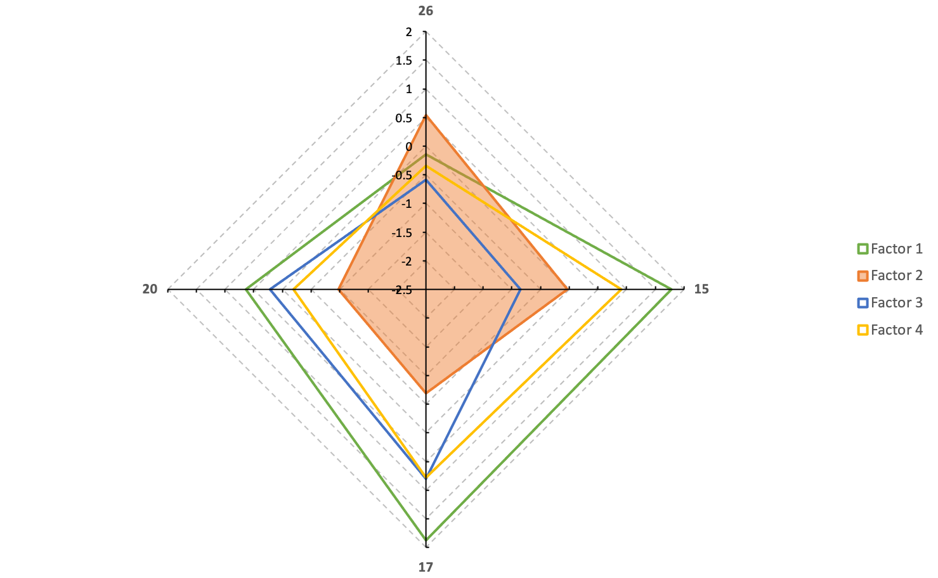
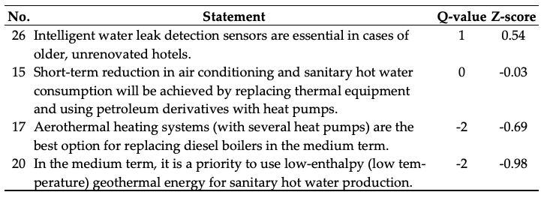
“Techies” mindset
Distinguishing statements for Factor 2

Slide 24
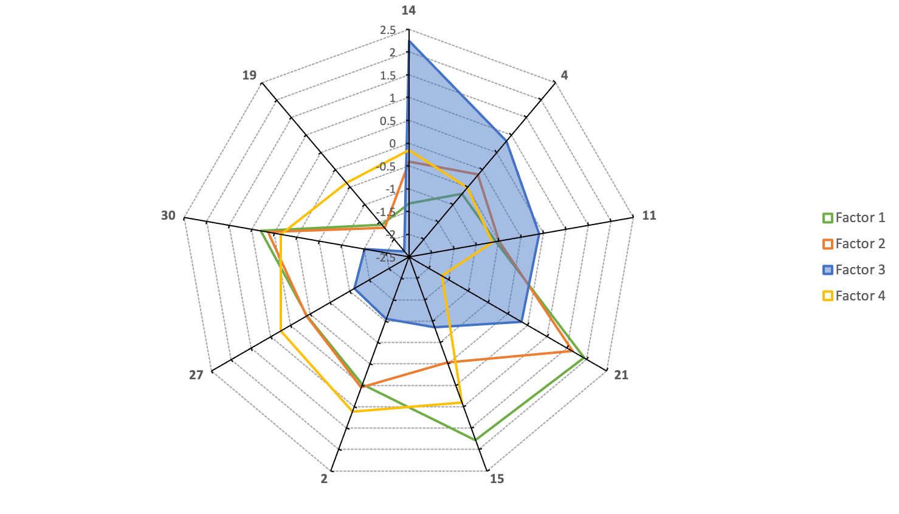
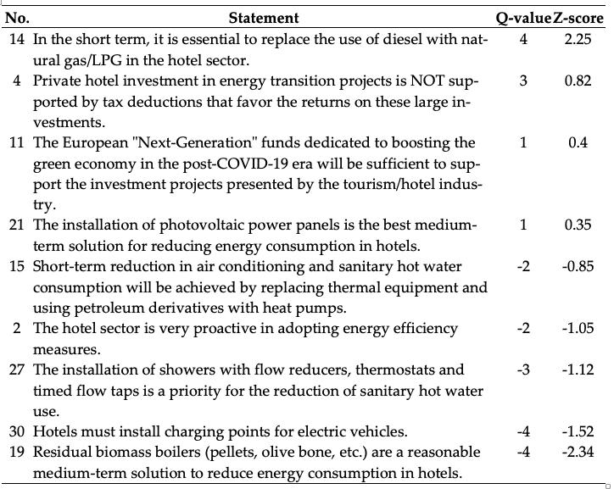
“Skeptics” mindset
Distinguishing statements for Factor 2

Slide 25
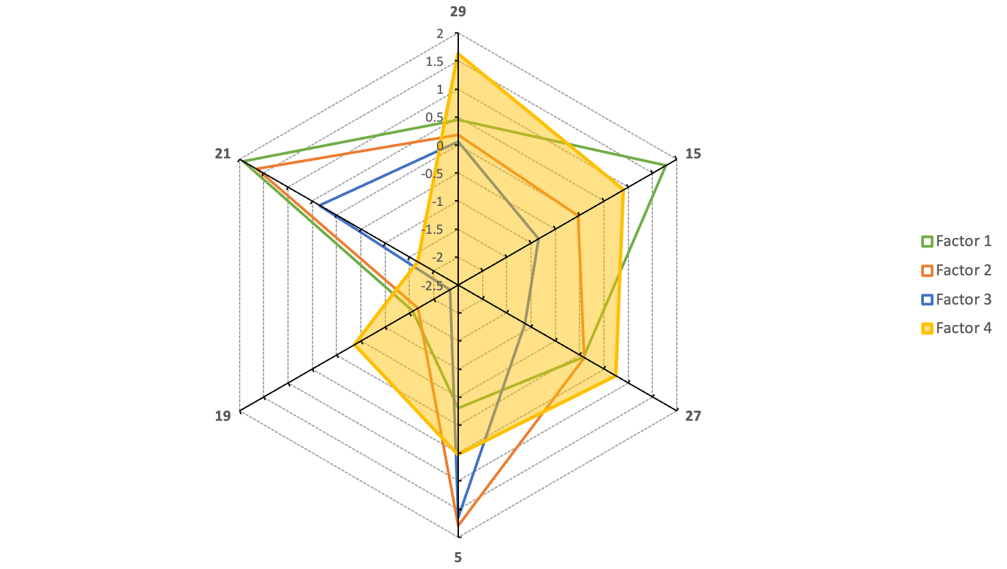
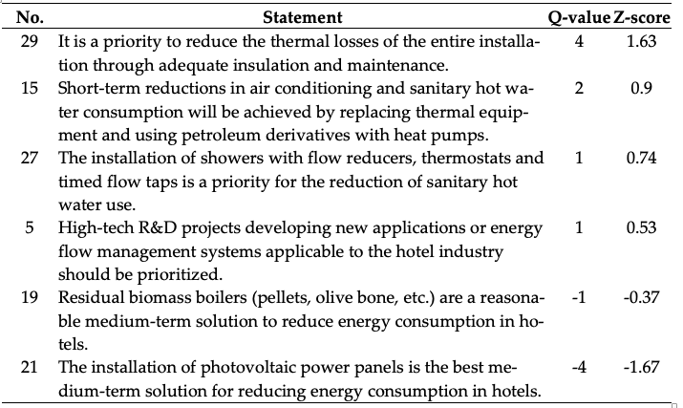
“Trusting” mindset
Distinguishing statements for Factor 4

