Slide 1
Reconciling the Pigovian and Sandmo Principles of Emission Pricing
Ross McKitrick
Department of Economics and Finance
University of Guelph
IAEE
2021

Slide 2
Pigovian pricing
Most economists know just enough about the Pigovian principle of pollution pricing to get it sort of right, but still wrong
As a result some major policy applications are mishandled, including:
Cost-Benefit Analysis
Carbon border tax adjustments
Implications of combining emission charges and regulations
The key to getting Pigou right is to connect it to Sandmo’s (1975) analysis

Slide 3
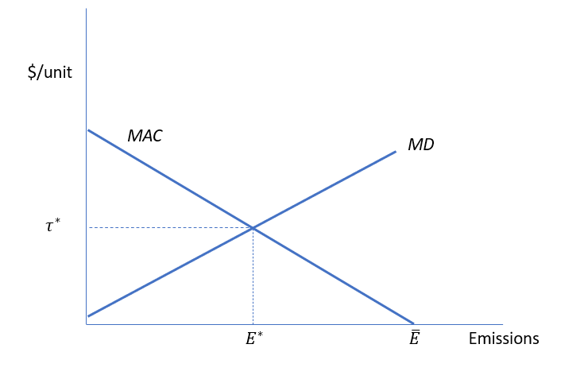
The Pigovian Principle
Economic activity generates pollution emissions $E$
These cause Total Damages $TD(E)$ and Marginal Damages $MD(E)$
There is a Marginal Abatement Cost line $MAC(E)$
Optimal emissions $E^{∗}$ occur where $MD\left(E^{∗}\right)=MAC(E^{∗})$
This also defines the optimal shadow price $τ=MD(E^{∗})$
Charge polluters $τ$ to get an optimal outcome

Slide 4
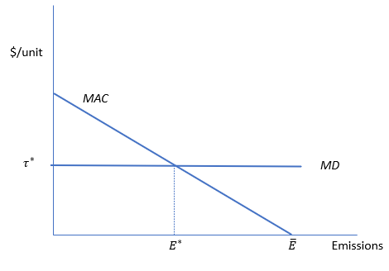

Four implications
If $MD$ is constant then optimal policy is $τ=MD$
If $MD>0$ it is always welfare-improving to reduce emissions from the unregulated level
If an abatement policy costs less than $MD$ at the margin CBA implies it should be implemented
If $MD$ is the same across jurisdictions every country should pay the same emission tax

Slide 5
Sandmo analysis (& extensions)
The optimal policy is never $τ=MD$
Taxing emissions can reduce welfare even if $MD>0$
$MD(E^{∗})$ is the wrong shadow price for CBA
Even if $MD$ is the same everywhere, $τ^{∗}$ is unlikely to be

Slide 6
Sandmo (1975)
Made 1 change to standard model: assumed there are pre-existing taxes other than lump-sum
Implication: Marginal Cost of Public Funds ($MCPF$) > 1
Result: $τ^{∗}=\frac{MD}{MCPF}$
Since $MCPF$ is typically 1.5 or higher this implies $τ^{∗}<MD$

Slide 7
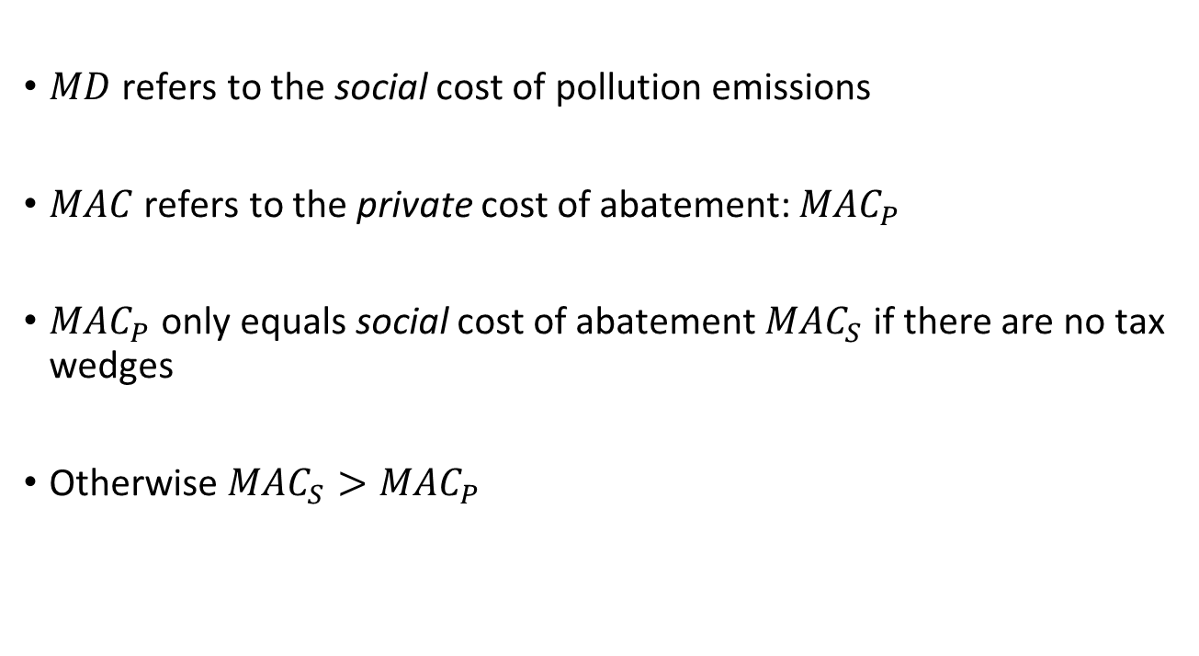
What’s missing in Pigou analysis?
$MD$ refers to the social cost of pollution emissions
$MAC$ refers to the private cost of abatement: $MAC_{P}$
$MAC_{P}$ only equals social cost of abatement $MAC_{S}$ if there are no tax wedges
Otherwise $MAC_{S}>MAC_{P}$

Slide 8
Sandmo Model
$/unit
MAC_{P}
$$τ^{∗}$$
MD
$$E^{∗}$$
$$\overline{E}$$
Emissions

Slide 9
Sandmo Model
$/unit
MAC_{S} = Social Marginal Abatement Costs
MAC_{P}
$$τ^{∗}$$
MD
$$E^{∗}$$
$$\overline{E}$$
Emissions

Slide 10
Sandmo Model
$/unit
MAC_{S} = Social Marginal Abatement Costs
MAC_{P}
$$τ^{∗}$$
MD
$$E^{∗}$$
$$\overline{E}$$
Emissions

Slide 11
Sandmo Model
$/unit
MAC_{S} = Social Marginal Abatement Costs
MAC_{P}
MD
$$aMD$$
$$E^{∗}$$
$$\overline{E}$$
Emissions

Slide 12
Sandmo rule
$τ^{∗}=aMD$ where $a=\frac{1}{MCPF}$
Assumes:
Taxes rather than tradable quotas
Emission tax revenues recycled via tax reductions elsewhere so tax system is always optimized
No other emission reduction policies in place
What if these don’t hold?
Emergence of “damage threshold”

Slide 13
Damage thresholds
Bovenberg and Goulder 1996,
Goulder, Parry and Burtraw 1997,
Parry Williams and Goulder 1999
Bento and Jacobsen 2007
Example: Social Cost of Carbon (SCC)

Slide 14
“Second-Best” Case
$/unit
MAC_{S}
MAC_{P}
SCC
$$τ^{∗}$$
$$E^{∗}$$
$$E^{∗}$$
$$\overline{E}$$
Emissions

Slide 15
Third-Best Case
$/unit
MAC_{S}
MAC_{P}
SCC
$$E^{∗}$$
$$E^{∗}$$
$$\overline{E}$$
Emissions

Slide 16
Third-Best Case
$/unit
MAC_{S}
MAC_{P}
SCC
Damage Threshold Z
$$E^{∗}$$
$$E^{∗}$$
$$\overline{E}$$
Emissions

Slide 17
Third-Best Case
$/unit
MAC_{S}
MAC_{P}
SCC
Damage Threshold Z
$$τ^{∗}$$
$$E^{∗}$$
$$E^{∗}$$
$$E^{∗}$$
$$\overline{E}$$
Emissions

Slide 18
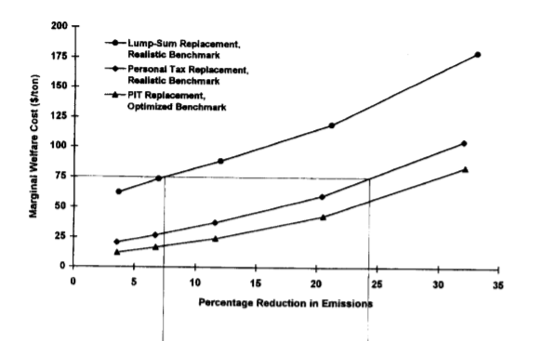
Bovenberg & Goulder 1996

Slide 19
Bovenberg & Goulder 1996

Slide 20

General model
Optimal tax
$$τ^{∗}=aMD−b$$
where
$$a=\frac{1}{MCPF}$$
$b$ may be < or $≥$ 0

Slide 21

General model
Social optimum occurs where
$$MD=MAC_{s}=\frac{1}{a}MAC_{p}+\frac{b}{a}$$
Threshold
$$Z=\frac{b}{a}$$

Slide 22

General model
Social optimum occurs where
$$MD=MAC_{s}=\frac{1}{a}MAC_{p}+\frac{b}{a}$$
Threshold
$$Z=\frac{b}{a}$$

Slide 23
Implications
Pigovian rule never applies:
$τ^{∗}=MD$ (or SCC) only if $a=1$ and $b=0$ which never happens
If $MD(\overline{E})<\frac{b}{a}$ then any emission reduction reduces welfare
B&G 1995: If SCC < $75 (in today’s $) any non-revenue raising climate policy is welfare-reducing
SCC is wrong measure to use in CBA
Using it would lead to excessive regulation

Slide 24
Carbon border tax adjustments
Even if SCC is the same everywhere MCPF is not
Every country should have a different optimal carbon tax
Carbon border tax adjustments need to take account of different marginal excess burdens
It is not automatically the case that if one country has a lower carbon price than another (or a relatively lax emissions policy) it therefore has an unfair advantage and should face punitive trade measures.
It would be easy, in fact, to construct a case in which one jurisdiction with a low carbon tax would be justified in imposing a border tax on another jurisdiction with a higher carbon tax.

Slide 25
Further implications
When using non-revenue raising emission regulations $Z>0$
But welfare loss can sometimes be cured by implementing an emission tax
In neighbourhood of unregulated emissions $\overline{E}$ emission taxes are marginally less costly than regulations. But as emissions go to zero, this ranking reverses

