Slide 1
Electricity tariff cost reflectivity and time of use tariff in java-bali system
Arionmaro Asi Simaremare
1st IAEE Online Conference - June 2021

Slide 2
OUTLINE
Introduction
Methodology
Result and Discussion
Conclusion

Slide 3
Introduction

Slide 4
Public utility tariff
Public utility is a corporate entity that provide certain goods and/or services to the public in where in delivering those goods and/or services it is deemed more economical to be done by single or small number of entity thus requires some regulation on the price to be paid by the customers.
e.g: water, gas, electricity
Bonbrights principal of public utility tariff
1. Requirements of revenue for the utility
2. Just and fair allocation of costs among customers
3. Promoting optimal efficiency of resource allocation
Additional:
Simple, understandable, acceptable, stable,
non-discriminative and non-controversial

Slide 5
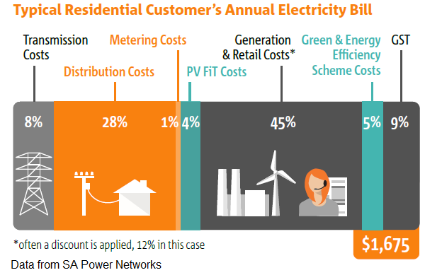
Cost of providing electricity
1. Generation Cost: Investment Cost, Fix O/M Cost, Fuel Cost, Variable O/M Cost
2. Transmission Cost: mostly (sunk) investment cost
3. Distribution Cost: mostly (sunk) investment cost
4. Retail management cost: mostly fixt O/M cost
5. Other tax and levies

Slide 6
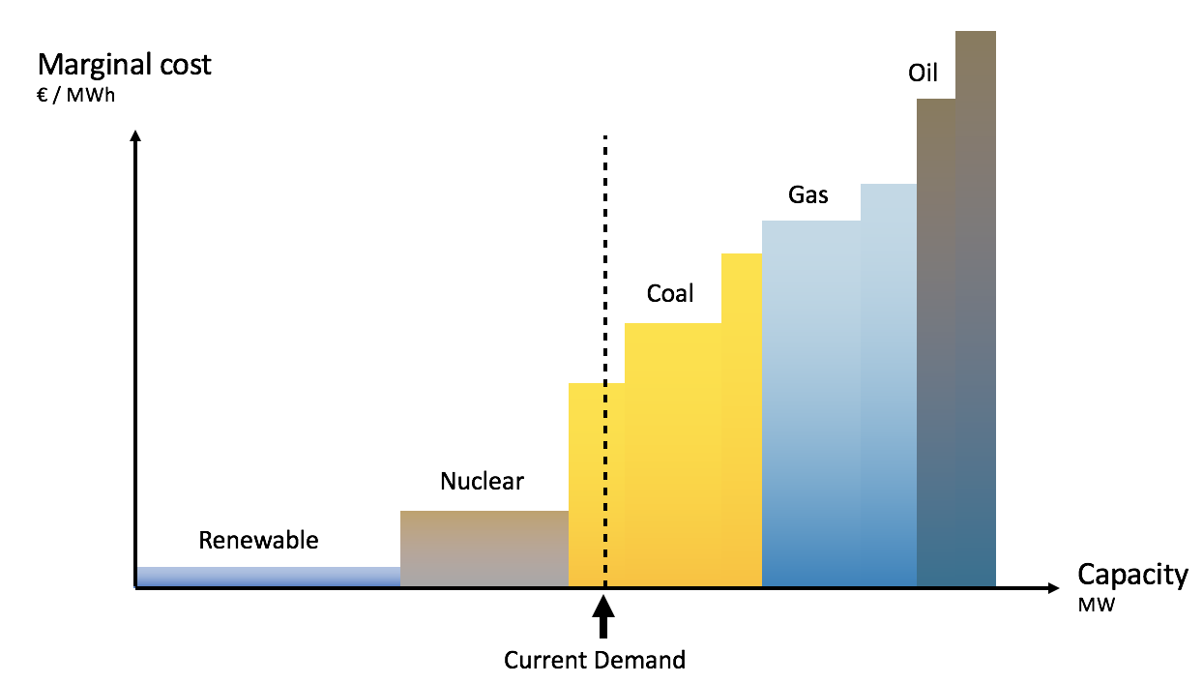
Generators Merit Order
- Composition of generators that being operated varies at all time depends on the load requirement
- Generators will be stacked based on their operating cost and available capacity – starting from the lowest cost.
- High operating cost generators will be dispatched when needed (e.g. at high load)

Slide 7
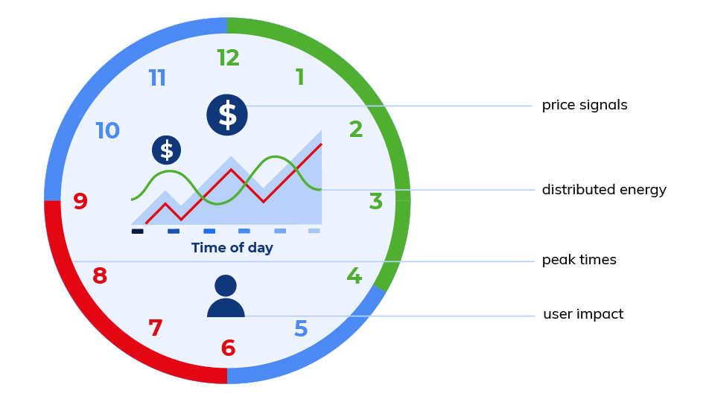
Common Electricity Tariff that being used widely
1. Flat/FixedTariff
2. Tiered Tariff (increasing/decreasing block)
3. Time of Use (base, shoulder, peak)
4. Demand Charge (based on the peak demand of customer)
5. Seasonal Tariff (depends on season)
6. Critical Peak (high tariff at system critical peak)
7. Dynamic Real Time (depends on market price)

Slide 8
Special Purpose Tariff
Residential, Business (LV)
Tariff in Java-Bali: Flat tariff and peak/off-peak tariff
Business, Industry (MV)
Industry (HV)

Slide 9
Methodology

Slide 10
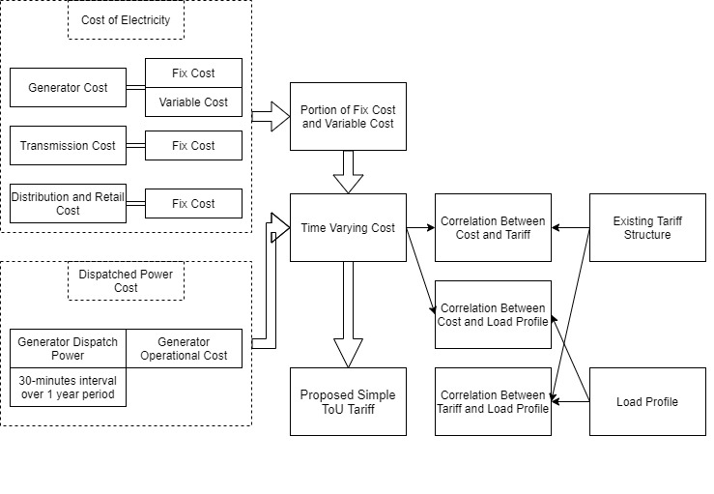
Framework of this study

Slide 11
Result and Discussion

Slide 12
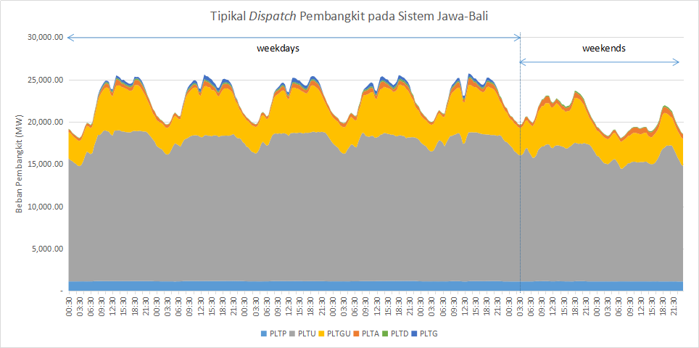
Typical dispatch of generators in Jawa-Bali system
Dominated by CFPP and CCGT
No significant change on the composition of CFPP and CCGT at weekends

Slide 13
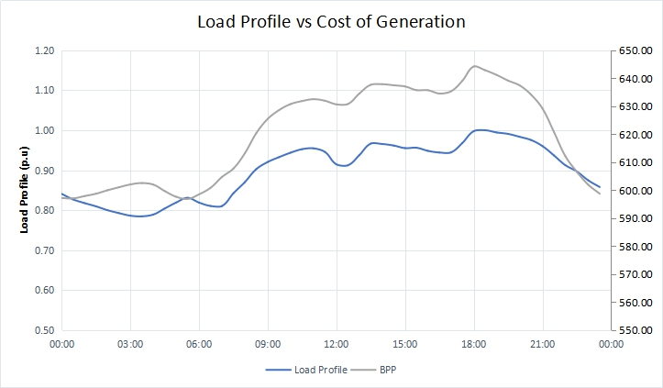
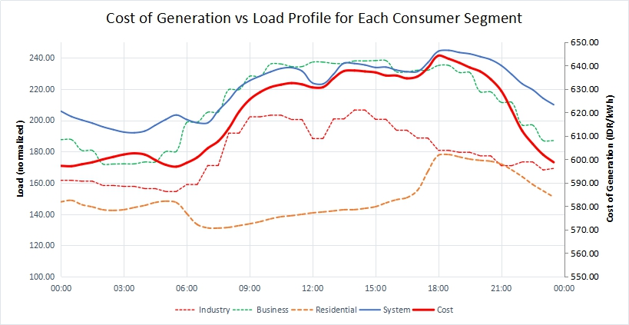
Java-Bali system generation cost and Load Profile
Generators operational cost highly correlated with the load profile. Biaya operasi tinggi ketika PLTG dan PLTD beroperasi.
R_Squared
Industry | Business | Residential | Total System
0.81 | 0.93 | 0.37 | 0.95

Slide 14
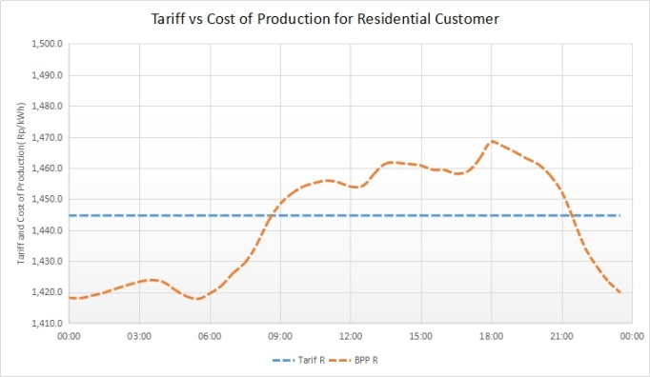
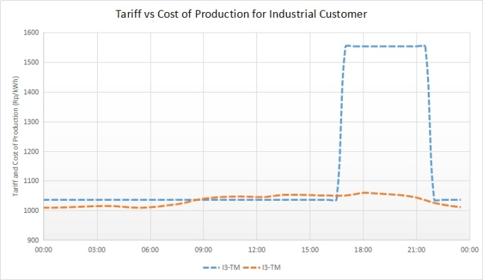
Existing Tariff Evaluation
Existing tariff, both flat and peak/off-peak tariff, poorly reflect the production cost of electricity at all time.
R_Squared
RT | B2-TR | B3-TM | I3-TM | I4-TT | P1-TR | P2-TM | P3-TR | L
-0.00 | -0.00 | 0.50 | 0.50 | - | -0.00 | 0.50 | -0.00 | -

Slide 15
Time of Use Tariff proposal
Two period of tariff, high tariff period (09.00 - 21.00) dan low tariff period (21.00 - 09.00)
Three schemes of calculation to be evaluated

Slide 16
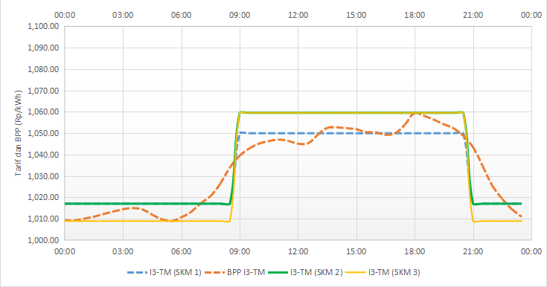
ToU Tariff Evaluation
Time of use tariff vs cost of production for industrial customers
The proposed ToU Tariff shows improved cost reflectivity compared to existing tariff
There is no time period where the tariff imposed is significantly higher than the production cost, as opossed to existing tariff
R_Squared
Residential | Business | Industry
0.92 | 0.92 | 0.92

Slide 17
Conclusion

Slide 18
Conclusion and Future works
Existing electricity tariff, either flat or peak/off-peak tariff, doesn't reflect the cost of electricity production very well
Flat tariff doesn't provide incentive for customers to adjust their energy usage
Existing peak/off-peak tariff charge customers much higher than the electricity production cost at peak load period
This studi proposes simple time of use tariff that divide the tariff into two period: high tariff period (09.00-21.00) and low tariff period (21.00-09.00)
Proposed ToU tariff can reflect the cost of electricity production very well.
Proposed ToU tariff provide incentive for the customers to adjust their energy usage at peak load period
Future works to evaluate the perception of customers towards the proposed tariff and impact on their energy usage at certain period.

Slide 19
THANK YOU

