Slide 1
The value of energy efficiency in residential buildings –
A matter of heterogeneity?!
1st IAEE Online Conference 7th – 9th June 2021
Joachim Geske, Imperial College London

Slide 2
The value of energy efficiency in residential buildings – A matter of heterogeneity?!
Building sector accounts for 36% of CO₂ emissions (EU, 19% world)
70-80% of potentially climate neutral buildings already exist
Increasing refurbishment rates: subsidizing renovations, increasing opportunity costs of non-renovation, building regulations and standards and by increasing market transparency – Energy efficiency rating
Comparable measure of energy consumption of a building - for 20 years.
Does efficiency capitalize when selling? Econometric analyses of premiums.
        Which premiums do we expect?
        Which premiums do we see?
        Why is that?
        Conclusions

Slide 3
1. What do we expect? Pricing efficiency by arbitrage
What does theory tell us about the value of the more efficient building on the market?
Capitalization (only) a problem if owners change.
Guess we have removed all building characteristics by econometric methods
Budlings differ only with respect to efficiency – energy consumption/bill (rating).
Notes:
Kann man nicht die nicht Energy-related features of the building im Epsilon unterbringen? Warum nicht? Würde die Unabhängigkeitsforderung abschwächen.

Slide 4

1. What do we expect? Pricing efficiency by arbitrage
Energy Bill over the
Next 10 y: 7000 €
Energy Bill over the
Next 10 years 1000 €
?
Premium of the efficient building:
+6000 €
Heroic assumptions:
Rational decision making
(otherwise) identical buildings
Homogenous preferences + expectations
Pricing by arbitrage:
Buyers don’t mind which building they get as long as they have all the same value.
Otherwise the sellers would suffer…
Notes:
Kann man nicht die nicht Energy-related features of the building im Epsilon unterbringen? Warum nicht? Würde die Unabhängigkeitsforderung abschwächen.

Slide 5
1. What do we expect? Pricing efficiency by arbitrage
Consequences
The price passes the savings that will “arise” for the buyer only in future through to the seller in the present.
The price "hoovers" the expected savings completely.
Cost differences should result in the same price differences.
Therefore, the relationship between premiums and operating costs should linear.
Let’s see whether the world is as simple as that….

Slide 6
2. What do we see? Energy efficiency premium UK (Fuerst et al., 2015)
180
50
R=5%
178
R=10%
40
176
30
Share of dwellings %
174
20
R=30%
Dwelling Price £1000
172
10
170
0
168
166
A
B
C
D
E
F
0
400
800
1200
1600
2000
Energy Cost £/a
Nonlinear! Premium (pass through?)

Slide 7
2. What do we see? Energy efficiency premium international
Nonlinear! Premium

Slide 8
3. Why is that? Energy efficiency premium puzzle
Possible explanations:
Heterogeneity of buyers
income (mixed evidence), environmental friendly preferences (no data), discounting (evidence)
Heterogeneity of buildings
Unobservable features of the building (market supply matters, limiting arbitrage)
Econometrics
Endogeneity of the unobserved building quality; Mitigation; Including quality; not a convincing concern against non-linearity
Information
Option value of refurbishment – energy price uncertainty. Only applies to below average buildings
Bounded rationality (very special misjudgement needed)
Notes:
Disussing the comperative statics.

Slide 9
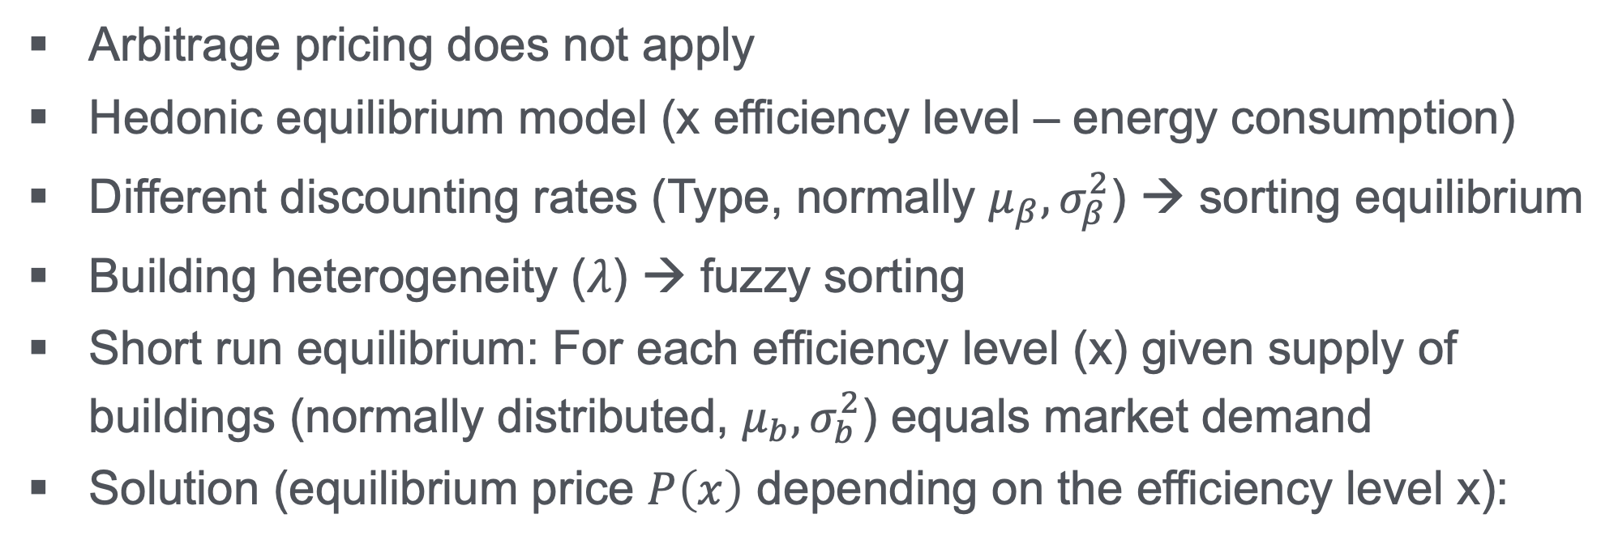
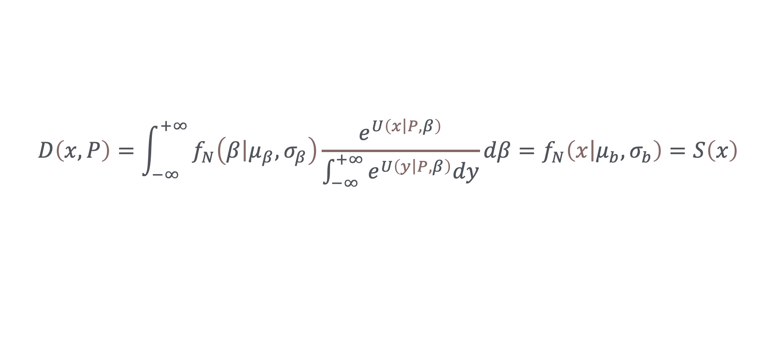
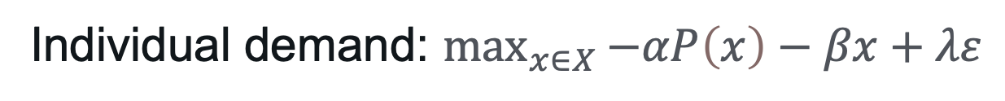
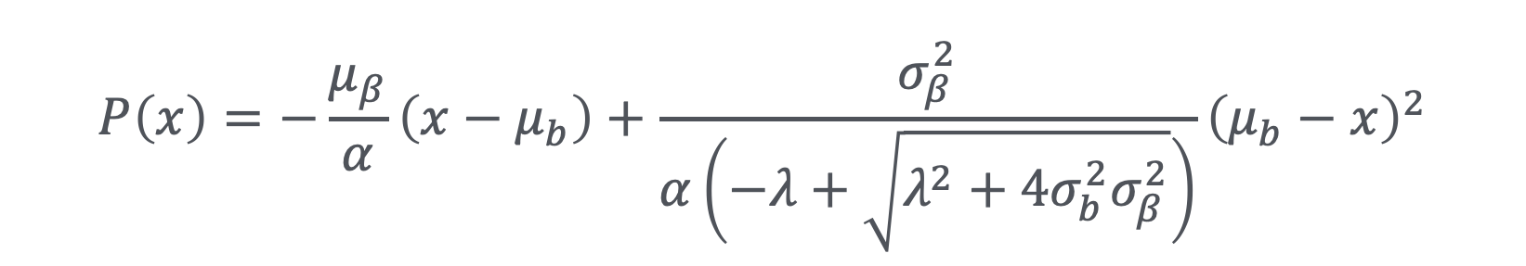
3. Why is that? Hedonic equilibrium
Arbitrage pricing does not apply
Hedonic equilibrium model (x efficiency level – energy consumption)
Different discounting rates (Type, normally $μ_{β},σ_{β}^{2}$) → sorting equilibrium
Building heterogeneity ($λ$) → fuzzy sorting
Short run equilibrium: For each efficiency level (x) given supply of buildings (normally distributed, $μ_{b}, σ_{b}^{2}$) equals market demand
Solution (equilibrium price $P\left(x\right)$ depending on the efficiency level x):
Individual demand: $\max_{x∈X}{−αP\left(x\right)−βx+λε}$
$$D\left(x,P\right)=\int_{−∞}^{+∞}{f_{N}\left(\left.β\right|μ_{β},σ_{β}\right)\frac{e^{U\left(\left.x\right|P,β\right)}}{\int_{−∞}^{+∞}{e^{U\left(\left.y\right|P,β\right)}dy}}dβ}=f_{N}\left(\left.x\right|μ_{b},σ_{b}\right)=S\left(x\right)$$
$$P\left(x\right)=−\frac{μ_{β}}{α}\left(x−μ_{b}\right)+\frac{σ_{β}^{2}}{α\left(−λ+\sqrt{λ^{2}+4σ_{b}^{2}σ_{β}^{2}}\right)}{\left(μ_{b}−x\right)}^{2}$$
Notes:
Assumptions of pricing by arbitrage violated. More sophisticated concept than arbitrage pricing required: hedonic equilibrium! Comparative statics

Slide 10
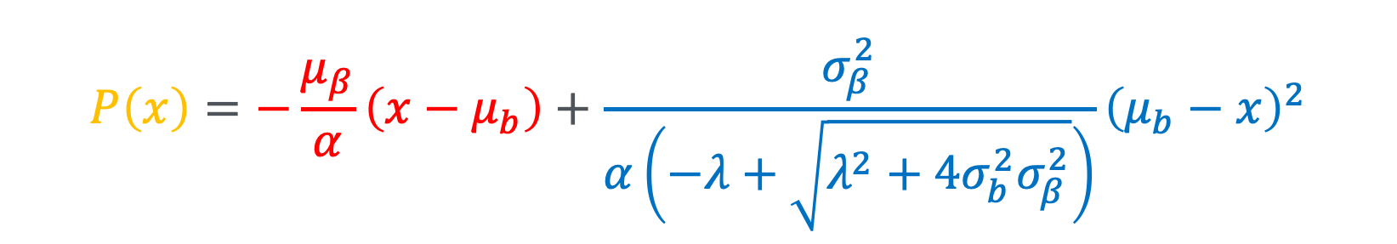
3. Why is that? Hedonic equilibrium
$$P\left(x\right)=−\frac{μ_{β}}{α}\left(x−μ_{b}\right)+\frac{σ_{β}^{2}}{α\left(−λ+\sqrt{λ^{2}+4σ_{b}^{2}σ_{β}^{2}}\right)}{\left(μ_{b}−x\right)}^{2}$$
Building Price Premium
Building
price
Scarcity
Premium
y
Nonlinear premium!
Energy efficiency rating
(Energy Expenditure)
C
D
Average
Building
(reference)
E
Discounted
energy costs
Notes:
All the heterogenity is in the blue expression
Only switching off both hzeterogeineties delivers the first expression.

Slide 11
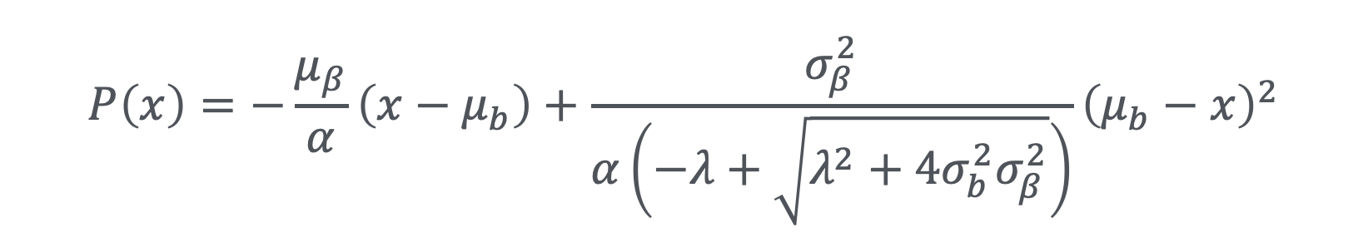
3. Why is that? consequences
Intuition: “if you want to sell sth. you have a lot of (D rated buildings) – you need to go down with the price!” or “if efficient buildings a scarce – you need to pay a premium”
Now: interpolating the estimated price premiums by a parabola and identifying the parameters → passthrough of more 73%!
$$P\left(x\right)=−\frac{μ_{β}}{α}\left(x−μ_{b}\right)+\frac{σ_{β}^{2}}{α\left(−λ+\sqrt{λ^{2}+4σ_{b}^{2}σ_{β}^{2}}\right)}{\left(μ_{b}−x\right)}^{2}$$

Slide 12
4. Conclusion
Nonlinearity of price premiums for efficiency (Puzzle)
Not to explain with pricing by arbitrage
Heterogeneity of preferences and perception of buildings can explain it – with more sophisticated concept
Supply in specific segments matters! Scarcity!
Passthrough > 73%
Efficiency capitalizes not to bad
Heterogeneity matters for the capitalization of efficiency!

Slide 13


