Slide 1
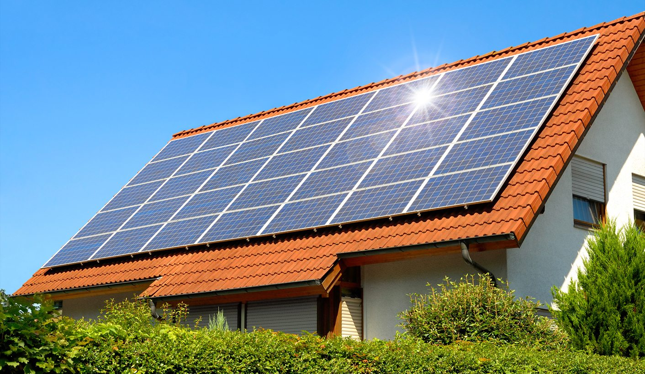
Analysis of Market Characteristics and Promotion Strategy of Rooftop PV
Airlangga University Cooperation and Development Management Agency
&
Center for Research and Development of Electricity PLN Jakarta

Slide 2
General Description
Source: World Bank (2020)

Slide 3
Indonesia's total energy consumption in 2018 reached 114 MTOE, consisting of:
40% of the transportation sector
*96% of fuel is dominated by energy, while the rest is supplied by biodiesel and natural gas
36% industrial sector
*The majority comes from natural gas and coal
16% of the household sector
*Dominated by electricity, is predicted to increase from 60% (2018) to 90% (2020)
6% commercial sector
2% other sectors

Slide 4
The household sector has the largest consumption of electrical energy when compared to other sectors.
According to Santoso & Salim (2019) the distribution of electricity sales to the household sector is 93,634.63 GW or the equivalent of 49.26% of total electricity sales.
High energy consumption can lead to scarcity as Indonesia's population growth has increased significantly
It is necessary to use alternative energy sources so that energy availability can meet the needs of future generations
Some of the potential energies as a substitute for non-renewable energy include hydropower, geothermal, bio-power plants, biofuel, solar, wind and marine energy. Hydropower has the potential to generate 94.3 GW; geothermal 28, 32.65 GW; GW bio PLT; BBN 200 thousand Bph; solar 207.8 GWp; wind 60.6 GW; and 17.9 GW of marine energy

Slide 5
ESDM Minister Regulation No. 49 of 2018 to encourage the use of solar energy as a new and renewable energy
Security requirements for the installation of rooftop solar panels that must comply with certain standards, one of which is the PT Perusahaan Listrik Negara (PLN) standard.
Solar energy has the greatest potential, namely 207.8 GWp

Slide 6
Ministry of Energy and Mineral Resources Policy No. 49 in 2018
The growth of rooftop solar panels in April 2020 reached 17% compared to December 2019 (PT PLN, 2020)
20% decrease in revenue at PLN Main Distribution Unit (UID) Jakarta Raya when customers start using rooftop solar panels.
PT PLN needs to enter the PV Rooftop market as an anticipation of the decline in sales of PLN's main business, namely conventional electricity due to the rapid growth of the PV Rooftop business.
PT PLN can accelerate the target of achieving the use of the EBT level of 23% by 2025
As a solution to meet customer demands in Green Energy.
PT PLN can determine the right promotional strategy in targeting target consumers
Analysis of the characteristics of the PV Rooftop market in Indonesia, the current position of PT PLN in the PV Rooftop market in Indonesia, and the benefits for each customer who installs PV Rooftop
Reviewing financing schemes for customers related to savings and financing for purchasing PV Rooftop with credit schemes & projected losses for PT PLN

Slide 7
Solar PV System
On-grid
On-grid distributed
Grid-connected centralized
Off-grid
Off-grid domestic
Off-grid non domestic
Hybrid
Combined on-grid and off-grid systems

Slide 8
Government Policy Regarding Solar Power Development
Feed-In-Tariff
Providing these incentives to stimulate market growth
Only lasted 1 year (2013-2014)
Local Fare Policy
Ministry of Energy and Mineral Resources No. 12/2017
The price the developer gets is a predetermined local rate.
Rooftop Photovoltaic Solar Systems (RPVSS)
PLN customers can generate electricity supply independently from the solar PV system
Customers can export excess electricity to the national grid for 65% of the full retail rate.
Made in 2018

Slide 9
PV Rooftop Customer Procedure
1. Customers apply for a subscription to the rooftop PV system by attaching some administrative and technical requirements
2. PLN evaluates the administrative and technical requirements no later than 15 working days after the complete documents are received.
3. Business entities carry out the construction and installation of PV rooftops and inspection of PV rooftop installations to issue an Operation Acceptable Certification (SLO).
4. The customer pays the cost of supplying and installing the export-import kWh meter.
5. The PLN unit provides and installs import-export kWh meters.

Slide 10
Rooftop PV Marketing Strategy Based on Previous Studies
Social Marketing Strategy (Eagel et al, 2017)
How to communicate to influence homeowners to want to switch to energy saving power.
Educational programs such as newsletters, the internet, and applications can be a solution for respondents who lack information.
Cost-Performance (Noguchi, 2005)
The value-added production approach by setting a higher standard on house building.
A bulk custom design approach that can reduce production costs by achieving economies of scope.
Balance Score Card (Bach dkk, 2001)
BSC tries to provide a balanced impact report that is holistic and value-based.
Integrating all the interests of stakeholders, including owners, customers, employees, and others on the scorecard.

Slide 11
Example of the Basic Model of EBT Business in Japan
Aggregation Model Based on FIT Source
This model is based on the national aggregation scale on a number of small-scale solar panels such as households and companies
Renewable Energy Service Provider Integrated Model
The energy producers are owned by the company and sold under the FIT energy source
Centralized City Balancing Group Model
Regional Retail Energy Sources by Consumption Cooperatives
Solar power arrangements are focused at the city level with local companies joining joint ventures
Through cooperatives, the distribution of renewable energy sales can be accelerated

Slide 12
Methodology
Approach
Qualitative (FGD, Questionnaire, In-depth Interview)
Quantitative (Descriptive statistical analysis of primary data)
Types and Sources of Data
Primary data (results of interviews or answers to questionnaires from respondents)
Secondary data (publications and information from the State Electricity Company (PLN), journals, etc.)
Analysis Technique
Data collection
Validity and Reliability Test
Offline survey in Jakarta, East Java, Bali
Realization: 323 respondents (117 Existing, 206 Potential)
Estimation: 500 respondents (250 Existing, 250 Potential)
The accuracy of the data obtained on the object of research with the data reported by the researcher
Knowing the consistency of research instruments on the results achieved in different situations
Descriptive Statistics Analysis
SWOT analysis

Slide 13
Aggregate Respondents

Slide 14
Profile of Aggregate Rooftop PV Respondents
Origin of Aggregate Respondents

Slide 15
Profile of Aggregate Rooftop PV Respondents
Profile of Respondents Based on Gender
Profile of Respondents Based on Age Ranges

Slide 16
Profile of Aggregate Rooftop PV Respondents (Household)
Profile of Respondents Based on Residence Location
Profile of Respondents Based on Education

Slide 17
Profile of Aggregate Rooftop PV Respondents (Household)
Profile of Respondents Based on the Number of Household Members
Profile of Respondents Based on Occupation

Slide 18
Monthly Income of Household Rooftop PV Respondents
Income | Respondent
< 5 million | 77
5,1 - 10 million | 75
10,1 - 15 million | 36
15,1 - 20 million | 27
20,1 - 25 million | 13
25,1 - 30 million | 16
30,1 - 35 million | 5
35 million < | 14

Slide 19
Profile of Aggregate Rooftop PV Respondents (Industry)
Profile of Respondents Based on Type of Business
Profile of Respondents Based on Form of Business

Slide 20
Profile of Aggregate Rooftop PV Respondents (Industry)
Profile of Respondents Based on Business Location from City Center

Slide 21
Respondents of Existing Household

Slide 22
Profile of Existing Household Rooftop PV Respondents
Origin of Existing Household Rooftop PV Respondents

Slide 23
Profile of Existing Household Rooftop PV Respondents
Profile of Respondents Based on Gender
Profile of Respondents Based on Age Ranges

Slide 24
Profile of Existing Household Rooftop PV Respondents
Profile of Respondents Based on Education
Profile of Respondents Based on Residence Location

Slide 25
Profile of Existing Household Rooftop PV Respondents
Profile of Respondents Based on Household Members
Profile of Respondents Based on Occupation

Slide 26
Monthly Income of Existing Household Rooftop PV Respondents
Income | Respondent
< 5 million | 16
5,1 - 10 million | 11
10,1 - 15 million | 17
15,1 - 20 million | 16
20,1 - 25 million | 4
25,1 - 30 million | 10
30,1 - 35 million | 4
35 million < | 11

Slide 27
Profile of Existing Household Rooftop PV Respondents
Profile of Respondents Based on House Size
Profile of Respondents Based on Home Ownership

Slide 28
Profile of Existing Household Rooftop PV Respondents
Electrical Power of Existing Household Respondents Before Rooftop PV Installation
Electrical Power of Existing Household Respondents After Rooftop PV Installation

Slide 29
Number of Electronic Items from Existing Household Rooftop PV Respondents
Name of Electronic Items | Number of Electronic Items
 | 0 | 1 | 2 | 3 | 4 | 5 | 5< | Total
Refrigerator | 2 | 49 | 28 | 8 | 2 | 0 | 0 | 89
Television | 4 | 19 | 24 | 15 | 19 | 4 | 4 | 89
Air Conditioning | 13 | 9 | 18 | 15 | 13 | 9 | 12 | 89
Dispenser | 18 | 48 | 20 | 1 | 2 | 0 | 0 | 89
Washing Machine | 15 | 60 | 14 | 0 | 0 | 0 | 0 | 89
Electric Stove | 60 | 22 | 7 | 0 | 0 | 0 | 0 | 89
Computer | 13 | 17 | 23 | 16 | 5 | 6 | 9 | 89
Electric Vehicle | 87 | 2 | 0 | 0 | 0 | 0 | 0 | 89

Slide 30
Respondents of Potensial Household

Slide 31
Profile of Potensial Household Rooftop PV Respondents
Origin of Potensial Household Rooftop PV Respondents

Slide 32
Profile of Potensial Household Rooftop PV Respondents
Profile of Respondent Based on Age Ranges
Profile of Respondent Based on Gender

Slide 33
Profile of Potensial Household Rooftop PV Respondents
Profile of Respondent Based on Education
Profile of Respondent Based on Residence Location

Slide 34
Profile of Potensial Household Rooftop PV Respondents
Profile of Respondent Based on Household Members
Profile of Respondent Based on Occupation

Slide 35
Monthly Income of Potensial Household Rooftop PV Respondents
Income | Respondent
< 5 million | 61
5,1 - 10 million | 64
10,1 - 15 million | 19
15,1 - 20 million | 11
20,1 - 25 million | 9
25,1 - 30 million | 6
30,1 - 35 million | 1
35 million < | 3

Slide 36
Profile of Potensial Household Rooftop PV Respondents
Profile of Respondent Based on House Size
Profile of Respondent Based on Home Ownership

Slide 37
Profile of Potensial Household Rooftop PV Respondents
Electrical Power of Potensial Household PV Rooftop Respondents

Slide 38
Number of Electronic Items from Potensial Household Rooftop PV Respondents
Name of Electronic Items | Number of Electronic Items
 | 0 | 1 | 2 | 3 | 4 | 5 | 5< | Total
Refrigerator | 11 | 131 | 28 | 4 | 0 | 0 | 0 | 174
Television | 4 | 101 | 40 | 18 | 7 | 1 | 3 | 174
Air Conditioning | 55 | 62 | 27 | 15 | 11 | 3 | 1 | 174
Dispenser | 49 | 112 | 11 | 2 | 0 | 0 | 0 | 174
Washing Machine | 36 | 127 | 10 | 1 | 0 | 0 | 0 | 174
Electric Stove | 149 | 22 | 3 | 0 | 0 | 0 | 0 | 174
Computer | 65 | 71 | 25 | 11 | 0 | 1 | 1 | 174
Electric Vehicle | 172 | 2 | 0 | 0 | 0 | 0 | 0 | 174

Slide 39
Respondents of Existing Industry

Slide 40
Profile of Existing Industry PV Rooftop Respondents
Origin of Existing Industry PV Rooftop Respondent

Slide 41
Profile of Existing Industry PV Rooftop Respondents
Profile of Respondents Based on Age Ranges
Profile of Respondents Based on Gender

Slide 42
Profile of Existing Industry PV Rooftop Respondents
Profile of Respondents Based on the Form of Business
Profile of Respondents Based on Business Location

Slide 43
Profile of Existing Industry PV Rooftop Respondents
Profile of Respondents Based on Type of Business
Profile of Respondents Based on the Business Sector

Slide 44
Profile of Existing Industry PV Rooftop Respondents
Profile of Respondents Based on Area
Profile of Respondents Based on the Distance from City Center

Slide 45
Profile of Existing Industry PV Rooftop Respondents
Profile of Respondents Based on Number of Rooms
Profile of Respondents Based on Workers

Slide 46
Respondents of Potensial Industry

Slide 47
Profile of Potensial Industry Rooftop PV Respondents
Origin of Potensial Industry Rooftop PV Respondents

Slide 48
Profile of Potensial Industry Rooftop PV Respondents
Profile of Respondents Based on Age Ranges
Profile of Respondents Based on Gender

Slide 49
Profile of Potensial Industry Rooftop PV Respondents
Profile of Respondents Based on the Form of Business
Profile of Respondents Based on Business Location

Slide 50
Profile of Potensial Industry Rooftop PV Respondents
Profile of Respondents Based on Type of Business
Profile of Respondents Based on Business Sector

Slide 51
Profile of Potensial Industry Rooftop PV Respondents
Profile of Respondents Based on Area
Profile of Respondents Based on the Distance from City Center

Slide 52
Profile of Potensial Industry Rooftop PV Respondents
Profile of Respondents Based on Number of Workers
Profile of Respondents Based on Number of Rooms

Slide 53
Market Characteristics of PV Rooftop
Aspect of Supply
Aspect of Demand

Slide 54
Aspect of Supply
1) Legality Aspect
The legality of using Rooftop Solar Electricity or PV Rooftop is based on several regulations that have been made by the Indonesian government.
Law Number 30 of 2009 concerning Electricity has covered community participation in energy supply.
Minister of Energy and Mineral Resources Regulation Number 49 of 2018 concerning the Use of Rooftop Solar Power Generation Systems by Consumers of PT Perusahaan Listrik Negara (Persero).

Slide 55
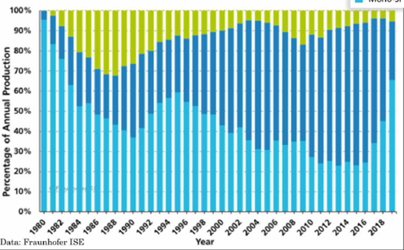
PV Technology Market Share
The fluctuation of different material types since 1980 are thin film PV, multi-Si, mono-Si. 90% of the PV in the market is made of c-Si (multi) whereas c-Si is mostly made in China.
The amount of use of c-Si cannot be separated from its progress which is getting better, starting from BSF and PERC based with 20% efficiency then changing to TOPCOn, HRC, and IBC with efficiency increasing to 25%.

Slide 56
PV Rooftop Vendors
Vendor Address | Vendor Name | Number of Respondents
Bali | CV Citra Surya Dewata | 2
 | Inecosolar | 2
 | Koperasi Amoghasiddhi | 1
 | PT Daya Matahari Indonesia | 2
 | PT Nusa Solar | 1
 | PT Solar Power Indonesia | 11
 | PT Solar System | 4
 | PT Wido Solar | 1
 | Solar Panel Bali | 6
 | Surya Panel Bali | 1
Bogor | PT Altamaya Teknik Mandiri | 1
Jakarta | EASR | 1
 | EIN | 1
 | ELN | 3
 | ESDM | 8
 | PT Contained Energy Indonesia | 19
 | PT Sinar Metrindo Perkasa | 1

Slide 57
Probolinggo | Paiton Energy dan IBEKA | 1
 | PT Integral Sinergi | 1
Semarang | PT Sarana Bangunindo Sejahtera | 3
Surabaya | CV Cahaya Indo Falih | 1
 | PT Bina Lintas Usaha Ekonomi | 1
Tangerang | CV Mitra Energi Mandiri | 1
 | PT Berlin Energi | 1
 | PT Enerba Teknologi | 7

Slide 58
How to Buy and Installation Procedures
Duration of Installments
Information Resources Regarding Rooftop PV
How to Buy Rooftop PV

Slide 59
PV Rooftop Installation Initial Costs
Respondents' Perceptions Regarding the Price of PV Rooftop Installation

Slide 60
Ease of PV Rooftop Installation Licensing Procedures
PV Rooftop Installation Services Options
The Case Regarding PV Rooftop Installation

Slide 61
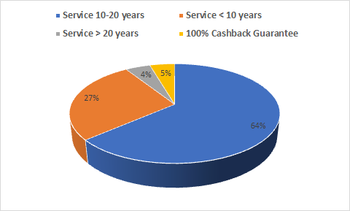
Installation Costs
The results of the survey on household respondents show that the initial investment costs incurred by respondents vary.
Most of the customers said that the initial investment cost for PV Rooftop is Rp. 10,000,000- Rp. 30,000,000.
The survey results show that 71% of existing household PV Rooftop users say they get a guarantee from the PV Rooftop vendor.
Warranty form Provided

Slide 62
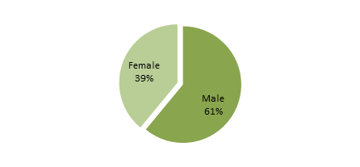
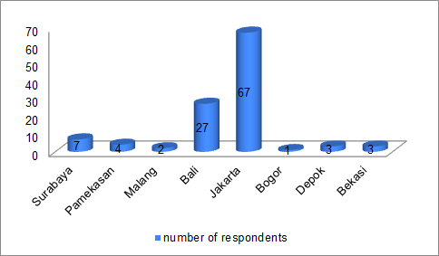
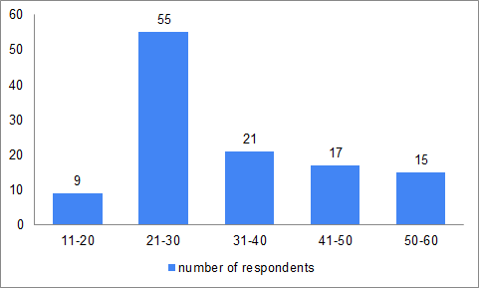
Aspect of Demand
1. Profile of potential respondents who are interested in installing a PV Rooftop (Household)
-The percentage of respondents who are interested in using PV Rooftop is dominated by male gender, which is 61% and is in the age range of 21-30 years.
-Jakarta and Bali have a greater interest in using PV Rooftop compared to other districts or cities.
-Respondents who have a high interest in using PV Rooftop are respondents whose houses are in the middle of the city, with a percentage of 46%.

Slide 63
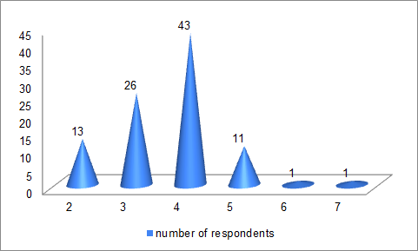
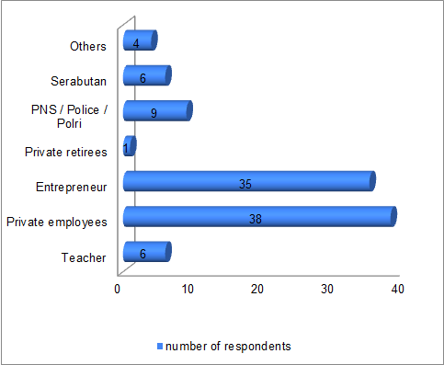
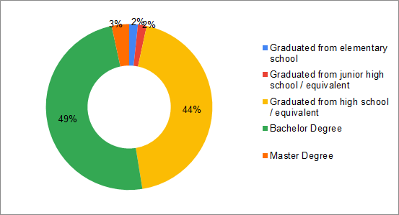
The interest in using PV Rooftop is dominated by families with 4 members.
Respondents who show the most interest in PV Rooftop have the latest educational background of S1, namely 49% and the majority of respondents whose jobs are private employees and entrepreneurs.

Slide 64
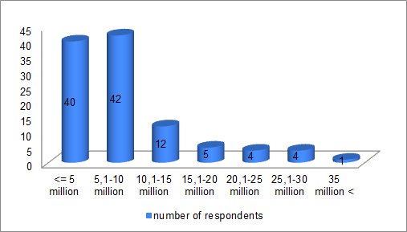
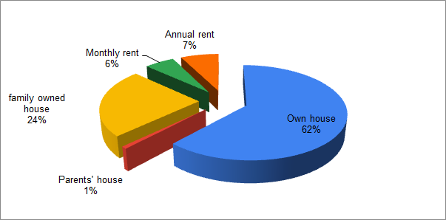
Prospective customers who have the potential to install PV Rooftop have an average monthly total income of 5.1-10 million.
People with the status of their own homes are most interested in installing PV Rooftop, which is 62%.

Slide 65
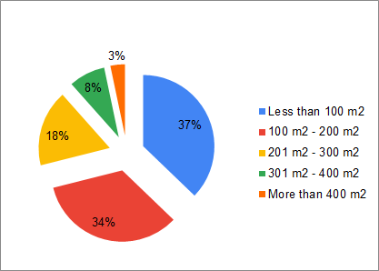
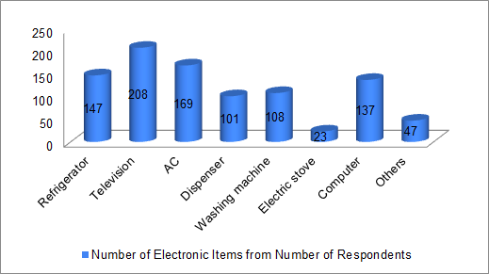
Potential customers who have the potential to install a PV Rooftop also have a house with an area of less than 100 m2 to 200 m2
Based on this figure, it shows that the average person has electronic goods in the form of a refrigerator, television, air conditioner, and so on.

Slide 66
Profile of potential respondents who are interested in installing a PV Rooftop (Industry)
The industry is interested in installing or using PV Rooftop if the business location is in the middle of a city or suburb.
The form of business or industry that is interested in using PV Rooftop is dominated by PT business forms of 42.9%.
As for the type of business, service is the type of business that is most interested in using PV Rooftop at 53.3%.

Slide 67
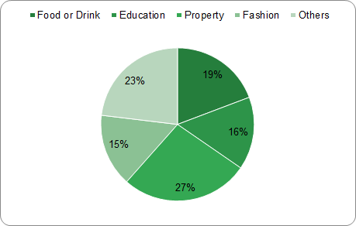
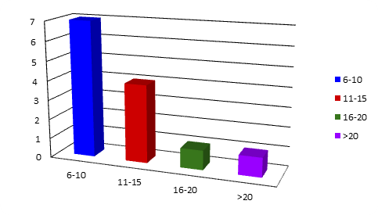
Industries or businesses that produce products in the form of property are industries or businesses that are most interested in using PV Rooftop
In addition, the number of business rooms owned by industries or businesses that are interested in using PV Rooftop ranges from 6-10 rooms.

Slide 68
Advantages of Using Rooftop PV
The use of rooftop solar electricity has an economic advantage in the on-grid class, namely that it can reduce PLN bills.
The savings are obtained according to the type of PV Rooftop used by users of rooftop solar electricity and the amount of electricity used because the use for households and industries has different usage capacities.

Slide 69
Advantages of Using Rooftop PV

Slide 70
Advantages of Using Rooftop PV
Var1 is a variable of electricity expenditure before using PV Rooftop
Var2 is a variable of electricity expenditure after using PV Rooftop
There is a hypothesis:
H0: mean (diff) = 0, there is no difference between before and after using PV Rooftop.
H1: mean (diff) ≠ 0, there is a difference before and after using PV Rooftop.
The results show that the P-Value is 0.000 (less than the critical limit of 0.05), which means that it rejects the null hypothesis and accepts hypothesis one. This analysis shows that there is a difference in the average expenditure of electricity costs before and after using PV Rooftop. The results of the paired t-test analysis show that the average expenditure of electricity costs before using the PV Rooftop is Rp. 2,846,118 but after using PV Rooftop the average electricity cost is Rp. 2,044,600. So that there was a savings of approximately 28.16%.

Slide 71
Weakness of Rooftop PV from Customer Perspective
There are several disadvantages of PV Rooftop from the point of view of customers, both from households and industries.
Number | Statement | Perceptions of Household Respondents |  |  |  |  | Perceptions of Industry Respondents
 |  | STS (%) | TS (%) | S (%) | SS (%) | Rata-rata | STS (%) | TS (%) | S (%) | SS (%) | Rata-rata
1. | The price is too expensive | 1.14 | 7.95 | 61.36 | 29.55 | 3.19 | 0.00 | 11.54 | 50.00 | 38.46 | 3.26
2. | Depends on the weather | 0.00 | 5.68 | 73.86 | 20.45 | 3.14 | 0.00 | 7.41 | 51.85 | 40.74 | 3.34
3. | The area required for installation is too large | 1.14 | 38.64 | 46.59 | 13.64 | 2.72 | 7.41 | 29.63 | 44.44 | 18.52 | 2.74
4. | The materials used are less environmentally friendly (difficult to recycle) | 1.16 | 47.67 | 40.70 | 10.47 | 2.60 | 3.85 | 50.00 | 34.62 | 11.54 | 2.53
5. | Appliance overheats often occurs | 3.41 | 59.09 | 29.55 | 7.95 | 2.42 | 0.00 | 73.08 | 23.08 | 3.85 | 2.42

Slide 72
Rooftop PV Use Factor Analysis
Factor analysis produces four factors that represent the reasons for using PV Rooftop. The four factors are named: (1) Culture; (2) Environmental Awareness; (3) Knowledge of Technology; and (4) Loyalty

Slide 73
Factor | Item
Factor 1 Culture | Because it is easy to find in my area Because in accordance with the life of modern society Because it reflects the culture in my environment Because the environment is used to using it Because it is influenced by my role and status in society Because it is practical and easy to find
Factor 2 Environmental Awareness | Because they want to reduce air pollution Because they want to contribute in conserving non-renewable fossil energy Because you want to apply the use of Green Energy Because solar power is a sustainable source of energy Because they want to be the person (industry) who started the PV Rooftop usage Movement in Indonesia
Factor 3 Technology Knowledge | Because following the current trend Because considering today's popular technology Because it reflects self-identity (industry) Due to the perception of advertising
Factor 4 Loyalty | Keep using PV Rooftop even though I know it's expensive Still using PV Rooftop even though I know that currently it is still imported from abroad Due to peer influence (other industries)

Slide 74
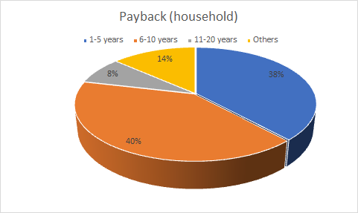
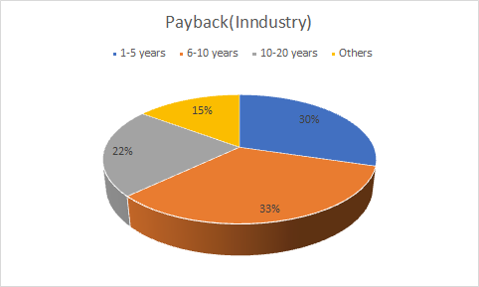
Existing Customer Satisfaction Level
The results show that 40% of household respondents answered that the return on investment will occur in 6-10 years from the initial installation.
Likewise in the industry, the majority of returns on capital occurred for 6-10 years
Duration of Payback (Household)
Payback Period (Industry)

Slide 75
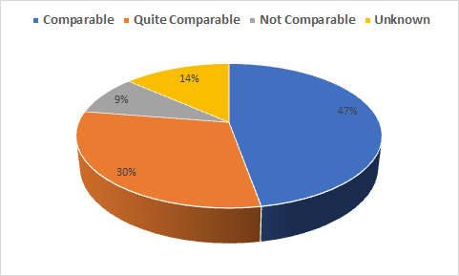
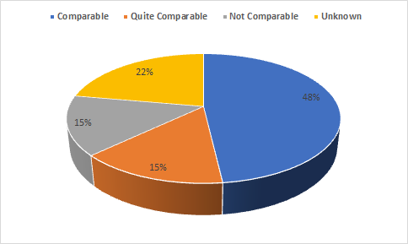
Benefit and Cost Comparison
Benefit and Cost Comparison (Household)
Both household and industrial customers say the benefits are worth the money.
Benefit and Cost Comparison (Industry)

Slide 76
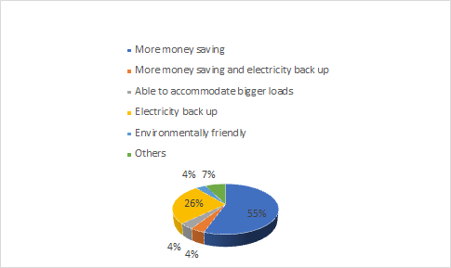
Benefits obtained When Using Rooftop PV
Industry
Household

Slide 77
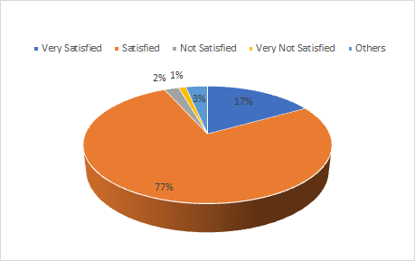
Respondent Satisfaction with PV Rooftop Provider Services
Household
Industry

Slide 78
Prospects for PLN's Involvement in Rooftop PV Business in Indonesia

Slide 79
PV Rooftop Business Model Plans in Indonesia
There are three types of business models offered by PLN, namely the Sapphire, Ruby, and Emerald Packages.
1500 WP |  | 3000 WP |  | 5000 WP
Installment Period | Cost per Month | Installment period | Cost per Month | Installment period | Cost per Month
5 years | Rp. 613,075 | 5 years | Rp. 934,193 | 5 years | Rp. 1,450,159
10 years | Rp. 391,135 | 10 years | Rp. 601,746 | 10 years | Rp. 925,184
15 years | Rp. 324,481 | 15 years | Rp. 499,202 | 15 years | Rp. 767,523
Sapphire Package Installment Details

Slide 80
Ruby Package Installment Details
1500 WP |  | 3000 WP |  | 5000 WP
Installment Period | Cost per Month | Installment period | Cost per Month | Installment period | Cost per Month
10 years | Rp. 359,667 | 10 years | Rp. 553,334 | 10 years | Rp. 553,334
15 years | Rp. 290,557 | 15 years | Rp. 447,010 | 15 years | Rp. 686,279
20 years | Rp. 259,585 | 20 years | Rp. 339,362 | 20 years | Rp. 614,020
25 years | Rp. 243,471 | 25 years | Rp. 374,571 | 25 years | Rp. 575,903
Emerald Package Installment Details
2.200 VA |  | 3.500 VA |  | 5.500 VA
Percentage | Rp/kWh | Percentage | Rp/kWh | Percentage | Rp/kWh
50% | Rp. 2,066,9 | 50% | Rp. 2,032,7 | 50% | Rp. 1,928,7
75% | Rp. 2,366,4 | 75% | Rp. 2,192,1 | 75% | Rp. 2,148,1
100% | Rp. 2,493,1 | 100% | Rp. 2,336,8 | 100% | Rp. 2,318,1

Slide 81
Respondents' Perceptions If PLN Enters the PV Rooftop Market in Indonesia
There are various opinions from respondents, both household and industry, regarding if PLN enters the PV Rooftop market in Indonesia

Slide 82
Perceptions of Household Respondents
Number | Statement | STS (%) | TS (%) | S (%) | SS (%) | Mean
1 | I hope there is regular monitoring of the installation of PV Rooftop by PLN | 0.00 | 2.66 | 60.08 | 37.26 | 3.35
2 | If PLN opens a PV Rooftop service, the installation licensing procedure will be easier | 0.00 | 3.04 | 60.08 | 36.88 | 3.34
3 | I hope there is a financing facility for the PV Rooftop installation package | 0.00 | 2.66 | 65.78 | 31.56 | 3.29
4 | I hope that PLN can open PV Rooftop services | 0.00 | 3.04 | 65.02 | 31.94 | 3.29
5 | I will turn to the PV Rooftop Vendor which can provide cheaper prices with the same quality | 0.38 | 9.51 | 53.61 | 36.50 | 3.26
6 | If I use PLN services to install PV Rooftop, I feel safer | 0.00 | 7.22 | 62.74 | 30.04 | 3.23

Slide 83
Perceptions of Industry Respondents
Number | Statement | STS (%) | TS (%) | S (%) | SS (%) | Mean
1 | If PLN opens a PV Rooftop service, the installation licensing procedure will be easier | 0.00 | 0.00 | 56.67 | 43.33 | 3.43
2 | I will turn to the PV Rooftop Vendor which can provide cheaper prices with the same quality | 1.67 | 8.33 | 40.00 | 50.00 | 3.38
3 | I hope there is regular monitoring of the installation of PV Rooftop by PLN | 0.00 | 3.33 | 56.67 | 40.00 | 3.37
4 | I hope that PLN can open PV Rooftop services | 0.00 | 1.67 | 61.67 | 36.67 | 3.35
5 | I hope there is a financing facility for the PV Rooftop installation package | 0.00 | 6.67 | 51.67 | 41.67 | 3.35
6 | If I use PLN services to install PV Rooftop, I feel safer | 0.00 | 8.33 | 48.33 | 43.33 | 3.35

Slide 84
PLN's Involvement in Rooftop PV Business
PLN's involvement in the PV Rooftop business can have good prospects if you pay attention to respondents' perceptions regarding several things, including ..

Slide 85
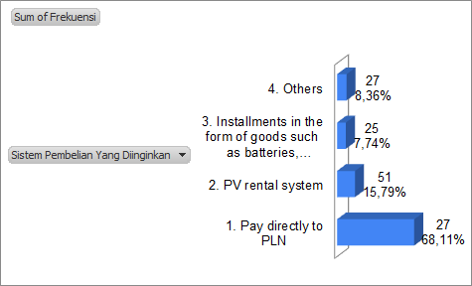
Cont'...
The Watt Peak Package that The Respondent Wants to Buy
The Purchasing System Consumers Want

Slide 86
Period of Installment Ability
Cont'...
Repayment Ability (year) | Number of Respondent | Percentage
5 years | 77 | 23,84
2 years | 65 | 20,12
3 years | 57 | 17,65
1 year | 47 | 14,55
10 years | 23 | 7,12
4 years | 14 | 4,33
Cash | 13 | 4,02
6 years | 7 | 2,17
8 years | 6 | 1,86
15 years | 5 | 1,55
Depend on cost | 2 | 0,62
12 years | 1 | 0,31
0,25 years | 1 | 0,31
4,5 years | 1 | 0,31
Don't want | 1 | 0,31
3,5 years | 1 | 0,31
Depends on usage | 1 | 0,31
20 years | 1 | 0,31
Total | 323 | 100

Slide 87
Cont'...
There are 245 respondents or 75.85% of respondents who agree that there is a PV Rooftop service at the nearest PLN.

Slide 88
Cont'...
Most of the respondents allocated a fee for installments per month which was less than Rp. 300,000. This was stated by 112 respondents or 34.7% of respondents
Allocation of Costs for Installments

Slide 89
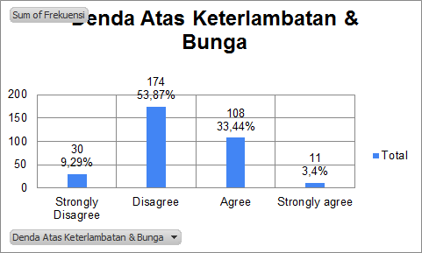
Cont'...
Late fees and Interest
Willingness to Pay for Solar Panel Insurance Per Month

Slide 90
Cont'..
There were 220 respondents or 58.11% of respondents who agreed that PLN should open consulting services related to the risks it experienced
Opening of Risk Consulting Services

Slide 91
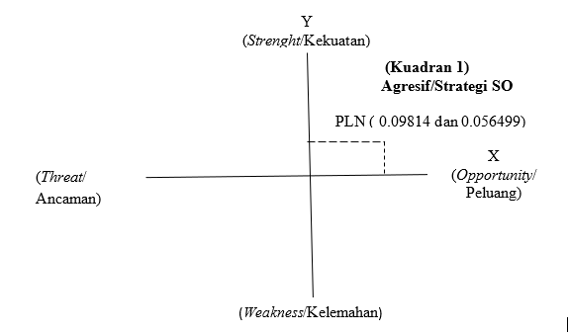
Developing a Strategy Based on PLN's Position with a SWOT Analysis
The position of PLN in the Cartesian diagram can be shown in the following figure

Slide 92
Based on the diagram, Cartesian, in quadrant 1, PLN is in a very strong position because apart from having excellent strength, PLN also has ample opportunities to expand the rooftop solar PV project. PLN can carry out an aggressive strategy by carrying out vertical integration and diversifying conglomerates.
Cont'...
Aggressive Strategic
Vertical Integration
Upstream-downstream vertical integration strategy
Conglomerate Diversification
To maintain the survival of the company

Slide 93
Marketing Strategy
Marketing Concept
Strategic Marketing
Segmentating
Targeting
Tactical Marketing
Product
Place
Positioning
Price
Production

Slide 94
Cont'...
Integrated Marketing Communications
advertising
event & experiences
personal selling
direct & database marketing
public relation & publicity
online & social media marketing
mobile marketing
sales promotion

Slide 95
Rooftop PV Market Development Challenges in Indonesia
Among the various renewable energy alternatives, such as geothermal (geothermal), hydro (water), wind (wind), the existence of solar power plants (solar panels) is considered the lowest usage in Indonesia which is only in the range of 0.1% based on data from PLN 2020
However, solar panel technology is suitable and capable of supporting the process of producing electrical energy which is still a luxury material with high taxes, so that not all citizens and companies are able and willing to use solar panels.
The lack of public interest in using renewable energy such as solar panels will reduce the potential income from PLN
The energy transition must be accompanied by various policy incentives and special facilities from the government for PLN

Slide 96
Conclusion

Slide 97
Respondent Demographic Profile
1.
From 323 respondents, overall the largest respondents came from Jakarta, male, age range 21-30 years, house location in the middle of the city, graduated from S1, has 4 household members, the majority work as entrepreneurs, monthly income is less than 5 million , the form of an individual company, the type of service business, and the distance from the business location to the city center as far as 1-5 kilometers. As for users of PV Rooftop Existing, both from the household and industry side, it shows that the largest respondents come from Bali and Jakarta.

Slide 98
2.
Rooftop PV Market Characteristic
Supply Aspect
The use of rooftop solar electricity in Indonesia is legally issued by the ministry and by PT. PLN as a state-owned company that provides electricity facilities for Indonesia
There are already many vendors scattered in various regions in Indonesia, including Bali, Bogor, Jakarta, Probolinggo, Semarang, Surabaya, and Tangerang which respondents chose to install solar panel roofs in their homes or business locations.
Most respondents in getting information about PV Rooftop are friends or relatives, the average purchase is paid in cash, and the average initial installation cost is around 1-25 million
Regarding the initial investment of PV Rooftop users, the largest investment value for households is 250 million, while for industry is 2 billion rupiah.

Slide 99
2.
Rooftop PV Market Characteristic
Demand Aspect
The use of rooftop solar electricity or PV Rooftop can provide benefits in the form of savings, namely a reduction in electricity bills from PLN. The name of this article is:
Based on the results of the factor analysis, the reason why customers install PV Rooftop is due to cultural factors, environmental awareness, technological knowledge and loyalty.
The consumer satisfaction of PV Rooftop users, both household and industrial, can be seen from several indicators, most of which show high satisfaction with the use of PV Rooftop. On the point of customer satisfaction, it is also clearly explained that 78% of respondents claim to be satisfied with the PV Rooftop services they have.

Slide 100
3.
Prospects for PLN's Involvement in Rooftop PV Business in Indonesia
The PV Rooftop business model plan that will be offered by PLN includes three packages, including the Sapphire, Ruby, and Emerald packages. Each package has different benefits and types of services.
Based on the results of the SWOT analysis, PLN is in a very strong position because apart from having very good strength, PLN also has ample opportunities to expand the rooftop solar PV project. The strategy that can be applied in this condition is an aggressive strategy because PLN has a great opportunity to become a market leader. PLN can carry out an aggressive strategy by carrying out vertical integration and diversifying conglomerates.

Slide 101
Policy Recommendations
Based on the conclusions that have been presented, there are several policies that can be carried out by PLN to determine the right promotion strategy in targeting target consumers. Some of these policies include::
In Indonesia, the renewable energy market has great potential, especially solar energy such as PV Rooftop. This gives PT PLN a great opportunity to enter the PV Rooftop market in Indonesia. Great opportunities are accompanied by challenges that must be faced by PT PLN, namely the low purchasing power of the community. The survey results show that some of the existing users bought cash. However, when asked for the opportunity to pay in installments with several duration options, the respondent showed a positive response. Most of the respondents are willing to pay PV Rooftop installments, with the most chosen duration is 5 years or 23.84% of respondents. However, of the willingness to pay in installments, 53.87% were not willing to be subject to fines. This means that PT PLN has the potential to enter the market and target the community, by providing various facilities that are attractive and not burdensome to the community, such as an installment purchase system based on the installment period that is of interest to the community, various Watt Peak packages. , and other facilities.

Slide 102
2) In addition, the results of the analysis in this study also show that the preferences of PV Rooftop users are not always based on environmental orientation. This survey shows that 69% of households claim to benefit in the form of cheaper electricity costs. That is, explaining and educating the public about the net benefits received in proportion to the initial investment issued is important. Given that 69% of household respondents also said that the installation of PV Rooftop is included in the expensive category. So that increasing education to the public about the costs and benefits received by the community needs to be improved.
3) Based on the results of the analysis, one of the weaknesses of PV Rooftop is the high price, people are still calculating and thinking about the advantages and disadvantages of installing PV Rooftop. The thing that needs to be highlighted on PV Rooftop products if people think that it is economically more profitable to use conventional electricity is to rely on services and products. Service and product are two components that play an important role so that a good product will also be accepted by the community. Then, educate the public that the benefits arising from using PV Rooftop are not only felt now but for a long period of time. So, the main key lies in educating the public about the products being marketed, in this case PV Rooftop.

Slide 103
Thank you

