Slide 1
Long-Term Planning and Characterization of Latin American Electrical Systems based on their Resources
Authors: Lorena Di Chiara (lorenadichiara@gmail.com)
Gonzalo Casaravilla (gcp@fing.edu.uy)
Ruben Chaer (rchaer@fing.edu.uy)
June 2021

Slide 2
Objective
Determine the long-term optimal generation expansion of a power systems considering: hydroelectric integration and storage capacity (reservoir), variability of flows, wind and irradiance similar to Latin American countries, as well as, fossil fuel price, installation costs and operation and maintenance costs of different technologies.

Slide 3
Hydroelectric Generation in Latin America
In 2019, hydroelectric generation in Latin America represented approximately 50% of the electricity demand.
Most Latin American countries flows are influenced by the climatological phenomena El Niño / La Niña (pseudo-cycles from 5 to 8 years).
Extreme situations may cause severe droughts or floods.

Slide 4
General Assumptions
Latin America is divided in 3 regions:
Central America
Southern Cone (includes Argentina, Uruguay and Rio Grande do Sul)
Andean Region
12 scenarios hydroelectric installed capacity and storage:
Installed capacity: 60%, 40% and 20% of peak demand
Storage capacity (reservoir): Few hours, 1 week, 12 weeks and 52 weeks
3 Fossil fuel prices scenarios:
Low Price: Availability of sufficient native Natural Gas (NG) (Andean Region)
Medium Price: LNG and NG import (3 regions)
High Price: Oil (Southern Cone, Central America)

Slide 5
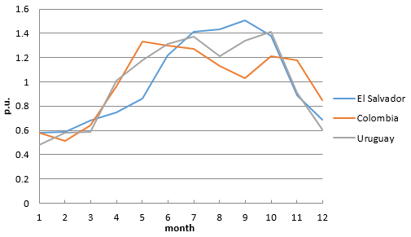
Hydroelectric resource modeling
Year | Central America | Southern Cone (without Brazil) | Andean Region
2005 | 50 | 57 | 57
2006 | 50 | 58 | 60
2007 | 51 | 54 | 62
2008 | 56 | 54 | 65
2009 | 52 | 55 | 62
2010 | 56 | 52 | 57
2011 | 49 | 51 | 63
2012 | 50 | 50 | 62
2013 | 48 | 53 | 60
2014 | 45 | 51 | 57
2015 | 45 | 55 | 54
Source: XM Colombia, UT El Salvador, 80 years historical flow Uruguay.
Source: SieLAC - OLADE
Hydro modeling:
Similarities in Annual FC in the three regions.
Average 55% and extreme values 40% and 70%.

Slide 6
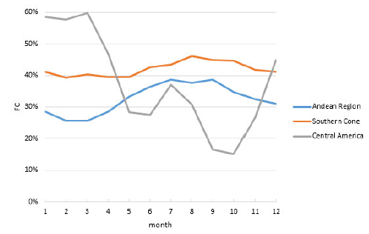
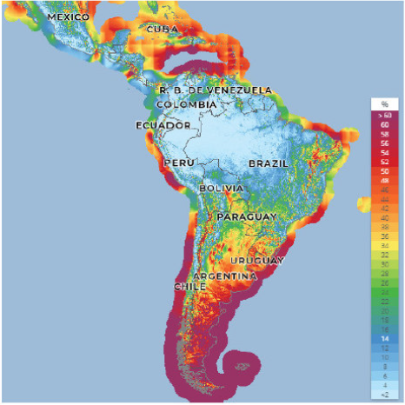
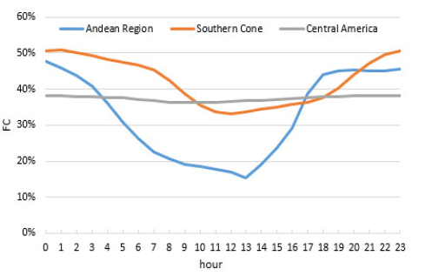
Wind resource modeling
Annual FC:
Southern Cone: 42%
Andean Region: 32.5%
Central America: 37.5%
Global Wind Atlas – 100 meters height

Slide 7
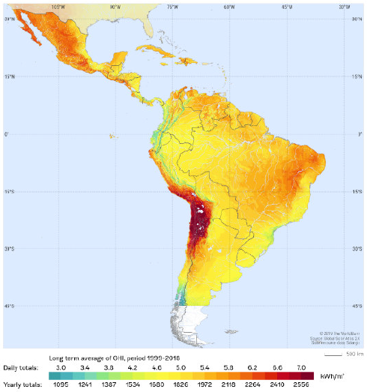
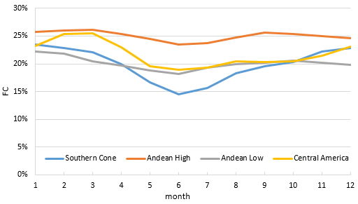
Solar resource modeling
Annual FC:
Southern Cone: 20%
Andean Region: 25%, 20%
Central America: 21.5%
Global Solar Atlas

Slide 8
Candidate plants modeling
 | Wind onshore | PV | Turbine | Combined Cycle
Capacity (MW) | 50 | 50 | 60 | 120
Lifetime (years) | 20 | 20 | 25 | 25
Investment cost (USD/kW installed) | 1400 | 800 | 1000 | 1200
Availability Factor (%) | 1 | 1 | 0.85 | 0.85
Fossil Fuel Price | Variable cost Turbine (USD/MWh) | Variable cost Combined Cycle (USD/MWh)
 |  | Technical minimum | Nominal
Low Price | 31 | 32 | 25
Medium Price | 57 | 59 | 43
High Price | 88 | 90 | 60
Turbines can operate for very short-time periods while combined cycles must be on / off some hours (at least 1 day in this study)

Slide 9
Planning Model
One of the most suitable models to carry out power systems planning studies with a high share of hydroelectric and non-conventional renewable energy (NCRE) integration is the stochastic model SimSEE (Simulation of Electric Power Systems) with the Generation Investment Planning Module (PIG-OddFace) used in Uruguay.
SimSEE is the power system planning tool used by OLADE.

Slide 10
System modeling
Electrical system: Modeled as a single node.
Demand: Hourly data adjusted to 10.000 GWh/year (peak demand around 1.900 MW)
Daily time step (24 hours) with 4 division (1, 4, 13, 6 hours)
Wind, solar and hydro resources are modelled using stochastics models (CEGH).
Discount rate 10%
Costs/Prices: 2020 constant dollars.
Taxes are not considered.

Slide 11
Results
Medium and High fossil fuels prices ➔ High share of NCRE, specially in systems with 20% hydroelectric capacity.
Increase in fossil fuel prices ➔ Increases the share of NCRE.
Same hydroelectric installed capacity, storage capacity increases ➔ Integration of NCRE increases.
Low fuel prices (3 USD/MBTU): Only thermal expansion.
Low fossil fuel price increases 1 USD/MBTU ➔ NCRE are competitive options.
Systems with little storage capacity ➔ Daily evolution of wind and PV generation has a more important role.

Slide 12
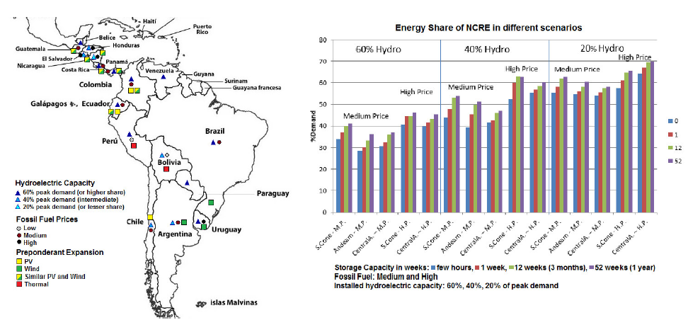
Results

Slide 13
Conclusions
Except in scenarios with low fossil fuel prices, wind and solar PV are competitive generation expansion options.
Wind and PV generation expansion varies along Latin American countries. Depends mainly on fossil fuel prices, hydroelectric and storage capacity, flows, solar and wind resources.
Southern Cone: Wind energy is the predominant expansion option.
Chile: Solar PV is the predominant option.
Central America countries: Share of wind a PV capacity is similar.
Important: This is an energy study. It is necessary to carry out a flexibility and stability study, specially in systems with 20% hydroelectric capacity.

Slide 14
Thank you for your attention.
lorenadichiara@gmail.com

