Slide 1
ASYMMETRIC TRANSMISSION OF GASOLINE PRICES IN BRAZIL: IMPACTS OF THE NEW PETROBRAS STRATEGY AND INFLUENCE OF ETHANOL MANDATE
Francisco Teixeira Raeder, Niágara Rodrigues and Luciano Losekann
Universidade Federal Fluminense (UFF) – Niterói/Brazil
Group of Energy and Regulation (GENER/UFF)
June 9, 2021

Slide 2
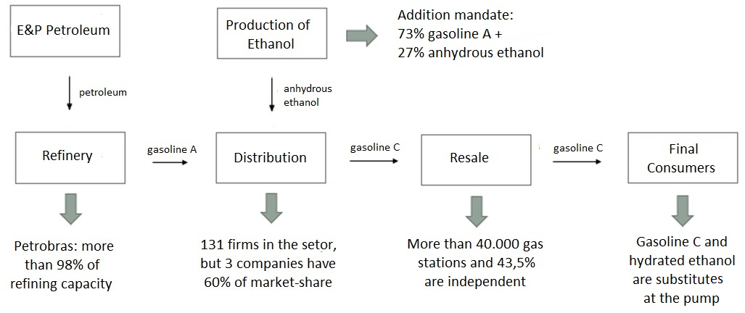
Introduction: The Brazilian Gasoline Market
Source: Authors’ elaboration

Slide 3
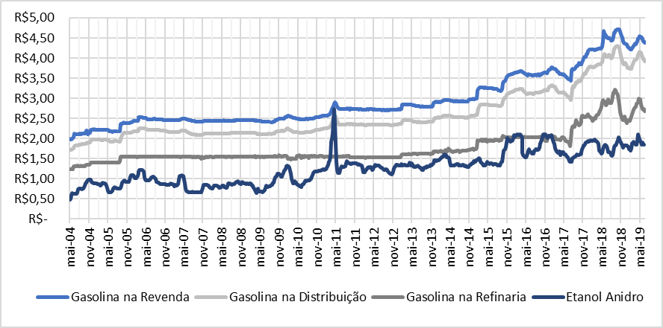
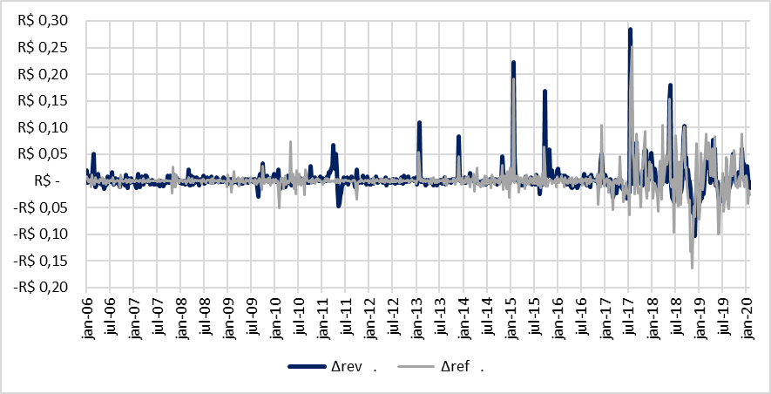
The Problem: Pricing Strategy and Price Transmission
Petrobras is the main agent in the industry → relevance of its pricing strategy
Two periods: stability (until 2015) and short-term international alignment (since 2016)
After price formation in refinery, how are readjustments transmitted through all activities?
Source: Authors’ elaboration using data from ANP (2020) and CEPEA (2020)

Slide 4
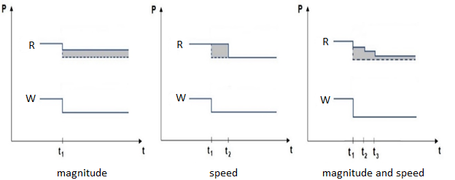
What is Asymmetry in Price Transmission?
Differences (in magnitude and/or speed) between negative and positive price adjustments in retail (e.g.: resale), in a specific market, when price changes in wholesale (e.g.: refinery)
“Feather” and “Rocket” Effects → generally, price goes up like a rocket and goes down like a feather
Asymmetrical transmissions cause distributive distortions in welfare → they are not Pareto-efficient
Examples of “Feather” Effect
Source: Adapted from Meyer and von Cramon-Taubadel (2004)

Slide 5
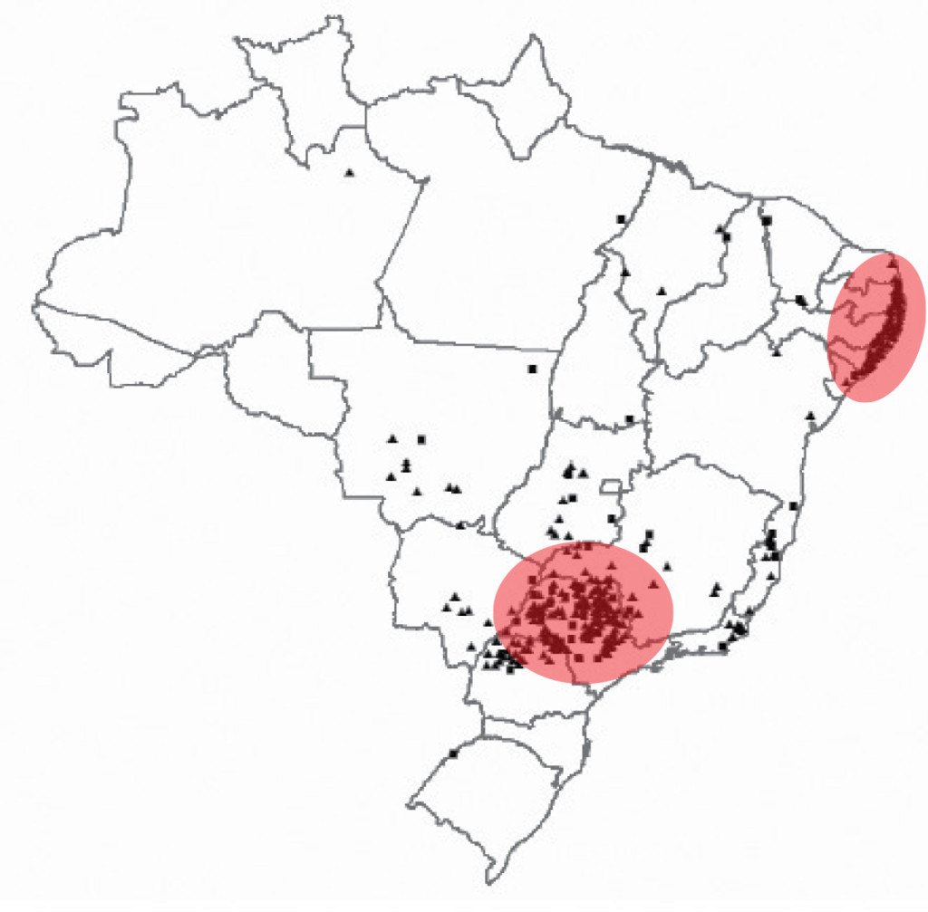
What Causes Asymmetry in Price Transmission?
Imperfect Competition:
Market power
Collusion
Profitability/Margins
Search Costs
b) Brazilian Particularities:
Ethanol Addition Mandate → transportation costs depends on the distance from production center
Taxation → the “ICMS” (tax on circulation of products and services) rate is defined by each State
Production of ethanol in Brazil
Source: NovaCana (2020)

Slide 6
Objective, Research Questions and Methods
Objective: to verify the presence of asymmetries in price transmission between: (i) refinery, ethanol and distribution; and (ii) distribution and resale (gas stations)
Two periods: stability (2004-2015) and short-term international alignment (2016-2019)
Brazilian regions: North, Northeast, South, Southeast and Midwest
Research Questions:
Does Petrobras’ pricing strategy change the dynamic of price transmission?
Does the ethanol mandate influence asymmetries?
How much do consumers lose because of asymmetries?
Methods: Long-term relationships and Dynamic Ordinary Least Squares (DOLS) Estimator:
${Dist}_{t}= β_{0}+ β_{1}{Ref}_{t}+ β_{2}{Eth}_{t}+ ε_{t} (1)$
${Res}_{t}= β_{0}+ β_{1}{Dist}_{t}+ ε_{t} (2)$
Hipóteses: Transmissão de preços da gasolina entre o produtor e o posto se dá de maneira assimétrica, isto é, ocorrem os efeitos “foguete” e “pena” e há perdas para o consumidor em termos de bem-estar social
Metodologia: Modelo de Correção de Erros (ECM), pois tal metodologia corrige os eventuais desvios (assimetrias) do equilíbrio de longo prazo
Três exercícios:
1) Equações simultâneas utilizando séries temporais e ECM
2) Equações simultâneas utilizando dados em painel e ECM
3) Impacto da assimetria em termos de perda de bem-estar social

Slide 7
Methods: Testing for Asymmetries
Lagged residuals from (1) and (2) used in Error Correction Models:
${∆Dist}_{t}= α+\sum_{i=1}^{I}{θ_{i}{∆Dist}_{t−1}}+\sum_{j=0}^{J+}{β_{j}^{+}{∆Ref}_{t−j}^{+}}+\sum_{j=0}^{J−}{β_{j}^{−}{∆Ref}_{t−j}^{−}}+\sum_{k=0}^{K+}{β_{k}^{+}{∆Eth}_{t−k}^{+}}+ \sum_{k=0}^{K−}{β_{k}^{−}{∆Eth}_{t−k}^{−}}+ λ^{+}{ECM}_{t−1}^{+}+ λ^{−}{ECM}_{t−1}^{−}+ε_{t}$ (3)
${∆Res}_{t}= α+\sum_{i=1}^{I}{θ_{i}{∆Res}_{t−1}}+ \sum_{j=0}^{J+}{β_{j}^{+}{∆Dist}_{t−j}^{+}}+\sum_{j=0}^{J−}{β_{j}^{−}{∆Dist}_{t−j}^{−}}+ λ^{+}{ECM}_{t−1}^{+}+ λ^{−}{ECM}_{t−1}^{−}+ε_{t}$ (4)
Hypothesis tests in (3) and (4)
Instantaneous Asymmetry of Magnitude: $H_{0}: β_{0}^{+}= β_{0}^{−}$ (5)
Short-term Asymmetry of Magnitude: $H_{0}: \sum{β^{+}}= \sum{β^{−}}$ (6)
Asymmetry of Speed: $H_{0}: λ^{+}= λ^{−}$ (7)
Hipóteses: Transmissão de preços da gasolina entre o produtor e o posto se dá de maneira assimétrica, isto é, ocorrem os efeitos “foguete” e “pena” e há perdas para o consumidor em termos de bem-estar social
Metodologia: Modelo de Correção de Erros (ECM), pois tal metodologia corrige os eventuais desvios (assimetrias) do equilíbrio de longo prazo
Três exercícios:
1) Equações simultâneas utilizando séries temporais e ECM
2) Equações simultâneas utilizando dados em painel e ECM
3) Impacto da assimetria em termos de perda de bem-estar social

Slide 8

Methods: Consumer Cost
Two Cumulative Response Functions (positive and negative) for resale, after a 1% shock in distribution
Average prices in Brazil (not in regions)
$$Consumer Cost= \sum_{j=0}^{J}{{CRF}_{t+j}^{+}− {CRF}_{t+j}^{−}} (8)$$
Where:
${CRF}_{t+j}^{+}= {CRF}_{t+j−1}^{+}+ {\hat{β}}_{t+j}^{+}+ \sum_{i=1}^{I}{{\hat{θ}}_{i}^{+}}{∆Res}_{t+j−i}^{+}+ λ^{+}\left({CRF}_{t+j−1}^{+}−\hat{β_{1LT}}\right)$
${CRF}_{t+j}^{−}= {CRF}_{t+j−1}^{−}+ {\hat{β}}_{t+j}^{−}+ \sum_{i=1}^{I}{{\hat{θ}}_{i}^{−}}{∆Res}_{t+j−i}^{−}+ λ^{−}({CRF}_{t+j−1}^{−}−\hat{β_{1LT}})$
Hipóteses: Transmissão de preços da gasolina entre o produtor e o posto se dá de maneira assimétrica, isto é, ocorrem os efeitos “foguete” e “pena” e há perdas para o consumidor em termos de bem-estar social
Metodologia: Modelo de Correção de Erros (ECM), pois tal metodologia corrige os eventuais desvios (assimetrias) do equilíbrio de longo prazo
Três exercícios:
1) Equações simultâneas utilizando séries temporais e ECM
2) Equações simultâneas utilizando dados em painel e ECM
3) Impacto da assimetria em termos de perda de bem-estar social

Slide 9
Results: Asymmetries Between Refinery, Ethanol and Distribution
Decrease in the number of magnitude asymmetries in refinery: instantaneous (5 → 2) and short-term (4 → 3)
New magnitude asymmetries in ethanol: instantaneous (0 → 3) and short-term (2 → 4)
Decrease in the number of asymmetries of speed (3 → 2)
“Rocket” in magnitude; “Feather” in speed
Period | Region | Magnitude (Refinery) |  | Magnitude (Ethanol) |  | Speed
 |  | Instantaneous | Short-Term | Instantaneous | Short-Term
2004-2015 | Midwest | Yes | Yes | No | Yes | No
 | Northeast | Yes | Yes | No | No | Yes
 | North | Yes | Yes | No | No | No
 | Southeast | Yes | No | No | No | Yes
 | South | Yes | Yes | No | Yes | Yes
2016-2019 | Midwest | Yes | No | No | Yes | Yes
 | Northeast | No | Yes | No | Yes | Yes
 | North | Yes | Yes | Yes | Yes | No
 | Southeast | No | No | Yes | No | No
 | South | No | Yes | Yes | Yes | No
Source: Authors’ Elaboration

Slide 10
Results: Asymmetries Between Distribution and Resale
Period | Region | Magnitude Instantaneous | Magnitude Short-Term | Speed
2004-2015 | Midwest | Yes | Yes | Yes
 | Northeast | No | No | Yes
 | North | Yes | No | Yes
 | Southeast | Yes | Yes | No
 | South | Yes | No | Yes
2016-2019 | Midwest | Yes | Yes | No
 | Northeast | Yes | Yes | Yes
 | North | No | No | No
 | Southeast | Yes | Yes | Yes
 | South | Yes | Yes | Yes
The number of instantaneous asymmetries of magnitude remains the same (4 → 4)
Increase in the number of short-term magnitude asymmetries (2 → 4)
Decrease in the number of asymmetries of speed (4 → 3)
“Rocket” in magnitude; “Feather” in speed
Source: Authors’ Elaboration

Slide 11
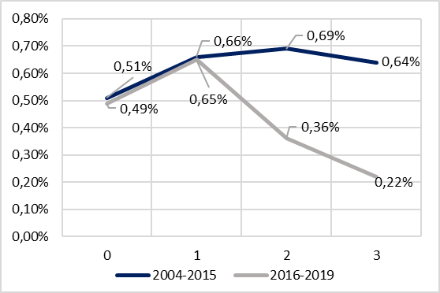
Results: Consumer Cost and Loss of Welfare
There is no difference between Petrobras’ pricing strategy in t=0 and t=1
After t=2, the consumer cost decreased in the second period
Assumptions:
15.000 km in a year
Fuel consumption: 1 liter per 10 km
Gasoline price: R$ 4,80
Thus, weekly expenditure: R$ 138,24
Period | Monetary Loss
2004-2015 | R$ 2,57
2016-2019 | R$ 2,07
↓ 19%
Source: Authors’ Elaboration

Slide 12
Conclusions
Price transmission process, in all Brazilian regions, is asymmetric (except for the North region, from distribution to resale, in the second period)
Petrobras’ pricing strategy and ethanol addition mandate influence the price transmission dynamics between refinery and distribution
Short-term international alignment → better for consumers in terms of welfare, but volatility is still an issue for consumers
Discussion: how to mitigate the asymmetries?
Transparency

Slide 13
Thank You!
Francisco Teixeira Raeder francisco.raeder@yahoo.com.br

