Slide 1

POTENTIAL OF ELECTRIC VEHICLES TO OVERCOME TRANSMISSION LINE CONGESTIONS AND BALANCE REDISPATCH NEEDS
A CASE STUDY FOR THE AUSTRIAN CONTROL AREA
Christoph Loschan, Carlo Corinaldesi, Georg Lettner
(TU Wien – Energy Economics Group)
1st IAEE Online Conference
7.6.2021

Slide 2
Overview
1
Motivation & Introduction
2
Model Formulation
2.1
Aggregation
2.2
Dispatch
2.3
Redispatch
3
Results

Slide 3
Introduction & Motivation
Dispatch
Market-based (Merit Order)
Congestion
temporary overload
Redispatch
Power increase/decrease of power plants
> Volatile RESE generation
> geographical unequal distribution
> EV Demand:
simultaneity not correlated to generation
No allocation of transfer capacities within a bidding zone

Slide 4
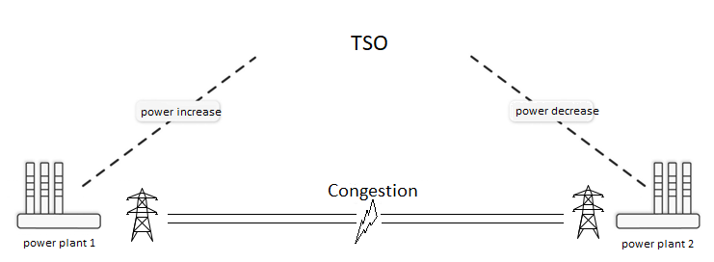



Motivation & Research question
Pairwise power increase/decrease
Th. power plants (50 MW+)
Research Question: Can we use a Demand-side-management of Electric vehicles charging processes to compensate redispatch needs?

Slide 5
Model Overview
Aggregation
of the model-input
Dispatch
Market-based
Disaggregation
of balancing groups
Charging profiles
Balancing groups (BGs)
Without transmission lines (except interconnector & FBMC)
Objective: OV cost minimisation
17 BGs in Austria
Redispatch
Within Austria
Objective: Redispatch costs minimisation
Balance redispatch needs, overcome congestions
all transmission lines (NTC & power flow)
PP usage, RESE curtailment, storage usage, unchanged from Dispatch
Th. PP regulation
Additional RESE curtailment
EV Demand-side-management
Charging processes -> charging types (per BG)
Austria 9 (from 17) BGs
Th. PP, RESE, storages

Slide 6
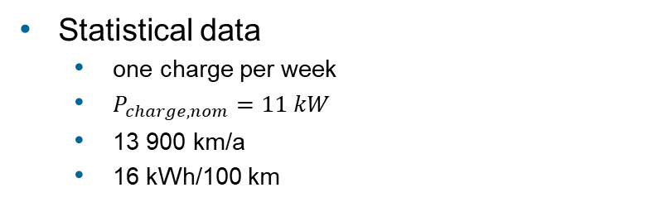
Model Formulation
Plugged-in EVS
Energy demand & DSM potential
➔
Statistical values of charging behaviour [2]
Charging processes
  aggregate -> 6 different charging types
Statistical data
  one charge per week
  $P_{charge,nom}=11 kW$
  13 900 km/a
  16 kWh/100 km
Aggregation

Slide 7




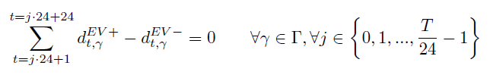
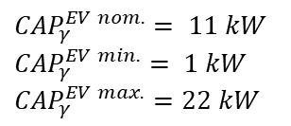
Model Formulation
Scenario depending: 0 or decision variable
DSM restrictions
pre optimisation calculation
}
Energy balance
$${CAP}_{γ}^{EV nom.}= 11 kW$$
$${CAP}_{γ}^{EV min.}= 1 kW$$
$${CAP}_{γ}^{EV max.}=22 kW$$
Aggregation

Slide 8
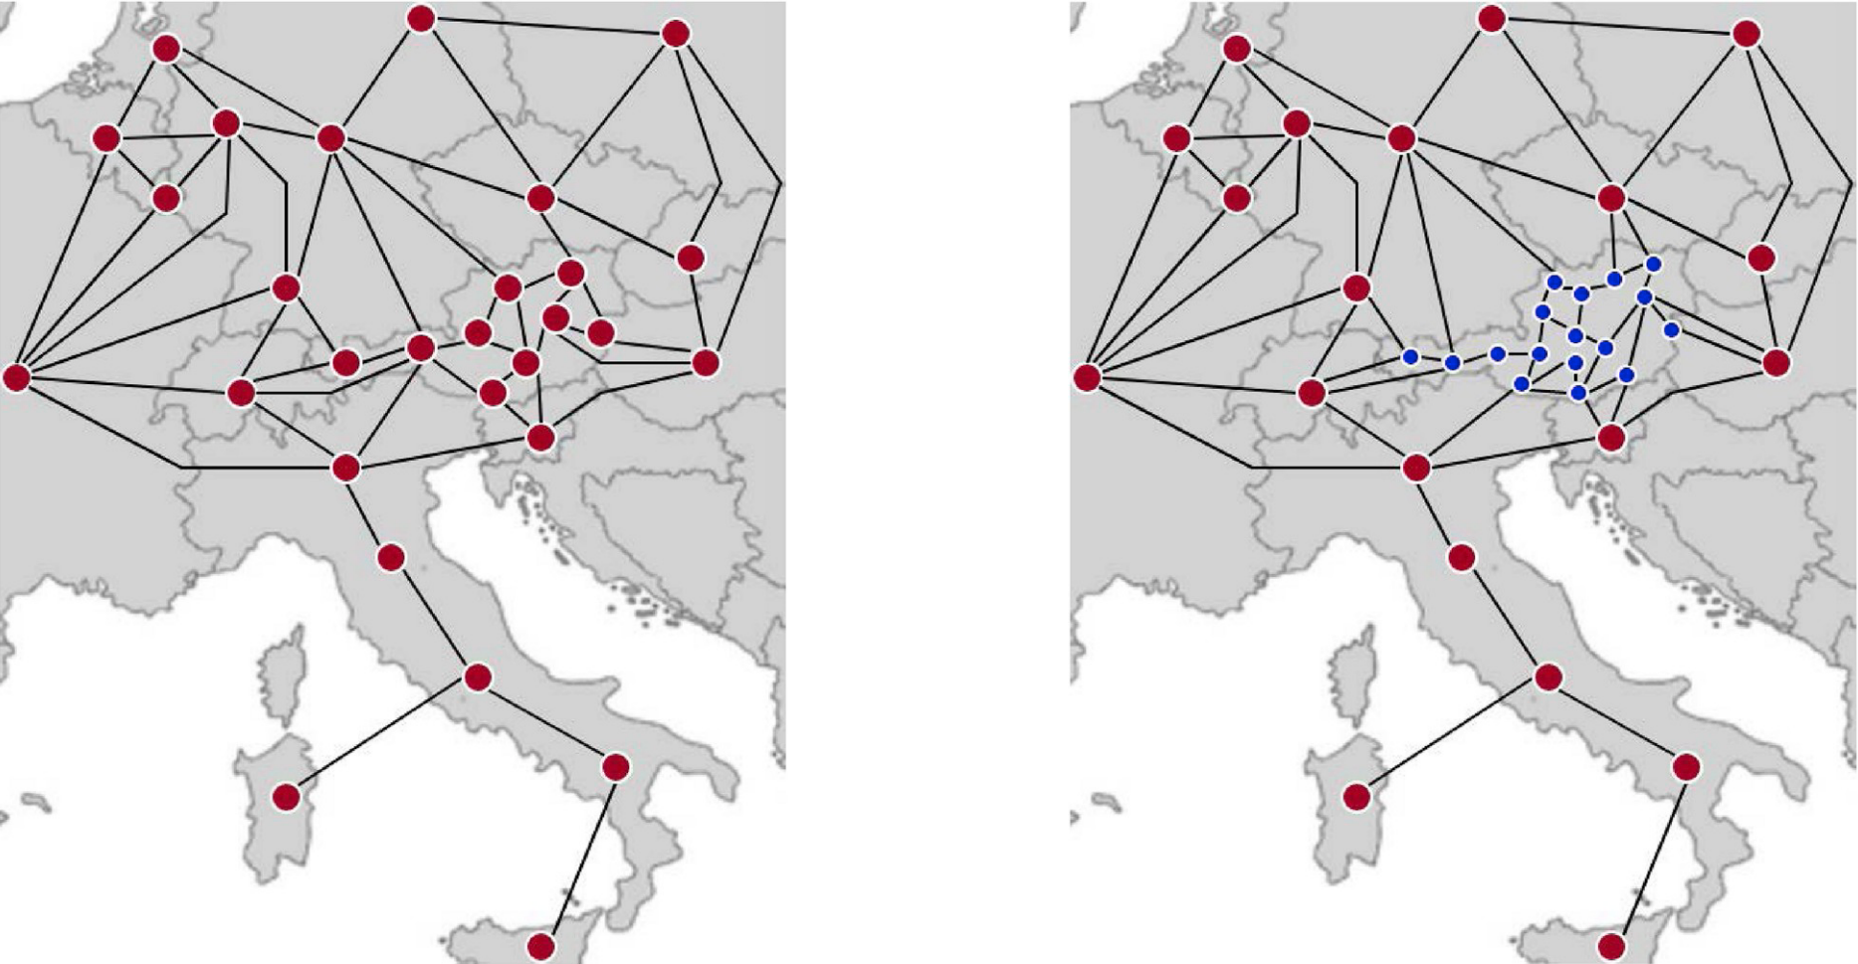
Model overview – nodes & connections
Min. OV costs (Max. social welfare)
(th. PP, RESE, storages)
365 x 1 day optimisation
DC loadflow between spot markets
&
critical branches in Austria (FBMC)
[1]
Dispatch

Slide 9
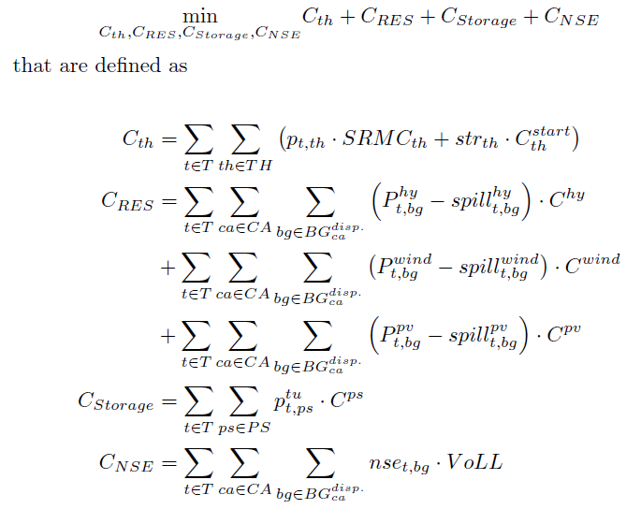
Model Formulation - Objective
365 x 1 Day-ahead optimisation
thermal generation
RESE
Storage usage
Not supplied energy
Dispatch

Slide 10
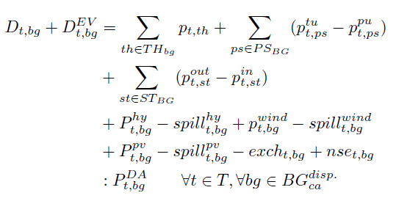

Model Formulation - Constraints
Demand compensation
in every aggregated balancing group
thermal PP
for all RES types
Dispatch

Slide 11

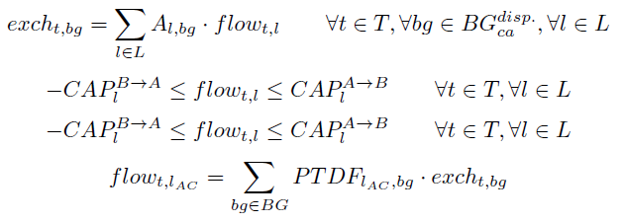
Model Formulation - Constraints
Technical &
Annual pattern storage constraints
Power flow between aggregated
balancing groups
NTC limit
Dispatch

Slide 12
Model overview – nodes & connections
Min Redispatch costs in Austria
Detailed power plant allocation
EV DSM
Transmission grid & DC loadflow
[1]
Redispatch

Slide 13
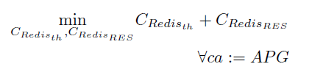
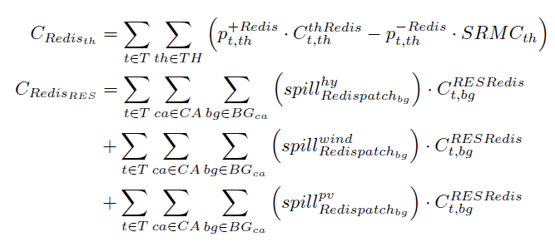


Model Formulation - Objective
Redispatch costs minimisation
in Austria
Redispatch costs for thermal PP
Redispatch costs for RESE
Redispatch

Slide 14
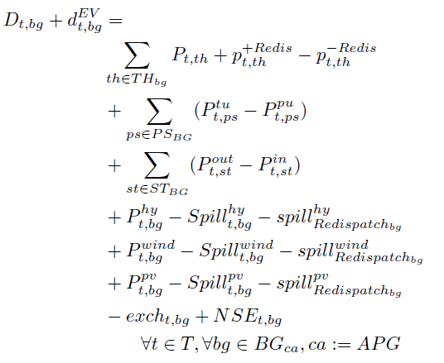
Model Formulation - Constraints
Demand compensation
in every balancing group
In Austria
Dispatch = Constants
Redispatch = Decision variables
Redispatch

Slide 15
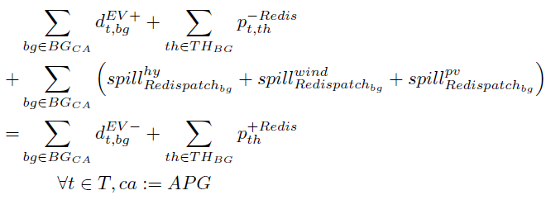
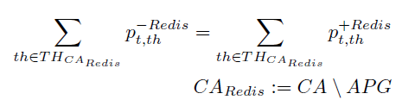

Model Formulation - Constraints
Energy equilibrium
(power sum = const.)
Redispatch

Slide 16
Results - Scenarios
ENTSO-E 2030 NT scenario
  Existing power plants and RES-E
  Electricity demand
3 Different scenarios
  200k EVs
  600k EVs
  2 Million EVs in Austria
3 Variants per scenario
  No DSM
  DSM usage in Redispatch
  DSM usage in Dispatch

Slide 17
Results: 600k – Redispatch energy
Lower RESE curtailment
Less gas turbines

Slide 18
Results – Costs - EV perspective
Energy is shifted to times with lower day-ahead prices
Without DSM:
Charging costs: 750 €
With DSM:
Charging costs: 709 €
-> 5,5 % cost reduction
24

Slide 19
Results: 600k – Redispatch costs
6,6 % cost reduction

Slide 20
Results: 600k – Redispatch CO2 emissions
20 % Redispatch caused CO2 emissions reduction

Slide 21
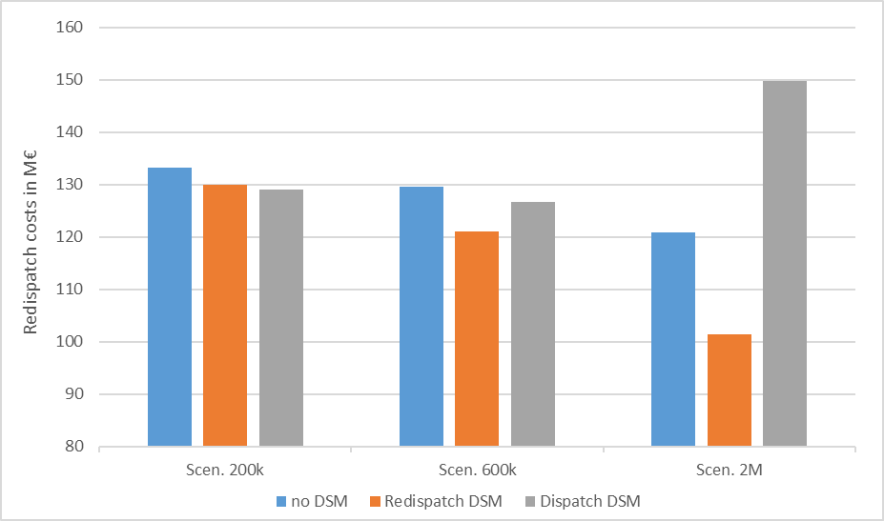
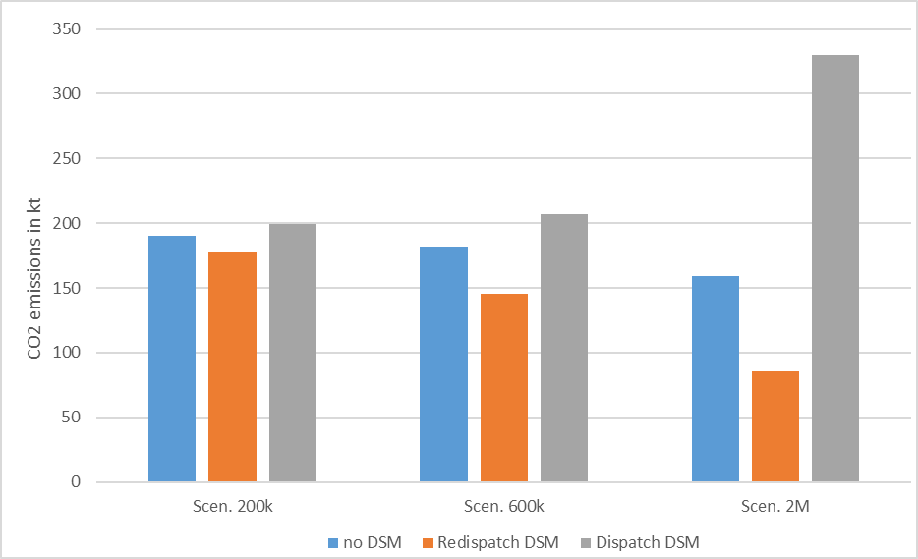
Results: Summary & Conclusion
-20 % / +20 %
-2.5 % / -3 %
DSM during Redispatch
  Lowest RESE curtailment
  during Redispatch and Overall
  Lowest CO2 emissions
DSM during Dispatch ->
  Market based DSM
  Congestion more often
  Higher CO2 Emissions
Electric Vehicles
  High DSM potential (often available, whole year)
  Reduction of Redispatch costs
  Reduction of CO2 emissions
-7% / -2 %
-46% / +107 %
-7% / +5%
-20 % / +13 %

Slide 22
Thank you!
Christoph Loschan, Carlo Corinaldesi, Georg Lettner
(TU Wien – Energy Economics Group)
This work is done in the ABS4TSO project [3], supported with the funds from the Austrian Research Promotion Agency (FFG).

Slide 23
References
[1] Figure: L.Lang, The meaning of flow-based market coupling on redispatch measures in Austria, 2020, Energy Policy, Volume 136, https://doi.org/10.1016/j.enpol.2019.111061
[2] Statistic: C.Nelder, Electric Vehicles as Distributed Energy Resources, 2016, Project: EV-Grid Integration, https://www.researchgate.net/publication/324417842
[3] ABS4TSO project, https://projekte.ffg.at/projekt/2926652

