Slide 1
Sector Coupling of a Local Energy System Influence of Location Dependent Parameters
Frida Revheim, Daniel Schwabeneder, Georg Lettner
TU Wien ESEA
revheim@eeg.tuwien.ac.at
1st IAEE Online Conference
08.06.21

Slide 2
Introduction
Introduction and motivation
Methodology
Model development
Use cases
Preliminary results
Further work

Slide 3
Idea and motivation
Sector coupling could be part of a solution to reach GHG emission targets
Green hydrogen and green heat
Curtailment reduction
Potential benefits of sector coupling will depend on system location and location-specific variables
Electricity generation
Energy demands
Available fuel options
Comparative analysis is performed to evaluate the influence of location-dependent parameters on system operation and profitability
Two key motivational factors:
Ensure continued implementation and operation of RES
Reduce GHG emissions

Slide 4
Investigated KPIs
Investigated KPIs:
Profitability
Degree of utilization of implemented technologies
GHG emission reduction potential
Renewable energy self-reliance
External energy purchase
Curtailment reduction

Slide 5
Methodology – model development
Optimization model of sector coupled system developed in Julia
Operational model, not considering investment costs
Objective: optimize system operation to maximize profit, while meeting energy demands and following constraints at all times
Revenues:
Selling electricity to the electricity market
Selling hydrogen to the gas market
Selling hydrogen to industry/mobility
Costs:
Buying electricity to cover electricity demand
Buying electricity to feed into heat pump
Buying heat produced by alternative heat source to cover heat demand
Buying natural gas to cover gas demand

Slide 6
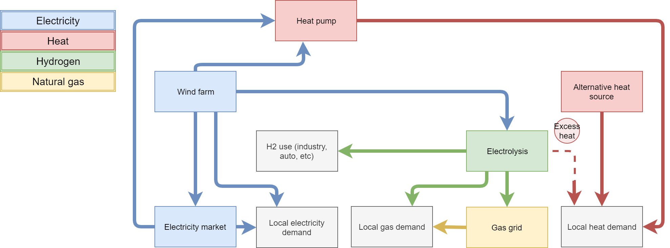
Methodology – model development
Investigated system includes both P2H and P2G technology
Three different use cases
Austria, Norway, Spain
Location-dependent parameters as input for model
Electricity generation from wind farm
Local electricity, heat and gas demand
Electricity prices, gas prices, price for alternatively produced heat
Alternatives to green heat and the corresponding emissions
Electricity mix

Slide 7
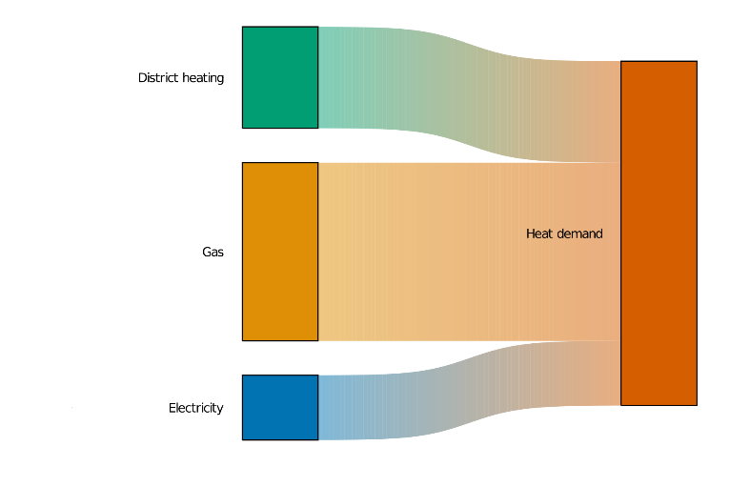
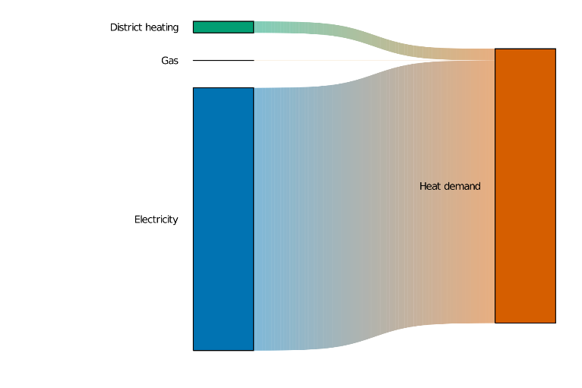
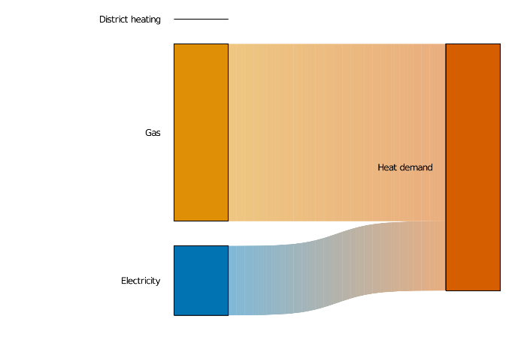
Methodology – use cases
Austrian use case[1]:
Neusiedl am See region
4290 households
Wind farm with 32 MW installed capacity
Majority of heat demand covered by gas
Norwegian use case[1]:
Åfjord municipality
1961 households
Wind farm with 57.5 MW installed capacity
Majority of heat demand covered by electricity
No gas demand considered
Spanish use case[1]:
Municipalities of Isar,Las Quintanillas,Rabé de las Calzadasandand Estepar
1000 households
Wind farm with 31.5 MW installed capacity
Majority of heat demand covered by gas
No district heating demand considered

Slide 8
Methodology – scenarios
Three scenarios investigated for each use case
Scenario 1
Electricity demand → electricity generated by wind farm and electricity bought from electricity market
Heat demand → heat bought from an alternative heat source
Gas demand → natural gas bought from the gas grid
Scenario 2
Electricity demand → electricity generated by wind farm and electricity bought from electricity market
Gas-using customers assumed connected to district heating grid
Heat pump scaled according to district heating demand
Scenario 3
Electricity demand → electricity generated by wind farm and electricity bought from electricity market
Gas-using customers assumed switching to green hydrogen
Heat pump scaled according to district heating demand
Electrolyzer scaled according to gas demand
Scenario 2
Wind farm
Heat pump
Scenario 3
Wind farm
Heat pump
Electrolyzer
Scenario 1
Wind farm

Slide 9
Results – economic, AT use case
System is profitable in all investigated scenarios
Introduction of electrolyzer significantly influences profit
Introduction of heat pump reduces costs related to covering the heat demand

Slide 10
Results – economic, NO use case
System is profitable in all investigated scenarios
Slight increase in profitability due to heat pump implementation
No electrolyzer implemented (no gas demand)

Slide 11
Results – economic, ES use case
System is profitable in all investigated scenarios
Slight increase in profitability due to heat pump implementation
No heat pump implemented in scenario 3 (no district heating demand)

Slide 12
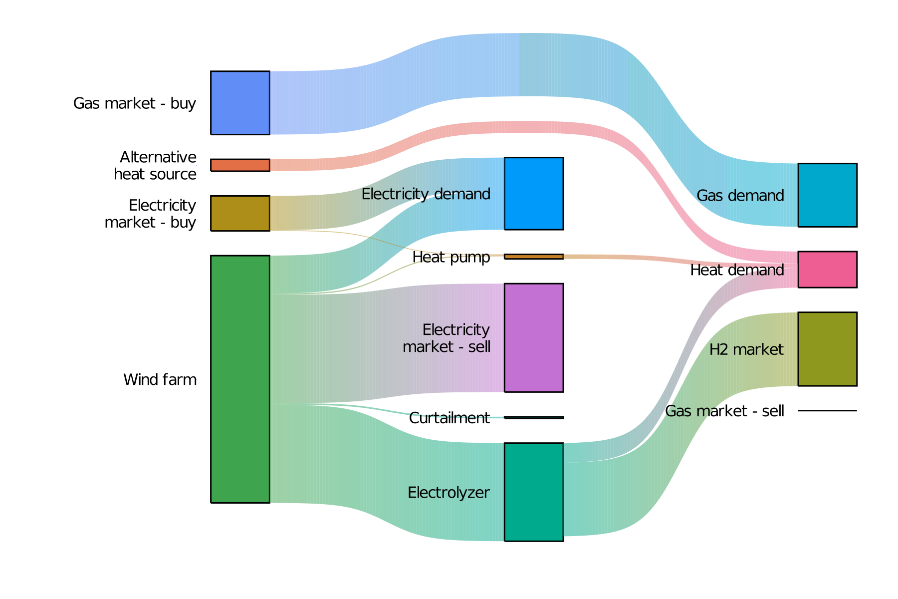
Utilization of implemented technologies to cover demands – Austria scenario 3
Overview of technology utilization in Austrian use case – scenario 3
Generated electricity is either sold, used to cover demand or fed into electrolyzer
Gas demand fully met by bought natural gas

Slide 13
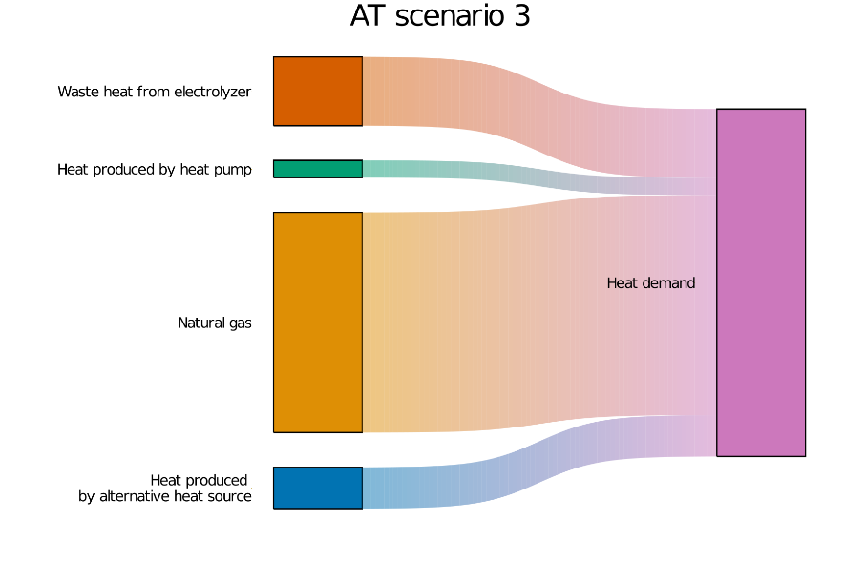
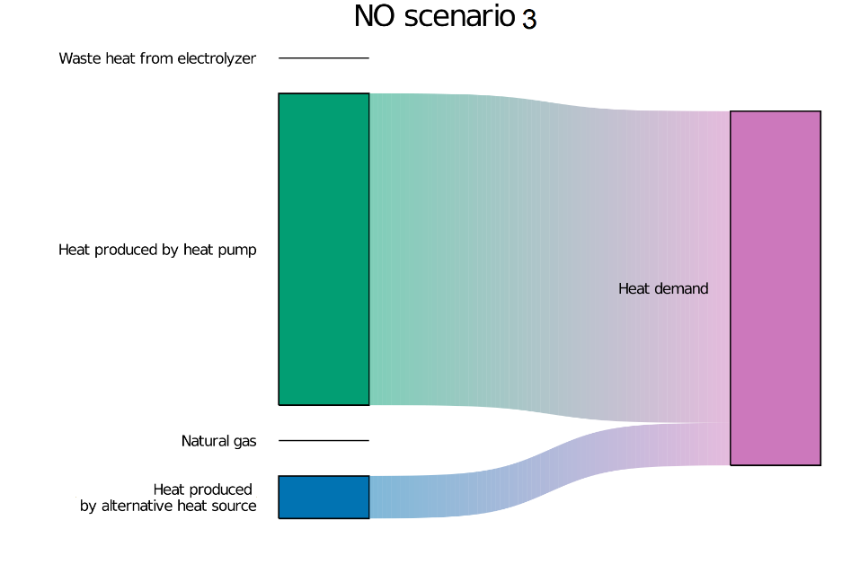
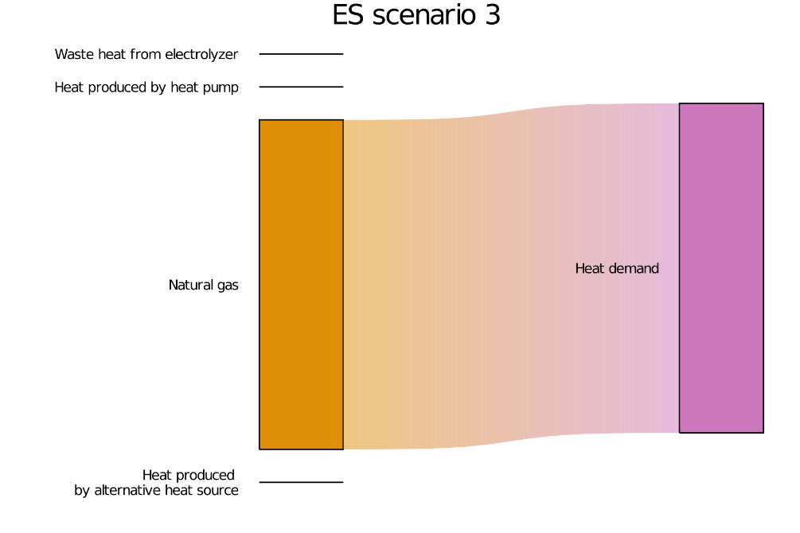
Utilization of implemented technology to cover heat demand
Focusing on heat demand originally covered by district heating and gas
Heat demand coverage in scenario 3
AT: Heat pump and electrolyzer
NO: heat pump
ES: electrolyzer
Excluding heat demand covered by electricity

Slide 14
Results KPI – GHG emission reduction potential
Significant emission reduction potential
Reduction depending on:
Size of technology
Electricity mix
Alternative fuel (natural gas, bio pellets)
All green hydrogen sold to market → no emission reduction achieved

Slide 15
Results KPI – renewable energy self-reliance
Majority of electricity demand covered by electricity generated by wind farm
Implementation of electrolyzer reduces degree of electricity self-reliance
Introduction of heat pump can significantly affect degree of heat energy self-reliance

Slide 16
Results KPI – external energy purchase
Clear correlation with degree of energy self-reliance
Coverage of gas demand fully dependent on natural gas purchase
Amount of electricity bought from the grid depend on utilization and size of implemented technologies

Slide 17
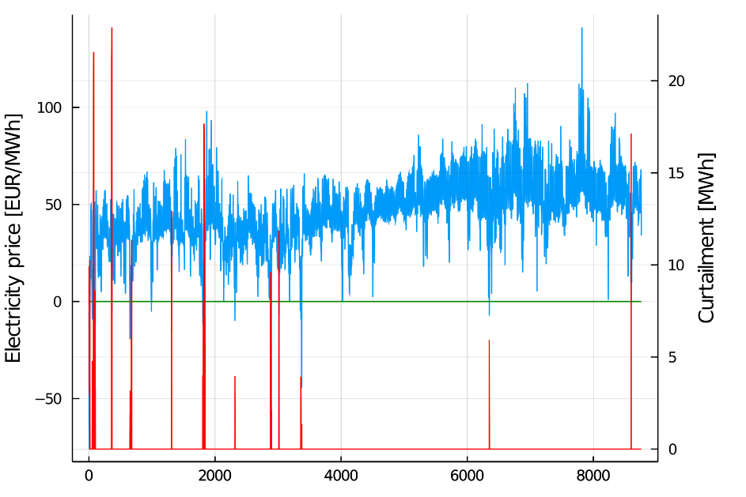
Results KPI – curtailment reduction
Curtailment due to negative electricity prices
No curtailment in NO and ES
Curtailment reduced with heat pump and electrolyzer implemented

Slide 18
Concluding remarks and further work
Utilization of sector coupling concepts has the potential to reduce GHG emissions, increase degree of energy self-reliance and reduce curtailment
Benefits of sector coupling depend on local conditions
Further work could investigate
Optimal system topology when considering investment costs
Impact of local policy levers on influential parameters (e.g. electricity generation, energy demand, available fuel options)

Slide 19
References and acknowledgements
This work is done in the “ThermaFLEX” project [2] and is supported with the funds from the Climate and Energy Fund and implemented in the framework of the RTI-initiative “Flagship region Energy” within Green Energy Lab.
[1] Energy Data, EuroStat, https://ec.europa.eu/eurostat/web/energy/data
[2] ThermaFLEX, Green Energy Lab, https://greenenergylab.at/en/projects/thermaflex/

Slide 20
Frida Revheim
TU Wien
Energy Economic Group, EEG
Gußhausstraße 25-29 / E370-3
1040 Vienna, Austria
Email: revheim@eeg.tuwien.ac.at
Web: http://www.eeg.tuwien.ac.at
Thank you!

